Slide 1
Teknik Presentasi

Slide 2
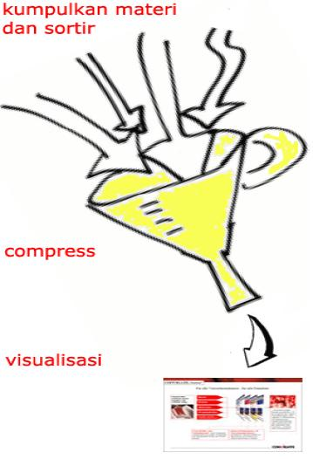
Presenter yang handal tidak menceritakan semua yang dia ketahui, tapi cukup menampilkan apa-apa saja guna mencapai tujuannya

Slide 3
Karena waktu yang tersedia selalu terbatas
Your audience will spend too much time trying to read this paragraph instead of listening to you

Slide 4
Reduksi teks dan visualisasi
Ajak audiens berpikir dengan gambar
Tampilkan dengan kalimat pendek
Perjelas dengan ilustrasi

Slide 5
Layout dan design
Pilih warna background yang kontras
Buat layout yang seragam dari awal sampai akhir
Different styles are disconcerting to the audience
You want the audience to focus on what you present, not the way you present

Slide 6
Font
Choose a clean font that is easy to read
Roman and Gothic typefaces are easier to read than Script or Old English

Slide 7
Font size
Bulleted items should be no smaller than 22 points
The title should be no smaller than 28 points

Slide 8
Bullet
Limit the number of bullets in a screen to six
If you crowd too much text, the audience will not read it
Too much text makes it look busy and is hard to read
Why should they spend the energy reading it, when you are going to tell them what it says?
Our reading speed does not match our listening speed

