Slide 1
Strategi CRM (Lanjutan)
Pertemuan 5

Slide 2
Traditional VS e - business
back
Back-Office
shop
e-Commerce
window
Web site
Front Office

Slide 3
“A CRM initiative should help an organization generate more leads, convert a high proportion of them to customers, retain customers longer through enhanced service and ensure more profitability from the customers through the effective promotion of additional products and services.”
Subhomoy Sengupta, General Manager, Applications Sales, Oracle India

Slide 4
Tujuan Strategi CRM
Tujuan strategi CRM :
Untuk mengoptimalkan keuntungan perusahaan , penerimaan dan kepuasan konsumen dengan fokus pada keseluruhan proses yang berpusat pada konsumen

Slide 5
Elemen CRM
IT & technology Management
CRM systems Control and follow up on
Coupling back-front office customer accounts
Interaction-systems to forward Customer profitability
Customer-relations (Call centres, Customer loyalty/development
E-commerce etc.) Visible management
CRM Strategy
Customer Strategy
Relation Strategy
Strategies to customer information
Culture & People Processes
Customer oriented organisation Loyalty-creating deliverances
Customer focused attitudes Focus on sales & marketing
Internal marketing Key A. Managem. 1-t-1 market

Slide 6
Hal – hal yang perlu diperhatikan dari konsumen
Masalah, Penyakit, Ketakutan, Kebutuhan, keinginan, hal – hal yang disukai, pengalaman, aspirasi, relasi, afiliasi, pertanyaan, pilihan, aktivitas, komunikasi, interaksi, emosi, ingatan, tingakat kepuasan, keyakinan, kepercayaan, opini, kebiasaan, tingkah laku, value, prioritas, kepribadian, konsep diri, Investasi, penghargaan, ROI, gaya hidup, kelas sosial, siklus hidup, kebudayaan, pendidikan, keluarga, kebudayaan, hobi, ketertarikan…

Slide 7
Customer Relationships Today
Customer
Relationships
Branding
Product
Distribution
Pricing
Community
Communication
Building a customer-centric approach to Internet marketing by focusing on customers

Slide 8
CRM People
Customer Segments: Suspects, Visitors, Prospects, Subscribers , Patrons, Members, Users, Consumers, VIP’s, Volunteers, Annual/ Major Donors, Advisors, Advocates, Legislators, Strategic Partners, Sponsors
Users: Management, Employees and Visitors
Suppliers: Services- Consultants (CRM/ Customer Development) Products- Technology ( Software, Hardware, Connectivity)

Slide 9
Age of the never-satisfied customer…
CRM becomes a support tool in a time characterized by:
Increased competition
Globalization
Growing cost of customer acquisition
High customer turnover
CRM is all about creating a better value proposition to customers
Information and communication technology is now acting as a catalyst for CRM
Extended enterprise
World wide web and the Internet

Slide 10
Defining CRM
Retention
How can we improve retention?
What is our average customer relationship length?
How can we hold customer for as long as possible?
What is the most cost effective method of retention?
Expansion
How many products does our average customer buy?
How can we induce our current base to buy more products?
Who are the prime targets for expansion?
What is the cost of expansion?

Slide 11
Managing the customer life cycle
Acquiring
new customers
Enhancing
profitability of existing
customers
Retaining
profitable customers
for life

Slide 12
Acquiring new customers
Promoting the company’s product and service leadership
Redefine the companies competitive edge and innovations
Offer a superior product backed by an excellent service
Example: Browsing on the net, submitting a request, receiving a phone call
Model for a sales and service strategy

Slide 13
Enhancing profitability of existing customers
Encouraging cross-selling and up-selling
Cross selling is used by suggesting alternative products or up-selling by rendering the customer more informed with the new products and services.
Broadening the relationship between the company and the customers
Providing a value proposition represented by offering a greater convenience at low cost (one-stop-shopping)
Example: “Best Buy” an electronic retailer with more than 300 stores capitalizes on committed relationships with customers
3000 calls a day with more than 50% having computer-based answers and solutions

Slide 14
Retaining profitable customers for life
Retention focused on service adaptability
Delivering not what the market wants but what the customer wants
Providing a value proposition that offers a proactive relationship that works on the best interest of the customer
Example: customer retention is becoming a key competitive strategy for many companies

Slide 15
It even ties into BI… (Business Intelligence)
CRM is closely related to business intelligence because both methods involve using technology to gather, analyze and organize data in order to develop relevant information.
CRM is just a more specific form of BI that concentrates strictly on customer’s behaviors and actions, for both past and future information.

Slide 16
View Of CRM
Firm
It is at the end of the value chain (Porter 1985)
Activities needed to keep a product/service working for the buyer after it is sold and delivered
A linear process with three phases separated by time
Pre-transaction: organizational buy-in and preparation
Transaction: minimize time between ordering and receiving the product
Post-transaction: customer care
A set of activities a firm engages in to win and keep customers over and above assembly and sale activities

Slide 17
View Of CRM
2. Customer
This is a life cycle model with four stages
Assessment: do I need the product/service?
Acquisition: how and where can I buy it?
Ownership: where the product/service is used
Retirement: should I get another one?
If the customer engages in another transaction, the cycle begins anew
She can be at different stages of the cycle if she has purchased different products at different times

Slide 18
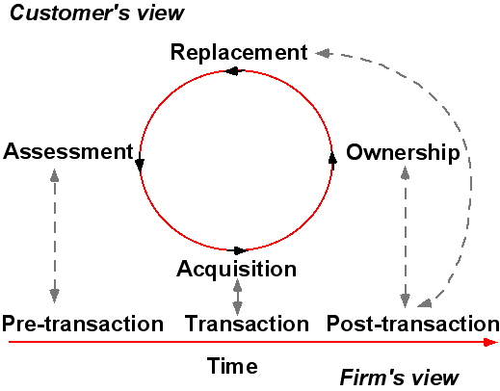
Firm and customer views of CRM

Slide 19
Manfaat CRM bagi Penjualan
CRM methods and technologies improve sales by:
Providing common access to account and contact management information
Making real-time and timely sales information and analysis available (by channels and stages of the sale)
Allowing review and monitoring of the sales status
Forecasting and analysis of sales and customer data
Providing mobile access for sales agents: sales summaries and performance monitoring
Tracking sales: identifying top performers

Slide 20
Manfaat CRM bagi pemasaran
CRM methods and technologies improve marketing by:
Automating the marketing process
Tracking campaigns through their lifecycles (planning to executing to analysis)
Integrating marketing with other customer-oriented processes (sales and service) and with ERP solutions for better information about customers
Providing multiple channels for customer interaction
Developing a centralized database of product, price and competitive information

Slide 21
Manfaat CRM bagi CSS
CRM methods and technologies improve customer service and support by:
Automating and tracking customer care
Providing incident, defect, and order tracking
Maintaining a problem and solution database
Handling repair scheduling and dispatching
Storing and retrieving service requests, agreements, contracts, and dispositions
Allowing multiple contact channel choices for customers

Slide 22
Manfaat CRM
Strategic issues
Enrich relationship
Minimize competition
Economy
Suppress intermediaries
Improve customer fidelity
CLIENT
Increase added value
Know the individual customer
Improve products attraction
Understand expectations
Improve quality
Answer in a proactive way
Reduce costs
Sales Marketing
Design
Production
Quality
Reduce time cycles

Slide 23
Future Trends
CRM future trends include:
CRM applications will change from employee-only tools to tools used by suppliers, partners, and even customers
CRM will continue to be a major strategic focus for companies
CRM applications will continue to adapt wireless capabilities supporting mobile sales and mobile customers
CRM suites will incorporate PRM and SRM modules

Slide 24
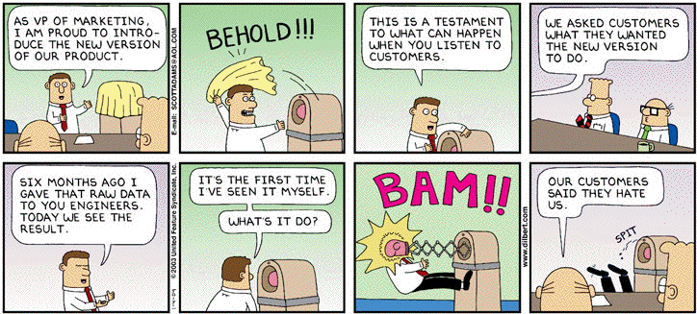
I. What is customer relationship management?
www.unitedmedia.com/comics/dilbert/

Slide 25
Pertanyaan
Jelaskan hubungan antara CRM dengan BI (Business Inteligent)
Jelaskan makna dari istilah – istilah berikut berikut contoh yang mencerminkan makna dari istilah tersebut:
Up Selling
Cross Selling
Retention
Apakah iklan merupakan bagian dari strategi CRM ? Jelaskan jawaban Anda

Slide 26
Pertanyaan Take Home
Mengapa CRM gagal dalam mencapai keberhasilan dan keuntungan dari penerapan CRM saat diimplementasikan oleh perusahaan. Berikan contoh kasus perusahaan yang gagal dalam pencapaian tujuan CRM ketika menerapkan CRM

