Slide 1
KOMUNIKASI DATA
S. Indriani L, M.T
ERROR DETECTION AND ERROR CORRECTION

Slide 2
Objectives
Mahasiswa mampu mengenali eror yang terjadi pada transmisi asinkron, dan mendeteksinya dengan menggunakan bit parity.
Mahasiswa mampu mengenali eror yang terjadi pada transmisi sinkron, dan eror dikoreksi dengan menggunakan LRC dan VRC.
Mahasiswa dapat menjelaskan bagaimana mendeteksi eror pada transmisi sinkron dan dengan menggunakan checksum dan CRC
Mahasiswa dapat menjelaskan bagaimana eror pada transmisi sinkron dapat dikoreksi dengan menggunakan kode Hamming
Mahasiswa mampu menjelaskan bagaimana eror dapat dikoreksi menggunakan ARQ (Automatic Repeat Request).

Slide 3
Error Detection and Correction
Types of Errors
Detection
Error Correction

Slide 4
Error Detection and Correction
Data can be corrupted during transmission. For reliable communication, error must be detected and corrected
are implemented either at the data link layer or the transport layer of the OSI model

Slide 5
Type of Errors

Slide 6
Type of Errors (cont’d)
Single-Bit Error
~ is when only one bit in the data unit has changed (ex : ASCII STX - ASCII LF)

Slide 7
Type of Errors (cont’d)
Multiple-Bit Error
~ is when two or more nonconsecutive bits in the data unit have changed (ex : ASCII B - ASCII LF)

Slide 8
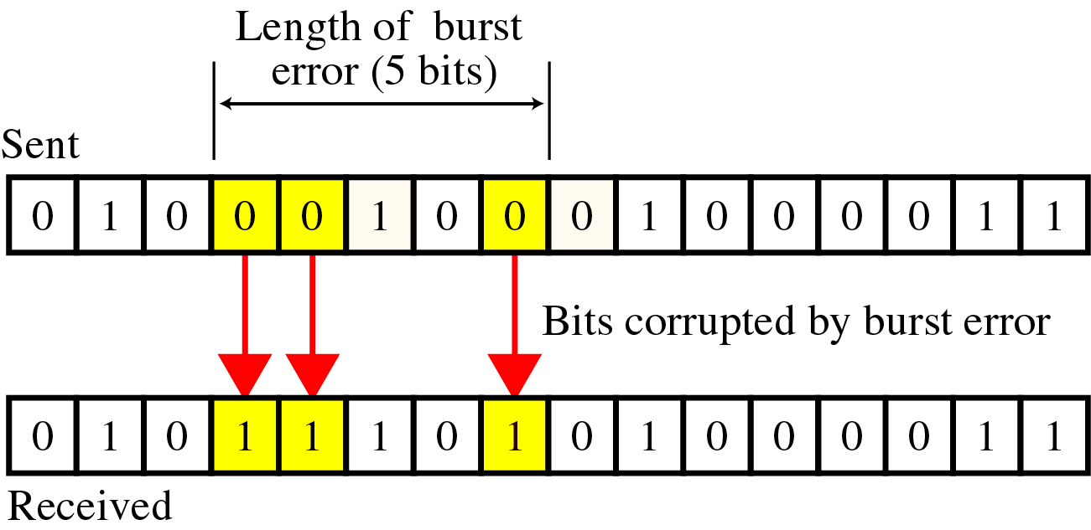
Type of Errors(cont’d)
Burst Error
~ means that two or more consecutive bits in the data unit have changed

Slide 9
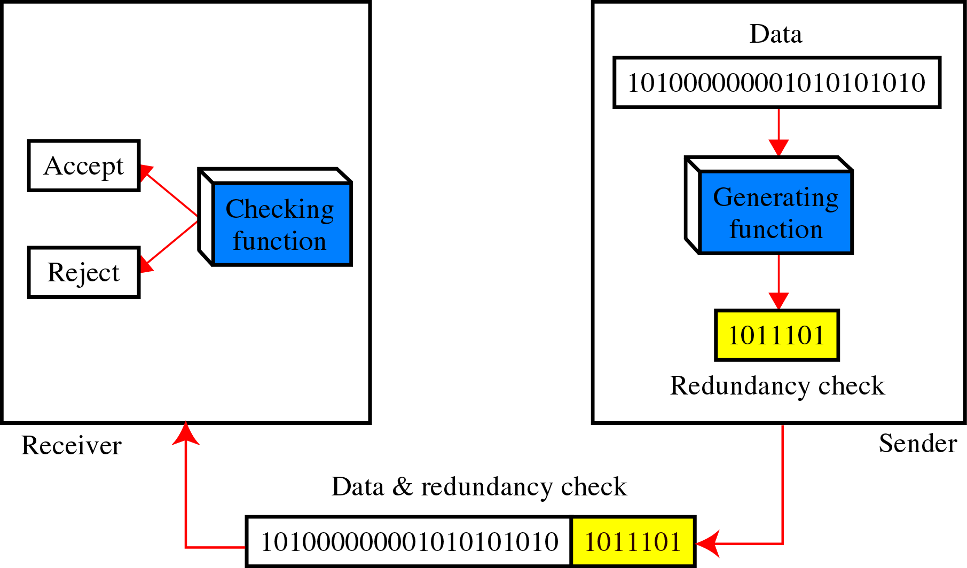
Error Detection
Deteksi eror menggunakan konsep dari redundansi, maksudnya adalah dengan menambahkan bit tambahan untuk mendeteksi eror di Penerima.

Slide 10
Teknik mendeteksi eror
VRC (Vertical Redundancy Check)
LRC (Longitudinal Redundancy Check)
CRC (Cyclic Redundancy Check)
Checksum

Slide 11
1. Vertical Redundancy Check (VRC)
Sebuah bit paritas ditambahkan ke setiap unit data sehingga total dari ‘1’ (termasuk bit paritas) menjadi genap untuk paritas genap dan ganjil untuk paritas ganjil
Pada contoh berikut untuk VRC paritas genap dapat mendeteksi semua single bit eror. Untuk multiple bit atau burst error, hanya jika jumlah totalnya adalah ganjil

Slide 12
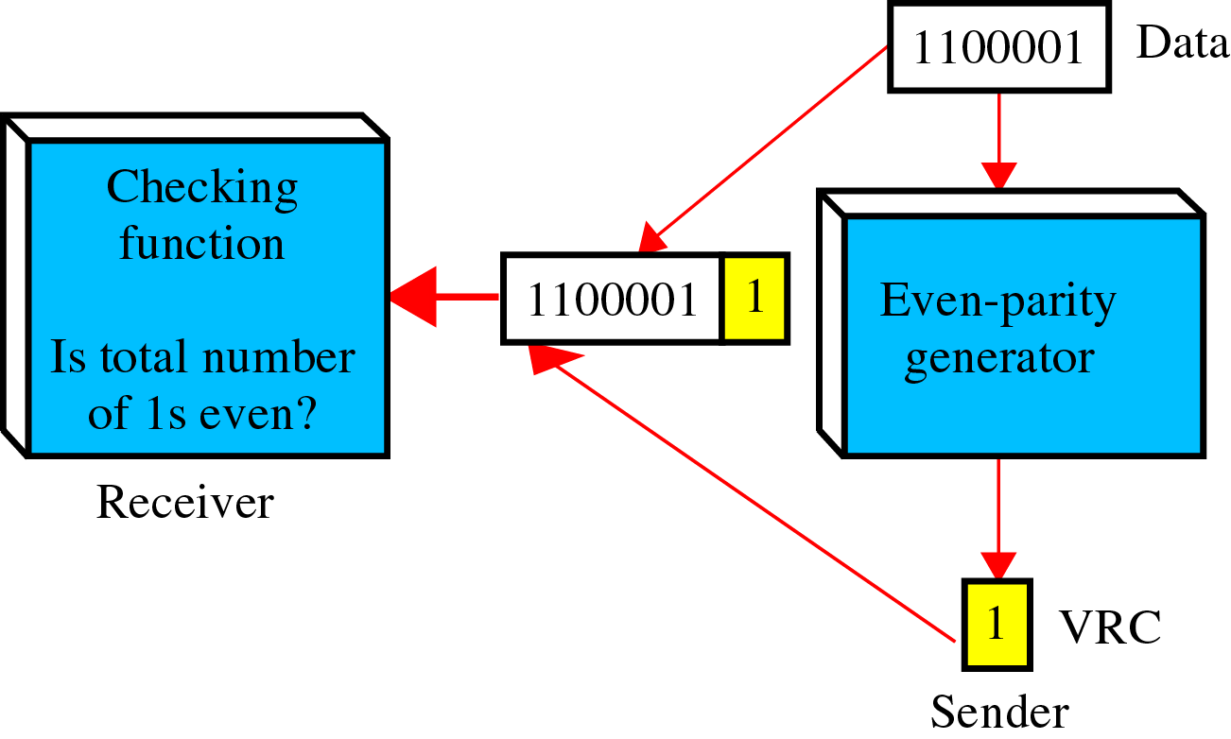
Konsep dari VRC Paritas Genap

Slide 13
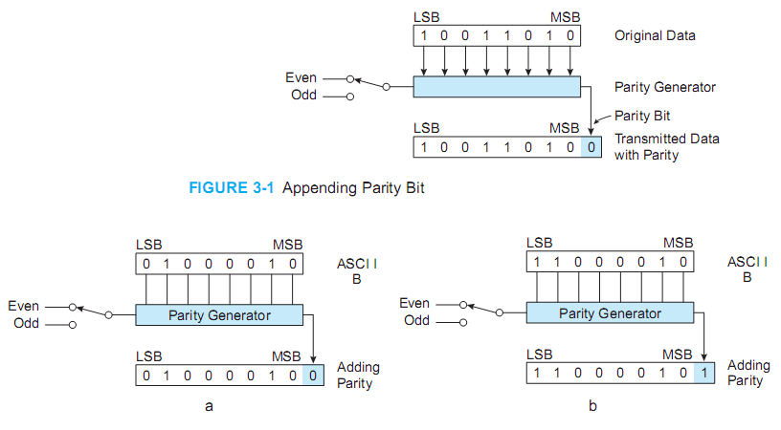

Slide 14
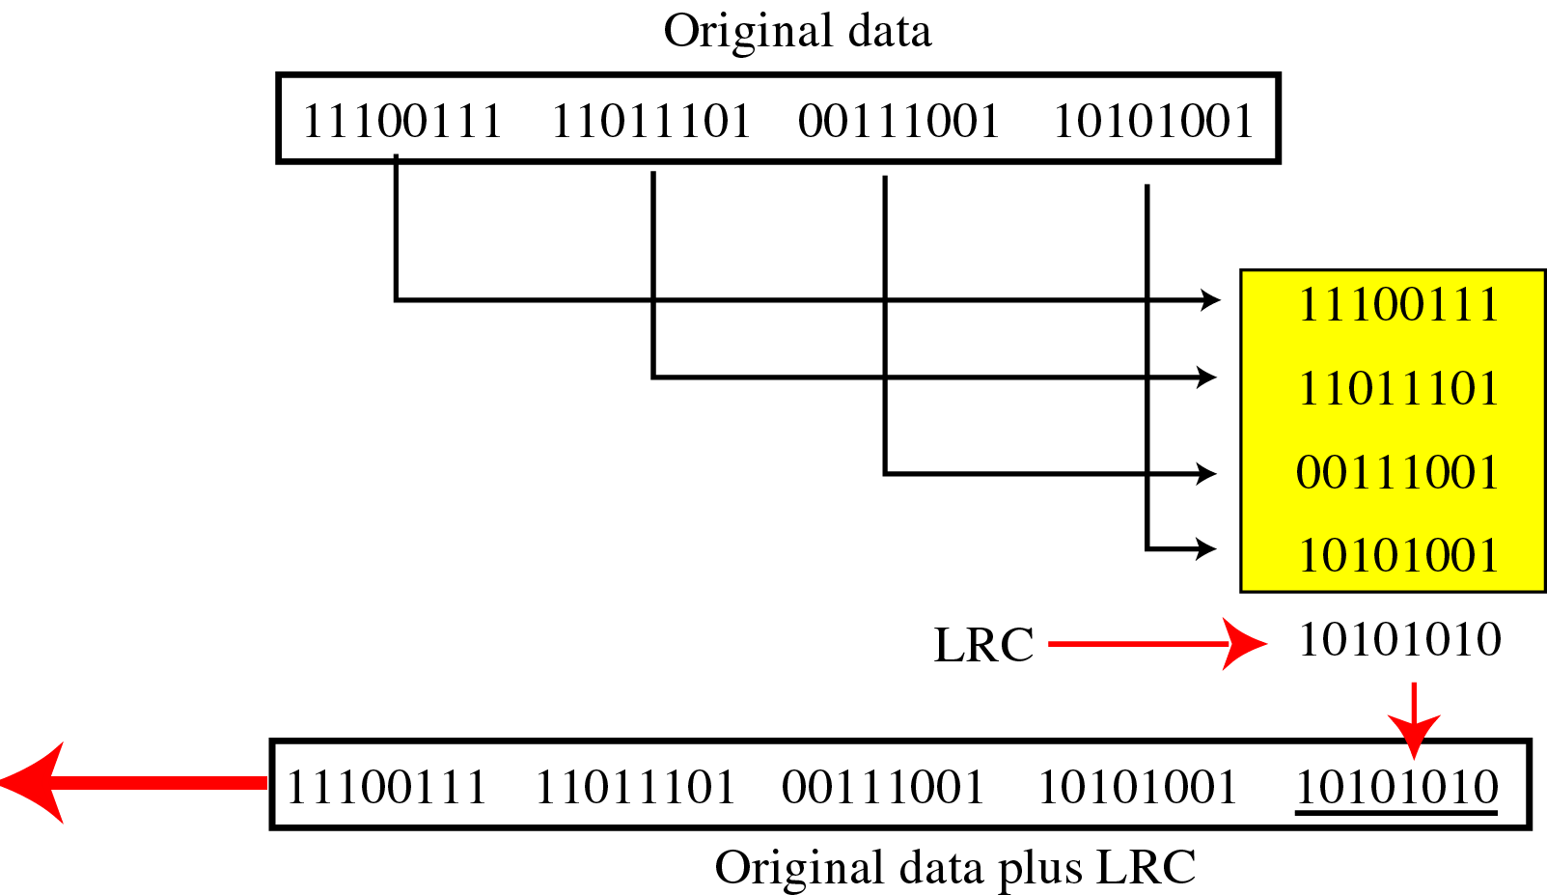
Longitudinal Redundancy Check (LRC)
LRC (Longitudinal Redundancy Check)
Parity bits of all the positions are assembled into a new data unit, which is added to the end of the data block

Slide 15
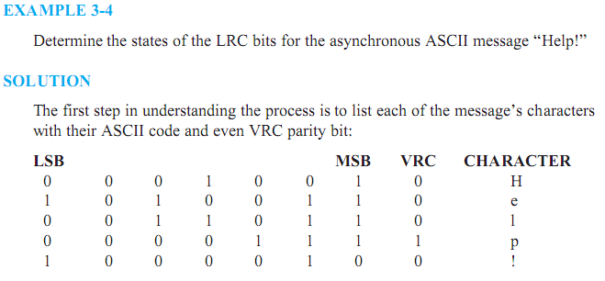

Slide 16
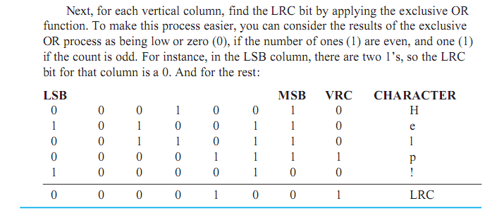

Slide 17
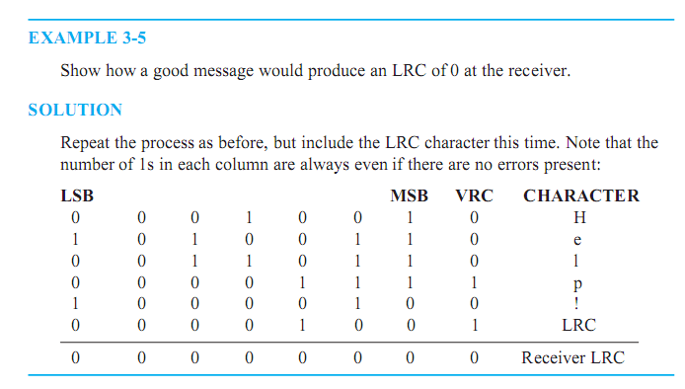

Slide 18
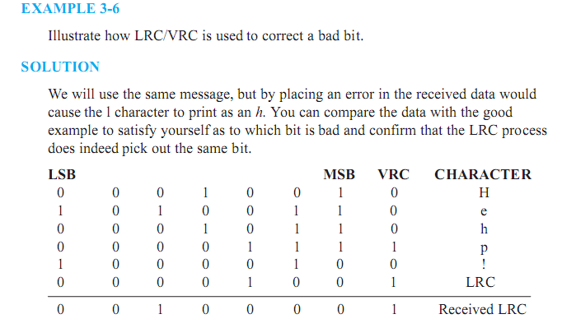

Slide 19
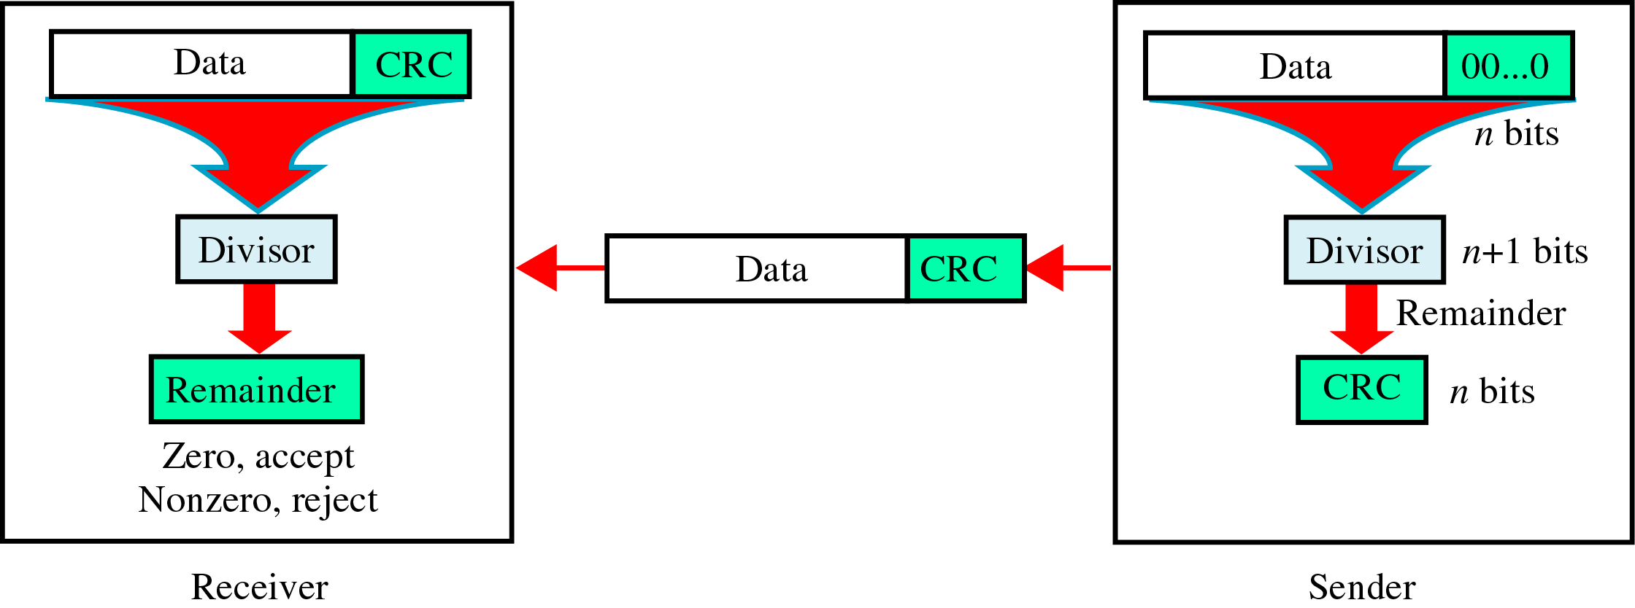
3. Cyclic Redundancy Check (CRC)

Slide 20
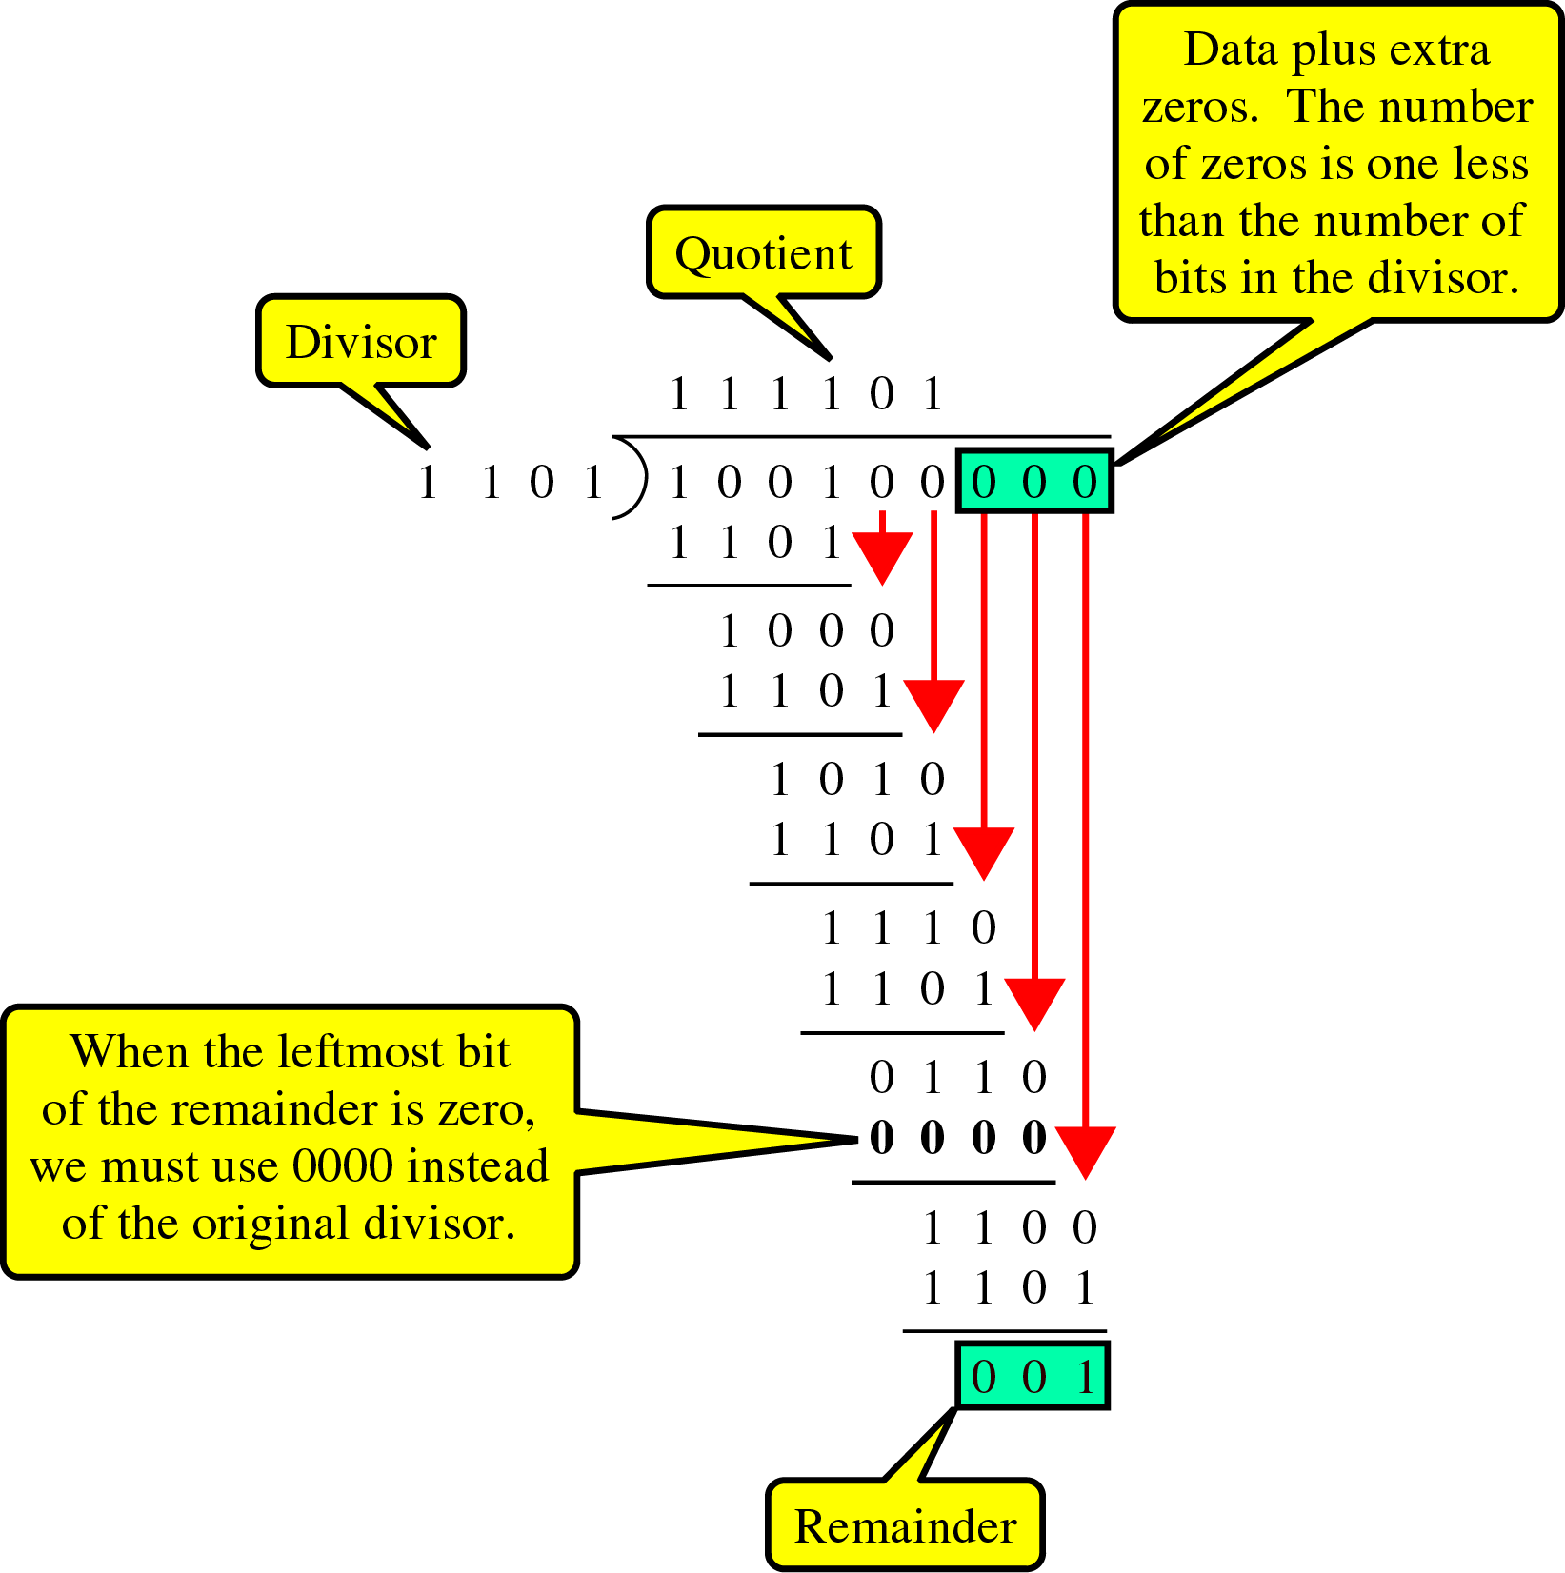
CRC generator
~ uses modular-2 division.
Binary Division
in a
CRC Generator

Slide 21
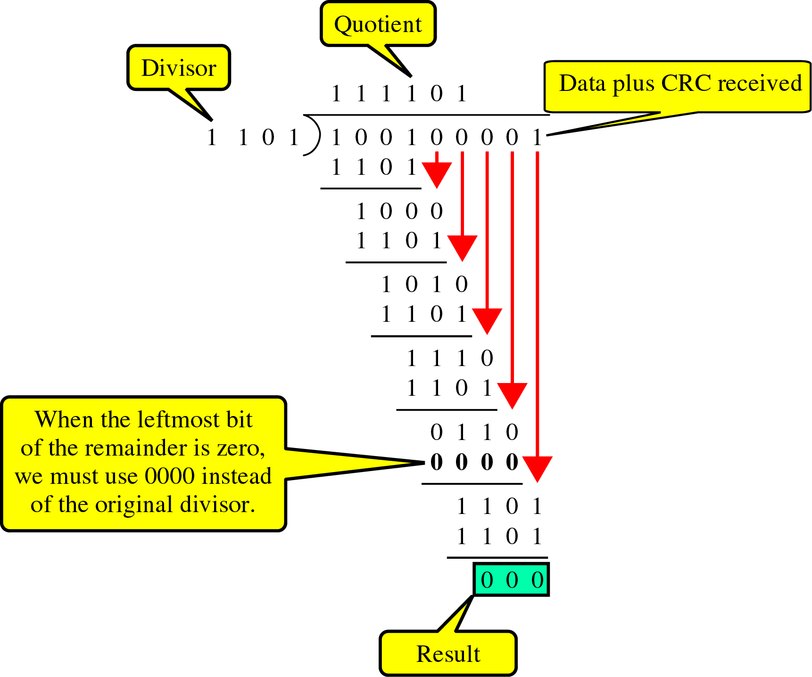
Detection(cont’d)
Binary Division
in a
CRC Checker

Slide 22
Polynomials
CRC generator(divisor) is most often represented not as a string of 1s and 0s, but as an algebraic polynomial.

Slide 23
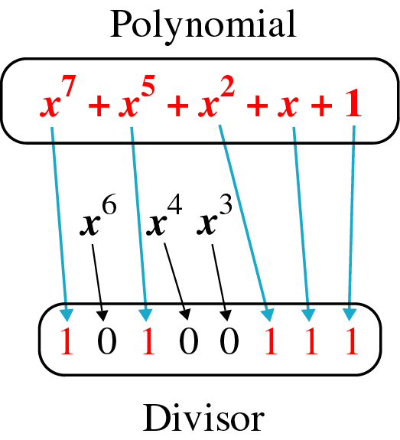
A polynomial representing a divisor

Slide 24
Standard polynomials

Slide 25
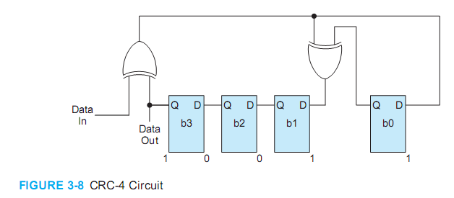

Slide 26
4. Checksum
Checksum
~ used by the higher layer protocols
~ is based on the concept of redundancy(VRC, LRC, CRC ….)

Slide 27
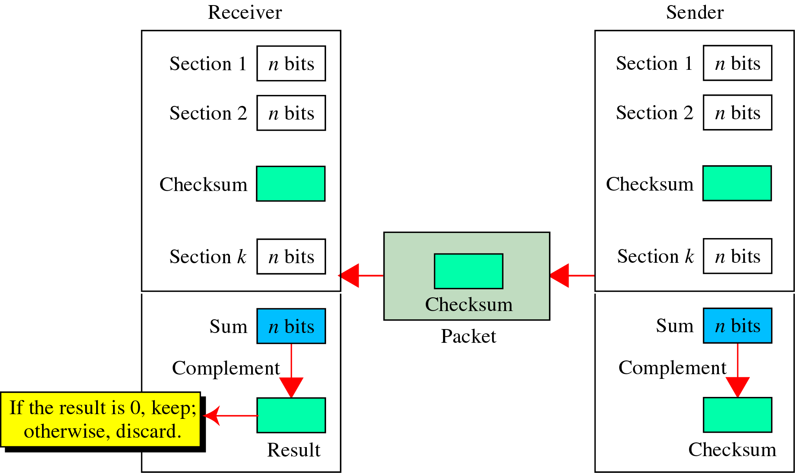
Checksum Generator

Slide 28
To create the checksum the sender does the following:
The unit is divided into K sections, each of n bits.
Section 1 and 2 are added together using one’s complement.
Section 3 is added to the result of the previous step.
Section 4 is added to the result of the previous step.
The process repeats until section k is added to the result of the previous step.
The final result is complemented to make the checksum.

Slide 29
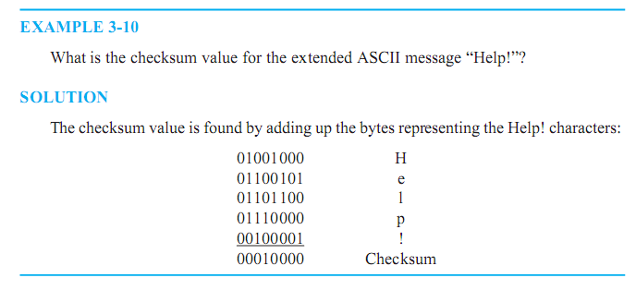

Slide 30
Detection(cont’d)
data unit and checksum

Slide 31
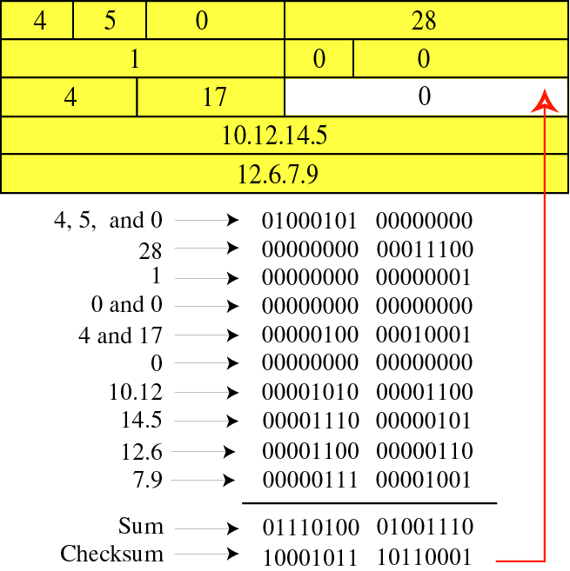
Detection(cont’d)

Slide 32
Error Correction
~ can be handled in two ways
✶ when an error is discovered, the receiver can have the sender retransmit the entire data unit.
✴ a receiver can use an error-correcting code, which automatically corrects certain errors.

