Slide 1
Media Humas
Dian S. Purwanty, S.Sos., M.M.
Program Studi Ilmu Komunikasi – Humas
Universitas Komputer Indonesia
Bandung, 22 Februari 2011

Slide 2
What in your mind for the first time ?

Slide 3
What is public relations ?

Slide 4
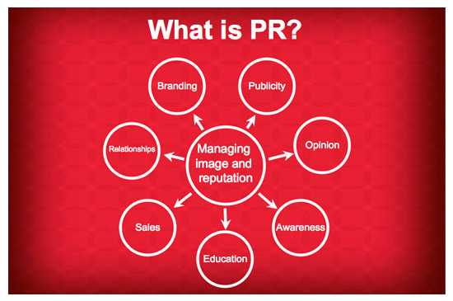
What is public relations ?

Slide 5
Important points !
PR is much more than a news release.
At the core, PR is a strategic function managing image and reputation.
PR rounds out your marketing toolbox.
PR is more credible than advertising
PR efforts can be tracked.

Slide 6
Definisi Public Relations !
Frank Jefkins
Public relations is a system of communication to create a good will.
John E. Marston
Public relations is planned, persuasive communication designed to influence significant public.

Slide 7
Definisi Public Relations !
IPR (Institute of Public Relations)
PR adalah keseluruhan upaya yang dilakukan secara terencana dan berkesinambungan dalam rangka menciptakan dan memelihara niat baik (good will) dan saling pengertian antara suatu organisasi dengan segenap khalayaknya.

Slide 8
TUJUAN Public Relations
Menciptakan pemahaman (mutual understanding) antara perusahaan dan publiknya
Corporate Image
Image corporate (Corporate Social Responsibility)
Membentuk opini publik yang favourable
Membentuk goodwill dan kerjasama

Slide 9
Pekerjaan PR
Publication & Publicity
Events
News
Community Involvement
Identity Media
Lobbying
Social Investment

Slide 10
Ruang Lingkup Media PR
Media press
Audio Visual
Radio
Televisions
Exhibitions
Printed material
Sponsored books
Direct mail
Spoken word
Sponsorship
House journals
House style
Corporate identity
Etc.

Slide 11
Buku Referensi
Abdullah, Iqbal Alan (2009).Manajemen Konferensi dan Event. Jogjakarta. Gadjah Mada University Press.
Abdurrachman, Oemi. (2001). Dasar-dasar Public Relations. Bandung. PT. Citra Aditya Bakti.
Anggoro, Linggar. (2002). Teori & Profesi Kehumasan. Jakarta: PT. Bumi Aksara.
Beard, Mike. (2001). Manajemen Departemen Public Relations. Jakarta. Erlangga.
Effendy, Onong Uchjana. (1993). Human Relations dan Public Relations.Bandung. Mandar Maju.
Iriantara, Yosal dan A. Yani Surachman. (2006). Public Relations Writing: Pendekatan Teoritis dan Praktis. Bandung. Remaja Rosdakarya.

Slide 12
Buku Referensi
Jefkins, Frank. (1992). Public Relations. Jakarta: Erlangga.
Kriyantono, Rachmat. (2008). Public Relations Writing. Jakarta. Prenada Media.
Mulyana, Deddy. (2005). Pengantar Ilmu Komunikasi. Bandung. Remaja Rosdakarya.
Ruslan, Rosady. (1999). Seri-1 Praktik dan Solusi Public Relations dalam Situasi Krisis dan Pemulihan Citra. Jakarta. Penerbit Ghalia Indonesia.
Soemirat, Soleh dan Elvinaro Ardianto. (2005). Dasar-dasar Public Relations. Bandung : PT. Remaja Rosdakarya.
Suhandang, Kustadi. (2004). Public Relations Perusahaan: Kajian, Program dan Implementasi. Bandung. Penerbit Nuansa.

