Slide 1
Bab 2 : KARAKTERISTIK SENSOR
Dr. Ir. Yeffry Handoko Putra, M.T

Slide 2
ISI KULIAH
Karakteristik Dasar
Identifikasi Karakteristik Sensor

Slide 3

KARAKTERISTIK
SENSOR
Karakteristik STATIK
Karakteristik DINAMIK

Slide 4
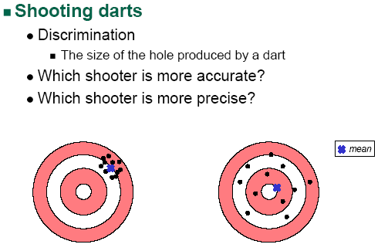
Karakteristik : Pendahuluan

Slide 5
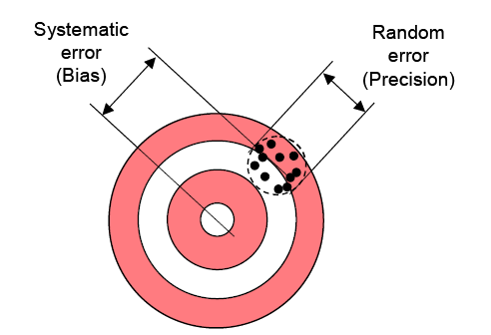
Contoh : Kesalahan sistematik dan random

Slide 6
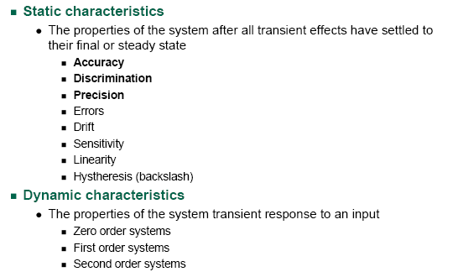
Karakteristik Sensor

Slide 7
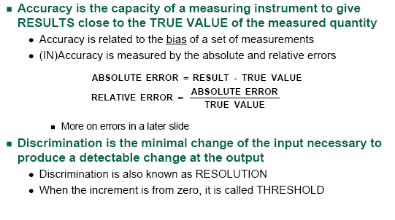
Akurasi, Diskriminasi dan Presisi

Slide 8
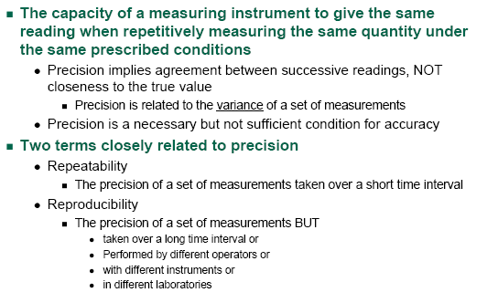
Presisi

Slide 9
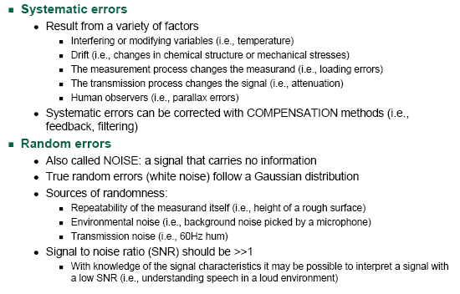
Akurasi dan Errror

Slide 10
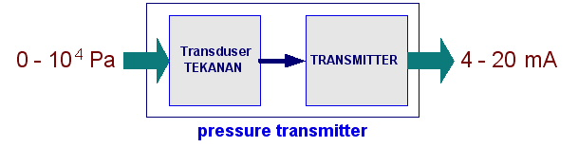
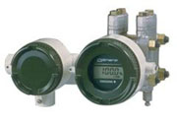
Rentang Input & Output
RANGE
Input Range
  Rentang nilai antara input minimum dan input maksimum
  Misal : Input range suatu transduser tekanan 0 s/d 10⁴ Pa
Output Range
  Rentang nilai antara output minimum dan output maksimum
  Misal : Output range suatu transmitter 4 s/d 20 mA
Input range : 0 s/d 10⁴ Pa
Output range : 4 s/d 20 mA

Slide 11
Span
SPAN
Variasi maksimum input atau output suatu sistem pengukuran
  Input Span = Input_{max} – Input_{min}
  Output Span = Output_{max} – Output_{min}
Contoh
  Suatu Pressure Transmitter memiliki span sebagai berikut
    Input Span = 10⁴ Pa
    Output Span = 16 mA
Input span : 10⁴ Pa
Output span : 16 mA

Slide 12
Linieritas
LINIERITAS
Suatu sistem dikatakan linier jika hubungan input dan output merupakan suatu garis lurus
Nilai output suatu sistem linier dinyatakan sbb

Slide 13
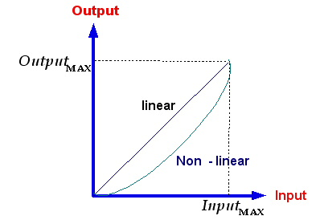
Non-linieritas
NON-LINIERITAS
Suatu sistem dikatakan non-linier jika hubungan input dan output bukan merupakan suatu garis lurus
Contoh kurva linier dan non-linier :

Slide 14
Persamaan Output
Secara umum, Output suatu sistem merupakan fungsi Input dengan bentuk persamaan polinomial berikut
Contoh
Tegangan keluaran suatu termokopel copper-constantan (type T), diekspresikan dengan persamaan polinom berikut,
Untuk rentang 0 s/d 400 ºC, tegangan keluaran E(T=0) = 0 μV &
E(T=400ºC) = 20869 μV . Persamaan linier untuk rentang tsb,
Kesalahan linierisasi adalah,

Slide 15
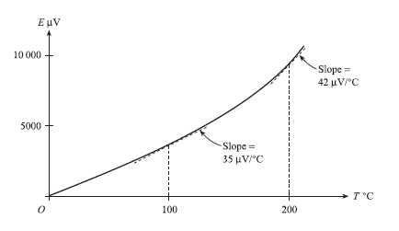
Sensitivitas
SENSITIVITAS
Perbandingan perubahan keluaran sistem terhadap perubahan masukan sistem
Contoh : Sensitivitas Termokopel Cooper - Constantant

Slide 16
Input Gangguan
EFEK LINGKUNGAN (environmental effect)
Secara umum, output pengukuran tidak hanya fungsi input pengukuran, tetapi juga fungsi input lingkungan seperti temperatur lingkungan, tekanan atmosfir, kelembaban relatif, suplai tegangan dsb.
Terdapat 2 jenis input lingkungan
  Modifying Input
    Menyebabkan sensitivitas linier sistem pengukuran berubah
  Interfering Input
    Menyebabkan intersepsi atau zero bias sistem pengukuran berubah
Notes:
Contoh mengukur suhu dengan memegang termometer terus menerus,
Input interfernya adalah tangan yang memberikan offset dari temperatur tubuh
Input modifyingnya kalau termometer itu dikibas2

Slide 17
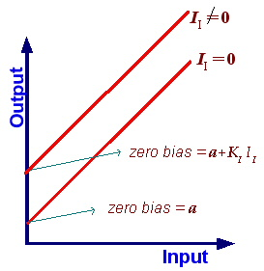
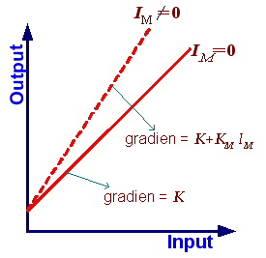
Input Gangguan
Efek lingkungan
Efek Modifying Input
Efek Interfering Input

Slide 18
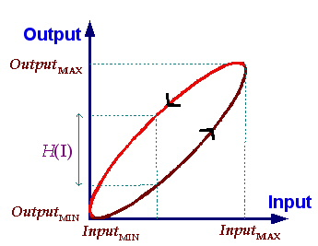
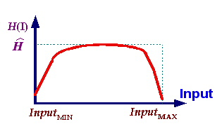

Histeresis
HYSTERESIS
  Histeresis adalah perbedaan nilai Output pengukuran pada saat nilai Input pengukuran membesar (naik) dan mengecil (turun).

Slide 19
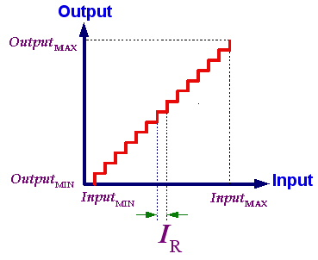
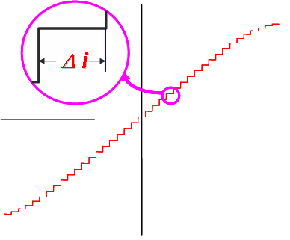
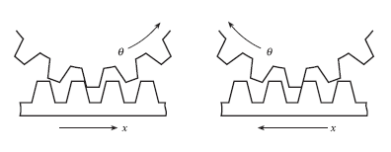

Resolusi
RESOLUSI
Perubahan nilai terkecil Input pengukuran yang memberikan respon pada Output pengukuran
Hasil pengukuran:
4,235 mm
4,240 mm
4,236 mm
4,235 mm
4,237 mm
Resolusi ?

Slide 20
Aging
WEAR & AGING
  Efek ini mengakibatkan karakteristik sistem pengukuran seperti konstanta pengukuran K dan zero bias a berubah secara perlahan-lahan selama masa pakai

Slide 21
Reliability
Reliability is the ability of a sensor to perform a required function under stated conditions for a stated period. It is expressed in statistical terms as a probability that the device will function without failure over a specified time or a number of uses.
the procedure for predicting in-service reliability is :
the MTBF (mean time between failure) calculation described in MIL-HDBK-217 standard.

Slide 22
Kesalahan
ERROR BANDS (pita error)
  Efek non-linieritas, histeresis dan resolusi, pada sistem pengukuran relatif sulit untuk dikuantifikasi secara tepat.
  Kinerja suatu sistem pengukuran dinyatakan dalam error bands
  Kinerja sistem pengukuran dinyatakan dalam fungsi probability density p(O)

Slide 23
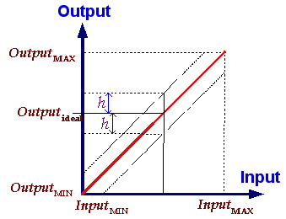
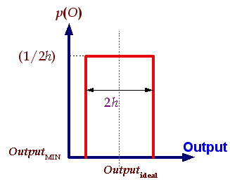
Kesalahan
ERROR BANDS (pita error)

Slide 24
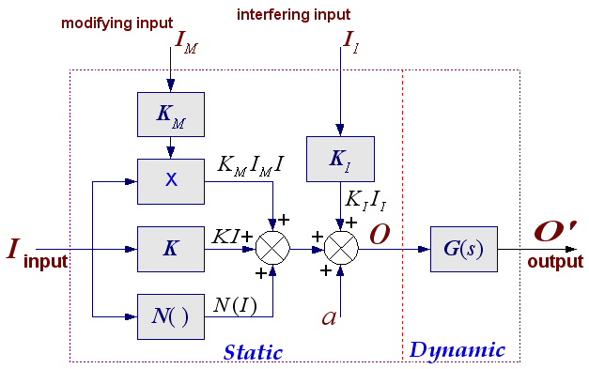
MODEL Umum Sensor

Slide 25
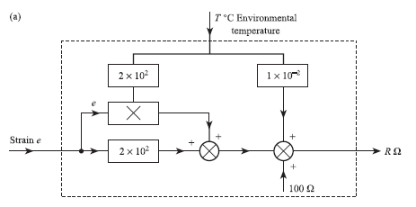
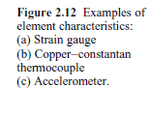
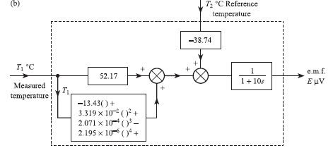
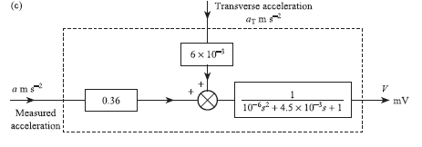
Contoh

Slide 26
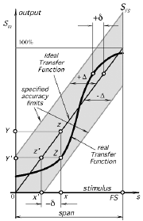

Slide 27
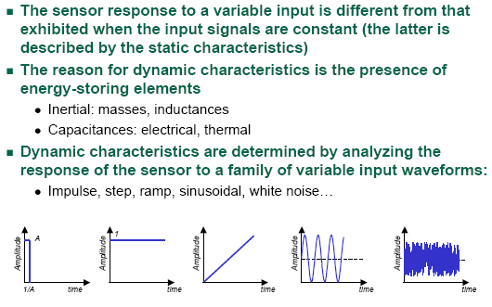
Karakteristik Dinamik

Slide 28
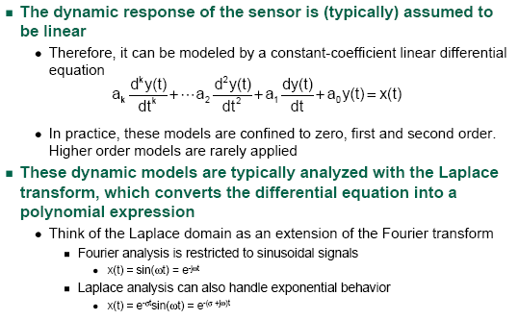
Model Dinamika

Slide 29
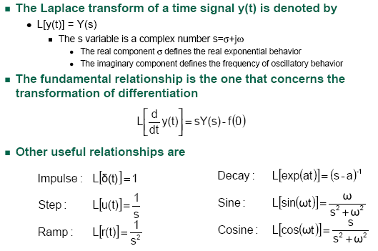
Review Transformasi LAPLACE

Slide 30
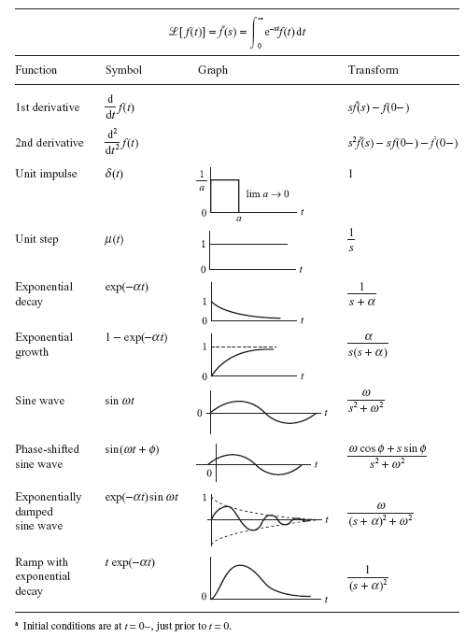

Slide 31
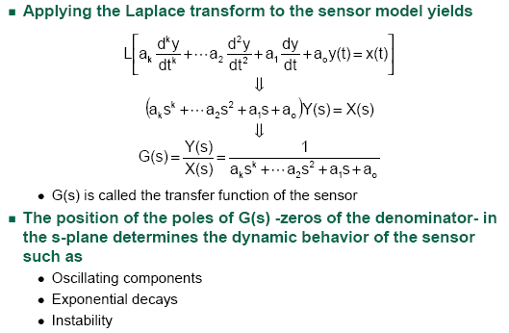
Review Transformasi LAPLACE

Slide 32
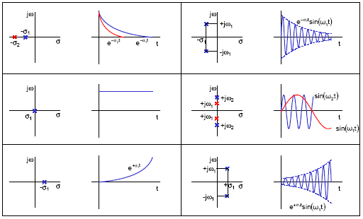
Lokasi pole dan perilaku dinamik

Slide 33
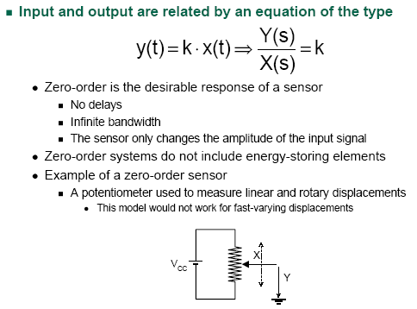
Sensor orde NOL

Slide 34
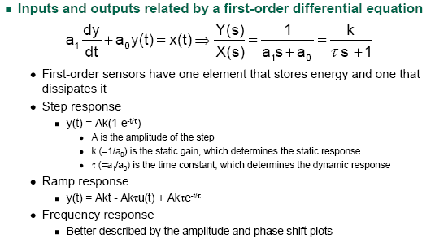
Sensor orde SATU

Slide 35
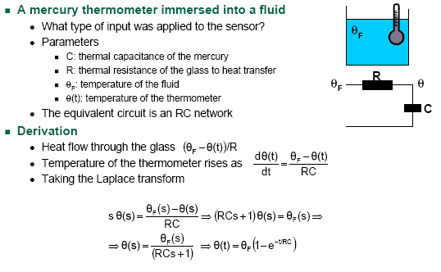
Contoh sensor orde SATU

Slide 36
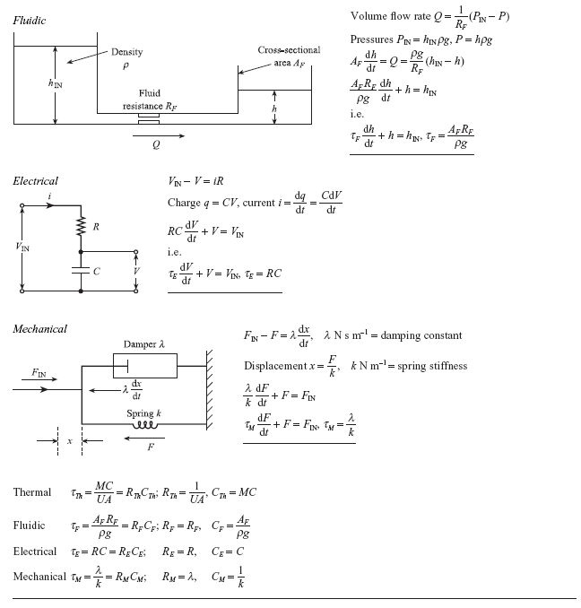

Slide 37
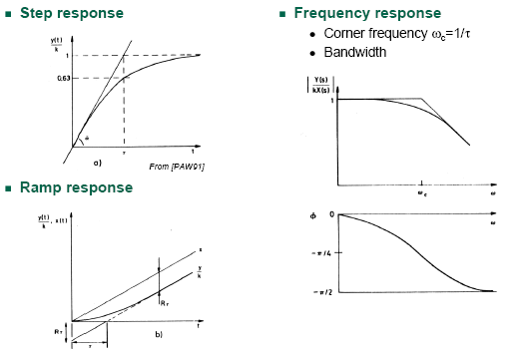
Respon sensor orde SATU

Slide 38
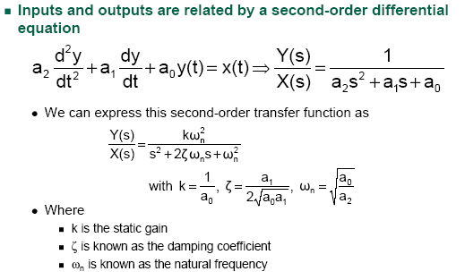
Sensor orde DUA

Slide 39
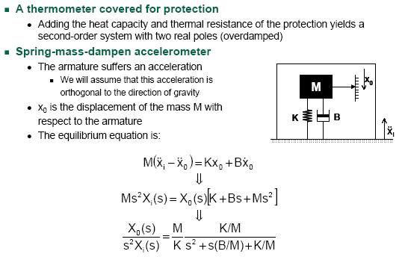
Contoh sensor orde DUA

Slide 40
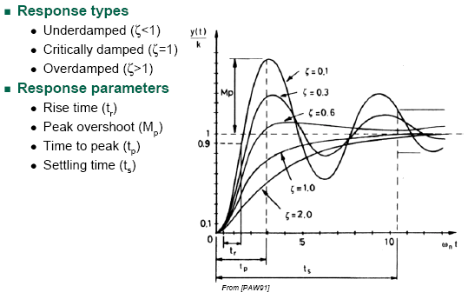
Respon STEP orde DUA

Slide 41
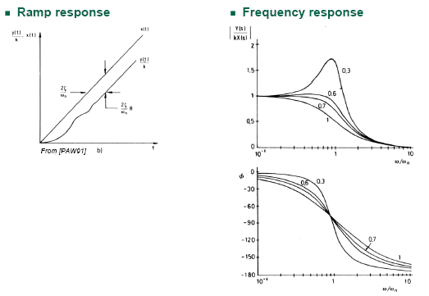
Respon orde DUA

Slide 42
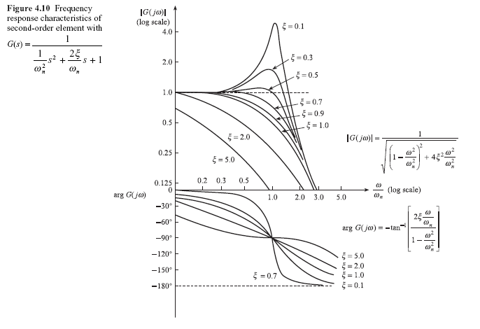
Respon Frekuensi pada orde dua

Slide 43
Faktor Lingkungan
Storage conditions:
nonoperating environmental limits to which a sensor may be subjected during a specified period without permanently altering its performance under normal operating conditions.
Short- and long-term stabilities (drift)
  The short-term stability is manifested as changes in the sensor’s performance within minutes, hours, or even days. The sensor’s output signal may increase or decrease, which, in other terms, may be described as ultralow-frequency noise.
  The long-term stabilitymaybe related to aging of the sensor materials, which is an irreversible change in the material’s electrical, mechanical, chemical, or thermal properties; that is, the long-term drift is usually unidirectional
Temperature factors
A self-heating error : when an excitation signal is absorbed by a sensor and changes its temperature by such a degree that it may affect its accuracy.
Notes:
2.17 Environmental Factors
Storage conditions are nonoperating environmental limits to which a sensor may be
subjected during a specified period without permanently altering its performance under
normal operating conditions. Usually, storage conditions include the highest and
the lowest storage temperatures and maximum relative humidities at these temperatures.
The word “noncondensing” may be added to the relative humidity number.
Depending on the sensor’s nature, some specific limitation for the storage may need
to be considered (e.g., maximum pressure, presence of some gases or contaminating
fumes, etc.).
Short- and long-term stabilities (drift) are parts of the accuracy specification.
The short-term stability is manifested as changes in the sensor’s performance within
minutes, hours, or even days. The sensor’s output signal may increase or decrease,
which, in other terms, may be described as ultralow-frequency noise. The long-term
stabilitymaybe related to aging of the sensor materials, which is an irreversible change
in the material’s electrical, mechanical, chemical, or thermal properties; that is, the
long-term drift is usually unidirectional. It happens over a relatively long time span,
such as months and years. Long-term stability is one of the most important for sensors
used for precision measurements. Aging depends heavily on environmental storage
and operating conditions, how well the sensor components are isolated from the
environment, and what materials are used for their fabrication. The aging phenomenon
is typical for sensors having organic components and, in general, is not an issue for
a sensor made with only nonorganic materials. For instance, glass-coated metaloxide
thermistors exhibit much greater long-term stability compared to epoxy-coated
thermistors.Apowerful way to improve long-term stability is to preage the component
at extreme conditions. The extreme conditions may be cycled from the lowest to
the highest. For instance, a sensor may be periodically swung from freezing to hot
temperatures. Such accelerated aging not only enhances the stability of the sensor’s
characteristics but also improves the reliability (see Section 2.18), as the preaging
process reveals many hidden defects. For instance, epoxy-coated thermistors may
be greatly improved if they are maintained at +150◦C for 1 month before they are
calibrated and installed in a product.
Environmental conditions to which a sensor is subjected do not include variables
which the sensor measures. For instance, an air-pressure sensor usually is subjected
not just to air pressure but to other influences as well, such as the temperatures of air
and surrounding components, humidity, vibration, ionizing radiation, electromagnetic
fields, gravitational forces, and so forth. All of these factors may and usually do affect
the sensor’s performance. Both static and dynamic variations in these conditions
should be considered. Some environmental conditions are usually of a multiplicative
nature; that is, they alter a transfer function of the sensor (e.g., changing its gain). One
example is the resistive strain gauge, whose sensitivity increases with temperature.
Environmental stability is quite broad and usually a very important requirement.
Both the sensor designer and the application engineer should consider all possible external
factors which may affect the sensor’s performance.Apiezoelectric accelerometer
may generate spurious signals if affected by a sudden change in ambient tem perature, electrostatic discharge, formation of electrical charges (triboelectric effect),
vibration of a connecting cable, electromagnetic interference (EMI), and so forth.
Even if a manufacturer does not specify such effects, an application engineer should
simulate them during the prototype phase of the design process. If, indeed, the environmental
factors degrade the sensor’s performance, additional corrective measures
may be required (see Chapter 4) (e.g., placing the sensor in a protective box, using
electrical shielding, using a thermal insulation or a thermostat).
Temperature factors are very important for sensor performance; they must be
known and taken into account. The operating temperature range is the span of ambient
temperatures given by their upper and lower extremes (e.g., −20◦C to +100◦C)
within which the sensor maintains its specified accuracy. Many sensors change with
temperature and their transfer functions may shift significantly. Special compensating
elements are often incorporated either directly into the sensor or into signal conditioning
circuits, to compensate for temperature errors. The simplest way of specifying
tolerances of thermal effects is provided by the error-band concept, which is simply
the error band that is applicable over the operating temperature band. A temperature
band may be divided into sections, whereas the error band is separately specified for
each section. For example, a sensor may be specified to have an accuracy of ―

