Slide 1
Requirements Determination

Slide 2
What is a Requirement?
A statement of what the system must do
A statement of characteristics the system must have
Focus is on business user needs during analysis phase
Requirements will change over time as project moves from analysis to design to implementation

Slide 3
Requirement Types
Functional Requirements
  A process the system hast to perform
  Information the system must contain
Nonfunctional Requirements
  Behavioral properties the system must have
    Operational
    Performance
    Security
    Cultural and political

Slide 4
Documenting Requirements
Requirements definition report
  Text document listing requirements in outline form
  Priorities may be included
Key purpose is to define the project scope: what is and is not to be included.

Slide 5
Determining Requirements
Participation by business users is essential
Three techniques help users discover their needs for the new system:
  Business Process Automation (BPA)
  Business Process Improvement (BPI)
  Business Process Reengineering (BPR)

Slide 6
Basic Process of Analysis (Determining Requirements)
Understand the “As-Is” system
Identify improvement opportunities
Develop the “To-Be” system concept
Techniques vary in amount of change
  BPA – small change
  BPI – moderate change
  BPR – significant change
Additional information gathering techniques are needed as well

Slide 7
Requirements Analysis Techniques

Slide 8
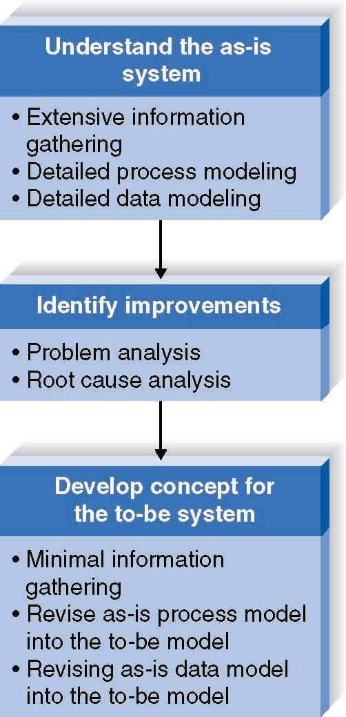
Business Process Automation
Goal:
Efficiency
for users

Slide 9
Identifying Improvements in As-Is Systems
Problem Analysis
  Ask users to identify problems and solutions
  Improvements tend to be small and incremental
  Rarely finds improvements with significant business value
Root Cause Analysis
  Challenge assumptions about why problem exists
  Trace symptoms to their causes to discover the “real” problem

Slide 10
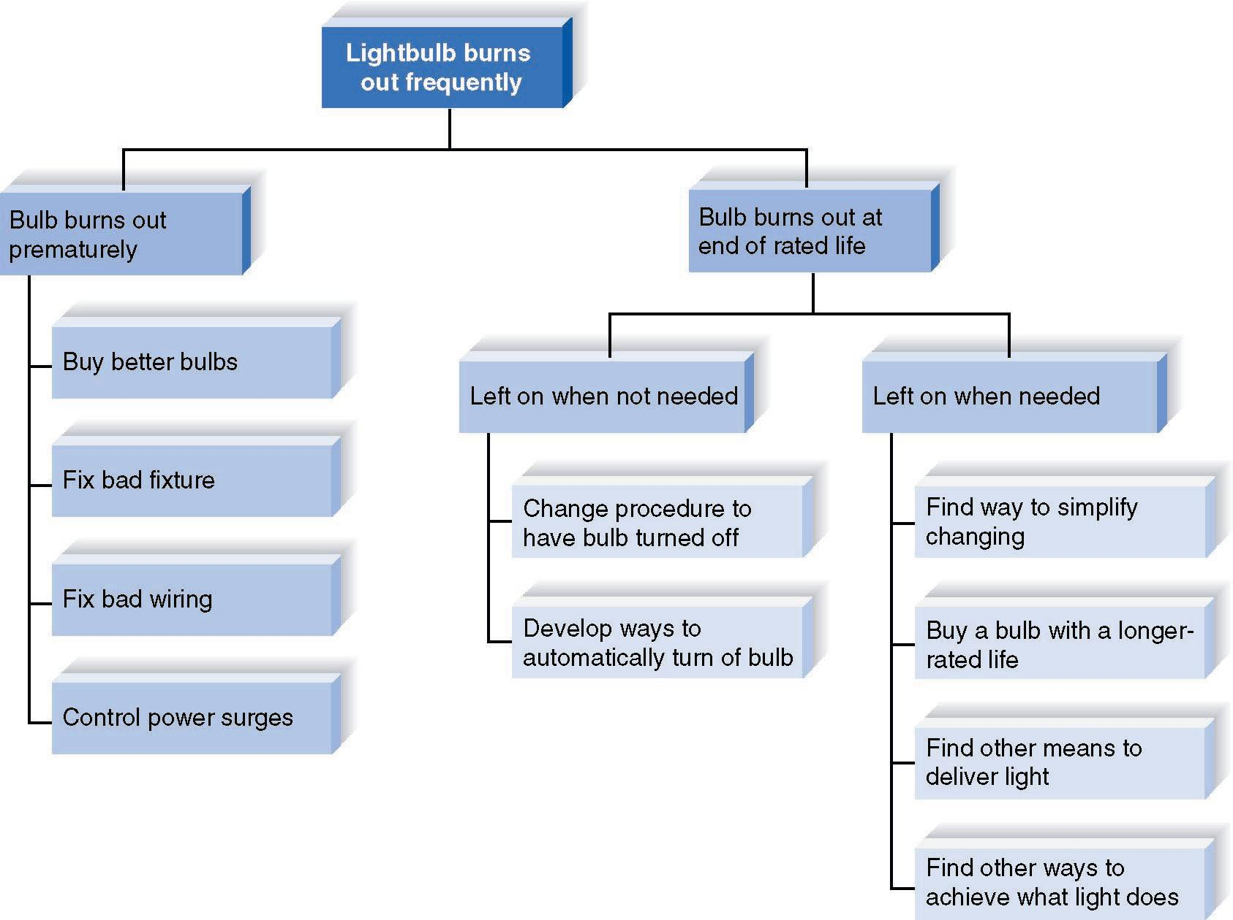
Root Cause Analysis Example

Slide 11
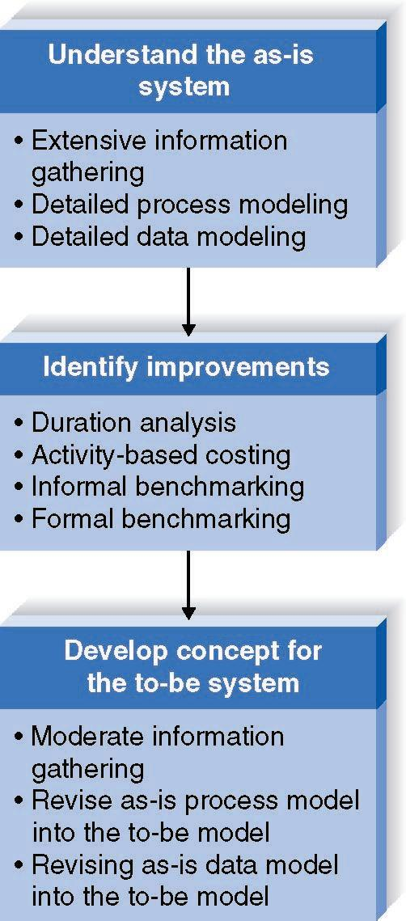
Business Process Improvement
Goal:
Efficiency
and
effectiveness
for users

Slide 12
Duration Analysis
Calculate time needed for each process step
Calculate time needed for overall process
Compare the two – a large difference indicates a badly fragmented process
Potential solutions:
  Process integration – change the process to use fewer people, each with broader responsibilities
  Parallelization – change the process so that individual step are performed simultaneously

Slide 13
Activity-Based Costing
Calculate cost of each process step
Consider both direct and indirect costs
Identify most costly steps and focus improvement efforts on them

Slide 14

Benchmarking
Studying how other organizations perform the same business process
Informal benchmarking
  Common for customer-facing processes
  Interact with other business’ processes as if you are a customer

Slide 15
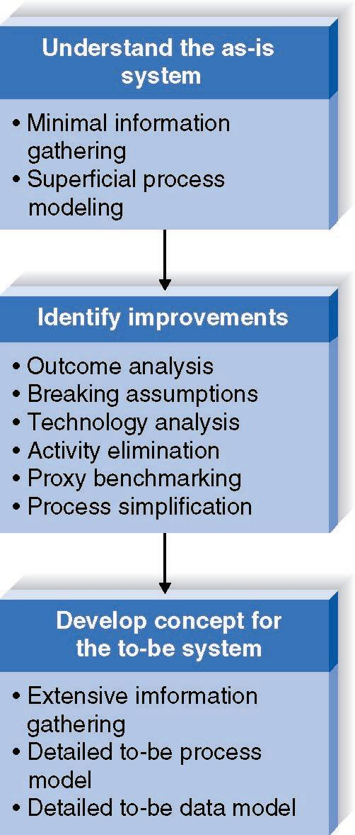
Business Process Reengineering
Goal:
Radical redesign of business processes

Slide 16
Outcome Analysis
Consider desirable outcomes from customers’ perspective
Consider what the organization could enable the customer to do

Slide 17
Technology Analysis
Analysts list important and interesting technologies
Managers list important and interesting technologies
The group identifies how each might be applied to the business and how the business might benefit

Slide 18
Activity Elimination
Identify what would happen if each organizational activity were eliminated
Use “force-fit” to test all possibilities

Slide 19
Selecting an Analysis Technique
Potential business value
Project cost
Breadth of analysis
Risk

Slide 20
Characteristics of Analysis Techniques
Business Business Business
Process Process Process
Automation Improvement Reeingineering
Potential Business Low-Moderate Moderate High
Value
Project Cost Low Low-Moderate High
Breadth of
Analysis Narrow Narrow-Moderate Very Broad
Risk Low-Moderate Low-Moderate Very High

Slide 21
Requirements-gathering Techniques

Slide 22
Interviews
Most commonly used technique
Basic steps:
  Selecting Interviewees
  Designing Interview Questions
  Preparing for the Interview
  Conducting the Interview
  Post-Interview Follow-up

Slide 23
Selecting Interviewees
Based on information needs
Best to get different perspectives
  Managers
  Users
  Ideally, all key stakeholders
Keep organizational politics in mind

Slide 24
Types of Questions
Types of Questions
Examples
Closed-Ended Questions
* How many telephone
orders are received per day?
* How do customers place orders?
* What additional information
would you like the new system
to provide?
Open-Ended Questions
* What do you think about the
current system?
* What are some of the problems
you face on a daily basis?
* How do you decide what types of
marketing campaign to run?
Probing Questions
* Why?
* Can you give me an example?
* Can you explain that in a bit
more detail?

Slide 25
Organizing Interview Questions
Unstructured interview useful early in information gathering
  Goal is broad, roughly defined information
Structured interview useful later in process
  Goal is very specific information

Slide 26
Structuring the Interview
EXAMPLES?
High Level:
Very General
Medium-Level:
Moderately
Specific
Low-Level:
Very Specific
TOP DOWN
BOTTOM UP

Slide 27
Interview Preparation Steps
Prepare general interview plan
  List of question
  Anticipated answers and follow-ups
Confirm areas of knowledge
Set priorities in case of time shortage
Prepare the interviewee
  Schedule
  Inform of reason for interview
  Inform of areas of discussion

Slide 28
Conducting the Interview
Appear professional and unbiased
Record all information
Check on organizational policy regarding tape recording
Be sure you understand all issues and terms
Separate facts from opinions
Give interviewee time to ask questions
Be sure to thank the interviewee
End on time

Slide 29
Conducting the Interview
Practical Tips
Take time to build rapport
Pay attention
Summarize key points
Be succinct
Be honest
Watch body language

Slide 30
Post-Interview Follow-Up
Prepare interview notes
Prepare interview report
Have interviewee review and confirm interview report
Look for gaps and new questions

Slide 31
Joint Application Development
A structured group process focused on determining requirements
Involves project team, users, and management working together
May reduce scope creep by 50%
Very useful technique

Slide 32
JAD Participants
Facilitator
  Trained in JAD techniques
  Sets agenda and guides group processes
Scribe(s)
  Record content of JAD sessions
Users and managers from business area with broad and detailed knowledge

Slide 33
JAD Sessions
Time commitment – ½ day to several weeks
Strong management support is needed to release key participants from their usual responsibilities
Careful planning is essential
e-JAD can help alleviate some problems inherent with groups

Slide 34
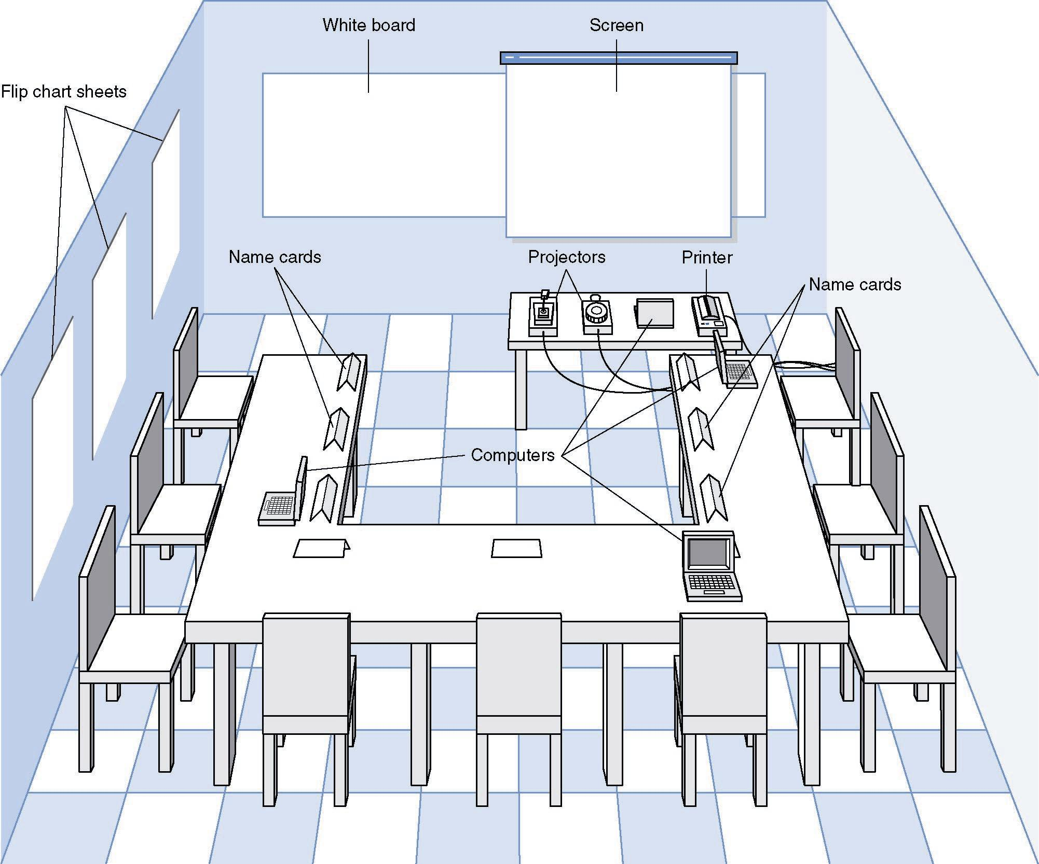
JAD Meeting Room

Slide 35
The JAD Session
Formal agenda and ground rules
Top-down structure most successful
Facilitator activities
  Keep session on track
  Help with technical terms and jargon
  Record group input
  Stay neutral, but help resolve issues
Post-session follow-up report

Slide 36
Managing Problems in JAD Sessions
Reducing domination
Encouraging non-contributors
Side discussions
Agenda merry-go-round
Violent agreement
Unresolved conflict
True conflict
Use humor

Slide 37
Questionnaires
A set of written questions, often sent to a large number of people
May be paper-based or electronic
Select participants using samples of the population
Design the questions for clarity and ease of analysis
Administer the questionnaire and take steps to get a good response rate
Questionnaire follow-up report

Slide 38
Good Questionnaire Design
Begin with non-threatening and interesting questions
Group items into logically coherent sections
Do not put important items at the very end of the questionnaire
Do not crowd a page with too many items
Avoid abbreviations
Avoid biased or suggestive items or terms
Number questions to avoid confusion
Pretest the questionnaire to identify confusing questions
Provide anonymity to respondents

Slide 39
Document Analysis
Study of existing material describing the current system
Forms, reports, policy manuals, organization charts describe the formal system
Look for the informal system in user additions to forms/report and unused form/report elements
User changes to existing forms/reports or non-use of existing forms/reports suggest the system needs modification

Slide 40
Observation
Watch processes being performed
Users/managers often don’t accurately recall everything they do
Checks validity of information gathered other ways
Be aware that behaviors change when people are watched
Be unobtrusive
Identify peak and lull periods

Slide 41
Selecting the Appropriate Requirements-Gathering Techniques
Type of information
Depth of information
Breadth of information
Integration of information
User involvement
Cost
Combining techniques

Slide 42
Selecting the Appropriate Techniques
Interviews JAD Questionnaires Document Observation
Analysis
Type of As-Is As-Is As-Is As-Is As-Is
Information Improve. Improve. Improve.
To-Be To-Be
Depth of High High Medium Low Low
Information
Breadth of Low Medium High High Low
Information
Integration Low High Low Low Low
of Info.
User Medium High Low Low Low
Involvement
Cost Medium Low- Low Low Low-
Medium Medium

