Slide 1

UML Diagramming and Notation
Teknik Informatika – Universitas Komputer Indonesia

Slide 2
List of Material
Introduction of UML
Use Case Modelling
Activity Diagram Modelling
Sequence Diagram Modelling
Class and Object Diagram Modelling
State Diagram Modelling
Deployment Diagram

Slide 3
Introduction of UML

Slide 4
UML History (1)
OO languages muncul pada pertengahan tahun 70 sampai 80.
Antara tahun 89 sampai 94, metode OO meningkat dari 10% sampai 50%.
Dicetuskan oleh Three Amigos:
  Grady Booch - Fusion
  James Rumbaugh – Object Modeling Technique (OMT)
  Ivar Jacobson – Object-oriented Software Engineering: A Use Case Approach (Objectory)
  ( And David Harel - StateChart)

Slide 5
UML History
Unification of ideas began in mid 90’s.
    Rumbaugh joins Booch at Rational ’94
  v0.8 draft Unified Method ’95
    Jacobson joins Rational ’95
  UML v0.9 in June ’96
  UML 1.0 offered to OMG in January ’97
  UML 1.1 offered to OMG in July ’97
    Maintenance through OMG RTF
  UML 1.2 in June ’98
  UML 1.3 in fall ’99
  UML 1.5 http://www.omg.org/technology/documents/formal/uml.htm
  UML 2.0 underway http://www.uml.org/

Slide 6
UML (Unified Modelling Language)
An effort by IBM (Rational) – OMG to standardize OOA&D notation
Combine the best of the best from
  Data Modeling (Entity Relationship Diagrams);
  Business Modeling (work flow); Object Modeling
  Component Modeling (development and reuse - middleware, COTS/GOTS/OSS/…:)
Offers vocabulary and rules for communication
Not a process but a language

Slide 7

UML for Visual Modelling
Sales
Representative
Places Order
Customer
Fulfill Order
Item
Business Process
via
Ships the Item
A picture is worth a thousand words!

Slide 8
Building Blocks of UML
Things - important modelling concepts
Relationships – tying individual things
Diagram – grouping interrelated collections of things and relationships

Slide 9
Structural Thing in UML
Event Mgr
thread
time
Start
suspend( )
stop( )
Course.cpp
IGrade
<<interface>>
IGrade
UnivWebServer
setGrade()
getGrade()
Register
for Courses
Manage Course
Registration
Use Case
Collaboration
(a system service
sequence of
Interactions w. actor)
(chain of responsibility
shared by a web of interacting objects,
structural and behavioral)

Slide 10
Behavioral Thing in UML
Verbs.
Dynamic parts of UML models: “behavior over time”
Usually connected to structural things.
Two primary kinds of behavioral things:
Interaction
a set of objects exchanging messages, to accomplish a specific purpose.
harry: Student
ask-for-an-A
katie: Professor
name = “Harry Kid”
name = “Katie Holmes”
State Machine
specifies the sequence of states an object or an interaction goes through during its lifetime in response to events.
received-an-A/
buy-beer
inStudy
inParty
sober/turn-on-PC

Slide 11
Group Thing in UML
For organizing elements (structural/behavioral) into groups.
Purely conceptual; only exists at development time.
Can be nested.
Variations of packages are: Frameworks, models, & subsystems.
Course Manager
Course Manager
Student Admission
-Student
+Department
Annotational Things in UML: Note
- Explanatory/Comment parts of UML models - usually called adornments
- Expressed in informal or formal text.
flexible
drop-out dates
operation()
{for all g in children
g.operation()
}

Slide 12
Relationship in UML
1. Associations
Structural relationship that describes a set of links, a link being a connection between objects. variants: aggregation & composition
2. Generalization
a specialized element (the child) is more specific the generalized element.
3. Realization
one element guarantees to carry out what is expected by the other element.
(e.g, interfaces and classes/components; use cases and collaborations)
4. Dependency
a change to one thing (independent) may affect the semantics of the other thing (dependent).

Slide 13
UML 1.x VS UML 2.0
UML 1.x: 9 diagram types.
UML 2.0: 12 diagram types
Structural Diagrams
Represent the static aspects of a system.
  Class;
  Object
  Component
  Deployment
Structural Diagrams
  Class;
  Object
  Component
  Deployment
  Composite Structure
  Package
Behavioral Diagrams
Represent the dynamic aspects.
  Use case
  Sequence;
  Collaboration
  Statechart
  Activity
Behavioral Diagrams
  Use case
  Statechart
  Activity
Interaction Diagrams
  Sequence;
  Communication
  Interaction Overview
  Timing
13

Slide 14
UML Diagram
Structural diagrams
  Used to describe the relation between classes
Behavior diagrams
  Used to describe the interaction between people (actors) and a use case (how the actors use the system)

Slide 15
Structural Diagram
Class diagram
Object diagram
Component diagram
Deployment diagrams

Slide 16
Behavioral Diagram
Use case diagrams
Sequence diagrams
Collaboration diagrams
Statechart diagrams
Activity diagrams

Slide 17
Commonly Used Diagram (1)
Use case diagram
  Describing how the system is used
  The starting point for UML modeling
Use case scenario
  A verbal articulation of exceptions to the main behavior described by the primary use case
Activity diagram
  Illustrates the overall flow of activities

Slide 18
Commonly Used Diagram (2)
Sequence diagrams
  Show the sequence of activities and class relationships
Class diagrams
  Show classes and relationships
Statechart diagrams
  Show the state transitions

Slide 19
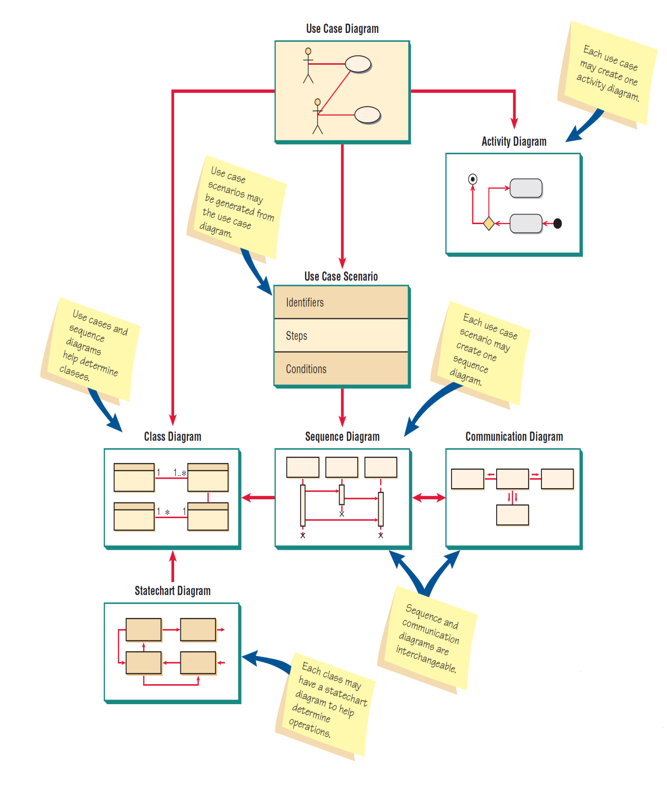
Overview of UML Diagram

Slide 20
Use Case Modelling

Slide 21
Use Case Model
Describes what a user expects the system to do
  functional requirements
May describe only the functionalities that are visible to the user
  requirements view
May include additional functionalities to elaborate those in the previous step
  design view
Consists of use case diagrams and textual descriptions

Slide 22
Element of Use Case Diagram
Subject
dependency
Use case
Use case
association
generalization
association
Use case
Use case
actor
dependency

Slide 23
Use Case Symbol
SYMBOL | NAME OF SYMBOL | EXPLANATION
 | Actor | Accessing use case
 | Use Case | Show what the system do
 | Association | Relate the actor with use case
 | System Boundary | Show boundary between system and its environment

Slide 24
Use Case Definition (1)
Subject
  A black box that describes the system or subsystem that is modeled
  Example: ATM system, login subsystem
  Represented optionally as a rectangle in the use case diagram, but generally not shown
Actor
  A role played by an external entity that interacts with the subject
  One object may play multiple roles in a context in which case there will be multiple actors
  example: bank manager playing the role of a teller or that of a customer

Slide 25
Use Case Definition (2)
Primary actor
  An actor who initiates the major, main or important use cases in the system
  Example : a customer in a banking system
Secondary actor
  An actor who is involved with one or more use cases but does not initiate any use case
  Example : database
There is no syntactic difference between a primary actor and a secondary actor

Slide 26
Use Case Definition (3)
Generalization between actors
  One actor can be a specialization of another actor
  Based on the same concept as the specialization relationship between classes
  Example : preferred customer in a bank is a specialization of a customer
Use case
  An important functionality to be implemented and is visible to the actors
  An interacting behavior between an actor and the subject
    Must yield an observable result to the actor
  Example: “deposit” in a banking system

Slide 27
Use Case Definition (4)
Association
  An interaction between an actor and a use case
  Unidirectional associations must be represented by arrows
    Direction of arrow indicates information flow
  Bi-directional associations can be represented by double-sided arrows or straight lines

Slide 28
Use Case Definition (5)
“include” dependency
  One use case may include another use case
  If use case A includes use case B, B must be implemented in order to implement A
  Represented as a dashed arrow from A to B with a label “<<include>>”
  Example : use case “withdraw” includes use case “update account”
<<include>>
A
B

Slide 29
Use Case Definition (6)
“extend” dependency
  One use case may be extended by another use case
  If use case A is extended by use case B, then both A and B can be independently implemented and used
    A will occasionally use B depending on some constraints

Slide 30
Use Case Definition (6)
“extend” dependency (continued)
  Represented as a dashed arrow from B to A with a label “<<extend>>”
    Notice that the arrow is reversed
  Example :
    Use case “withdraw” is extended by use case “compute penalty” when the user withdraws an amount more than the balance in the account; the use case “compute penalty” is therefore occasionally used by “withdraw”.
<<extend>>
A
B

Slide 31
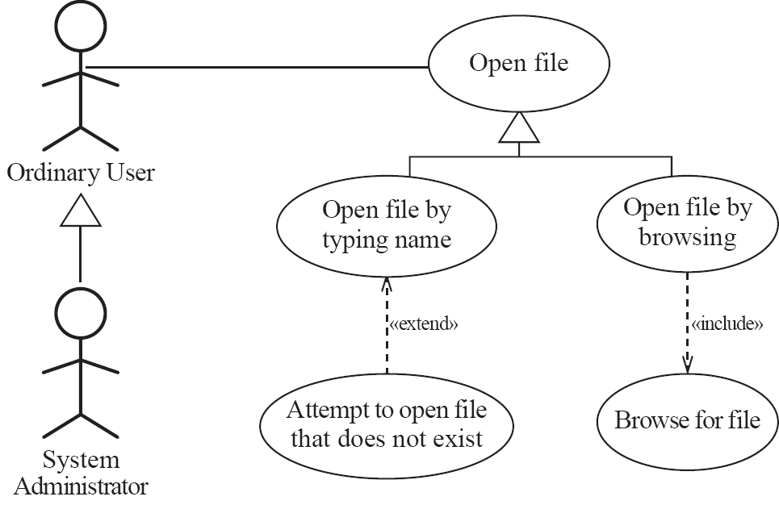
Example of Generalization, Extension, and Inclusion

Slide 32
Constraints in Use Case Model
Every use case must be connected to an actor or be included in another use case or extends another use case
Every use case connected to an actor must return an observable result to the actor
  The result may be data, confirmation or termination of an action

Slide 33
How To Find Use Case?
Every requirement is a use case
Every functionality that supports the implementation of a requirement is a use case
  Design issue
  Found when the first (abstract) use case model is refined to express a design
Do not confuse a “use case” with a “method” in implementation
  Generally, there is a one-to-many relationship between a use case and a method

Slide 34
How To Find Use Case Relationship?
Extracted from the application domain
Must be justifiable from the application domain or from the designer’s choice
Examples
  Use case “withdraw” includes use case “update account” is justifiable from application domain
  Use case “withdraw” is extended by “compute penalty” is a designer’s choice
    Designer can decide to implement two different versions of withdrawals or just only one with no extension

Slide 35
Use Case Narrative/Scenario
Important for design and implementation of use cases
Different types
  Textual (informal) descriptions
  Algorithmic descriptions
  Diagrammatic descriptions (activity diagram)

Slide 36
Describe An Use Case
A. Name: Give a short, descriptive name to the use case
B. Actors: List the actors who can perform this use case
C. Goals: Explain what the actor or actors are trying to achieve
D. Preconditions: State of the system before the use case
E. Summary: Give a short informal description
F. Related use cases
G. Steps: Describe each step using a 2-column format
H. Postconditions: State of the system in following completion
A and G are the most important

Slide 37
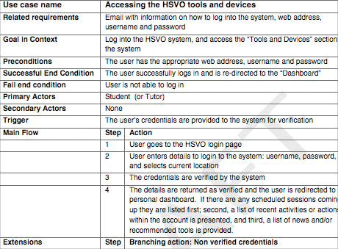
Example of Use Case Narrative/Scenario

Slide 38
Case Study for Use Case Modelling

Slide 39
Case Study - ATM
Model only the transactions
Customer accounts assumed to exist
  Opening and closing of accounts are handled by another portion of the system
Include operations “deposit”, withdraw”, “check balance”, “transfer”
If balance is zero or less than the amount to be withdrawn, then withdrawal should fail

Slide 40
Case Study - ATM
Login
Logout
Deposit
customer
Withdraw
Check balance
Database
Transfer

Slide 41
Case Study – ATM (Revised)
Login
Logout
Validate account
Deposit
Withdraw
Update account
Check balance
Database
Transfer
All dependency relationships are of type <<include>>
Use case diagram for ATM – revised to show design issues

Slide 42
Activity Diagram Modelling

Slide 43
Activity Diagram
Represents a sequence of activities
An activity is a group of atomic actions
An action is indivisible (atomic) task
  Example: change the value of a variable/field
An activity may consist of sub-activities or actions or both
In general, activities may be decomposable but actions are not.
  Activities can be interrupted by events, but actions are not.

Slide 44
Activity Diagram
final
action
initial
subactivity
C
branch
merge
~C
action
C – Boolean expression

Slide 45
Semantic of Activity Diagram (1)
An activity diagram consists of a collection of action states, sub-activities and transitions
Every activity diagram must have only one initial state and one or more final states
  The initial state represents the beginning of the activity and a final state represents the termination of an activity
Actions are represented by action states (rounded rectangles)
A sub-activity is also represented by a rounded rectangle but with an icon inside the rectangle

Slide 46
Semantic of Activity Diagram (2)
When expanded, each sub-activity is diagrammatically substituted with the incoming and outgoing transitions matched
Sequence of actions is represented by transitions between actions
  Transitions are simple straight arrows with no labels or parameters
  Transitions may have guards/conditions, send-clause and actions (very similar to those in state transition diagrams)
  Transitions are augmented with conditions at branching

Slide 47
Semantic of Activity Diagram (3)
A branch is represented by a diamond
  Has one incoming transition to enter the branch
  Two or more outgoing transitions augmented with mutually exclusive conditions
A merger is also represented by a diamond
  Two or more incoming transitions and one outgoing transition
  The outgoing transition will be fired only when all the incoming transitions are fired

Slide 48
When to Use Activity Diagram
An activity diagram can be used to
  describe a use case
  describe a method in a sequence or communication diagram
  describe an action associated with a transition in a state diagram, or the entry action or the exit action of a state diagram
    Caution: the word “action” in state diagram represents a higher level task while the same word in an activity diagram represents an atomic non-divisible computation

Slide 49
More Syntax in Activity Diagram
Obj.action (params)
action
: Class
action
Fork node
Object
action
action
Join node

Slide 50
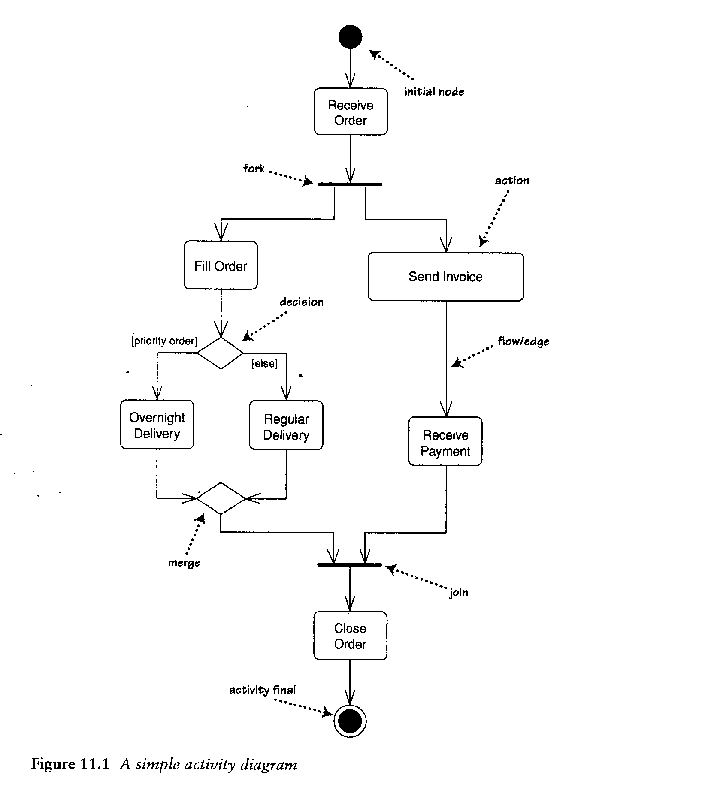
Example of Activity Diagram

Slide 51
Activity Partition
An activity partition represents a group of actions
  Actions grouped based on who performs the actions
  Actions grouped based on the functionality achieved by the actions
  Actions grouped based on timing events
Previous versions of UML call this as “swim lane”.

Slide 52
More Syntax in Activity Diagram
DisplayWindow
Installer
Initialize Bar
:Progress Bar
Update status of Bar
Display Bar

Slide 53
Sub Activity
An action state in an activity diagram can be represented by a sub activity as shown below
Subactivity
A sub activity represents a simplification of another activity diagram
It reduces the space for an activity diagram

Slide 54
Sub Activity Semantics
A subactivity is a representation of another activity diagram
The incoming arrow to a subactivity matches with the initial state of the activity diagram represented by the subactivity
The outgoing arrow from a subactivity matches with the final state of the activity diagram represented by the subactivity

Slide 55
Customer
Sales
Stockroom
Request service
Take Order
Pay
Fill Order
Deliver order
Collect order

Slide 56
Object as Parameters
Objects passed as parameters between action states can be represented in the activity diagram (and in swimlane diagram) using the same syntax for objects
The transition between an object parameters and an action state is represented with a dashed line, instead of a solid line

Slide 57
Customer
Sales
Stockroom
Request service
: Order [placed]
:Order [entered]
Take Order
Pay
Fill Order
: Order [filled]
:Order [delivered]
Collect order
Deliver order

Slide 58
Sequence Diagram Modelling

Slide 59
Sequence diagram
A two-dimensional chart that describes collaborations
Each sequence diagram describes a particular scenario
  E.g., a sequence diagram can describe successful withdrawal operation
  Another sequence diagram can describe failure of withdrawal operation due to insufficient funds
  It is also possible to describe both scenarios in one sequence diagram

Slide 60
Sequence diagram: basic syntax
Obj1 : ClassA
: ClassB
Obj2 : ClassC
method-in-B()
message
return
stimulus
message to self
lifeline
return
[condition] method(parameters)
return
concurrent method()
concurrent method()

Slide 61
Sequence diagram – semantics (1)
Rectangular boxes on the top indicate objects
The dotted vertical line indicates the life line of the corresponding object
Rectangular boxes on the dotted vertical line indicate the duration in which the corresponding object is active; the object is idle otherwise
A solid arrow with solid arrowhead indicates a message
A solid arrow with thin arrowhead indicates a stimulus
A dashed arrow indicates return of control

Slide 62
Sequence diagram – semantics (2)
Messages/stimuli may be augmented with conditions
Messages/stimuli can be concurrent
  start from one object and send messages or signals to more than one object at the same time
The vertical dimension indicates time axis
  A message ‘Y’ placed below a message ‘X’ in a sequence diagram indicates that message ‘X’ is sent before message ‘Y’

Slide 63
Sequence diagram – semantics (3)
Objects with dashed vertical line for the entire diagram have lifeline for the entire scenario
  These objects are assumed to be already created before this scenario starts and assumed to exist even after the scenario ends
Objects with short life span within a scenario can be shown differently (see the next diagram)
There is no ordering required among the placement of objects on the horizontal line
  A designer may choose the ordering for the convenience of drawing the diagram

Slide 64
Sequence diagram – extended syntax
: ClassA
constructor of B ()
: ClassB
constructor of C ()
: ClassC
message to self
[condition] method(parameters)
return

Slide 65
Sequence diagram – semantics (4)
The creation of an object is shown by the vertical displacement of the object from the top of the diagram. The object is placed at the point of creation
  See the creation of objects from class A and from class B
The termination of an object can be shown by placing an “X” at the bottom of its life line
  See the destruction of the object from class C

Slide 66
Sequence diagram – Specifying Loops
: User
: Accounts DB
Deposit (act[], amount)
Loop (1..act.length)
Validate Account (act[i])
Reserved word
: Account
Create (act[i], bal)
Deposit(amount)
Delete()
return
Depositing the same amount into several accounts

Slide 67
Concurrent messages / stimuli - semantics
an object can send two messages / stimuli to two different objects at the same time
  concurrent execution
  there may be a condition on each of these messages / stimuli but they can be totally different
  the tail end of these two messages / stimuli coincide at the originating object
  the arrow heads may physically be on different horizontal levels but logically they are at the same time line (horizontal level)
  see “Op4() and Op5()” in the diagram (next page)

Slide 68
Time-based messages / stimuli- semantics
a message can be split into two, leading to two destination objects with mutually exclusive conditions
  see “Op1(x)” in the diagram
a lifeline can be split into a side track for a specific duration to indicate mutually exclusive situations
  see “Obj4” in the diagram
iterations can be specified using a condition at the beginning of a message / stimulus
  see “Op2(y)” in the diagram
timing constraints can be added onto the messages / stimuli or on the vertical time axis

Slide 69
Concurrent and time-based messages and stimuli
Obj1 : C1
Obj2 : C2
Obj4 : C4
[t = 0]
[x > 0] Op1(x)
Obj3 : C3
[y >= 0] Op3(y)
[x <= 0] Op1(x)
[for each y] Op2(y)
return
return
return
return
[t <= 30]
Op4( )
X
Op5( )

Slide 70
Example – Course registration system
Scenario
  A student object checks the availability of seats in a course. If available, it sends a message to register. The course object checks for the prerequisites first. Upon acceptance, the course object returns the message back to the student object and at the same time informs the account object to bill the student. The account object then communicates with the student to get the payment for the course.
  The following diagram shows a successful course registration process

Slide 71
:Student
:Course
:Account
check seat availability()
return
register (id, prereqs)
check prerequisites(prereqs)
update enrollment (id)
return
initiate payment (id, course number)
request payment (course number, amount)
update student record (id, course number, amount)
payment (id, course number, amount)
return

Slide 72
Class and Object Diagram Modelling

Slide 73
Class diagram – basic syntax
Association name
Class name
Class name
Attributes
Methods
This is a
superclass
aggregation
Component
Aggregate
Class name
specialization
Class name
This is a subclass
Attributes
Methods
comments

Slide 74
Class Diagram: semantics (1)
A class icon must have a class name. Optionally, it can have attributes and/or methods.
Attributes and methods are strings and will not be validated by the modeling tools.
Attributes can be specified by their names or by <name : type> pairs.
Methods can be specified by their names or with partial signatures or with complete signatures.

Slide 75
Class Diagram: semantics (2)
Comments can be included in any diagram with a rectangle folded at right top corner
  The dotted line from the comment is important to indicate which portion of the diagram is explained by the comment
Suggestion
  For validation purposes, when showing aggregation relationship, the aggregate (the one near the diamond edge) must include an attribute whose type is the component class

Slide 76
Class

Slide 77
Details of a class icon
Account
Initial value
- Account number : Integer
- Balance : Real
- Overdraft : Boolean = true
+ public
private
# protected
~ visible within the package
+ GetAccountNumber () : Integer
# UpdateBalance (sign :Sign, amt : Integer)
~ ReturnBalance () : Real
ChangeOverdraft ()

Slide 78
An abstract class
Polygon
{abstract, author = Kasi, last modified = Oct 2002}
<<constructor>>
+ Polygon(List of Vertex vertices)
<<query>>
#area () : Real

Slide 79
Multiplicity
Multiplicity | Explanation
0..1 | 0 or 1
1 | Mandatory 1
0..* | 0 or Many
1..* | 1 or Many
* | Many

Slide 80
Object Diagram
act : Account
: Account
Account # = 1256
UserID = 120
Balance = 0
act : Account
Various representations of an account object

Slide 81
Association –syntax
Association label
Direction of association
uses
customer
Account
User
1
n
-Account number
-Balance
-Overdraft
Manager
1
cardinality
+Get accountID ()
+Update balance()
+Return balance()
Role names
{xor}
Unary association
uses
Corporate Account
n

Slide 82
Association – Semantics (1)
Every association is expected to be labeled
  UML does not require a name for an association
Direction of an association, cardinality, role name are all optional
  For unary associations, it is better to include role names
Representations of cardinality
  0, 1, * (zero or more), n..m (values in the range between n and m both inclusive)

Slide 83
Association – Semantics (2)
A constraint may be [optionally] placed between two associations
  See the example in the previous slide that asserts an Exclusive OR relationship between the associations
When a subclass specializes a superclass, it also inherits all associations between the superclass and other classes
In the previous example, the association “uses” between “User” and “Account” is also inherited by the pair “User” and “Corporate Account”

Slide 84
Association with qualifiers
uses
Account
User
1
n
Account number
-Account number
-Balance
-Overdraft
+Get accountID ()
+Update balance()
+Return balance()
Qualifier attribute
Qualifier
Corporate Account

Slide 85
Association - Qualifiers
Qualifiers can be attached to a “one-to-many” association
  It is rectangle attached to the “many” end of the association
A qualifier is a collection of variables whose values uniquely identify an instance at the “many” end of the association
  In the example, an account number uniquely identifies an account in a collection of accounts
Qualifier is part of the association

Slide 86
Association Class
User
Account
Transaction
Employee
Job
Salary

Slide 87
Association Class - semantics
A piece of information that belongs to both classes in an association is put into a separate class called “association class”
  Association class is a dependent class that depends on the other two classes in the association
  An association class cannot exist independently
  An object of an association class must refer to objects of the other two classes in the association
    Example: A “Transaction” object depends on a “User” object and on an “Account” object.

Slide 88
Shared Aggregation
An aggregation relationship in which the component can be shared by classes/objects outside the aggregation
Team
Person
Family
Person object is shared by both Team and Family objects
Shared aggregation is indicated by a hallow diamond
Caution: Changes made to a component object will affect all the aggregates that include the component.

Slide 89
Composite Aggregation
An aggregation relationship in which the component is an exclusive part of the aggregate; hence, not shared.
2
Wing
1
Air Plane
1
2
Engine
Composite aggregation is indicated by a filled diamond

Slide 90
Composition VS Aggregation
Bila Universitas ditutup maka Fakultas dan Jurusan akan hilang akan tetapi Dosen tetap akan ada. Begitupun relasi antar Fakultas dengan Jurusan

Slide 91
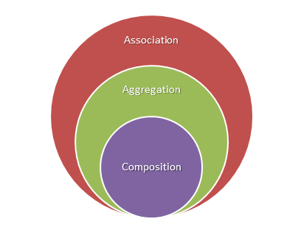
Association VS Composition VS Aggregation

Slide 92
Advanced Specialization
Person
Gender
{complete, disjoint}
Sports activity
{incomplete, overlapping}
Boy
Girl
Swimmer
Runner
These optional domain words make the relationships easier to understand.

Slide 93
How to find classes? (1)
Nouns in requirements document or use case descriptions may provide a good starting point, but often are inadequate
Each class should contain a distinct set of operations relevant to the system under consideration
  Think of a class as an ADT
Remove vague classes
  Classes that do not adequately describe themselves
    A class that represents the internet

Slide 94
How to find classes? (2)
Try not to include implementation-oriented classes in the analysis model
  May be introduced later during design and/or implementation
  Examples: array, tree, list
  These classes will not only occupy so much space in the diagram but also tend to divert the focus of analysis

Slide 95
How to identify associations? (1)
An association corresponds to a semantic dependency between classes
  Class A uses a service from class B (client-server)
  Class A has a structural component whose type is class B (aggregation)
  Class A sends data to or receives data from class B (communication)

Slide 96
How to identify associations? (2)
Include only those associations that are relevant to the current model
  Constrained by assumptions, simplifications, system boundary (what is expected to be provided by the system)
  Three different associations between “Faculty member” and “Course”
    “Faculty member” teaches “Course” in a course registration system
    “Faculty member” creates “Course” in a curriculum development system
    “Faculty member” evaluates “Course” in a course evaluation/inspection system

Slide 97
How to identify associations? (3)
Eliminate redundant associations
  “Faculty member” teaches “Course”
  “Course” is taught between “Time” to “Time”
  Therefore, “Faculty member” teaches between “Time” to “Time”
    use transitivity between associations
Remember that subclasses inherit the associations of a superclass

Slide 98
How to identify aggregations?
Aggregations are also associations
Identify as Association if it is not clear whether it is Association or Aggregation
  “Mail” has “Address” (aggregation)
  “Mail” uses “Address” for delivery (association)
  “Customer” has “Address” (aggregation)
  “Customer” resides at “Address” (association)
  “TV” includes “Screen” (aggregation)
  “TV” sends information to “Screen” (association)

Slide 99
How to identify specialization?
Generally, specialization relationships are noticeable in the application domain
Top-down approach
  “Student”, “Full-time Student”, “Part-time Student”
  “TV”, “Plasma TV”, “Flat Panel TV”
  “Customer”, “Bank manager”, “Teller”

Slide 100
How to identify specialization (2)
Some of them are discovered during analysis
Bottom-up approach
  “Part-time Instructor” derived from “Instructor” and “Student” while modeling a department
  “User” derived from “Customer”, “Bank Manager” and “Teller” while modeling an ATM system
  “Material” derived from “Book”, “Journal” and “Magazine” while modeling a library catalog system

Slide 101
Statechart Diagram Modelling

Slide 102
State diagram – basic syntax
event (EventParams) [guard] /
action (ActionParams)
initial
State name
actions
entry/ …
exit/ …
do/
event (params)
event (Eparams) / action (Aparams)
actions
Unnamed states
final

Slide 103
State Diagram
A transition between states is represented by the event that triggers the transition
Transitions may have guards or conditions under which the transitions fire
A state may optionally have a label
Every state may have
  An entry action – executed as soon as the state is entered
  An exit action – executed just before leaving the state
  A “do” action – executed while the object is in this state; it may be ongoing action until the object leaves the state

Slide 104
State Formal Definition (1)
A state is a condition in the life of an object during which the object performs an action or waits for some event
A state is represented by the collection of attributes and their corresponding values
An object after being created must be in at one particular state at any instant
  Unless otherwise mentioned, an object remains in a state for a finite time
  UML allows modeling of transient states (states that exist only for a very short and insignificant duration)

Slide 105
State Formal Definition (2)
A state (directly or indirectly) includes links (instances of associations) connected with the object at that instant
A state may be decomposed into concurrent sub-states (AND relationship)
A state may be composed using mutually exclusive disjoint sub-states (OR relationship)

Slide 106
Event Formal Definition
A noteworthy occurrence
  UML manual version 1.5
Something that happens within the system or interacting with the system at an instant
Something that has a significant impact on the system
Examples
  sending a signal or data
  receiving a signal or data
  making a request for execution
  a Boolean condition becoming true
  a timeout condition becoming true

Slide 107
Four types of events in UML
Signal event
  occurs when an object sends a signal to another object
Call event
  occurs when a method or operation in an object is invoked
Change event
  occurs when a Boolean condition is changed
Time event
  occurs when a time limit has reached

Slide 108
Transition (1)
Represents the change of states of an object
  switch from “Empty balance” to “Positive balance”
A transition is an abstraction of an operation
  The above transition is an abstraction of deposit operation
A transition has finite and significant duration
  Observable time taken to complete deposit operation

Slide 109
Transition (2)
A transition may have parameters
  A transition corresponding to the deposit operation will have the “amount” as a parameter
A transition is triggered/invoked/fired by the occurrence of an event
  The transition corresponding to deposit will occur by the event “request for deposit”
  The transition from “Positive balance” to “Empty balance” occurs by the completion of the operation “withdrawal”

Slide 110
Transition (3)
A transition may have a guard/condition
  The transition corresponding to the withdrawal operation will occur only if the balance is greater than or equal to the amount to be withdrawn
  The condition associated with a transition is always the precondition for the transition and hence must be checked before the transition occurs
An event may cause several transitions to fire
  The event that triggers the transition to move to “Empty balance” state after withdrawal may also cause a message to be sent to the account holder and at the same time may also cause a note to be recorded in the account log

Slide 111
Example of State Diagram: Student Class
register [#courses < minRequired] / updateCourses()
register[#courses < minRequired] / updateCourses()
Initial
continuing
entry/ initializeCourses()
register [#courses >= minRequired] / updateCourses()
completed
graduated
[complete
Graduation
Requirements]

Slide 112
Deployment Diagram Modelling

Slide 113
Deployment Diagram
Deployment diagrams show a system's physical layout, revealing which pieces of software run an what pieces of hardware.
embedded system:
Device, node, and hardware
Client/server System
Pure Distributed System
Re-engineering Application

Slide 114
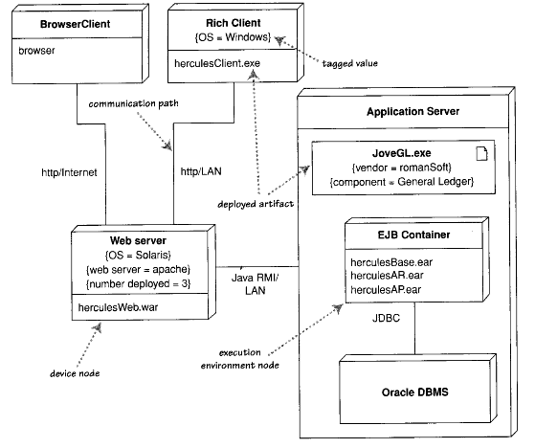
Example Deployment Diagram

Slide 115
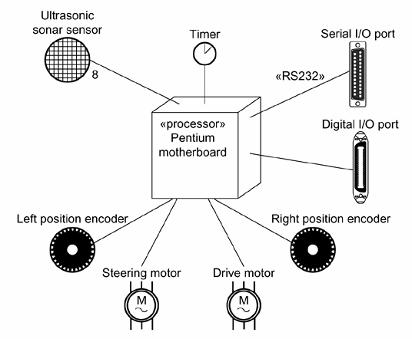
Example Deployment Diagram: Embedded System

Slide 116
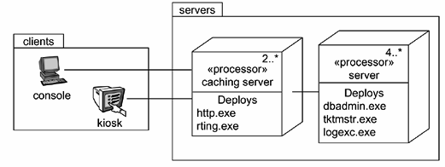
Example Deployment Diagram: Client/Server System

Slide 117
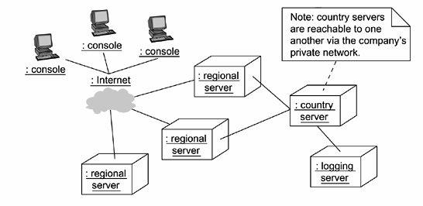
Example Deployment Diagram: Distributed System

Slide 118
Example Deployment Diagram: Distributed System

Slide 119
When to Use Deployment Diagram?
Don't let the brevity of this part make you think that deployment diagrams shouldn't be used . They are very handy in showing what is deployed where, so any nontrivial deployment can make good use of them.

