Slide 1
Hardware
Input and Output Devices

Slide 2
Functional Units
Arithmetic
Input
and
logic
Memory
Output
Control
I/O
Processor
Figure 1.1. Basic functional units of a computer.

Slide 3
Computer Basic Structure

Slide 4
Input Devices
Are used to get data into a system with minimum human intervention

Slide 5
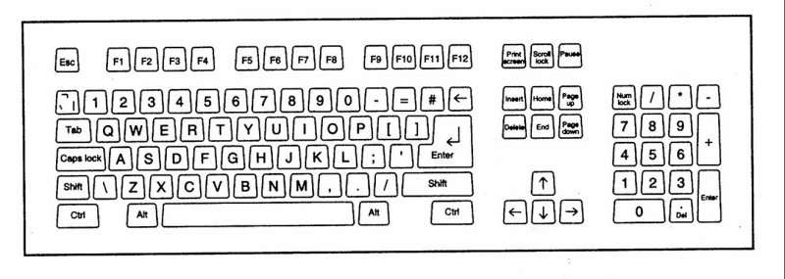
Types of input devices
Keyboards
→Most common are qwerty keyboard
Concept keyboard
keyboard with special design

Slide 6
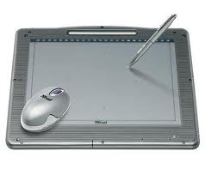
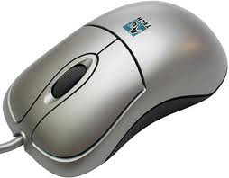
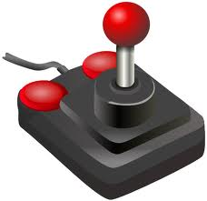
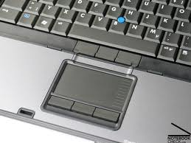
Types of input devices
Point and Click devices include mouse, tracker balls, touch sensitive pads, joysticks, light pens, touch screens, and graphic tablets.

Slide 7
Types of input devices
Readers
The most common types of reader used include magnetic strip readers, barcode readers, optical character readers/recognition, magnetic ink character readers/recognition, and optical mark readers/recognition).

Slide 8
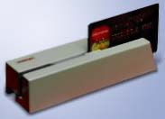
Types of input devices
Magnetic strip readers
The most common magnetic tape readers are those used at electronic points of sale (EPOS).
These ‘read’ the personal data stored on the magnetic strip of a credit or debit card.

Slide 9
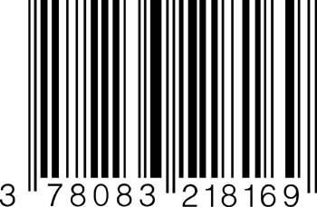
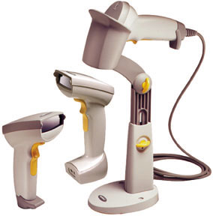
Types of input devices
Barcode Readers
Barcodes are used in shops, libraries, luggage handling, and stock control.
The lines on a barcode represent numbers, and can be scanned very quickly using a laser scanner.

Slide 10
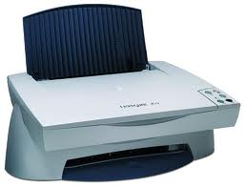
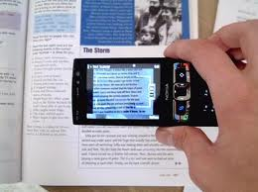
Types of input devices
Optical Characters Reader/Recognition
Optical character recognition is a method of inputting text using a scanner.
It requires special software to convert the scanned image of each letter into an ASCII (American Standard Code for Information Interchange) code, and it often confuses similar shaped letters and numbers (e.g. S and 5, B and 8).

Slide 11
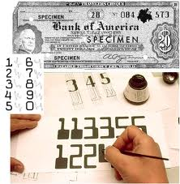
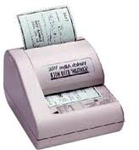
Types of input devices
→ Magnetic ink character Readers/Recognition
Magnetic ink characters are printed at the bottom of cheques.
They are used by banks to identify the bank a customer banks with, the individual branch where their account is held, and the customer’s bank account number.

Slide 12
Types of input devices
Optical Mark Reader/ Recognition
Optical mark recognition sense marks made on specially designed forms (e.g. multiple choice answer sheets, lottery cards).
OMR is a very cheap, easy and quick to handle system of inputting data, but if a user makes a mistake they are difficult to correct.

Slide 13
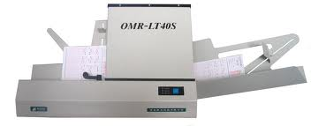
Types of input devices
Optical Mark Reader

Slide 14
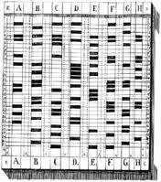
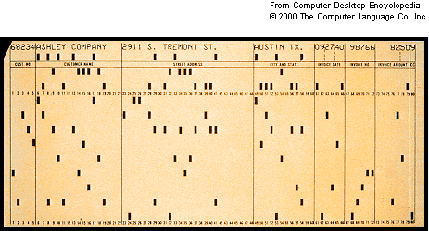
Types of input devices
Punch Card
Punched cards and tape were used by the first computers to store programs and data.
They are seldom used today except for clock cards, which records when a person starts and ends work, and Kimball tags, which are used for stock control.

Slide 15
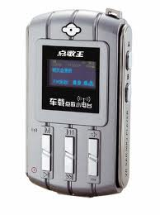
Types of input devices
Sound Capture Devices
The most common use of sound capture devices involves the use of voice recognition software and microphones.
Voice recognition software ‘remembers’ the way a user speaks, and converts their speech into text that appears on screen.

Slide 16
Types of input devices
Terminals
EPOS (Electronic Point Of Sale) and EFTPOS (Electronic Fund Transfer at Point Of Sale) terminals are connected, via secure Internet connections, to the computers of the main banks and credit card companies.
EPOS and EFTPOS allow a retailer to transfer the cost of what they have sold to a customer from the customer’s credit card or bank account to their own bank account.

Slide 17
Exploration
Describe about other input devices such as digital imaging devices, video digitizer, scanner, Digital Cameras, web cams, Tonal devices

Slide 18
Output Devices
Processed data or information
Types of output
Text
Graphics
Audio & video
Output devices
Monitors
Printers
Other Devices

Slide 19
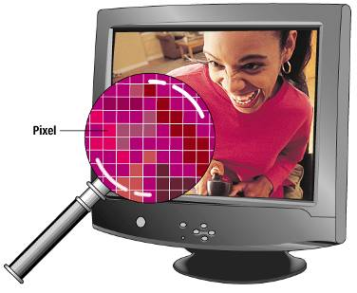
Monitors
Known as screens or display screens
Output referred to as soft copy
Features
Resolution-pixels
Dot pitch
Refresh rate
Size

Slide 20
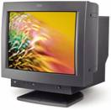
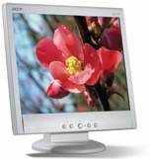
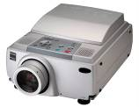
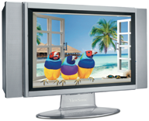
Monitors
Cathode-ray tube or CRTs
Flat-panel
Require less power to operate
Portable and thinner than CRTs
Other monitors
E-books
Data projectors
High-definition television (HDTV)

Slide 21
Printers
Translates information that has been processed by the system unit
Output referred to as hard copy
Features
Resolution
Color capability
Speed
Memory

Slide 22
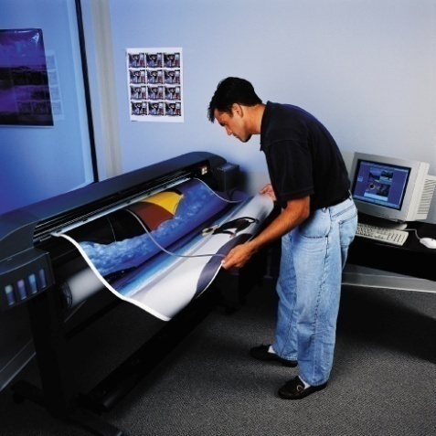
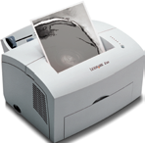
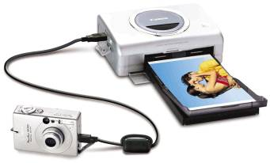
Printers
Ink-jet printer
Laser printer
Personal laser printers
Shared laser printers
Thermal printer
Other printers
Dot-matrix
Plotters
Photo printers
Portable printers

Slide 23
Audio – Output Devices
Translates audio information from the computer into sounds that people can understand
Common devices
Speakers
Headphones

Slide 24
Combination Input and Output Devices
Many devices combine input and output capabilities
Fax machines
Multifunction devices
Internet telephones
known as Telephony
and Voice-over IP (VoIP)
Three approaches
Terminals

Slide 25
Internet Telephone
Computer-to computer
Place free phone calls when using a computer to send and also to receive via the Internet
Software is available for free or very low cost
Computer-to traditional telephone
Place the call from a computer to a phone using an Internet phone service provider that supplies the software for a small monthly fee and/or airtime fee
Traditional telephone-to-traditional telephone
Subscription to an Internet phone service provider that supplies a special hardware adapter to connect a traditional phone to the Internet with a fee connected to service

Slide 26
Terminals
An input and output device
Connects to a mainframe or server
Types of terminals
Dumb terminal
Intelligent terminal
Network terminal
Internet terminal

Slide 27
Questions
Describe the three categories of output devices
What are combinations input and output devices? Describe four such devices

Slide 28
Thank You!

