Slide 1
Hardware Part 2
Processing Device and Storage Devices

Slide 2
Processing Characteristics and Functions (continued)
Clock speed: series of electronic pulses produced at a predetermined rate that affects machine cycle time
Often measured in:
Megahertz (MHz): millions of cycles per second
Gigahertz (GHz): billions of cycles per second
Microcode: predefined, elementary circuits and logical operations that the processor performs when it executes an instruction

Slide 3
Processing Characteristics and Functions
Computer execute an instruction during a machine cycle
Completing the instruction and execution phase – make up one machine cycle
Machine cycle time is measured in:
Nanoseconds (1 billionth of a second)
Picoseconds (1 trillionth of a second)
MIPS (millions of instructions per second)

Slide 4
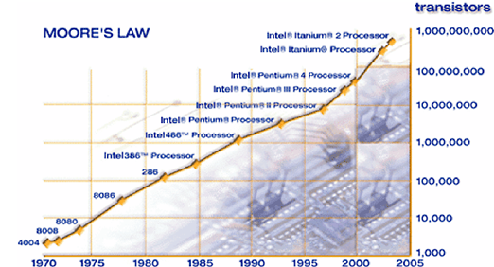
Physical Characteristics of the CPU (continued)
Figure 1: Moore’s Law

Slide 5
Physical Characteristics of the CPU
Collection of digital circuits on chips
Electrical current flows through silicon – to turn the digital circuit on or off
Gordon Moore – former Intel’s chairman hypothesised that progress in chip manufacturing: transistor density of chips will double every 18 months (Moore’s Law)

Slide 6
Memory Characteristics and Functions
Main memory
Located physically close to the CPU, but not on the CPU chip itself
Rapidly provides data and instructions to the CPU

Slide 7
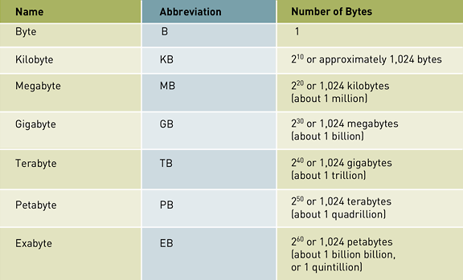
Storage Capacity
Table 1: Computer Storage Units

Slide 8
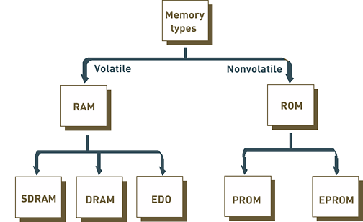
Types of Memory
Figure 2: Basic Types of Memory Chips

Slide 9
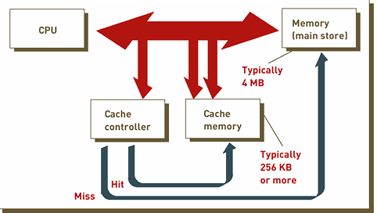
Types of Memory (Cash Memory)
Figure 3: Cache Memory

Slide 10
Multiprocessing
Multiprocessing: simultaneous execution of two or more instructions at the same time
Multiprocessing using coprocessors
Coprocessor: speeds processing by executing specific types of instructions while the CPU works on another processing activity

Slide 11
Parallel Computing
Parallel computing: simultaneous execution of the same task on multiple processors to obtain results faster
Massively parallel processing:
Speeds processing by linking hundreds or thousands of processors to operate at the same time, or in parallel
Each processor has its own bus, memory, disks, copy of the operating system, and applications

Slide 12
Parallel Computing (continued)
2 different approaches to achieving parallel computing
Single instruction/multiple data (SIMD) parallel processors
Multiple instruction/multiple data (MIMD) parallel processors
Grid computing: use of a collection of computers, often owned by multiple individuals or organizations, to work in a coordinated manner to solve a common problem

Slide 13
Secondary Storage
Permanent storage
Compared with memory, offers the advantages of nonvolatility, greater capacity, and greater economy
Selection of secondary storage : access methods, storage capacities, and portability required - determined by the information system’s objectives
Example: credit card company

Slide 14
Access Methods
Two types of access methods
Sequential access: records must be retrieved in order in which it’s stored
Devices used are called sequential access storage devices (SASDs)
Direct access: records can be retrieved in any order
Devices used are called direct access storage devices (DASDs)

Slide 15
Devices
Magnetic tapes
Magnetic disks
Optical disks
Digital video disk (DVD)
Holographic Versatile Disc (HVD)
Memory cards
Flash memory
RAID
Virtual tape

Slide 16
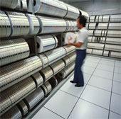
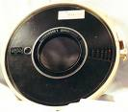
Magnetic Tapes
Sequential secondary storage medium
Primarily for storing backups
Tapes similar to audio and videocassettes
Portion of tapes are magnetized to represent bits

Slide 17
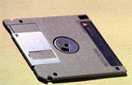
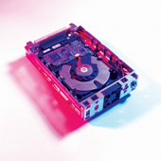
Magnetic Disks
Direct access storage medium
e.g. diskette, hard disks
Allows fast data retrieval

Slide 18
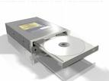
Optical Disc
Data is recorded by special lasers that physically burn pits in the disk.
Data accessed – optical disc device (compact disk player)
e.g. CD-ROM – 740MB, CD-RW

Slide 19
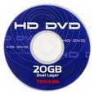
DVD and HVD
DVD (Digital Video Disc)
Looks like a CD but more storage capacity ~ 135min of digital video.
Software, video games, movies
HVD (Holographic Versatile Disc)
Advanced optical disk – ongoing research
Hold 200GB of data
Write data 10 times faster than DVD

Slide 20
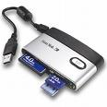
Memory cards
Functions as a hard disk drive
Portable, relatively easy to use
Need to use memory card reader/writer

Slide 21
Flash Memory
A silicon computer chip
Keeps its memory when the power is shut off
“Flash” – the memory cell is erased or reprogrammed in a single action or flash
e.g. – Migo – keychain device, comes with software that captures files and settings from e-mail, word processing, web browser, presentation programs.

Slide 22
RAID and Virtual Tape
Storage technologies
RAID –
Redundant array of independent /inexpensive disks
duplicate existing data on drives, provides exact copy, store on different physical disk drives
Virtual Tape
manages less frequently needed data
Move data to less costly storage media
Software – virtual tape server
Vendor – IBM and Storage Technology

Slide 23
Enterprise Storage Options
Needs to store massive amount of data
3 forms:
Attached storage
tape, hard disks, optical devices
Simple, cost effective - single users and small groups
Not allowed share storage
Network-attached storage (NAS)
Storage devices attach to a network
Users can share and access same information

Slide 24
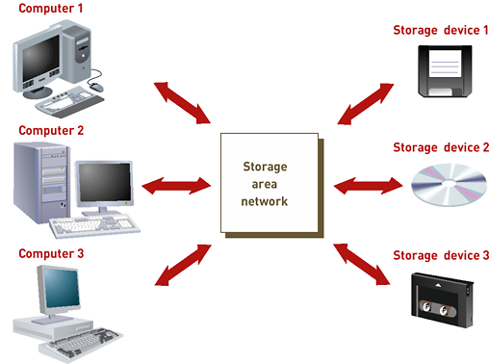
Enterprise Storage Options (continued)
Storage area network (SAN)
Special purpose, high speed network
Provides direct connections between data-storage devices and computer
Integrates different types of storage subsystems
Figure 3.9: Storage Area Network (SAN)

