Slide 1
Introduction to Information Technology

Slide 2
INTRODUCTION TO INFORMATION TECHNOLOGY
What you will learn in today’s class
Introduction to communication and IT
Introduction to Computer
Category
Hardware devices
Input and output devices

Slide 3
INTRODUCTION
Business growth is influenced by the use of Information Technology
Internet
Internet and networking – virtual marketing
Global trade
K-economy

Slide 4
The Importance of IT
essential ingredient in managing business processes of most organizations
reduction in administration costs
improve staff productivity
assist in the design & manufacture of products
improve the efficiency of interactions with clients, customers, suppliers & distribution outlets
create opportunities for new services, products & business ventures
speed, efficiency, effectiveness & competitive advantages

Slide 5
Introduction
What is Information Technology (IT)?
Definition
Process
Application (software)
Hardware
that is used to get, create, arrange, analyze and present the information in various format including text, image, audio and video.

Slide 6
Introduction to IT
Process
The ability to translate the information needs, to analyze and present the information and the ability to analyze the process effectiveness
It Includes techniques and activities that involve design, development, implementation and IT management.

Slide 7
Introduction to IT
Application (software)
software can be categorized into:
Curricular software
it is designed to educate students with concepts and skills. The learning objective is determine by the software
Generic software
Software that is used to achieve various learning objectives. Example: Word processor, databases and multimedia

Slide 8
Introduction to IT
Hardware
includes all types of technology hardware including computers, scanner, modem, printers etc.

Slide 9
Introduction to IT
The importance of computer
Efficiency and effectiveness in information management
Business management
Education purposes
Borderless world
Military
Entertainment
Finance and banking
Town planning
Publication
Graphic and animation

Slide 10
Introduction to IT
Problems
Computer crime
Hard to manage
Gap between humans
Privacy and confidentiality

Slide 11
Introduction to IT
Telecommunication devices
Wireless Phone
Personal Digital Assistant (PDA)
Walkie Talkie
Pager
Fax machine
Video Conferencing
Telegraph
Chatting software: Example IRC, Yahoo Messenger (not device)

Slide 12
Introduction to IT
PAGER
CELULAR PHONE

Slide 13
Introduction to IT
PDA
WALKIE TALKIE

Slide 14
Introduction to IT
FAX MACHINE

Slide 15
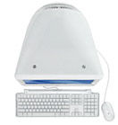
Introduction to IT
Computer

Slide 16
Introduction to IT
Monitor
Central Processing Unit (CPU)
Keyboard

Slide 17
Introduction to IT
What is a computer?
an electronic device that stores, retrieves, and processes data, and can be programmed with instructions. A computer is composed of hardware and software, and can exist in a variety of sizes and configurations.

Slide 18
Introduction to IT
3 Types of Computer
Analog
Process physical data. Example: Temperature, air pressure etc
Digital
Process data in binary ( 1 and 0)
Hybrid
Combination of analog and digital computers

Slide 19
Introduction to IT
Components of Computer
Central Processing Unit (CPU)
Manipulates raw data into a more useful form and controls the other parts of the computer systems
Primary Storage
Temporarily stores data and program instructions during processing. Example RAM
Secondary Storage
Store data and programs when they are not being used in processing. Example: HardDisk,Floppy A Disk, CD, DVD

Slide 20
Introduction to IT
Input Devices
Convert data and instructions into electronic form for input into the computer. Example: Keyboard, Mouse, Scanner
Output devices
Convert electronic data produced by the computer system and display them into a form that people can understand. Example: Printers, Video Display Terminal
Communication devices
Provide connections between the computer and communication networks. Example: Modem, Digital Camera, HeadPhone/Telephony)

Slide 21
Introduction to IT
Categories of Computers
Mainframe
Largest category of computer, used for major business processing.
Midrange
Middle-size computer capable of supporting the computing needs of small organizations or of managing networks of other computers.
Minicomputers
Middle-range computers used in Universities, factories and research laboratories as server to manage organization computer network

Slide 22
Introduction to IT
Microcomputers
Personal computers. Example: IBM, DELL, APPLE
Workstation
Desktop computer with powerful graphics and mathematical capabilities and the ability to perform several complicated at once. Used in scientific, engineering and design work
Supercomputer
Highly sophisticated and powerful computer that can perform very complex computations extremely rapidly. Used in scientific and military work, such as classified weapons research and weather forecasting.

Slide 23
Introduction to IT
Computer Hardware
Monitor – 14”, 15”, 17” & 21”
Keyboards- 108, 110, 114 keys
Mouse
Speaker
Printer
Scanner
CD Drive
CD Writer
Floppy A Drive
Joy Stick
Plotter

Slide 24
Introduction to IT
2 types of Monitor
CRT -Cathode Ray Tube
Function just like television set
Flat Panel
Using TFT (thin film transistor) technology
MONITOR

Slide 25
Introduction to IT
CPU
KEYBOARD

Slide 26
Introduction to IT
HARDDISK

Slide 27
Introduction to IT
Floppy Drive
Disket

Slide 28
Introduction to IT
JOYSTICK

Slide 29
Introduction to IT
SPEAKER
MOUSE

Slide 30
Introduction to IT
PRINTER
Types of Printers
Dot Matrix
Ink Jet
Laser Jet
Bubble Jet

Slide 31
Introduction to IT
INPUT
Pointing Device
Mouse
Touch Screen
Source Data Automation
Optical Character Recognition (OCR): Bar Code
Magnetic Ink Character Recognition (MICR)
Handwriting Recognition
pen-based input; PDA
notebook, laptop mouse pointing
Digital Scanner
Voice Input Device
microphone
Sensor Device

Slide 32
Introduction to IT
Output
Monitor (Cathode Ray Tube/CRT)
Monitor (Liquid Crystal Display/LCD)
Printer
Plotter
Speaker
HeadPhone
EarPhone

Slide 33
Introduction to IT
What we will learn
Software
Operating System
Programming Language
Windows Technology
IT in Management

Slide 34
Introduction to IT
Software
Complete instructions that control, manage and support operational activities of computer system.
3 basic functions :
a) manage computer system’s data sources
b) create platforms & tools to use the data source
c) act as the ‘middle-man’ between human and data source storage

Slide 35
Introduction to IT
Software
2 types of software (main):
System software
system Management programs & system development Programs
Application software
general purpose application programs & application specific programs

Slide 36
User
Application Software
System Software
Computer Hardware
Relationship between User, Application Software, System Software and Computer Hardware

Slide 37
Application Software
Word Processor
Program to manipulate text
Create, edit, delete, save and print. (eg: memo, letters report)
Advantages (in comparison with type writer)
Save time and efficient to create documents
More flexible in term of deleting, and editing the content
Used in
Business
Personal
Education…etc

Slide 38
Application Software
Electronic spreadsheet
Program to manipulate lines and numbers and to do calculation
Used to create charts, graph and table

Slide 39
Application Software
Database
a collection of related data
Shared collection of logically related data (and a description of this data), designed to meet the information needs of an organization
Advantages:
Data consistency
More information from the same amount of data
Sharing of data
Improved data integrity
Improved security
Enforcement of standards
Economy of scale

Slide 40
Application Software
Graphic Presentation
Create images and pictures
Animation
Example: Coral Draw, Photoshop

Slide 41
System Software
3 main system software:
Operating System
Manages and control the computer’s activities
Computer Language Translation Programs
Convert programming languages into machine language
Utility programs
Common processing tasks

Slide 42
Operating System
3 main functions of the operating system
Allocates and assigns system resources
Schedules the use of computer resources and computer job
Monitor computer system activities

Slide 43
Operating System
Example of operating system:
DOS
UNIX
OS/2
Windows 95/98/2000/NT/ME/XP
Macintosh

Slide 44
Operating System
Disk Operating System/DOS
Operating system for older IBM and IBM-compatible PCs.
Disadvantage:
Do not support multitasking
Limits program use of memory to 640 kilobytes

Slide 45
Operating System
OS/2 (Operating System/2)
Operating system for IBM PCS that can take advantage of the 32-bit microprocessor.
Support multitasking and networking.
Has its own graphical user interface and desktop and server version
Very memory intensive applications

Slide 46
Operating System
UNIX
Developed by Bell Laboratories in 1969
Operating System for all types of computers, which is machine independent and support multi-user processing, multitasking and networking. Used in high-end workstations and servers.

Slide 47
Operating System
Macintosh
Os for Macintosh computer that support multitasking
Has access to the internet and has powerful graphics and multimedia capabilities

Slide 48
Programming languages
Generation of programming languages
Machine language ( First Generation)
Using binary code ( 1 and 0 )
Programming in machine language is very slow, labor-intensive process
Example : 1010 1101

Slide 49
Programming languages
Assembly Language (2nd generation)
Developed in 1950s that resembles machine language but substitutes mnemonics for numeric codes ( example: load, sum)
Difficult to read, debug and learn and costly in term of programmers time

Slide 50
Programming languages
3rd generation
Specify instructions as brief statements that are more like natural language than assembly language.
Easier to write and understand in comparison of assembly language.
Example: FORTRAN, COBOL,BASIC, Pascal Lisp and C

Slide 51
Programming languages
4th generation
A programming language that can be employed directly by end user or less skilled programmers to develop computer applications more rapidly than conventional programming languages (nonprocedural or less)
Seven categories of 4th generation languages
Query languages
Report generators
Graphics languages
Application generators
Very high level programming languages
Application software packages
PC tools

Slide 52
Programming languages
5th generation- Artificial Intelligence Language
The latest for AI
Object-Oriented Programming language
Visual Basic, C++, Java, HTML, XML

Slide 53
Language Translation
Programs written in high-level language such as COBOL, C must be translated into machine language that the computer can execute
The program in high-level language before translation is called source code.
A compiler translates source code into machine code called object code
But some programming language do not use complier, but use an interpreter
Interpreter used to translate each source code statement one at a time into machine code during execution and executes it. It is a bit slow to execute since it translated one statement at a time.

Slide 54
Windows Technology
Microsoft Corporation- windows software since 1980
Windows – Operating System to control and manage computer activities
Based on graphical user interface – easier to use

Slide 55
Windows Technology
Dos
MS-DOS (Microsoft Disk Operating System)
Limited for only a user ( 1980 -1994)
Microsoft Windows 3.1
introduced graphical User Interface for example Program manager
Based on windows- allowing few program in their own windows.
Disadvantages:
Require high memory and storage
Operates only on computers with micro processor 286, 2MB RAM and at least 10MB hardisk

Slide 56
Windows Technology
Microsoft Windows 95
Popular in mid 90s
Used in personal PCs
Most of the software is based on windows format
Using storage area of 80 MB, 8MB RAM and micro processor at least 486 DX

Slide 57
Windows Technology
Microsoft Windows 95
Using 32-bit operating system
perform twice better than windows 3.1(16-bit)
Support multitasking
Support plug and play
Better GUI

Slide 58
Windows Technology
Windows 98
32-bit operating system that is closely integrated with the Internet and that supports multitasking, multithreading and networking
Faster and more integrated compare to windows 95 with support for additional hardware such as MMX, DVD.
The most visible features is integration of the OS with Web browser software

Slide 59
Windows Technology
Microsoft Windows 2000
32-bit operating system for PCs, workstations and network servers.
Support multitasking, multiprocessing, intensive networking and Internet services for corporate computing.

Slide 60
Windows Technology
Microsoft Windows ME (Millennium Edition)
Enhanced Windows Operating System for consumer users featuring tools for working with video, photos, music and home networking.
Improved capabilities for safeguarding critical files.

Slide 61
Windows Technology
Microsoft Windows NT (New Technology)
Posses the same ability in UNIX such as multi-user, multitasking and high security.
Suitable for high technology application, graphic and animation.
Appropriate as server in a network.

Slide 62
Windows Technology
Microsoft Windows XP (Experience)
Reliable, robust operating system with versions for both home and corporate users.
Features support of internet and multimedia and improved networking, security and corporate management capabilities

Slide 63
Microsoft Windows Vista
Vista, formerly code named Longhorn, is the most recent of Microsoft's Windows desktop operating systems. Vista was released for businesses, the holders of most volume licenses, on November 30, 2006. Bill Gates hosted the worldwide launch of Windows Vista and Microsoft Office 2007 in Times Square on January 29, 2007. Vista ships in nine different versions that fall under the main categories of home edition and business edition. The most noticeable change from Windows XP to Vista is a significantly redesigned user interface called Aero, which stands for "authentic, energetic, reflective and open." Other additions include a faster and customizable search engine and an XML-based specification for creating documents similar to Portable Document Format (PDF) files.
Microsoft has also identified several underlying technology improvements that distinguish Vista, including:
Enhancements to the basic structure of the operating system and the .NET framework.
A new audio system.
A simplified application deployment engine and application installer.
Increased support for digital rights management (DRM)
A messaging system that allows programs to interoperate similarly to Web services
Built-in IPv6 and peer-to-peer networking capabilities.
The multivendor security initiative previously known as Palladium

Slide 64
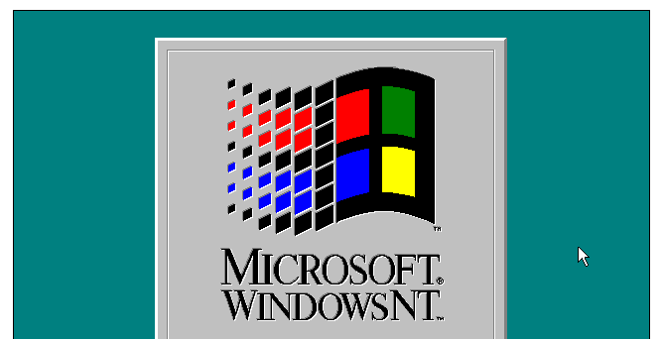
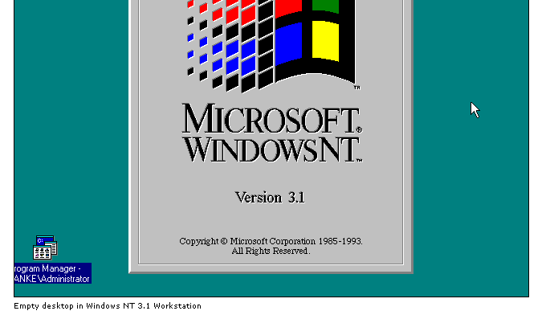
Windows Technology

Slide 65
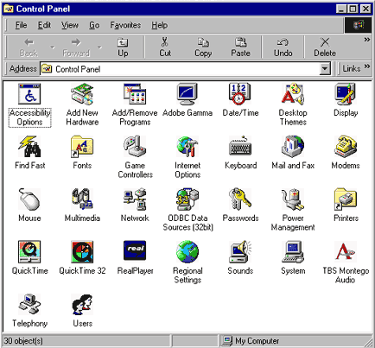
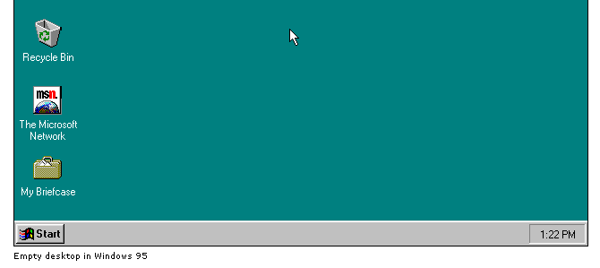
Windows 95
Windows 95

Slide 66
Windows Technology
Windows 98

Slide 67
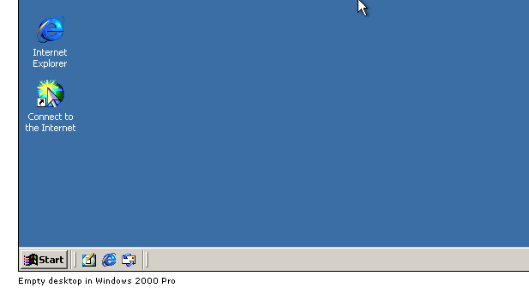
Windows 2000

Slide 68
Windows XP

Slide 69
LindowsOS
LindowsOS SPX - the first "Broadband OS" An operating system-- built to take full advantage of broadband technology. LindowsOS SPX is designed to fully utilize the world of tomorrow, where Internet connectivity is bountiful and cheap, and computers are ubiquitous. Open Source Software
Open source software is computer software for which the human-readable source code is made available under a copyright license (or arrangement such as the public domain) that meets the Open Source Definition. This permits users to use, change, and improve the software, and to redistribute it in modified or unmodified form. It is often developed in a public, collaborative manner. Open-source software is the most prominent example of open source development and often compared to user generated content.[1] source wikipidea.org

Slide 70
LindowsOS

Slide 71
System 1.1

Slide 72
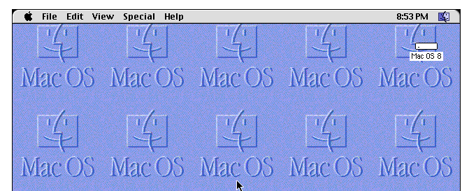
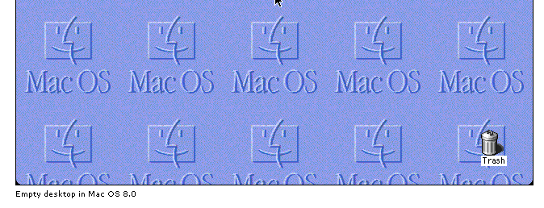
Mac OS 8.0

Slide 73
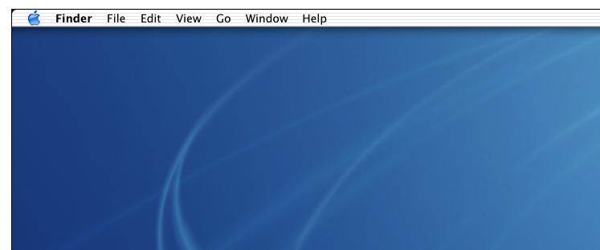
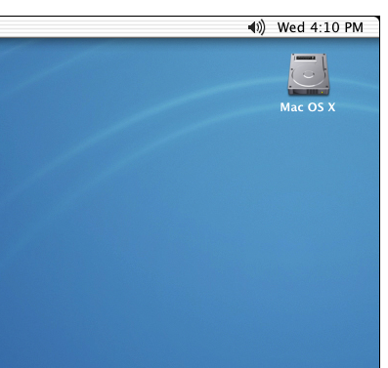
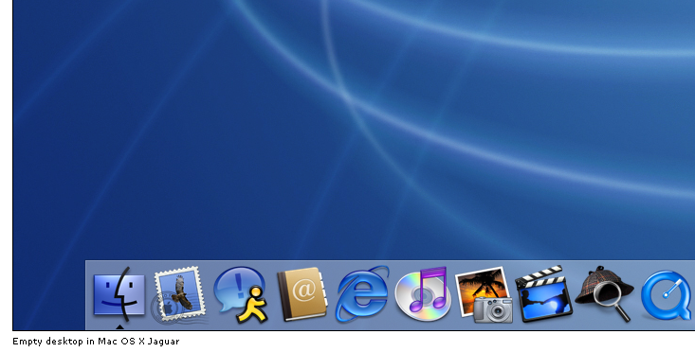
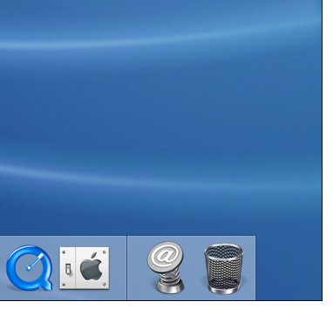
Mac OS X Jaguar

Slide 74
Internet Application
An electronic network of computers that includes nearly every university, government, and research facility in the world. Also included are many commercial sites. It started with four interconnected computers in 1969 and was known as ARPAnet.
Among the services
Email
File transfer
Telnet
IRC

Slide 75
IT in Management
Latest in cost efficiency- including labor cost, transportation, communication
Increment in business performance – virtual marketing and globalization, Sharing of information
Global marketing- E-commerce, E-business
Increment in customer satisfaction
Increment in share market
Low margin cost
Increment in quality- products and services

