Slide 1
The Internet and World Wide Web
Part I

Slide 2
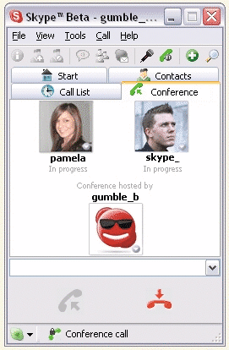
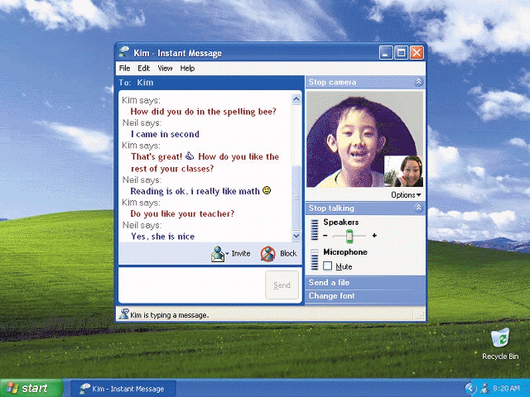
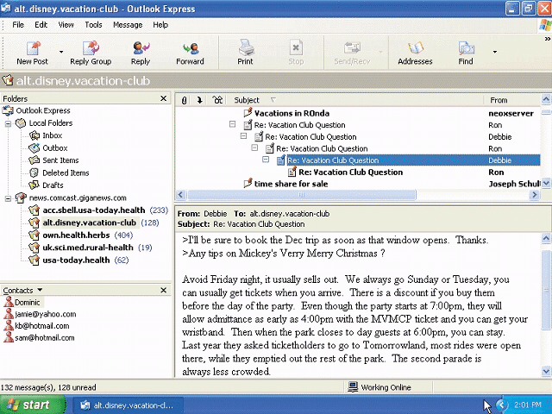
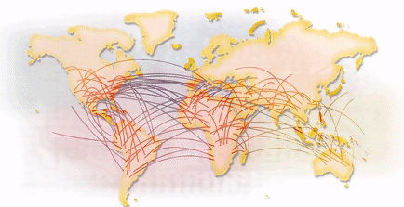
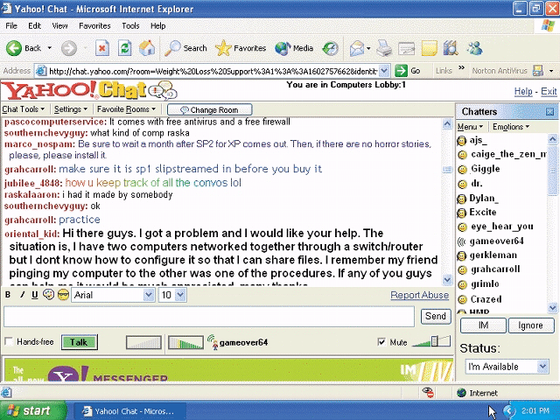
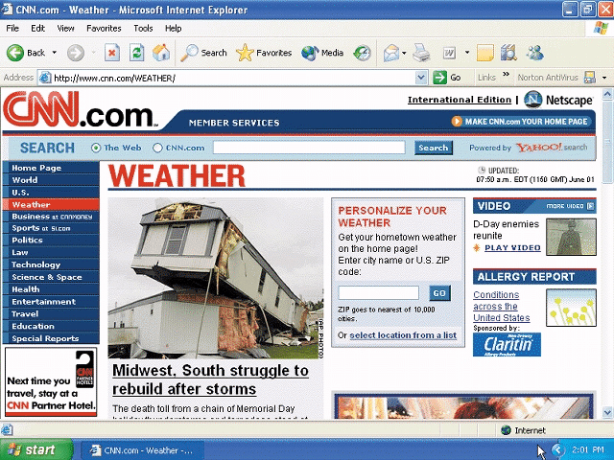
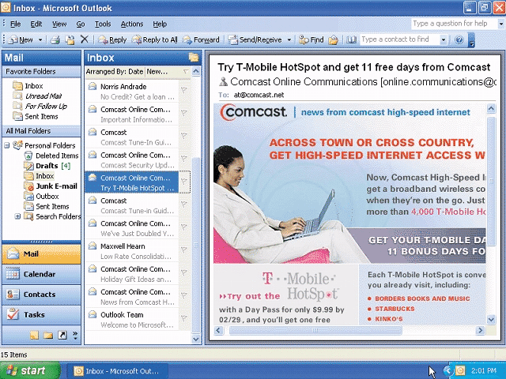
The Internet
What are some services found on the Internet?
Next

Slide 3
History of the Internet
How did the Internet originate?
ARPANET
Networking project by Pentagon’s Advanced Research Projects Agency (ARPA)
Goal: To allow scientists at different locations to share information
Goal: To function if part of network were disabled
Became functional September 1969
Next

Slide 4
History of the Internet
How has the Internet grown?
Today
More than 200 million host nodes
1984
More than 1,000 host nodes
1969
Four host nodes
Next
Notes:
a node (Latin nodus, ‘knot’) is a connection point, either a redistribution point or a communication endpoint (some terminal equipment).

Slide 5
History of the Internet
Who controls the Internet?
No onec—cit is a public, cooperative, and independent network
Several organizations set standards
World Wide Web Consortium (W3C)
Oversees research, sets standards and guidelines
Tim Berners-Lee, director
Internet2 (I2)
Internet-related research and development project
Develops and tests advanced Internet technologies
Next
Notes:
Named organizations that set standarts for Internet and the international and regional standart

Slide 6
How the Internet Works
How can you connect to the Internet?
Slow-speed technology
High-speed connection
Dial-up access modem in your computer uses a standard telephone line to connect to the Internet
Digital subscriber line (DSL), cable telephone Internet services (CATV), cable modem, fixed wireless, and satellite modems
Connection must be established each time you log on. Slow but inexpensive
Connection is always on— whenever the computer is running
Next
Notes:
Digital subscriber line (DSL, originally digital subscriber loop) is a family of technologies that provide internet access by transmitting digital data over the wires of a local telephone network.
A cable modem is a type of network bridge and modem that provides bi-directional data communication via radio frequency channels on a HFC and RFoG infrastructure.

Slide 7
Video: Choosing a Broadband Provider
Choose the broadband connection that will best meet your Internet connection needs
low quality (click to start)
high quality (click to start)
Next

Slide 8
How the Internet Works
What are ways to access the Internet?
ISP, Regional or National
OSP (AOL and MSN, for example)
Wireless Internet Service Provider
Next

Slide 9
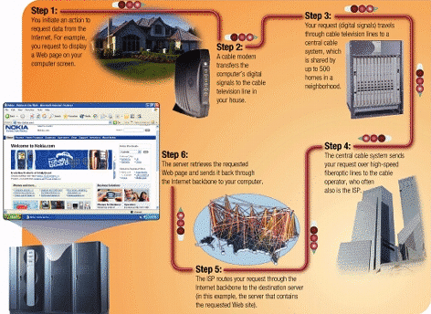
How the Internet Works
How might data travel the Internet using a cable modem connection?
Next

Slide 10
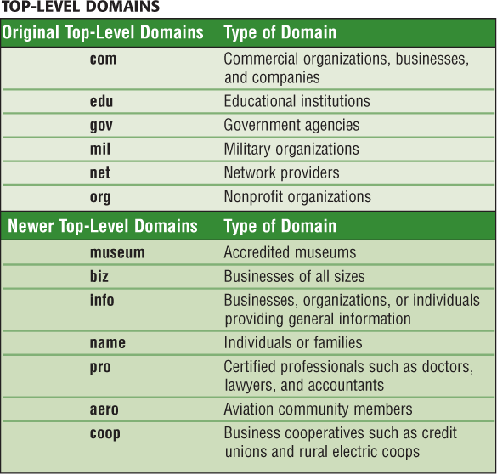
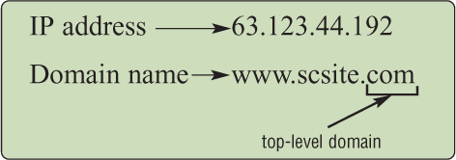
How the Internet Works
What is a domain name?
Text version of Internet protocol (IP) address
Number that uniquely identifies each computer or device connected to Internet
Next

Slide 11
The World Wide Web
What is the World Wide Web (WWW)?
A worldwide collection of electronic documents
Also called the Web
Each electronic document is called a Web page
Can contain text, graphics, sound, video, and built-in connections
A Web site is a collection of related Web pages
Next

Slide 12
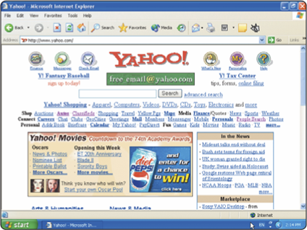
The World Wide Web
What is a Web browser?
Program that allows you to view Web pages
Microsoft Internet Explorer
Netscape
Opera
Safari
Mozilla
Next

Slide 13
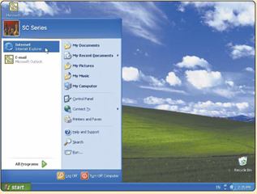
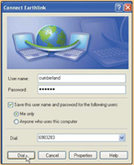
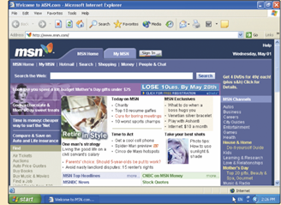
The World Wide Web
How does a Web browser display a home page?
Step 2. If necessary, connect to the Internet
Step 1. Click the Web browser program name
Step 3. Connection to the Internet occurs, and a home page displays
Next

Slide 14
The World Wide Web
What is a home page?
The first page that a Web site presents
Often provides connections to other Web pages
Next

Slide 15
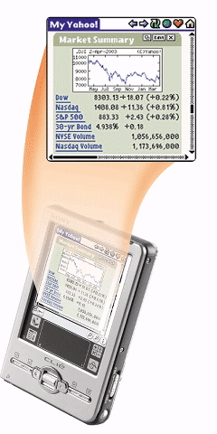
The World Wide Web
How do handheld computers and cellular telephones access the Web?
Use a microbrowser that displays Web pages that contain mostly text
Must be Web-enabled
Next

Slide 16
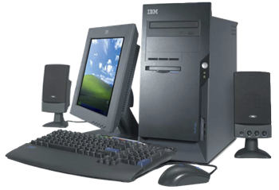
The World Wide Web
What is downloading?
The process of a computer receiving information
Depending upon connection speed, downloading can take from a few seconds to several minutes
Next

Slide 17
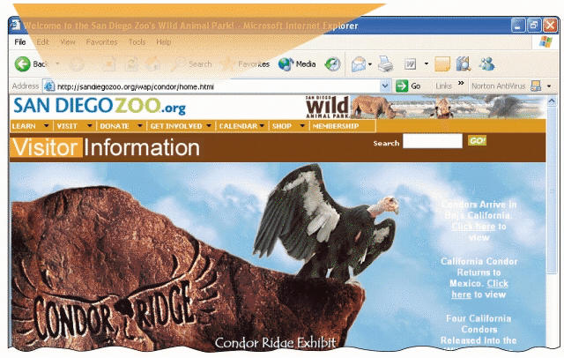
The World Wide Web
What is a URL?
Unique address for a Web page
A web server delivers the Web page to your computer
Click to view Web Link, click Chapter 2, Click Web Link from left navigation,
then click Web Addresses below Chapter 2
Next

Slide 18
The World Wide Web
What is a link?
Built-in connection to another related Web page location
Item found elsewhere on same Web page
Different Web page at same Web site
Web page at a different Web site
Next

Slide 19
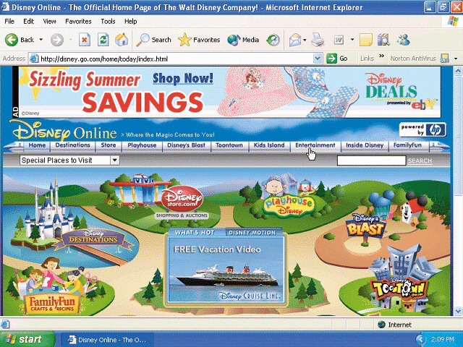
The World Wide Web
How can you recognize links?
Pointer changes to a small hand when you point to a link
A link can be text or an image
Text links are usually underlined and in a different color
Next

Slide 20
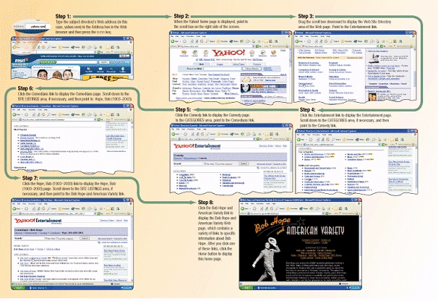
The World Wide Web
What is a subject directory?
Search tool with organized set of topics and subtopics
Lets you find information by clicking links rather than entering keywords
Next

Slide 21
The World Wide Web
What is a search engine?
Program used to find Web sites and Web pages by entering words or phrases called search text
Also called a keyword
Next

Slide 22
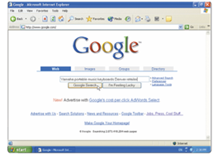
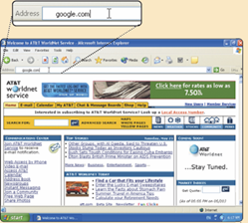
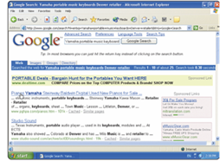
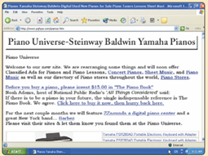
The World Wide Web
What is a hit?
Any Web site name that is listed as the result of a search
Step 2. Select type of search you want to run
Step 1. Go to search engine
Step 3. View hits
Step 4. Click link to view Web site
Next

Slide 23
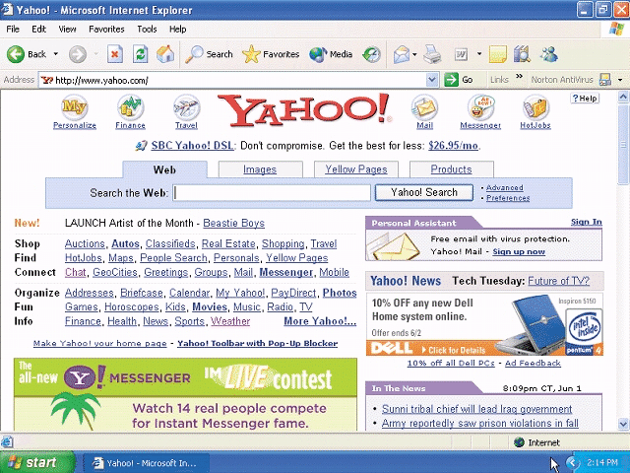
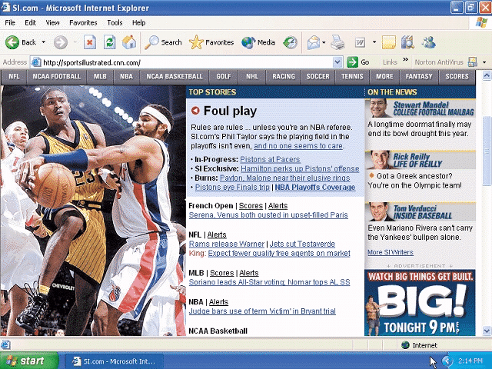
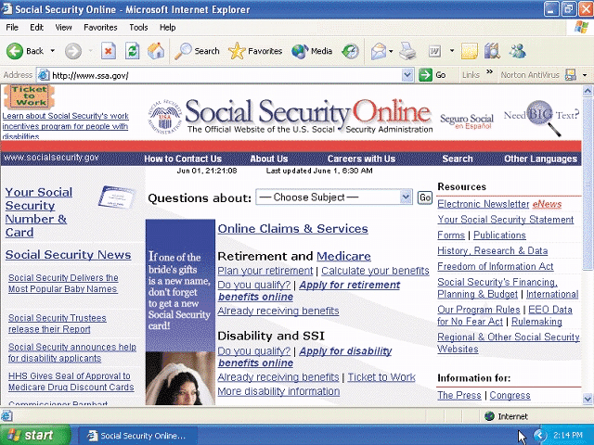
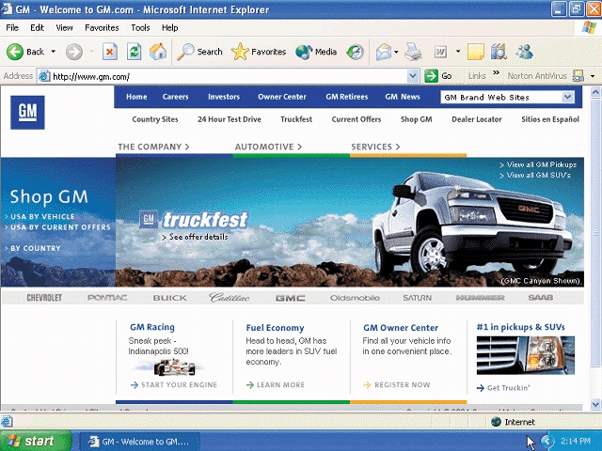
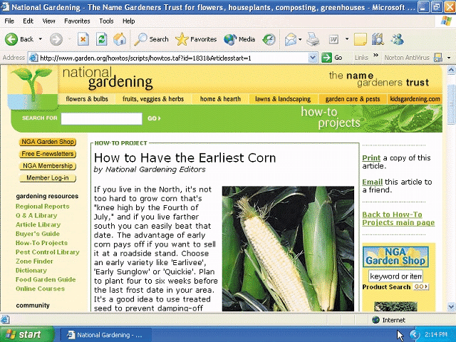
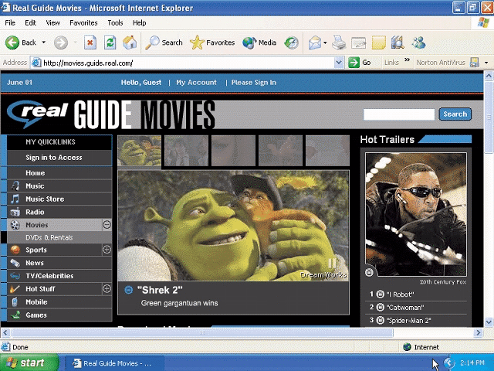
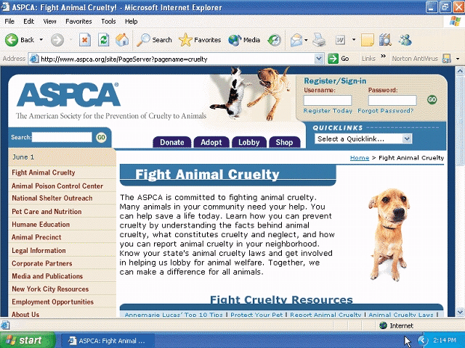
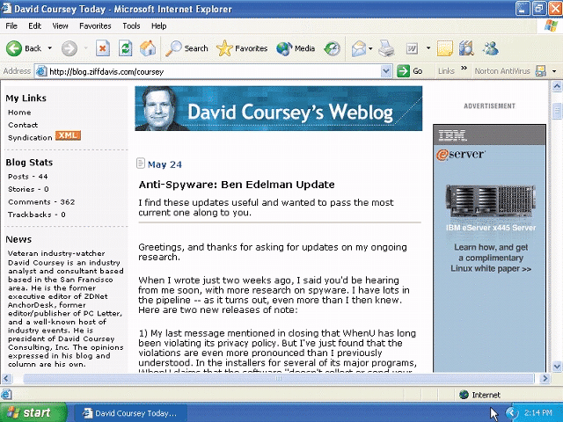
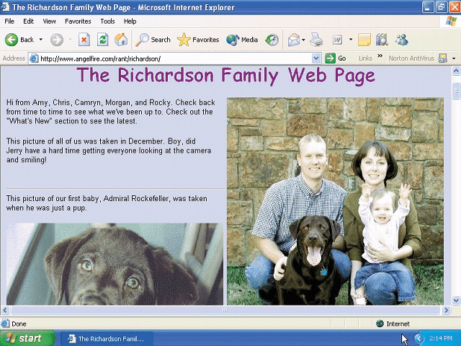
The World Wide Web
What are the nine basic types of Web sites?
Portal
News
Informational
Business/Marketing
Educational
Entertainment
Advocacy
Blog
Personal
Next

Slide 24
The World Wide Web
What is a portal?
A Web site that offers a variety of services from one, convenient location, usually for free
Searching, sports, e-mail, news, weather, auctions, Web communities (Web sites that join people with similar interests)
Next

Slide 25
The World Wide Web
What is a news Web site?
Contains newsworthy material
Stories and articles relating to current events, life, money, sports, and the weather
p. 82 Fig. 2-14b
Next

Slide 26
The World Wide Web
What is an informational Web site?
Contains factual information
Created by organizations and government agencies
Next

Slide 27
The World Wide Web
What is a business/marketing Web site?
Contains content that promotes products or services
Allows you to purchase products or services online
Next

Slide 28
The World Wide Web
What is an educational Web site?
Offers avenues for formal and informal teaching and learning
Some companies offer online training for employees
Some colleges offer online classes and degrees
Next

Slide 29
The World Wide Web
What is an entertainment Web site?
Offers an interactive and engaging environment featuring music, video, sports, games, and more
Next

Slide 30
The World Wide Web
What is an advocacy Web site?
Contains content that describes a cause, opinion, or idea
Next

Slide 31
The World Wide Web
What is a blog?
Uses a regularly updated journal format to reflect the interests, opinions, and personalities of the author and sometimes site visitors
Next

Slide 32
The World Wide Web
What is a personal Web site?
Web page maintained by private individual
Reasons: sharing life experience with the world or job hunting
Next

Slide 33
Assignment
Make your own Blog with content related to your hobby or anything you want to share about your life at any Blogsite and show your blog at our class next week.

Slide 34
Thank You

