Slide 1
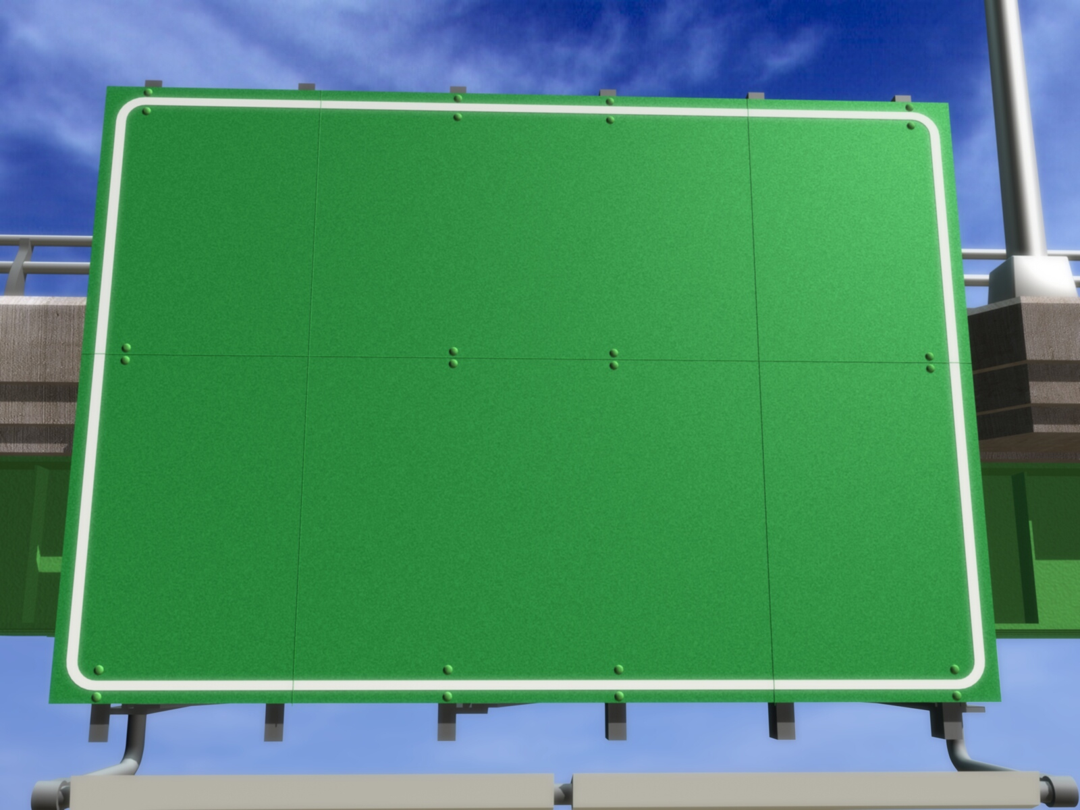
Double Linked List
Adam M.B.

Slide 2
❶❷❸❹
DEFINITION

Slide 3
Double Linked List
Linked list that its node consists of two connection fields (prev and next).
Left Connection Field (Prev)
Right Connection Field (Next)
Info Field
(Info)

Slide 4
Declaration
Kamus:
Type
nama_pointer = ↑Simpul
Simpul = Record
< medan_data : tipedata,
prev, next : nama_pointer >
EndRecord
nama_var_pointer : nama_pointer

Slide 5
Example of Declaration
Kamus:
Type
point = ↑Simpul
Simpul = Record
< info : char,
prev, next : point >
EndRecord
awal,akhir : point

Slide 6
Operation
Creation
Insertion
Delete
Traversal
Searching
Sorting
Destroy
Same with single linked list

Slide 7
❶❷❸❹
CREATION

Slide 8
Process
Pointer awal and akhir is given nil value.
awal
akhir

Slide 9
❶❷❸❹
INSERTION

Slide 10
Front Insertion
If list is empty (awal = nil).
awal
akhir
alloc(baru)
baru↑.info ← 1
baru
1
baru↑.next ← nil
baru↑.prev ← nil
awal ← baru
akhir ← baru

Slide 11
Front Insertion (cont’d)
If list isn’t empty (awal ≠ nil). For example, there is list that has two nodes:
awal
akhir
2
3
alloc(baru)
baru
1
baru↑.info ← 1
baru↑.prev ← nil

Slide 12
Front Insertion (cont’d)
awal
akhir
2
3
baru↑.next ← awal
baru
awal↑.prev ← baru
1
awal← baru

Slide 13
Front Insertion (cont’d)
The last result for front insertion if linked list wasn’t empty:
baru
awal
akhir
1
2
3

Slide 14
Back Insertion
If list is empty (awal = nil) → the process is same as front insertion if double linked list is empty.

Slide 15
Back Insertion (cont’d)
If list isn’t empty (awal ≠ nil). For example, there is list that has two nodes:
awal
akhir
2
3
alloc(baru)
baru
1
baru↑.info ← 1
baru↑.next ← nil

Slide 16
Back Insertion (cont’d)
New node will be inserted after the node that was refered by akhir.
awal
akhir
2
3
baru↑.prev ← akhir
akhir↑.next ← baru
1
akhir← baru
baru

Slide 17
Back Insertion (cont’d)
The last result for back insertion if linked list wasn’t empty:
awal
awal
akhir
akhir
2
2
3
3
1
1
baru

Slide 18
Middle Insertion
If list is empty (awal = nil) → the process is same as front insertion if linked list is empty.

Slide 19
Middle Insertion (cont’d)
If list isn’t empty (awal ≠ nil).
    Node 4 will be inserted before 9:

Slide 20
Middle Insertion (cont’d)
baru↑.prev ← bantu↑.prev
baru↑.next ← bantu
baru
4
alloc(baru)
baru↑.info ← 4

Slide 21
Middle Insertion (cont’d)
bantu↑.prev↑.next ← baru
bantu↑.prev ← baru
baru
4

Slide 22
Middle Insertion (cont’d)
The last result for middle insertion if linked list wasn’t empty:
baru
4

Slide 23
❶❷❸❹
DELETION

Slide 24
Front Deletion
Delete one node in beggining of linked list if linked list has only one node (awal = akhir).
menjadi
phapus ← awal
awal ← nil
elemen ← phapus↑.info
akhir ← nil
dealloc(phapus)

Slide 25
Front Deletion (cont’d)
If deletion happens in linked list with one node then linked list will be empty.
elemen
phapus
phapus ← awal
elemen ← phapus↑.info

Slide 26
Front Deletion (cont’d)
Awal
awal ← awal↑.next
atau awal ← phapus↑.next

Slide 27
Front Deletion (cont’d)
dealloc(phapus)
awal↑.prev ← nil

Slide 28
Front Deletion (cont’d)
The last result for front deletion if linked list has more than one node:
Awal
phapus
2

Slide 29
Back Deletion
Delete one node in back of linked list if linked list has only one node (awal = akhir). This process is same as front deletion if linked list has only one node.

Slide 30
Back Deletion (cont’d)
If linked list has more than one node (awal ≠ akhir). For example, linked list has four nodes.
phapus
phapus ← akhir
elemen ← phapus↑.info
elemen

Slide 31
Back Deletion (cont’d)
Awal
Akhir
akhir ← akhir↑.prev
atau akhir ← phapus↑.prev

Slide 32
Back Deletion (cont’d)
akhir↑.next ← nil
dealloc(phapus)

Slide 33
Back Deletion (cont’d)
The last result for back deletion if linked list has more than one node:
phapus
Awal
Akhir
9

Slide 34
Middle Deletion
Middle deletion in double linked list is similar as middle deletion in single linked list.

Slide 35
GRACIAS
THANK YOU
Contact Person:
Adam Mukharil Bachtiar
Informatics Engineering UNIKOM
Jalan Dipati Ukur Nomor. 112-114 Bandung 40132
Email: adfbipotter@gmail.com
Blog: http://adfbipotter.wordpress.com
Copyright © Adam Mukharil Bachtiar 2012

