Slide 1
The Internet and World Wide Web
Part II

Slide 2
The World Wide Web
What are the guidelines for evaluating the value of a Web site?
Affiliation
Audience
Authority
Content
Currency
Design
Objectivity
Next
Notes:
Questions : how to evaluate the value of web site base on the criteria ?

Slide 3
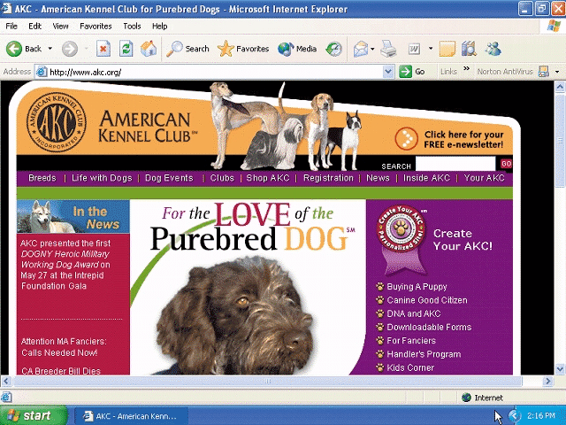
The World Wide Web
What is multimedia?
Application integrating text with other media elements
Graphics
Animation
Audio
Video
Virtual reality
Next
Notes:
Virtual reality : Computer systems able to combine a mixture of real world experiences and computer generated material to allow for simulated real world representation

Slide 4
The World Wide Web
What are used on the Web?
BMP
JPEG (pronounced JAY-peg)
PNG (pronounced ping)
GIF (pronounced JIFF)
TIFF
Next
Notes:
Explain about BMP, JPEG, PNG, GIF, TIFF

Slide 5
The World Wide Web
What is a thumbnail?
Small version of a larger graphicc—used to improve Web page display time
Usually click on thumbnail to display larger graphic
Next

Slide 6
The World Wide Web
What is animation?
Appearance of motion created by displaying a series of still images in sequence
Next

Slide 7
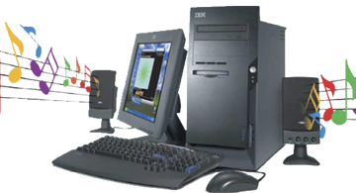
The World Wide Web
What is audio?
Music, speech, or any other sound
Individual compressed sound files that you download from the Web to your computer
Common Web audio file formats are AA, AAC, AIFF, ASF, MP3, WAV, WMA, RA, and QT
Once downloaded, you can play (listen to) the contents of the files
Next

Slide 8
The World Wide Web
What is streaming audio?
The process of transferring audio in a continuous and even flow
Enables you to listen to music as it downloads to your computer
Click to view Web Link, click Chapter 2, Click Web Link from left navigation,
then click Streaming Media below Chapter 2
Next

Slide 9
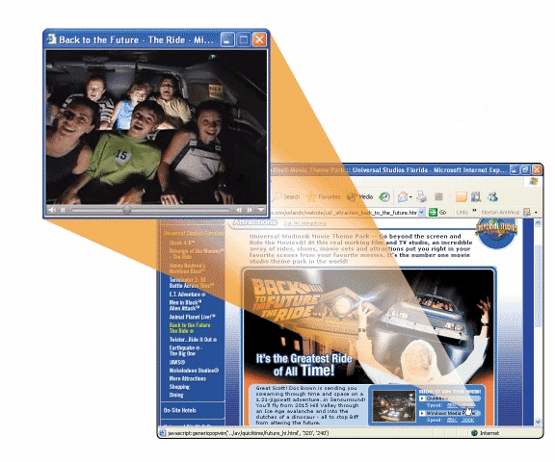
The World Wide Web
What is video?
Consists of full-motion images that are played back at various speeds
MPEG (Moving Pictures Experts Group) is popular video compression standard
Next

Slide 10
The World Wide Web
What is virtual reality (VR)?
Use of computers to simulate real or imagined environment
Appears as a three dimensional (3-D) space
Used for games and many practical applications
Next

Slide 11
The World Wide Web
What are plug-ins?
Programs that extend the capability of a browser
You can download many plug-ins at no cost from various Web sites
Click to view Web Link, click Chapter 2, Click Web Link from left navigation,
then click Plug-Ins below Chapter 2
Next

Slide 12
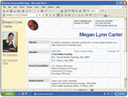
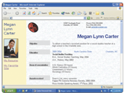
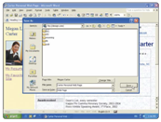
Web Publishing
What is Web publishing?
Development and maintenance of Web pages
Step 2. Analyze and design the Web site
Step 1. Plan the Web site
Step 3. Create the Web site
Step 5. Maintain the Web site
Step 4. Deploy the Web site
Next

Slide 13
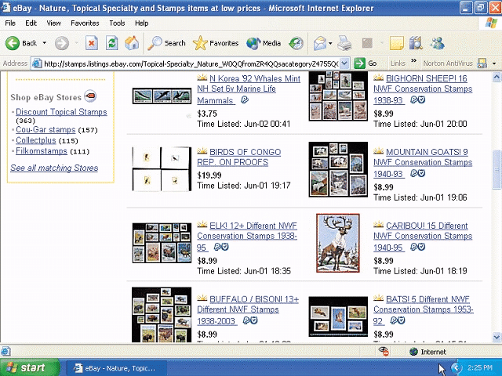
E-Commerce
What is E-commerce?
Short for electronic commerce
Business transaction that occurs over the Internet
Business to consumer (B2C) Sale of goods to general public
Consumer to consumer (C2C) One consumer sells directly to another
Business to business (B2B) Business providing goods and services to other businesses
Click to view Web Link, click Chapter 2, Click Web Link from left navigation,
then click E-Commerce below Chapter 2
Next

Slide 14
Other Internet Services
What is E-mail?
Short for electronic mail
The transmission of messages and files via a computer network
Messages can consist of simple text or can contain attachments, such as documents, graphics, or audio/video clips
Internet access providers usually provide an e-mail program
Some Web sites—such as MSN Hotmail and Yahoo!—provide free e-mail services
One of the original services on the Internet
Click to view Web Link, click Chapter 2, Click Web Link from left navigation,
then click E-Mail below Chapter 2
Next

Slide 15
Video: E-mail Basics
Learn how to use e-mail quickly and efficiently
low quality (click to start)
high quality (click to start)
Next

Slide 16
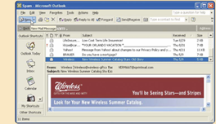
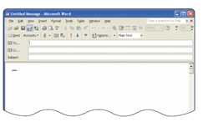
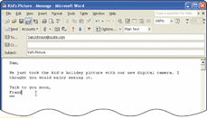
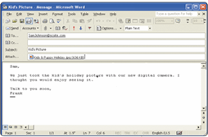
Other Internet Services
How do you send an e-mail message?
Step 2. Click the New Mail Message button
Step 1. Start an e-mail program (Microsoft Outlook, for example)
Step 3. Enter the recipient’s e-mail address, the subject, and the message
Step 5. The recipient opens the message
Step 4. Click the Insert file button if you want to attach a picture, for example, and click Send
Next

Slide 17
Other Internet Services
What is an e-mail address?
Unique name that consists of a user name and domain name that identifies the user
Next

Slide 18
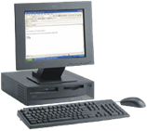
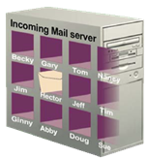
Other Internet Services
How does an e-mail message travel?
Step 1. Using e-mail software, you create and send message
Step 2. Your software contacts software on your ISP’s outgoing mail server
Step 4. When recipient uses e-mail software to check for e-mail messages, the message transfers from incoming mail server to recipient’s computer
Step 3. Software on outgoing mail server determines best route for data and sends message, which travels along Internet routers to recipient’s incoming mail server
Next

Slide 19
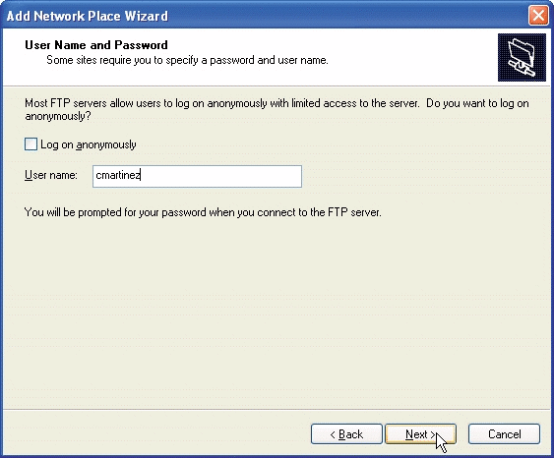
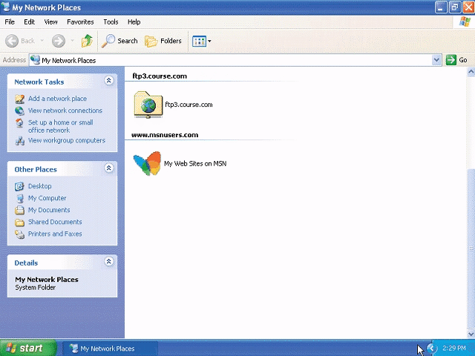
Other Internet Services
What is FTP?
File Transfer Protocol—Internet standard that allows you to upload and download files with other computers on the Internet
Click to view Web Link, click Chapter 2, Click Web Link from left navigation,
then click FTP below Chapter 2
Next

Slide 20
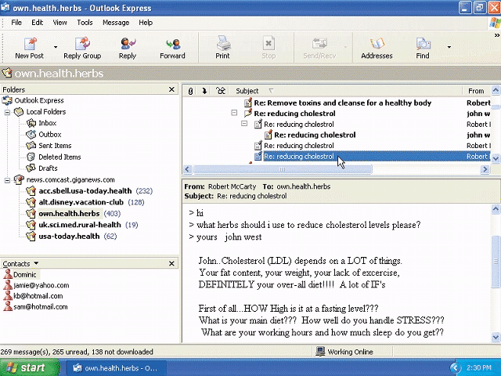
Other Internet Services
What are newsgroups and message boards?
Newsgroup
Online area where users discuss a particular subject
Message board
Type of discussion group
Many Web sites use message boards because they are easier to use
Click to view Web Link, click Chapter 2, Click Web Link from left navigation,
then click Newsgroups and Message Boards below Chapter 2
Next

Slide 21
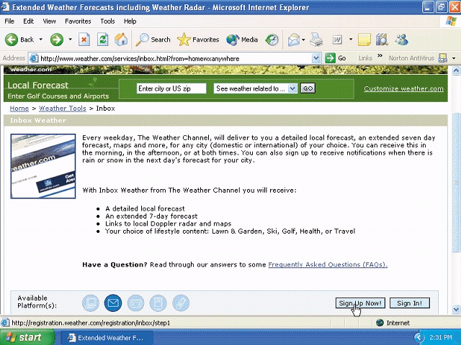
Other Internet Services
What is a mailing list?
Group of e-mail addresses given a single name
When a message is sent to the mailing list, everyone on the list receives the message
To add your name to a mailing list you must subscribe to it; to remove your name you must unsubscribe
Click to view Web Link, click Chapter 2, Click Web Link from left navigation,
then click Mailing Lists below Chapter 2
Next

Slide 22
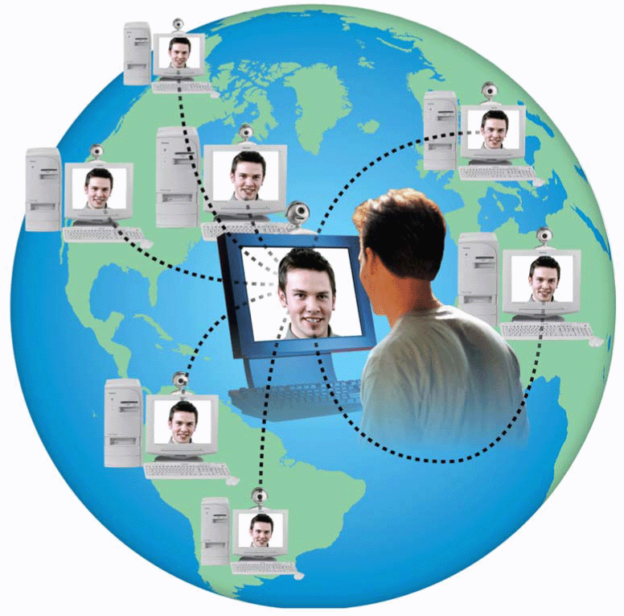
Other Internet Services
What is a chat?
Real-time typed conversation that takes place on a computer
Chat room is location on server that permits users to discuss topics of interest
Click to view Web Link, click Chapter 2, Click Web Link from left navigation,
then click Chat Rooms below Chapter 2
Next

Slide 23
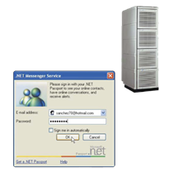
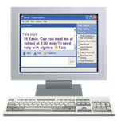
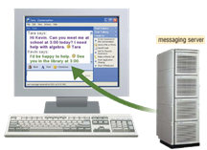
Other Internet Services
What is instant messaging (IM)?
A real-time Internet communications service that notifies you when one or more people are online and allows you to exchange messages or files
Step 2. The server determines if any of your established friends, family, or coworkers, called buddies, are online
Step 1. Login to the IM server
IM Server
Step 3. You send instant messages to an online buddy
messaging Server
Click to view Web Link, click Chapter 2, Click Web Link from left navigation,
then click Instant Messaging below Chapter 2
Step 4. Your Instant Message travels through a messaging server and then to the online buddy
Next

Slide 24
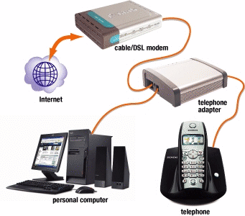
Other Internet Services
Enables users to speak to other users over the Internet using their computer
What is internet telephony?
Next

Slide 25
Netiquette
What is netiquette?
Code of acceptable behaviors users should follow while on the Internet
Golden Rule: Treat others as you would like them to treat you.
Next

Slide 26
THANK YOU

Slide 27
Questions
How to evaluate the value of web site base on the criteria ?
Explain about bmp, Jpeg, PNG, GIF, TIFF
Explain uses of virtual reality software/aplications and give example
Write example of e – commerce site that can be categorized to B2C, B2B, C2C
Explain how FTP works and in which layer FTP operates in OSI models?
Explain how internet telephony works and give example of internet telephony software

Slide 28
Mid Test Assignment
Create a website using any software you know about your daily life, your experience, your hobbies anything you want to write in your website. Your website min consist of 5 pages and make links between pages.
You will present your website at may 3rd, 2012 and your works must burn in a cd. Don’ forget to put label at the cd and write your identity (name, clas and nim)

