Slide 1
SCREEN – BASED CONTROL

Slide 2
Agenda
Mengidentifikasi karakteristik dan kemampuan dari berbagai layar kontrol
Memilih kontrol yang tepat bagi pengguna dan tugasnya

Slide 3
Screen Control
Sometimes called ‘widgets’
Widgets: the elements of a screen that constitute its body.
Definition: objek grafis yang mewakili sifat atau operasi dari objek lain
Functions:
Mengizinkan masuk atau pemilihan nilai tertentu
Mengizinkan perubahan atau penyuntingan suatu nilai tertentu
Menampilkan hanya bagian tertentu dari teks, nilai, atau grafis
Suatu perintah yang harus dilakukan
Memiliki jendela pop-up kontekstual

Slide 4
Three Extremely Important Principles
A control must:
Look the way it works
Work the way it looks
“Look” → “enter-ability” or “click-ability”
Used exactly as its design intended
Presented in a standard manner
Example:
Windows XP:
Raised elements can be pressed
Recessed elements can not be pressed
Elements on a flat white background can be opened, edited, or moved.

Slide 5
Operable Controls
… are those that permit:
Entry
Selection
Changing
Editing
Cause a command to be performed
Here are the classes… (next slide)

Slide 6
1 – Operable Buttons
Description
Suatu pengendalian persegi atau berbentuk persegi panjang dengan label di dalam yang menunjukkan tindakan yang harus diselesaikan
Label dapat terdiri dari teks, grafis, atau keduanya
Purpose
To start actions
To change properties
To display a pop-up menu
There are two kinds:
Command buttons
Toolbar buttons

Slide 7
1 – Operable Buttons
Keuntungan
Selalu terlihat, mengingat salah satu pilihan yang tersedia
Mudah
Dapat diselenggarakan secara logis dalam pekerjaan daerah
Dapat memberikan gambaran yang berarti dari tindakan yang akan dilakukan
ukuran lebih besar biasanya memberikan target seleksi lebih cepat
Dapat memiliki penampilan 3-D
Menambah gaya estetis menyenangkan untuk layar
Menyediakan umpan balik visual melalui gerakan tombol bila diaktifkan
Dapat mengizinkan penggunaan keyboard dan akselerator setara
Lebih cepat daripada menggunakan menu bar dua langkah / urutan pull-down
Kekurangan
Menghabiskan ruang layar
Ukuran membatasi jumlah yang dapat ditampilkan
Membutuhkan berpaling dari wilayah kerja utama untuk mengaktifkan
Membutuhkan memindahkan pointer untuk memilih

Slide 8
1 – Operable Buttons
To a window:
To cause something to happen immediately
To display another window
To display a menu of options
To set a mode or property value
In a web
Use links to show information
Things to consider:
Usage
Structure
Labels
Size
Number
Location & layout
Organization
Intent indicators
Expansion buttons
Default
Keyboard equivalent / accelerators
Button activation

Slide 9
2 – Text Entry / Read only controls
Usually referred as “field” or “text-box”
Unprotected: a text box into which information can be keyed
Protected: A text box used for display purposes only
Description
Usually rectangular in shape
Usually possesses a caption or label describing the kind of information contained within it
Two types exist
Single-line
Multiple-line
When first displayed, the box may be blank or contain an initial value
Purpose
To permit the display, entering, or editing of textual information
To display read-only information

Slide 10
2 – Text Entry / Read only controls
Advantages
Very flexible
Familiar
Consumes little screen space
Disadvantages
Requires use of typewriter keyboard.
Requires user to remember what must be keyed
Proper usage
Most useful for data that is
Unlimited in scope
Difficult to categorize
Of a variety of different lengths
When using a selection list is not possible

Slide 11
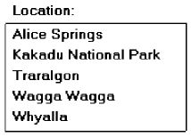
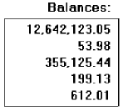
2 – Text Entry / Read only controls
Single occurrence
Multiple occurrence
Or
Read-only / display
Segmentation
If alphanumeric then
left justify
If numeric then right
justify
Or

Slide 12
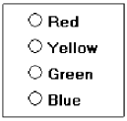
3 – Selection Controls
Presents on the screen all the possible alternatives, conditions, or choices that may exist for an entity, property, or value
Types
Radio button
Check box
Palette
List box
List view control
Drop-down / Pop-up list box
Or

Slide 13
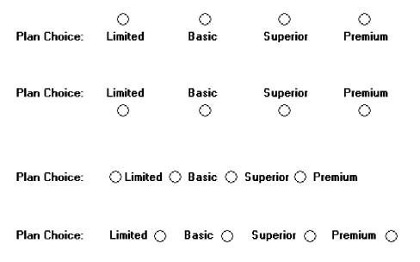
3 – Selection Controls: Radio button
“Only one selection permitted”
Poor
Poor
Poor
Poor
Better

Slide 14
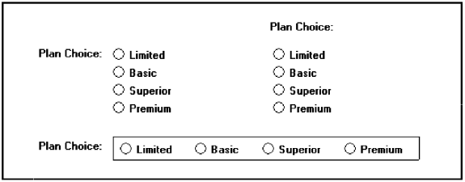
3 – Selection Controls: Radio button
Still better
Best !

Slide 15
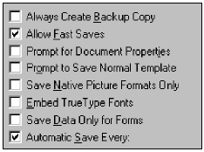
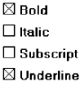
3 – Selection Controls: Check box
“Use for multiple selection”
Best !

Slide 16
3 – Selection Controls: Palette

Slide 17
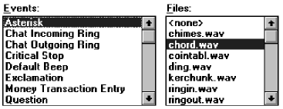
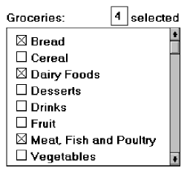
3 – Selection Controls: List box
List box with multiple selection

Slide 18
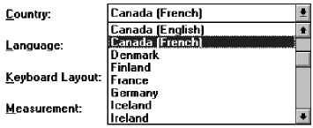
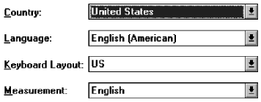
3 – Selection Controls: Drop Down/Pull-down
Then
Droped
Or
Pulled
down
Clicked

Slide 19
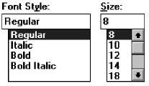
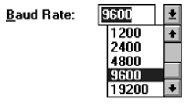
Combination Entry/Selection Controls
Combo boxes
Spin boxes
Combo box - Closed
Combo box - Opened

Slide 20
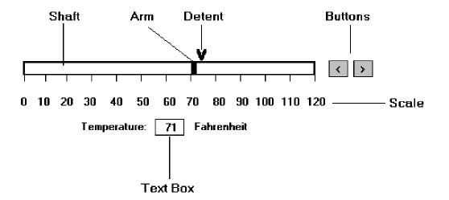
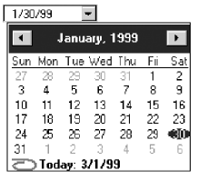
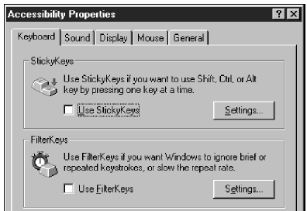
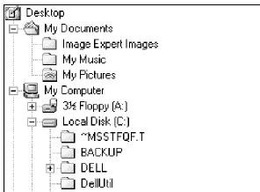
Other Operable Controls
Slider
Date picker
Tabs
Tree view

Slide 21
Custom Controls
Implement custom controls with caution
The addition of custom controls adds to this learning and increases system complexity
Images?? Buttons??
Are they clickable?
What is this??
What will happen if
I’m clicking it?
What task?
Where to pick?
I’m sure this are buttons,
Because they looks clickable

Slide 22
Presentation Controls
Teks statis bidang: informasi read-only tekstual
kotak Group: bingkai persegi panjang yang mengelilingi kontrol atau kelompok kontrol; keterangan opsional dapat disertakan.
Kolom judul: informasi tekstual read-only yang berfungsi sebagai judul di atas kolom teks atau angka
Alat ujung / balon tip: jendela pop-up kecil yang berisi informasi; bisa ditempatkan di balon

Slide 23
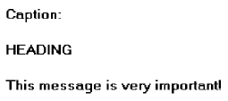
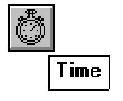
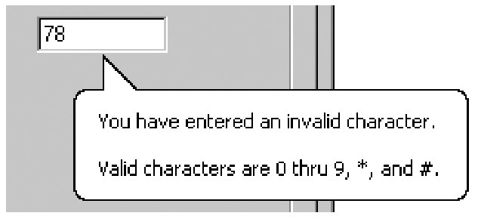
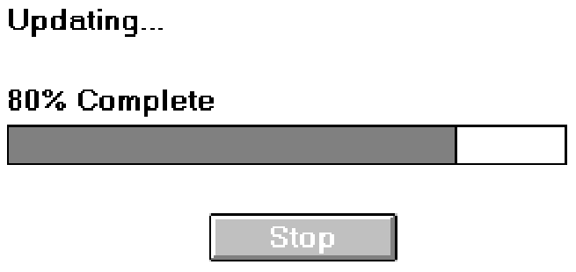
Optional caption
Static text
Tool tip / balloon tip
Progress indicators

Slide 24
Selecting the Proper Controls
Choose familiar controls
Consider the task
Reduce the number of “clicks”
Display as many control choices as possible
When to permit text entry?
Permit text entry if any of the following questions can be answered “Yes”
Is the data unlimited in size and scope?
Is the data familiar?
Is the data not conducive to typing errors?
Will typing be faster than choice selection?
Is the user an experienced typist?

Slide 25
Selecting the Proper Controls
Buttons or Menus for commands?
Consider the following:
Whether or not the command is part of a standard tool set.
The total number of commands in the application.
The complexity of the commands.
The frequency with which commands are used.
Whether or not the command is used in association with another control.

