Slide 1
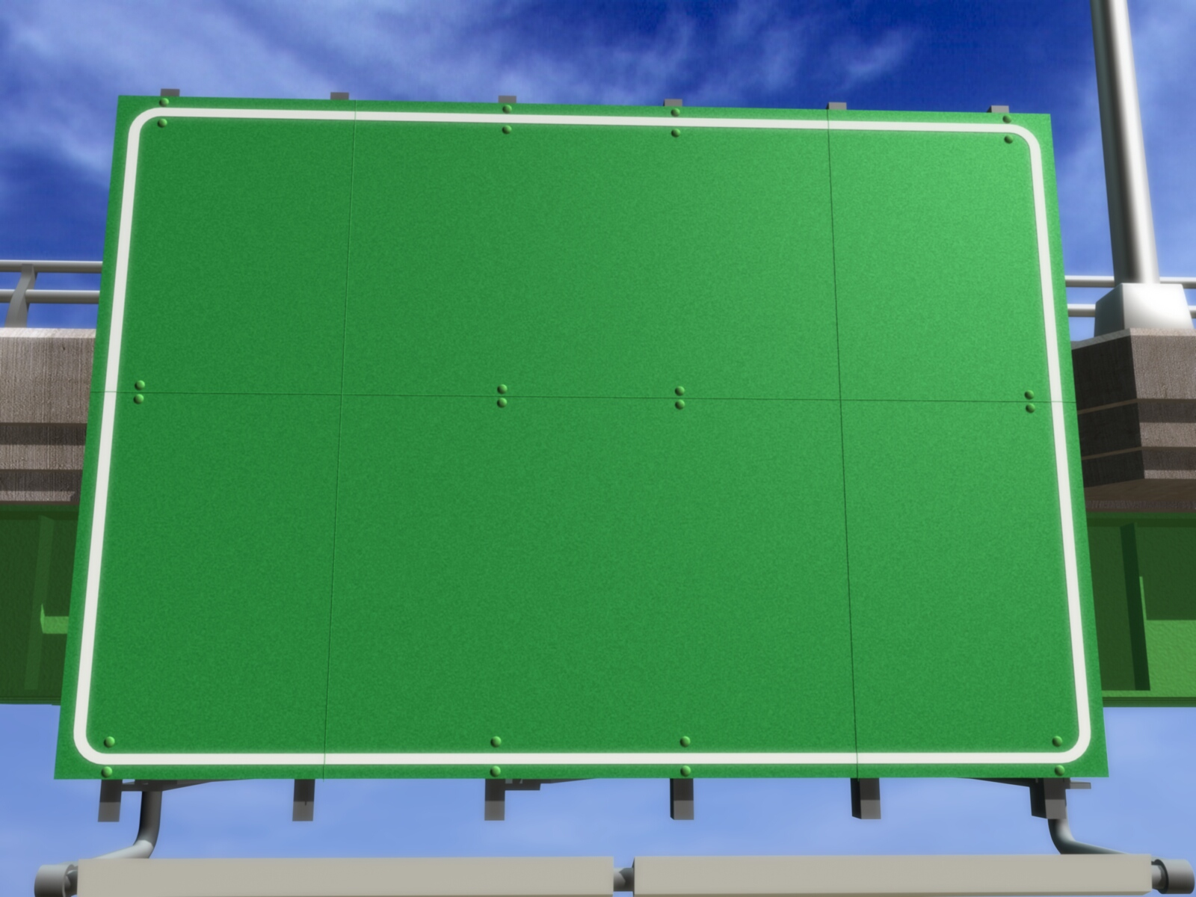
STACK
Adam M.B.

Slide 2
❶❷❸
DEFINITION

Slide 3
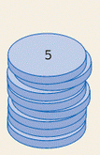

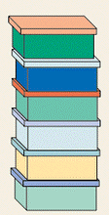
Stack
Stack is data structure whose its elemen can be added and taken only from last position (top).

Slide 4
Components of Stack
Top is a variable which refers to last position in stack.
Element is component which has data.
MaxStack is variable that describes maximum number of elements in a stack.

Slide 5
❶❷❸
DECLARATION

Slide 6
Declaration as Array
Kamus:
Const
MaxStack = value {value is integer number}
Type
NamaStack = array [1..MaxStack] of tipedata
Stack : NamaStack
Top : integer {pointer of stack}

Slide 7
Declaration as List
Kamus:
Type
NamaPointer = ↑Stack
Stack = Record
< MedanData : TipeData,
MedanSambungan : NamaPointer >
EndRecord
Top : NamaPointer {pointer of stack}

Slide 8
❶❷❸
OPERATION

Slide 9
Operation
Initialization
Empty Operation
Full Operation (array)/One Node Operation (Linked List)
Push
Pop

Slide 10
Main Operation
STACK
PUSH
POP
Add data to element in stack.
Take data from element in stack

Slide 11
Kinds of Operation
Stack Operation in array form
Stack Operation in Linked list form

Slide 12
❶❷
STACK OPERATION IN ARRAY FORM

Slide 13
Initialization
Operation that give a initial value for top pointer in stack with the following rules:
Give 0 if the first element starts from 1
Give -1 if the first element starts from 0

Slide 14
Empty Operation
Operation that returns true if the top pointer have 0 or -1 as its value (depend on initialization) or returns false to the contrary.

Slide 15
Full Operation
Operation that returns true if top have reached maximum array or maximum array -1 (depend on initialization) or returns false if top is not equal to maximum array.

Slide 16
Push
Steps in push operation:
Stack can be added when it’s not full
Add the top pointer with 1
Stack element, which was refered by top pointer, is filled with new data.

Slide 17
Push
Push(Top,Stack,8)
Push(Top,Stack,3)
1
4
Push(Top,Stack,5)
Push(Top,Stack,1)
5
3
Push(Top,Stack,7)
3
2
“Stack Penuh”
8
1
Top
Stack
0

Slide 18
Pop
Steps in pop operation:
Stack can be pop when its elements is not empty.
Element that have taken out from stack is saved in a variable.
Substract the top pointer with 1.

Slide 19
Pop
Pop(Top,Stack,Elemen)
1
4
Pop(Top,Stack,Elemen)
Pop(Top,Stack,Elemen)
5
3
Pop(Top,Stack,Elemen)
3
Pop(Top,Stack,Elemen)
2
“Stack Kosong”
8
1
Top
Stack
1
5
3
8
0
Elemen

Slide 20
❶❷
STACK OPERATION IN LINKED LIST FORM

Slide 21
Initialization
Prepare stack by giving null value to the top pointer in stack.

Slide 22
Empty Operation
Operation that returns true if the top pointer isn’t null or returns false to the contrary.

Slide 23
One Node Operation
Operation that returns true if right connection field has null value (stack only has one node) or returns false to the contrary.

Slide 24
Push
Steps of push operation in linked list form is similar with front insertion.

Slide 25
Push
Push(Top,8)
Top
baru
8
Push(Top,3)
Top
baru
3
8

Slide 26
Push
Push(Top,5)
Top
baru
5
3
8

Slide 27
Pop
Steps of pop operation in linked list form is similar with front deletion.

Slide 28
Pop
Pop(Top,Elemen)
Phapus
Top
5
3
8
Elemen

Slide 29
Pop
Pop(Top,Elemen)
Phapus
Top
3
8
Elemen

Slide 30
Pop
Pop(Top,Elemen)
Phapus
Top
8
Elemen

Slide 31
Exercise
Do the task 6.27 until 6.29 in page 210 at Data Structures book, seymour.

Slide 32
GRACIAS
THANK YOU
Contact Person:
Adam Mukharil Bachtiar
Informatics Engineering UNIKOM
Jalan Dipati Ukur Nomor. 112-114 Bandung 40132
Email: adfbipotter@gmail.com
Blog: http://adfbipotter.wordpress.com
Copyright © Adam Mukharil Bachtiar 2012

