Slide 1
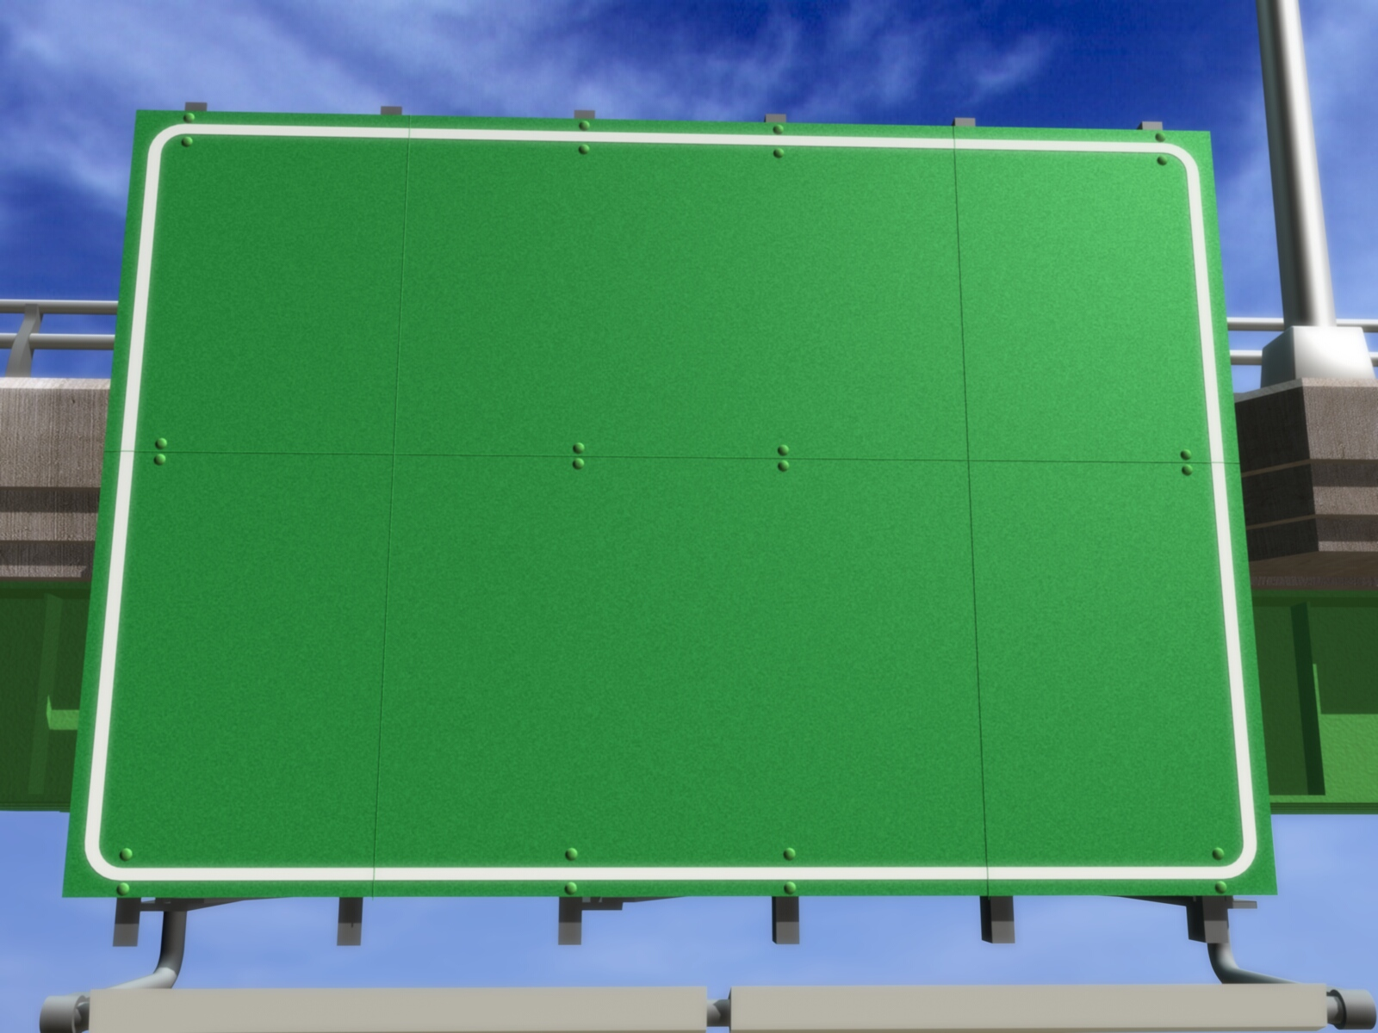
Tree
Adam M.B.

Slide 2
❶❷❸
TREE TRAVERSAL

Slide 3
Types of Tree Traversal
Preorder : Node – Left - Right
Inorder : Left – Node - Right
Postorder : Left – Right - Node

Slide 4
Ilustration (1)
H
A
C
B
Preorder (NLR) :
K
J
L
H
Inorder (LNR) :
A
B
C
J
H
K
L
B
C
A
J
L
A
K
Postorder (LRN) :
K
H
C
J
L
B

Slide 5
Ilustration (2)
A
B
D
C
A
B
D
E
I
C
F
Preorder (NLR) :
G
H
D
I
E
B
F
G
H
C
E
F
Inorder (LNR) :
A
Postorder (LRN) :
I
A
E
D
H
G
F
C
B
I
G
H

Slide 6
Case
E = A + BD^{H} – F
G - K
E =
(
A
+
B
*
D
^
H
-
F
)
/
(
G
-
K
)
Subtree Kiri
Root
Subtree Kanan
/
-
-
+
F
G
K
A
*
/
-
+
A
*
B
^
Prefix :
D
H
F
K
-
G
A
+
B
*
D
^
H
-
/
K
Infix :
F
G
-
B
^
Postfix:
A
B
F
-
D
H
^
*
+
G
K
/
-
D
H

Slide 7
Exercise
Make binary tree from this general tree and do the tree traversal process:
A
B
C
D
I
E
F
G
H
P
R
Q

Slide 8
❶❷❸
TREE TRAVERSAL INTO BINARY TREE

Slide 9
Example 1
Preorder :
Inorder :
B
D
E
I
C
F
H
G
J
D
I
E
B
H
F
G
C
J
B
D
C
E
F
J
I
H
G

Slide 10
Example 2
Inorder :
Postorder :
D
I
E
B
H
F
G
C
J
I
E
D
H
G
F
J
C
B
B
D
C
E
F
J
I
H
G

Slide 11
Exercise
Make binary tree from these result of tree traversal:
Inorder : BCDFGKMPSUWY
Preorder : MFDBCKGSPWUY
Postorder : EGHCIMFBNPJLKDA
Inorder : EBGCHFMIANJPDLK

Slide 12
m
❶❷❸
TREE TRAVERSAL USING STACK

Slide 13
Node have 2
Using Preorder
Rules :
If scanned node has 2 children then PUSH its right son (RS).
If scanned node hasn’t child then POP element of stack.

Slide 14
Node have 2
Using Preorder
Notes :
Arrow down (↓) means PUSH.
Arrow up (↑) means POP.
LS : Left Son
RS : Right Son

Slide 15
Node have 2
Using Preorder
B
Preorder (NLR) :
BDEICFGHA
Head
B
LS
D
RS
E
LS
I
C
D
C
RS B
RS B
RS C
E
F
A
LS
F
RS
G
RS
H
A
I
G
RS C
H

Slide 16
Node have 2
Using Inorder
Rules and Note :
If scanned node has left child then PUSH itself (Scanned Node Address).
If scanned node hasn’t child then POP element of stack.
Add = Address.

Slide 17
Node have 2
Using Inorder
B
Inorder (LNR) :
DIEBFGHCA
Head
B
LS
D
RS
E
LS
I
E
D
C
Add. B
Add. E
Add. E
Add. B
E
F
A
B
RS
C
LS
F
RS
G
RS
H
I
G
Add. C
Add. C
H
C
RS
A

Slide 18
Node have 2
Using Postorder
Rules :
If scanned node has 2 children then PUSH itself (Scanned Node Address) and its right child.
If scanned node has only 1 child then PUSH itself (Scanned Node Address).
If scanned node hasn’t child then POP element of stack.

Slide 19
Node have 2
Using Postorder
Postorder (LRN) :
IEDHGFACB
B
Head
B
LS
D
RS
E
LS
I
E
D
C
Add B
Add D
Add E
Add. E
Add. D
RS B
E
F
A
LS
RS
RS
D
C
F
G
H
I
G
RS B
Add C
Add F
Add G
Add G
RS C
H
G
F
A
C
B
Add F
RS C
Add C
Add B

Slide 20
Exercise 1
Traverse this tree using stack (3 ways):
A
B
C
D
E
H
I
F

Slide 21
Exercise 2
Make binary tree from this statement then traverse binary tree using stack (3 ways):
E = A + (B-D)^{H} – F
GK

Slide 22
Exercise 3
Make binary in linked list form from these result of tree traversal and traverse the result using stack in postorder way:
Preorder : RFCAEDLHPVTZXWY
Inorder : ACDEFHLPRTVWXYZ

Slide 23
Exercise 4
Make binary tree from this general tree and traverse the result using preorder, inorder, and postorder:
S
B
D
I
E
F
J
K
X
C
M
N
Y
P
L
A
P
G
H

Slide 24
GRACIAS
THANK YOU
Contact Person:
Adam Mukharil Bachtiar
Informatics Engineering UNIKOM
Jalan Dipati Ukur Nomor. 112-114 Bandung 40132
Email: adfbipotter@gmail.com
Blog: http://adfbipotter.wordpress.com
Copyright © Adam Mukharil Bachtiar 2012

