Slide 1
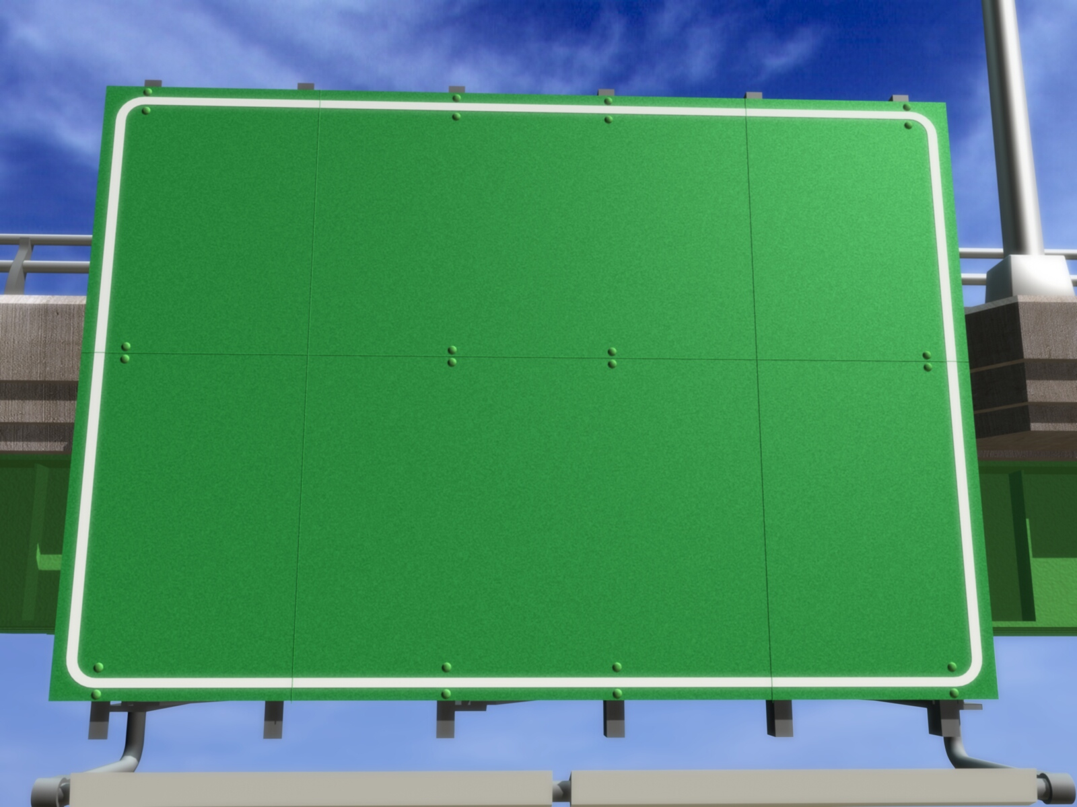
Heap Sort
Adam M.B.

Slide 2
❶❷❸
DEFINITION

Slide 3
Heap
Heap
Tree
Complete Binary Tree
(CBT)
  Min Heap
  Value of node <= value of its child
  Max Heap
  Value of node >= value of its child

Slide 4
Example of Heap
Max Heap
Min Heap
k
24
4
2k
2k+1
19
15
5
8
2k
2k+1
2k
2k+1
11
5
8
13
11
19
15
13
2k
4
24

Slide 5
❶❷❸
BASIC PROCESSES

Slide 6
Processes in Heap
Making of heap
Heap sort

Slide 7
Making of Heap
7
3
2
14
11
5
1
1
2
3
4
5
6
14
7
2
3
Shift down from middle node (Sum of node/2) until first node
14
11
7
3
2
5
N = 6, Middle = N/2 = 6/2 = 3
4
5
6
Reorganize on third node
14
3
11
7
5
2
Reorganize on second node
Reorganize on first node
14
11
5
3
7
2
1
2
3
4
5
6

Slide 8
Heap Sort 1
1
14
2
2
3
Binary tree in Max heap state.
“Fired” root and swap with last node.
Subtract number of nodes with 1.
If N > 1 then reorganize heap again.
Repeat step b to d until node is empty (N=0)
11
5
4
5
6
3
7
2
14
5
3
14
2
11
7
2
14
1
2
3
4
5
6

Slide 9
Heap Sort 1
1
Binary tree in Max heap state.
“Fired” root and swap with last node.
Subtract number of nodes with 1.
If N > 1 then reorganize heap again.
Repeat step b to d until node is empty (N=0)
14
2
2
3
11
5
4
5
6
3
7
2
14
5
3
14
2
11
7
2
14
1
2
3
4
5
6

Slide 10
Heap Sort 2
1
11
2
2
Reorganize heap
Middle = N/2 = 5/2 = 2
“Fired” root and swap with last node.
Subtract number of nodes with 1.
If N > 1 then reorganize heap again.
Repeat step b to d until node is empty (N=0)
2
3
2
Reorganize heap on second node.
7
11
5
Reorganize heap on first node.
4
5
3
2
7
11
11
14
2
11
7
2
2
2
11
5
3
7
2
14
1
2
3
4
5
6

Slide 11
Heap Sort 3
1
2
Reorganize heap
Middle = N/2 = 4/2 = 2
“Fired” root and swap with last node.
Subtract number of nodes with 1.
If N > 1 then reorganize heap again.
Repeat step b to d until node is empty (N=0)
2
7
2
3
Reorganize heap on second node.
7
2
3
5
Reorganize heap on first node.
4
3
2
2
7
11
14
7
11
2
2
7
5
2
2
3
3
7
2
7
14
1
2
3
4
5
6

Slide 12
Heap Sort 4
1
2
5
2
2
3
Reorganize heap
Middle = N/2 = 3/2 = 1
“Fired” root and swap with last node.
Subtract number of nodes with 1.
If N > 1 then reorganize heap again.
Repeat step b to d until node is empty (N=0)
3
5
2
Reorganize heap on first node.
5
7
11
14
5
7
11
2
2
2
5
5
3
7
2
2
3
2
14
1
2
3
4
5
6

Slide 13
Heap Sort 5
1
2
3
2
Reorganize heap
Middle = N/2 = 2/2 = 1
“Fired” root and swap with last node.
Subtract number of nodes with 1.
If N > 1 then reorganize heap again.
Repeat step b to d until node is empty (N=0)
2
2
Reorganize heap on first node.
3
3
5
7
11
14
5
7
11
3
2
2
2
2
3
5
3
7
2
2
3
2
14
1
2
3
4
5
6

Slide 14
Heap Sort 6
1
2
Because N = 1 then reorganize isn’t happen.
“Fired” root
Subtract number of nodes with 1.
Because N = 0 then sorting processes is finish.
2
3
5
7
11
14
5
7
11
2
2
2
3
5
3
7
2
2
3
2
14
1
2
3
4
5
6

Slide 15
m
❶❷❸
CASE

Slide 16
Node have 2
Case Example
Sort these name using heap sort method in descending way.
Num. | Name
1 | Rahmat
2 | Didin
3 | Ahmad
4 | Joned
5 | Syahrul
6 | Riki
7 | Arif
8 | Susi
9 | Donni
10 | Asih

Slide 17
Node have 2
Making of CBT
Complete Binary Tree
Rahmat
Didin
Ahmad
Joned
Syahrul
Riki
Arif
Susi
Donni
Asih
Not Heap
Rahmat
Didin
Ahmad
Joned
Syahrul
Riki
Arif
Susi
Donni
Asih
1
2
3
4
5
6
7
8
9
10

Slide 18
Node have 2
Heap Sort 1
Rahmat
Ahmad
Asih
Didin
Arif
Rahmat
Ahmad
Joned
Syahrul
Riki
Arif
Donni
Asih
Didin
Rahmat
Susi
Donni
Asih
Joned
Syahrul
Heap
Ahmad
Asih
Arif
Donni
Didin
Riki
Rahmat
Susi
Joned
Syahrul
1
2
3
4
5
6
7
8
9
10

Slide 19
Node have 2
Heap Sort 2
Syahrul
Ahmad
Asih
Arif
Donni
Didin
Riki
Rahmat
Susi
Joned
Syahrul
Not Heap
Syahrul
Ahmad
Ahmad
Asih
Arif
Donni
Didin
Riki
Rahmat
Susi
Joned
Ahmad
Syahrul
1
2
3
4
5
6
7
8
9
10

Slide 20
Node have 2
Heap Sort 3
Syahrul
Arif
Rahmat
Arif
Asih
Syahrul
Donni
Didin
Riki
Rahmat
Syahrul
Susi
Joned
Heap
Syahrul
Ahmad
Arif
Asih
Arif
Ahmad
Syahrul
Rahmat
Donni
Didin
Riki
Rahmat
Syahrul
Susi
Joned
Syahrul
1
2
3
4
5
6
7
8
9
10

Slide 21
Node have 2
Heap Sort 4
Arif
Joned
Asih
Rahmat
Donni
Didin
Riki
Syahrul
Susi
Joned
Not Heap
Arif
Arif
Ahmad
Joned
Asih
Rahmat
Donni
Didin
Riki
Syahrul
Susi
Joned
Ahmad
Arif
Syahrul
1
2
3
4
5
6
7
8
9
10

Slide 22
Node have 2
Heap Sort 5
Asih
Joned
Asih
Rahmat
Didin
Joned
Donni
Didin
Riki
Syahrul
Joned
Susi
Heap
Asih
Arif
Ahmad
Joned
Joned
Rahmat
Syahrul
Ahmad
Asih
Didin
Donni
Didin
Joned
Riki
Susi
Joned
Arif
Syahrul
1
2
3
4
5
6
7
8
9
10

Slide 23
Node have 2
Heap Sort 6
Asih
Susi
Didin
Rahmat
Donni
Joned
Riki
Syahrul
Susi
Not Heap
Asih
Didin
Rahmat
Joned
Syahrul
Asih
Arif
Ahmad
Susi
Donni
Riki
Susi
Ahmad
Asih
Joned
Arif
Syahrul
1
2
3
4
5
6
7
8
9
10

Slide 24
Node have 2
Heap Sort 7
Didin
Susi
Susi
Rahmat
Donni
Didin
Donni
Joned
Riki
Syahrul
Susi
Heap
Didin
Rahmat
Joned
Syahrul
Asih
Arif
Ahmad
Susi
Ahmad
Didin
Susi
Donni
Donni
Susi
Riki
Susi
Asih
Joned
Arif
Syahrul
1
2
3
4
5
6
7
8
9
10

Slide 25
Node have 2
Heap Sort 8
Syahrul
Didin
Donni
Rahmat
Susi
Joned
Riki
Syahrul
Not Heap
Didin
Donni
Rahmat
Susi
Joned
Didin
Asih
Arif
Ahmad
Syahrul
Riki
Syahrul
Ahmad
Didin
Susi
Asih
Joned
Arif
Syahrul
1
2
3
4
5
6
7
8
9
10

Slide 26
Node have 2
Heap Sort 9
Syahrul
Donni
Donni
Rahmat
Syahrul
Joned
Syahrul
Susi
Joned
Riki
Heap
Donni
Rahmat
Susi
Joned
Didin
Asih
Arif
Ahmad
Donni
Syahrul
Ahmad
Syahrul
Syahrul
Joned
Syahrul
Riki
Didin
Susi
Asih
Joned
Arif
Syahrul
1
2
3
4
5
6
7
8
9
10

Slide 27
Node have 2
Heap Sort 10
Riki
Donni
Joned
Rahmat
Susi
Syahrul
Riki
Not Heap
Rahmat
Susi
Donni
Didin
Asih
Arif
Ahmad
Donni
Syahrul
Ahmad
Riki
Joned
Syahrul
Donni
Riki
Didin
Susi
Asih
Joned
Arif
Syahrul
1
2
3
4
5
6
7
8
9
10

Slide 28
Node have 2
Heap Sort 11
Riki
Joned
Joned
Riki
Rahmat
Susi
Syahrul
Heap
Rahmat
Susi
Donni
Didin
Asih
Arif
Ahmad
Riki
Syahrul
Ahmad
Joned
Joned
Riki
Syahrul
Donni
Riki
Didin
Susi
Asih
Joned
Arif
Syahrul
1
2
3
4
5
6
7
8
9
10

Slide 29
Node have 2
Heap Sort 12
Syahrul
Joned
Riki
Rahmat
Susi
Syahrul
Not Heap
Joned
Riki
Rahmat
Susi
Joned
Donni
Didin
Asih
Arif
Ahmad
Syahrul
Syahrul
Syahrul
Ahmad
Joned
Donni
Riki
Didin
Susi
Asih
Joned
Arif
Syahrul
1
2
3
4
5
6
7
8
9
10

Slide 30
Node have 2
Heap Sort 13
Syahrul
Rahmat
Riki
Rahmat
Syahrul
Susi
Heap
Syahrul
Riki
Rahmat
Susi
Donni
Donni
Didin
Asih
Arif
Ahmad
Rahmat
Syahrul
Syahrul
Syahrul
Ahmad
Joned
Donni
Riki
Didin
Susi
Asih
Joned
Arif
Syahrul
1
2
3
4
5
6
7
8
9
10

Slide 31
Node have 2
Heap Sort 14
Rahmat
Susi
Riki
Syahrul
Susi
Not Heap
Riki
Rahmat
Donni
Donni
Didin
Asih
Arif
Ahmad
Susi
Susi
Syahrul
Ahmad
Rahmat
Syahrul
Rahmat
Syahrul
Joned
Donni
Riki
Didin
Susi
Asih
Joned
Arif
Syahrul
1
2
3
4
5
6
7
8
9
10

Slide 32
Node have 2
Heap Sort 15
Susi
Riki
Riki
Susi
Syahrul
Heap
Riki
Rahmat
Donni
Donni
Didin
Asih
Arif
Ahmad
Susi
Susi
Syahrul
Ahmad
Riki
Susi
Syahrul
Rahmat
Syahrul
Joned
Donni
Riki
Didin
Susi
Asih
Joned
Arif
Syahrul
1
2
3
4
5
6
7
8
9
10

Slide 33
Node have 2
Heap Sort 17
Syahrul
Susi
Susi
Syahrul
Heap
Riki
Rahmat
Donni
Donni
Didin
Asih
Arif
Ahmad
Syahrul
Susi
Syahrul
Ahmad
Susi
Susi
Syahrul
Syahrul
Rahmat
Syahrul
Joned
Donni
Riki
Didin
Susi
Asih
Joned
Arif
Syahrul
1
2
3
4
5
6
7
8
9
10

Slide 34
Node have 2
Heap Sort 16
Riki
Syahrul
Susi
Syahrul
Not Heap
Riki
Rahmat
Donni
Donni
Didin
Asih
Arif
Ahmad
Riki
Susi
Syahrul
Ahmad
Syahrul
Susi
Syahrul
Riki
Rahmat
Syahrul
Joned
Donni
Riki
Didin
Susi
Asih
Joned
Arif
Syahrul
1
2
3
4
5
6
7
8
9
10

Slide 35
Node have 2
Heap Sort 18
Syahrul
Susi
Syahrul
Heap
Susi
Riki
Rahmat
Donni
Donni
Didin
Asih
Arif
Ahmad
Susi
Susi
Syahrul
Ahmad
Syahrul
Syahrul
Susi
Syahrul
Rahmat
Syahrul
Joned
Donni
Riki
Didin
Susi
Asih
Joned
Arif
Syahrul
1
2
3
4
5
6
7
8
9
10

Slide 36
Node have 2
Heap Sort 19
Syahrul
Syahrul
Susi
Riki
Rahmat
Donni
Donni
Didin
Asih
Arif
Ahmad
Syahrul
Syahrul
Susi
Syahrul
Ahmad
Susi
Syahrul
Rahmat
Syahrul
Joned
Donni
Riki
Didin
Susi
Asih
Joned
Arif
Syahrul
1
2
3
4
5
6
7
8
9
10

Slide 37
GRACIAS
THANK YOU
Contact Person:
Adam Mukharil Bachtiar
Informatics Engineering UNIKOM
Jalan Dipati Ukur Nomor. 112-114 Bandung 40132
Email: adfbipotter@gmail.com
Blog: http://adfbipotter.wordpress.com
Copyright © Adam Mukharil Bachtiar 2012

