Slide 1
Graf types
Citra Noviyasari, S.Si, MT

Slide 2
Definition
A simple graph G = (V,E) consist of V, a nonempty set of vertices, and E, a set of unordered pairs of distinct elements of V called edges.
A multigraph G = (V,E) consists of a set V of vertices, a set E of edges and a function f from E to {{u,v} | u,v∈V, u ≠ v}. The edges e₁ and e₂ are called multiple or parallel edges if f(e₁) = f(e₂)
A directed multigraph G = (V,E) consist of a set V of vertices, a set E of edges, and a function f from E to {(u,v)| u,v∈V}. The edges e₁ and e₂ are multiple edges if f(e₁) = f(e₂)

Slide 3
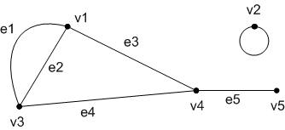
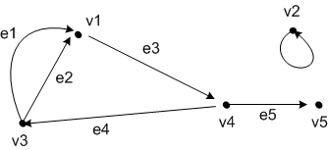
Contoh Graph

Slide 4
Two vertices u and v in an undirected graph G are called adjacent (or neighbors) in G if {u,v} is an edge of G. If e = {u,v} the edge e is called incident with the vertices u and v. The edge e is also said to connect u and v. The vertices u and v are called endpoints of the edge{u,v}
Two vertices u and v in an undirected graph is the number of edges incident with it, except that a loop at a vertex contributes twice to the degree o that vertex. The degree of the vertex v is denoted by deg(v)

Slide 5
Some special simple graph
Complete graphs
The complete graph on n vertices, denoted K_{n}, is the simple graph that contains exactly one edge between each pair of distinct vertices.

Slide 6
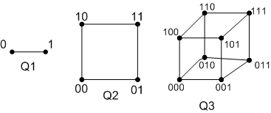
Some special simple graph
N-Cubes
The n-cube, denoted by Q_{n}, is the graph that has vertices representing 2^{n} bit string of length n. Two vertices are adjacent if and only if the bit strings that they represent differ in exactly one bit position.

Slide 7
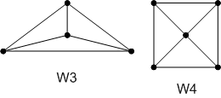
Some special simple graph
Wheels
We obtain the wheel Wn when we add an additional vertex to the cycle C_{n}, for n ≥ 3, and connect this new vertex to each of the n vertices in C_{n}, by new edges

Slide 8
Some special simple graph
Cycles
The cycle C_{n}, n ≥ 3, consist of n vertices v₁, v₂, .., v_{n} and edges {v₁, v₂}, {v₂, v₃} .., {v_{n-1}, v_{n}} and {v_{n}, v₁}

Slide 9
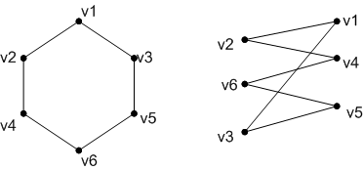
Bipartite Graphs
A simple graph G is called bipartite if its vertex set V can be partitioned into two disjoint nonempty sets V₁ and V₂ such that every edge in the graph connects a vertex in V₁ and a vertex in V₂ (so that no edge in G connects either two vertices in V₁ or two vertices in V₂)

Slide 10
Representing Graphs : Adjacency Matrices
Suppose that G = (V,E) is a simple graph where |V| = n. Suppose that the vertices of G are listed arbitrarily as v₁, v₂, .., v_{n} . The adjacency matrix A (or A_{G}) of G, with respect to this listing of the vertices, is the n x n zero – one matrix. A =[aij] then :

Slide 11
Representing Graphs : Incidence Matrices
Let G = (V,E) be undirected graph. Suppose that v₁, v₂, .., v_{n} are the vertices and e₁, e₂, .., e_{m} are the edges of G. Then the incidence matrix with respect to this ordering of V and E is the n x n zero – one matrix. M =[mij] then :

Slide 12
Isomorphism of Graphs
The simple graphs G₁ = (V₁, E₁) and G₂ = (V₂, E₂) are isomorphic if there is a one-to-one and onto function f from V₁ to V₂ with the property that a and b are adjacent in G₁ if only if f(a) and f(b) are adjacent in G₂, for all a and b in V1. Such a function f is called isomorphism. (Isos = equal and morphe = form)
Properties :
Both have same n
Both have same m
Both have same deg(v)

Slide 13
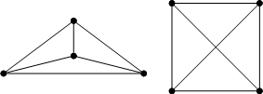

Slide 14
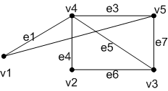
Connectivity
A path of length n from u to v, where n is a positive integer, in an undirected graph is a sequence of edges e₁, .., e_{n}, of the graph such that f(e₁)={x₁,x₂}, f(e₂)={x₀,x₁}, .. ,f(e_{n}) = {x_{n-1},x_{n}}. Where x₀ = u and x_{n} = v. When the graph is simple, we denote thes path by its vertex sequence
An undirected graph is called connected if there is a path between every pair of disticnt vertices of the graph

Slide 15
Euler Paths
An euler circuit in a graph G is a simple circuit containing every edge of G. An Euler path in G is a simple path containing every edge of G.
A connected multigraph has an Euler circuit if and only if each of its vertices has even degree
A connected multigraph has an Euler path but not an Euler circuit if and only if it has exactly two vertices of odd degree

Slide 17
Hamilton Paths
A path x₀, x₁, .., x_{n-1}, x_{n} in the graph G=(V,E) is called a Hamilton path if V = {x₀, x₁, .., x_{n-1}, x_{n}} and x_{i}≠x_{j} for 0≤i<j ≤n. A circuit x₀, x₁, .., x_{n-1}, x_{n}, x₀ (with n>1) is a graph G = (V,E) is called a Hamilton circuit if x₀,x₁,..,x_{n-1}, x_{n} is a Hamilton path
A connected multigraph has an Euler circuit if and only if each of its vertices has even degree

