Slide 1
Information Technology Project Management DR. HERMAN S. MBA
Magister Sistem Informasi
Universitas Komputer Indonesia

Slide 2
REFERENCE
Larson, E.W., Gray, C.F., 2011. Project Management: The Managerial Process, 5th Ed., Mc. Graw Hill.
Pinto, J.K., 2010. Project Management: Achieving Competitive Advantage, 2nd Ed., Pearson.
Schwalbe, K., 2007, Information Technology Project Management, 5th Ed.
Microsoft Project 2007
Win QSB2
Primavera 6.0 Suretrack

Slide 3
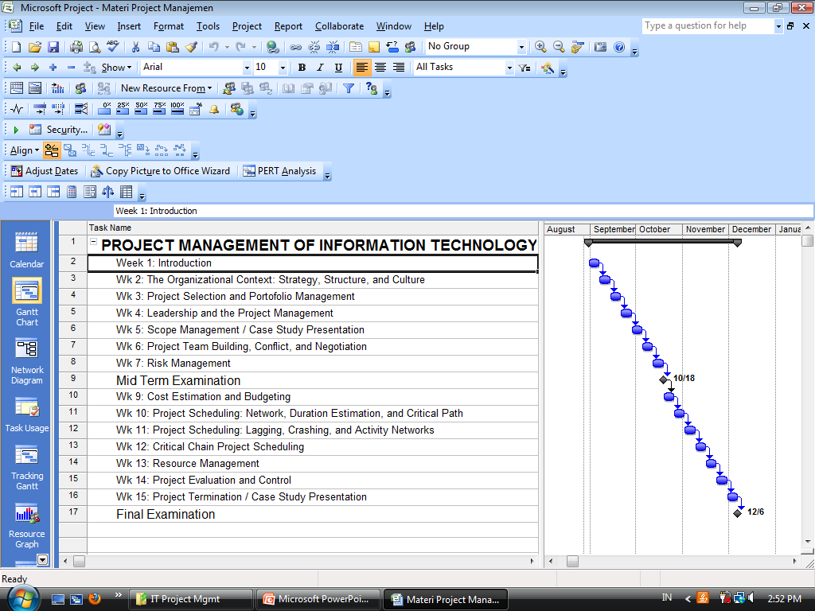
MATERI KULIAH

Slide 4
WHY Information Technology PROJECT MANAGEMENT?

Slide 5
PROJECT MANAGEMENT STATISTICS
Worldwide IT spending totaled more than $2.1 trillion in 2007, $3.7 trillion in 2011.
The number of people earning their Project Management Profesional certification more than 393000 in 2010, 285,000 in 2008 compare with 225,000 in 2006.

Slide 6
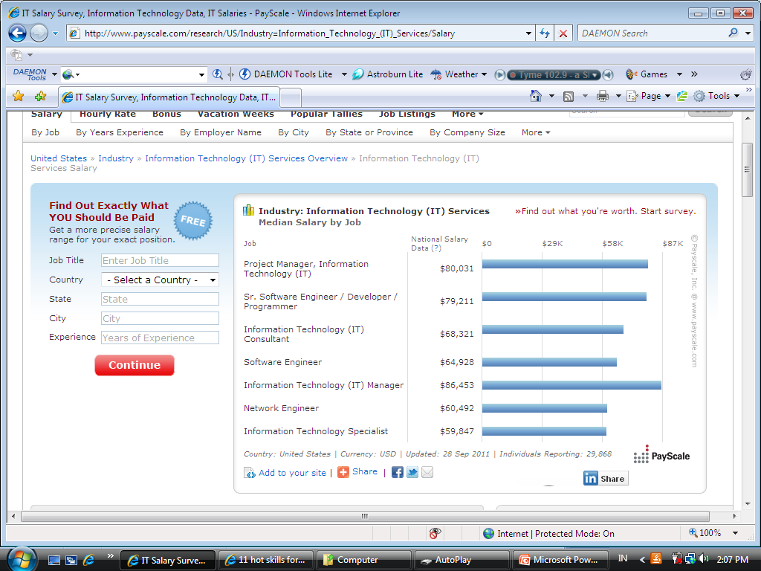
MOST DEMAND INFORMATION TECHNOLOGY SKILLS

Slide 7
Top IT Skills
SKILL PERCENTAGE OF RESPONDENTS
Project/program management 60%
Business process management 55%
Business analysis 53%
Application development 52%
Database management 49%
Security 42%
Enterprise architect 41%
Strategist/internal consultant 40%

Slide 8
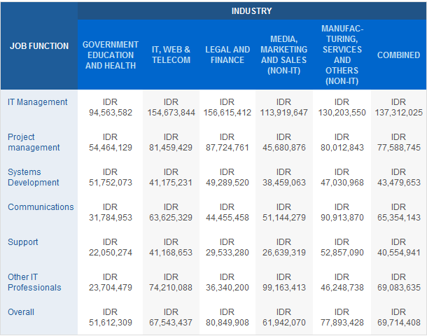
INDONESIAN ANNUAL AVERAGE IT SALARY RANGE - 2011
ZDNETAsia melakukan survey gaji pekerja IT di Indonesia. Survey dilakukan kepada 3.267 responder di Indonesia. Gaji rata-rata pekerja IT dalam setahun menurut industri dan fungsi kerjanya.

Slide 9
IT PROJECT HAVE A TERRIBLE TRACK RECORD

Slide 10
RECENT RESEARCH
65% of hardware and/or software development project fail (A Study of more than 300 large company conducted by Peat Marwick consultant).
More than half IT project become runaways (A study by META group).
Up to 75% of software project are canceled (Applied Data Research).
Only 2.5% of global business achieve 100% project success and over 50% of global business project fail (Price Water House Survey, 2004).
42% IRAQ Reconstruction project terminated due to mismanagement (The Special Inspector Geberal for Iraq Reconstruction)

Slide 11
Another Survey
A 1995 Standish Group Study (CHAOS) found that only 16.2% of IT Projects were succesfull in meeting scope, time, and cost goals
Over 31% of IT project were canceled before completion, costing over $81 billion in the U.S. alone

Slide 12
IT PROJECT
Improvements by 2001 (compared to 1995)
Time overruns significantly decreased to 163% compared to 222%
Cost overruns were down to 145% compared to 189%
Required features and functions were up to 67% compared to 61%
78,000 U.S. projects were successful compared to 28,000
28% of IT projects succeeded compared to 16%

Slide 13
Improvements by 2009
32 % IT Project were delivered on time & within budget.
44 % were “challenged”. (Late, or overbudget, or missed meeting performance).
24 % failed.

Slide 14
The reasons for the increase in successful projects
The average cost of a project has been more than cut in half.
Better tools have been created to monitor and control progress and
Better skilled project managers with better management processes are being used.

Slide 16
A project is “a temporary endeavor undertaken to create a unique product, service, or result” (PMBOK® Guide, Third Edition, 2004, p. 5)

Slide 17
ELEMENTS OF PROJECTS
Complex, one-time processses
Limited by budget, schedule, and resources
Developed to resolve a clear goal or set of goals
Customer focused

Slide 18
GENERAL PROJECT CHARACTERISTICS
Project are ad hoc endeavours with a clear life cycle
Projects are building blocks in the design and excecution of organizational strategies.
Project are responsible for the newest and most improved products, services, and organizational processes
Project provide a philosophy and strategy for the management of change

Slide 19
GENERAL PROJECT CHARACTERISTICS (Continued)
Project management entails crossing functional and organizational boundaries.
The traditional management function of planning, organizing, motivation, directing, and control apply to project management
The principal outcomes of a project are satisfaction of custumer requirement with the constraints of technical, cost, and schedule objectives
Project are terminated upon successfull completion of performance objectives

Slide 20
Differences Between Process & Project Management
Process | Project
Repeat process or product | New Process or Product
Several Objectives | One objective
Ongoing | One shot – limited life
People are homogenous | More heterogenous
Well-established system in place to integrate efforts | System must be created to integrate effort
Greater certainty of performance, cost, schedule | Greater uncertainty of performance, cost, schedule
Part of line organization | Outside of line organization
Bastion of establieshed practice | Violates established practice
Supports status quo | Upsets status quo

Slide 21
Project Size
Project Size Criteria - G.J. Ritz :
Size ($ Million)
Manhours (Thousand)
Small (1 - 10)
24 - 240
Medium (11 - 75)
240 – 1.200
Big (80 - 200)
1.200 – 3.000
Super (250 - 600)
3.000 – 6.000
Mega (1.000 – 3.000)
10.000 – 24.000

Slide 22
PROJECT LIFE CYCLE

Slide 23
Larson E.W., & Gray, 2011:7

Slide 24
Project Life Cycles and Their Effects

Slide 25
DETERMINANT OF PROJECT SUCCESS
The Triple Constraint

Slide 26
DETERMINANT OF PROJECT SUCCESS
The Quadruple Constraint

Slide 27
Four Dimensions of Project Success Importance

Slide 28
Information Technology Project Success
System quality
Information Quality
Use
User Satisfaction
Individual Impact
Organization Impact

Slide 29
Understanding Success Criteria
Iron Triangle | Information System | Benefits (Organization) | Benefits (Stakeholder)
Cost Quality Time | Maintainability Reliability Validity Information Technology Use | Improved efficiency Improved effectiveness Increase profits Strategic goals Organization Learning Reduced waste | Satisfied users Social & environmental impact Personal Development Profesional learning Economic impact

Slide 30
What Help Project Succeed
1. Executive support
2. User involvement
3. Experienced project manager
4. Clear business objectives
5. Minimized scope
6. Standard software infrastructure
7. Firm basic requirements
8. Formal methodology
9. Reliable estimates
10. Other criteria, such as small milestones, proper planning, competent staff, and ownership
*The Standish Group, “Extreme CHAOS,” (2001).

Slide 31
WHAT IS PROJECT MANAGEMENT ?
Project management is “the application of knowledge, skills, tools and techniques to project activities to meet project requirements” (PMBOK® Guide, Third Edition, 2004, p. 8)

Slide 32
PROJECT MANAGER
Project managers strive to meet the triple / quadruple constraint by balancing project scope, time, and cost goals

Slide 33
PROJECT MANAGER RESPONSIBILITIES
Selecting a team
Developing project objectives and a plan for execution
Performing risk management activities
Cost estimating and budgeting
Scheduling
Managing resources

Slide 34
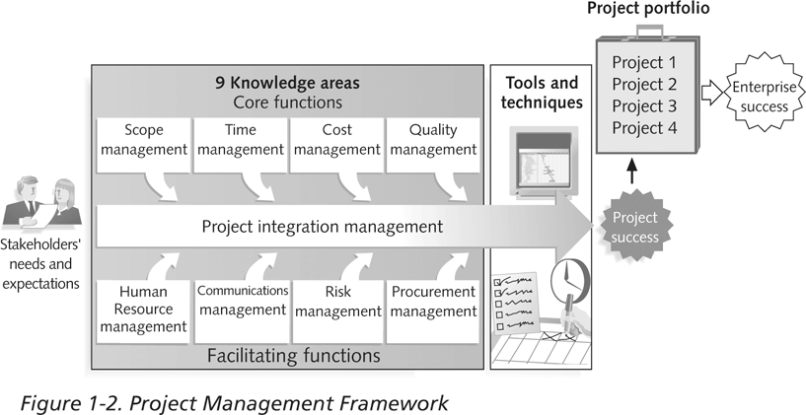
PROJECT MANAGEMENT FRAMEWORK

Slide 35
Sugested Skills for Project Manager
Project managers need a wide variety of skills
They should:
Be comfortable with change
Understand the organizations they work in and with
Be able to lead teams to accomplish project goals

Slide 36
Important Skills and Competencies for Project Manager
1. People skills
2. Leadership
3. Listening
4. Integrity, ethical behavior, consistent
5. Strong at building trust
6. Verbal communication
7. Strong at building teams
8. Conflict resolution, conflict management
9. Critical thinking, problem solving
10. Understands, balances priorities

Slide 37
Importance of Leadership Skills
Effective project managers provide leadership by example
A leader focuses on long-term goals and big-picture objectives while inspiring people to reach those goals
A manager deals with the day-to-day details of meeting specific goals
Project managers often take on the role of both leader and manager

Slide 38
Program
Program: group of related projects managed in a coordinated way to obtain benefits and control not available from managing them individually (PMBOK® Guide, Third Edition, 2004, p. 16)
Program managers oversee programs and often act as bosses for project managers

Slide 39
Project VS Program
PROGRAM
PROYEK D
PROYEK A
PROYEK B
PROYEK C

Slide 40
Project Management Maturity
Project management maturity model are used to allow organization to benchmark the best practices of successfull project management firms

Slide 41
Project Management Maturity (Spider Web Diagram)
Ring Level | Meaning
0 | Not defined or poor
1 | Defined but sub standard
2 | Standardized
3 | Industry leader or cutting edge

Slide 42
Project Management Maturity A Generic Model

Slide 43
TERIMA KASIH

