Slide 1
SISTEM BILANGAN
Number System

Slide 2
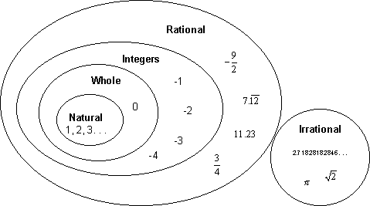
REAL NUMBER SYSTEM (ℝ)

Slide 3
Real Numbers (ℝ)
Rationals + Irrationals
All points on the number line
Or all possible distances on the number line

Slide 4
Field Axioms (Operation addition)
For every a,b  ℝ, we have a + b  R.
For every a,b,c  ℝ, we have a+(b+c) = (a+b)+ c
For every a  ℝ, we have a + 0 = a.
For every a  ℝ, there exists —a  R such that a + (—a) = 0.

Slide 5
Field Axioms (Operation multiplication)
For every a,b  ℝ, we have ab  R.
For every a, b, c  ℝ, we have a(bc) = (ab)c.
For every a  ℝ, we have a1 = a.
For every a  ℝ such that a ≠ 0, there exists a⁻¹  R such that aa⁻¹ = 1.
For every a, b  ℝ, we have ab = ba.

Slide 6
Field Axioms (Distributive Law)
For every a,b,c  ℝ, we have a(b + c) = ab + ac.

Slide 7
An Ordered Set
The real numbers have the property that they are ordered, which means that given any two different numbers we can always say that one is greater or less than the other. A more formal way of saying this is:
For any two real numbers a and b, one and only one of the following three statements is true:
1. a is less than b, (expressed as a < b)
2. a is equal to b, (expressed as a = b)
3. a is greater than b, (expressed as a > b)

Slide 8
Order Axioms
For every a, b  ℝ, exactly one of a < b, a = b, a > b holds.
For every a, b, c  ℝ satisfying a > b and b > c, we have a > c.
For every a,b,c  ℝ satisfying a > b, we have a + c > b + c.
For every a, b, c ℝ satisfying a > b and c > 0,
we have ac > bc.

Slide 9
Transitives
x < y and y < z ⇒ x < z
x < y ↔ x+z < y+z
Positive : x < y ↔ xz < yz
Negative : x < y ↔ xz > yz

Slide 10
NATURAL NUMBERS (ℕ)
ℕ = {1, 2, 3, ... }
“Number” meant something you could count.
These are called the natural numbers, or sometimes the counting numbers.

Slide 11
WHOLE NUMBERS
We call the set of natural numbers plus the number zero the whole numbers.

Slide 12
INTEGERS (ℤ)
Whole numbers plus negatives
ℤ = { . . . –4, –3, –2, –1, 0, 1, 2, 3, 4, . . .}

Slide 13
RATIONAL NUMBERS (ℚ)
All numbers of the form , where a and b are integers (but b cannot be zero)
Rational numbers include what we usually call fractions

Slide 14
IRRATIONAL NUMBERS
Cannot be expressed as a ratio of integers.
As decimals they never repeat or terminate (rationals always do one or the other)
Examples :

Slide 15
The Number Line
The ordered nature of the real numbers lets us arrange them along a line (imagine that the line is made up of an infinite number of points all packed so closely together that they form a solid line).

Slide 16
Absolute Value
When we want to talk about how “large” a number is without regard as to whether it is positive or negative, we use the absolute value function. The absolute value of a number is the distance from that number to the origin (zero) on the number line. That distance is always given as a non-negative number.
In short:
If a number is positive (or zero), the absolute value function does nothing to it:
If a number is negative, the absolute value function makes it positive:

Slide 17
Mini Test
4-3(8-12)-6
-[3(-6+13)-2(5-9)]
.
.
.
.
7.
8.
9.
10.

