Slide 1
Computer Evolution
Pengantar Ilmu Komputer

Slide 2
Computer Classification
Computer → Processing Device
Consist of 4 classification :
Manual Device
Mechanic Device
Electronic Mechanic Device
Electronic Device

Slide 3
Manual Device
Bone (300000BC)
Used for reminder and communication
ex : to count distance
Petroglyphs (300000 BC)
Used for note data

Slide 4
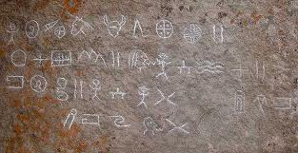
Petroglyphs

Slide 5
Papyrus (2600 BC)

Slide 6
Abacus (2500 BC)

Slide 7
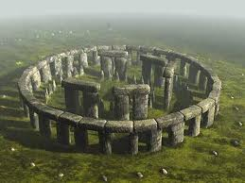
Stonehenge (1900 BC)

Slide 8
Oughtred’s Slide rule (1621)

Slide 9
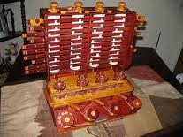
Mechanic Device
First Counting Device (Wilhem Schickard)

Slide 10
Pascal’s Machine Aritmethique (1642)

Slide 11
Leibnitz’s Calculating Machine (1673)

Slide 12
Logic Demonstrator (1777)

Slide 13
Jacuquard’s Loom (1804)

Slide 14
The Adder (1868)

Slide 15
Monroe Calculator (1911)

Slide 16
Electronic Mechanic Device
1890
Tabulation Machine (created by Dr. Herman Hollerith)
1920
1st otomatic counter machine (decision maker machine, by Leonardo Torresy Quevedo,Spain)
1931
1st Analog Computer (Differensial Analyzer, Dr. Vannevar Bush, MIT)
1938
1st electronic mechanic device (Complex Calculator, George R. Stibitz, Bell Laboratories)

Slide 17
Electronic Device
1942
1st digital computer
1944
Hardvard Mark I ASCC (1st otomatic arithmetic and logic, made by IBM, Prof. Howard Aiken,Harvard University )

Slide 18
1st Generation (1946 – 1959)
Vacuumtube
Machine/Assembly Languange
Secondary Storage : Magnetic Tape and Magnetic Disk
Punch Card and paper tape to feed program and to get results
Bulky
High Cost
Small Capasity
Consume more power with limited performance
Slow Process
For Scientific Computations

Slide 19
Vacuum Tube

Slide 20
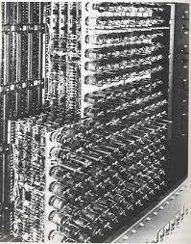

Slide 21
EDVAC (1945)

Slide 22
UNIVAC (1951)

Slide 23
2nd Generation (1959-1964)
Transistor
High Level Language : fortran, cobol
Magnetic ferrite core memories were used as main memory
Bigger memory capacity
Magnetic tapes and magnetic disks were used as secondary memory
Real time and Time sharing capabilities
Smaller in size
Punch cards used continued
Lesser power consumption and better performance
Busines application and Technique

Slide 24
Transistor

Slide 25
LARC

Slide 26
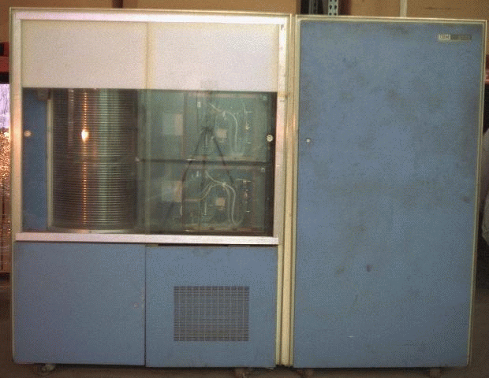
IBM 7094

Slide 27
3rd Generation (1964 – 1970)
IC (Integrated Circuit) as main component
Better Software
10000 times Faster then 1st generation
Bigger memory capacities
External Storage
Smaller electric power consumption
Multiprocessing and multiprogramming
Cheaper price
Smaller size
Visual and graphic display
Communication with other computer

Slide 28
Integrated Circuit

Slide 29
Sinclair

Slide 30
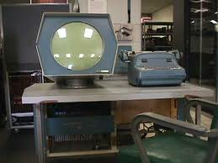
PDP 1

Slide 31
4th Generation (1970 - …)
Smaller size
Faster Processing
Cheaper Price
Bigger Capacity
Personal used
Software Development
Online application

Slide 32
Ultra-Large Scale Integration (ULSI)

Slide 33
Atari 2600 (1980)

Slide 34
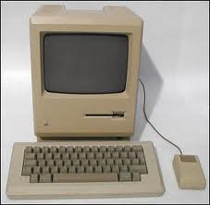
Motorolla 68000

Slide 35
5th Generation
Artificial Intelligent

Slide 36
Future Computer
Biochip → synthetic Protein
Similar to human characteristic : has emotion and thinking

Slide 37
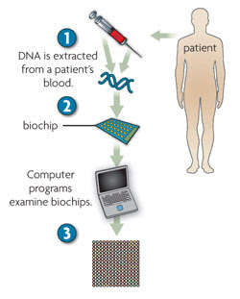
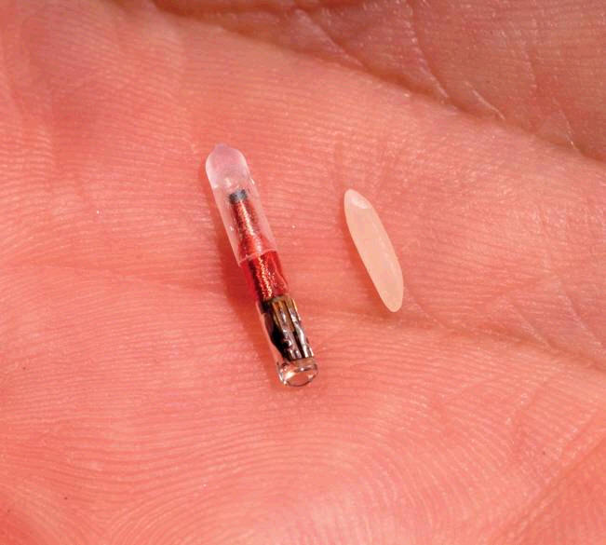
Biochip

Slide 38
Computer Classification
How to Process Data
How to use
Size
Generation

Slide 39
Way to Process Data
Analog Computer
For continue data and physical form
ex : electricity, temperature, speed, pressure
use for hospital (heart pressure), oil pipe, electricity power
advantage :
accept physical data and measure data without conversion
weakness :
precision

Slide 40
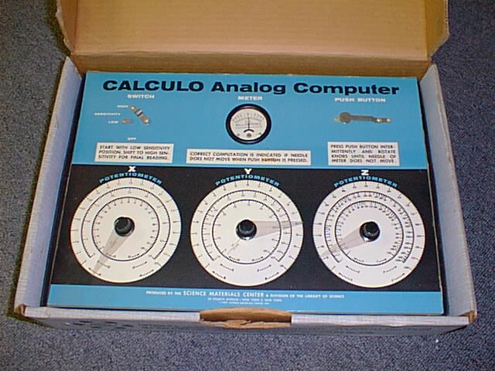
Calculo (1959)

Slide 41
Way to Process Data
Digital Computer
Numeric and character data form and usually used for business and technique
Advantage :
Faster data processing
Data Storing
Logical operation capabilities
Correctional or erasable data
Numeric, character and graphic output display

Slide 42
Way to Process Data
Hybrid Computer
Combination of analog computer and digital computer

Slide 43
Way to use
Special Purpose Computer
Made for certain case, usually used to handle one case. Used for automatic controller for industry. Ex : analog computer
General Purpose Computer
Made for handling many case. Slower then special purpose computer. Used for business, technique, education, word processing, gaming etc. Ex : General purpose computer

Slide 44
Size
Micro Computer
Single user
PC or notebook
Small Space
Smaller operand register
Mini Computer
Multiuser
Small room

Slide 45
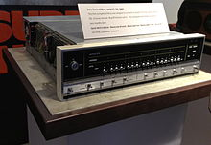
Data General Nova (mini computer)

Slide 46
Size
Medium Computer
Has many Input and Output Devices
Used for Data Communication with hundreds terminal dan separate from cmputer center
Expensive
Large Computer
Large size
Usually used by big company
High speed processing and big capacity, timesharing capabilities
Expensive

Slide 47
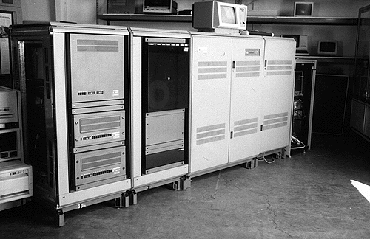
Dec Vax (Medium Computer)

Slide 48
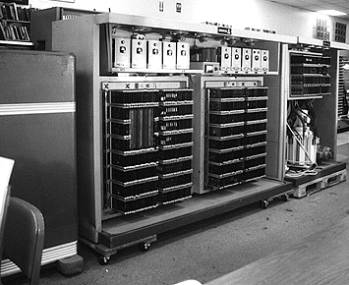
Z – 23 (Medium Computer)

Slide 49
Size
Super Computer
Thousands Computer connected
More effective in time sharing
Very expensive

Slide 50
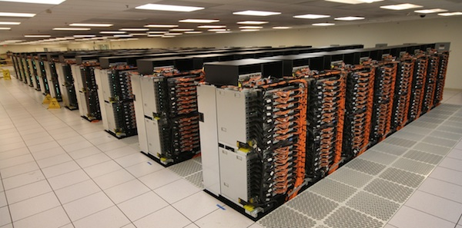
Sequoia
A petascale Blue Gene Supercomputer, constructed by IBM for The National Nuclear Security Administration for Advanced Simulation and Computing Program (ASC)

Slide 51
Questions
Find and write how to use Oughtred’s Slide Rule
Find some of Super Computer and find :
The owner (Country or organization)
Function and capabilities
And when it made
Visit next website to find hot topic about computer
http://www.siliconvalley.com
www.computeruser.com
Write your experience when you visit the website

