Slide 1
Sistem Koordinat
Cartesian coordinates in two dimensions

Slide 2
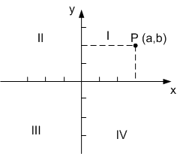
Koordinat Cartesius
For a given point P, a line is drawn through P perpendicular to the x-axis to meet it at X and second line is drawn through P perpendicular to the y-axis to meet it at Y.
The coordinates of P are X and Y
interpreted as numbers x and y on the corresponding number lines. The coordinates are written as an ordered pair (x, y).
The value of x is called the x-coordinate or abcissa and the value of y is called the y-coordinate or ordinate.

Slide 3
Gradien
the slope or gradient of a line describes its steepness, incline, or grade. A higher slope value indicates a steeper incline.
The slope is (in the simplest of terms) the measurement of a line, and is defined as the ratio of the "rise" divided by the "run" between two points on a line
.

Slide 4
Example
Suppose a line runs through two points: A(3, 2) and B(8, 4) . By dividing the difference in y-coordinates by the difference in x-coordinates, one can obtain the slope of the line:

Slide 5
Linear Function
Formula :
y = mx + c
Ax + By + C = 0
Point slope formula, throughs (x₁, y₁) with m :
The Secant line between two points(x₁, y₁) dan (x₂, y₂)
dengan

Slide 6
Example (1)
Suppose a line runs through two points: (-4, 2) and (6, -1) .
1st Way :
Gradien :
If through (-4, 2) then :
(form : y =mx +c)
(form : Ax+By+C=0)

Slide 7
2nd way :
form: Ax + By + C = 0
form : y = mx + C

Slide 8
Example (2)
Through (6, -1)

Slide 9
Lines
Parallel lines
parallel lines have the same slope — and lines with the same slope are parallel. m₁=m₂
Perpendicular lines
If you visualize a line with positive slope, then the perpendicular line must have negative slope So perpendicular slopes have opposite signs.
m₁.m₂ = - 1

Slide 10
Hubungan Dua Garis
x- dan y- Intercepts :
an x-intercept is a point in the equation where the y-value is zero, and
a y-intercept is a point in the equation where the x-value is zero.

Slide 11
Example
One line passes through the points (–1, –2) and (1, 2); another line passes through the points (–2, 0) and (0, 4). Are these lines parallel, perpendicular, or neither?
Since these two lines have identical slopes, then these lines are parallel.

Slide 12
One line passes through the points (0, –4) and (–1, –7); another line passes through the points (3, 0) and (–3, 2). Are these lines parallel, perpendicular, or neither?
If I were to flip the "3" and then change its sign, I would get " ^{–1}/₃". In other words, these slopes are negative reciprocals, so the lines through the points are perpendicular.

Slide 13
One line passes through the points (–4, 2) and (0, 3); another line passes through the points (–3,-2 ) and (3, 2) Are these lines parallel, perpendicular, or neither?

Slide 14
Example : Find the x- and y- intercepts of 25x² + 4y² = 9
Using the definitions of the intercepts, I will proceed as follows:
x-intercept(s):
y = 0 for the x-intercept(s), so:
25x² + 4y² = 9 25x² + 4(0)² = 9 25x² + 0 = 9 x² = ⁹/₂₅ x = ± ( ³/₅ )
Then the x-intercepts are the points ( ³/₅, 0) and ( ^{–3}/₅, 0)
y-intercept(s):
x = 0 for the y-intercept(s), so:
25x² + 4y² = 9 25(0)² + 4y² = 9 0 + 4y² = 9 y² = ⁹/₄ y = ± ( ³/₂ )
Then the y-intercepts are the points (0, ³/₂ ) and (0, ^{–3}/₂ )

Slide 15
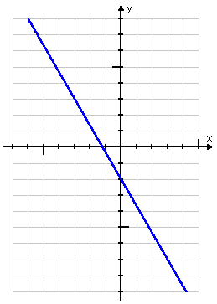
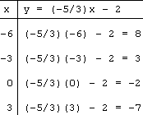
Examples : Graph y = (–5/3)x – 2
T-chart
Graph

Slide 16
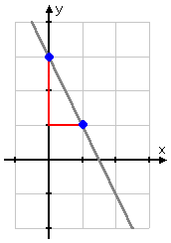
Drawn line equation: y = –2x + 3
the number on x is the slope, so m = –2 for this line. If, say, x = 0, then y = –2(0) + 3 = 0 + 3 = 3. Then the point (0, 3) is on the line

Slide 17
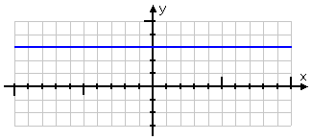
Graph y = 3
It doesn't matter what x-value you pick; you will always be 3.

Slide 18
Problem :
Drawn :
Graph y = 2x
Graph 4x – 3y = 12

Slide 19
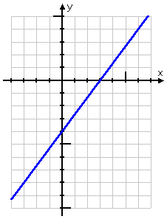
garis y = 2x
4x – 3y = 12

Slide 20
Menggambar Grafik Persamaan Kuadrat (Parabola)
Untuk menggambar suatu persamaan kuadrat, ikuti tiga langkah berikut :
Tentukan titik-titik potong dengan sumbu-sumbu koordinat :
Titik potong dengan sumbu x, syaratnya y = 0
Titik potong dengan sumbu y, syaratnya x = 0
2. Tentukan titik balik/puncak parabola, titik puncak dilalui sumbu simetri, koordinatnya adalah : dimana
3. Gambarkan beberapa titik lagi untuk membantu mempermudah penggambaran, kemudian hubungkan titik-titik tersebut dengan sebuah kurva mulus.

Slide 21
Find new equality that’s through (6, 8) and paralel with 3x – 5y = 11
3x - 5y = 11 or , m = 3/5 → m2 = 3/5
2nd line : through (6, 8) and m2 = 3/5

Slide 22
5y = 3x + 22 atau 3x – 5y + 22 = 0

Slide 23
The Distance Formula
Distance between A dan B :
Example :
Find the distance between the points A (-2, 3) dan B (4, -1)

Slide 24
Jarak Titik Ke Garis
Distance between T(x₁ ,y₁) to Ax + By + C = 0 adalah :
Example :
Find the distance between the points A (1, 2) to 4x + 5y + 8 = 0

Slide 25
Latihan
Tentukan gradien garis yang melalui titik (2, -4) dan (0,-6)
Tentukan persamaan garis :
Melalui titik (2, 3) dengan kemiringan 4
Melalui titik (2, 3) dan (4, 8)
3. Tuliskan persamaan garis melalui (3, -3) yang :
Sejajar garis 2x + 3y = 6
Tegak lurus garis 2x + 3y = 6
Sejajar garis yang melalui titik (-1, 2) dan (3, -1)
4. Tentukan persamaan garis yang melalui titik potong garis-garis 2x + 3y = 4 dan -3x + y = 5 dan tegak lurus dengan garis pertama.
5. Diketahui titik A(1, 2), B(3, -4), dan C(-2, 0). Tentukan persamaan garis yang melalui titik A dan sejajar garis BC.

