Slide 1
FILTER
Pertemuan-6
John Adler
KK-Komputasi dan Kecerdasan Buatan
Teknik Komputer
Universitas Komputer Indonesia-UNIKOM

Slide 2
Matlab Tutorial Continued
Files, functions and images.

Slide 3
Files
Matlab

Slide 4
Functions
Format: function o = test(x,y)
Name function and file the same.
Only first function in file is visible outside the file.
Look at sample function

Slide 5
Images
Black and white image is a 2D matrix.
Intensities represented as pixels.
Color images are 3D matrix, RBG.
Matlab

Slide 6
Debugging
Add print statements to function by leaving off ;
keyboard
debug and breakpoint

Slide 7
Conclusions
Quick tour of matlab, you should teach yourself the rest. We’ll give hints in problem sets.
Linear algebra allows geometric manipulation of points.
Learn to love SVD.

Slide 8
Linear Filtering
About modifying pixels based on neighborhood. Local methods simplest.
Linear means linear combination of neighbors. Linear methods simplest.
Useful to:
  Integrate information over constant regions.
  Scale.
  Detect changes.
Fourier analysis.
Many nice slides taken from Bill Freeman.

Slide 9
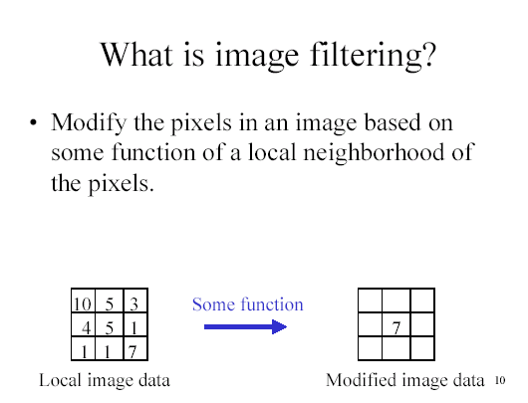
(Freeman)

Slide 10
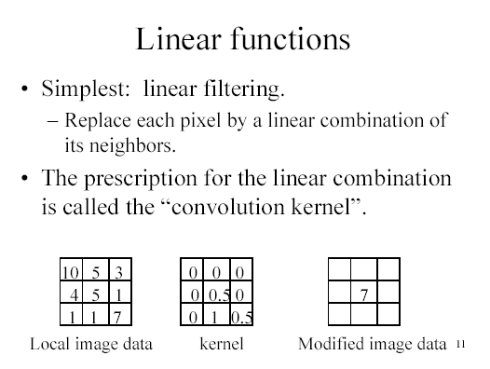
(Freeman)

Slide 11
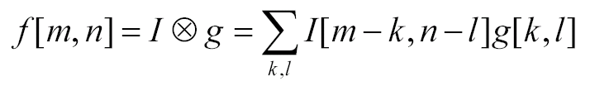
Convolution
Convolution kernel g, represented as matrix.
  it’s associative
Result is:

Slide 12
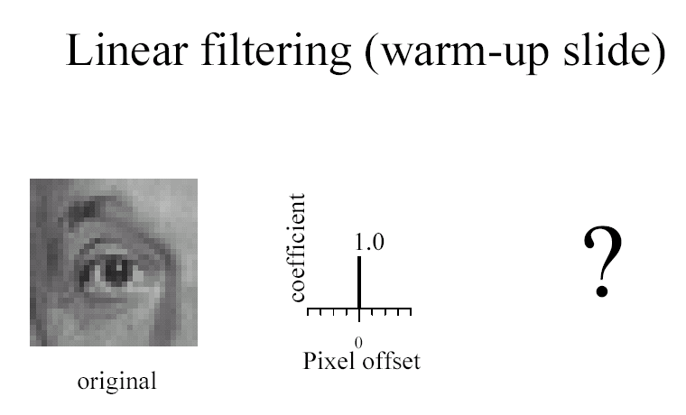

Slide 13
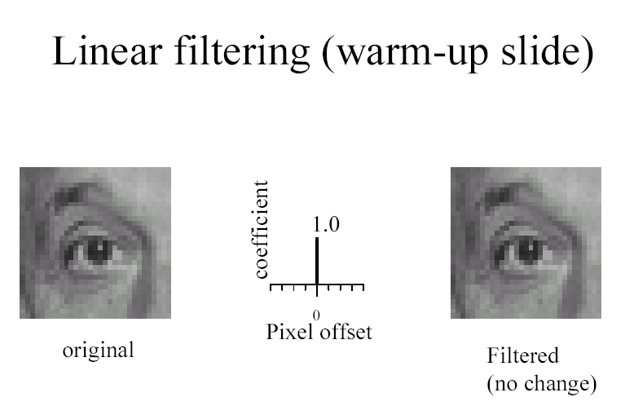

Slide 14
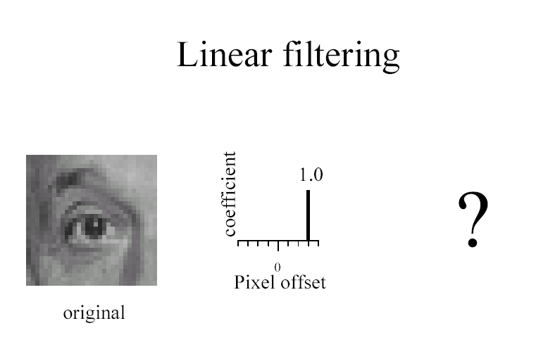

Slide 15
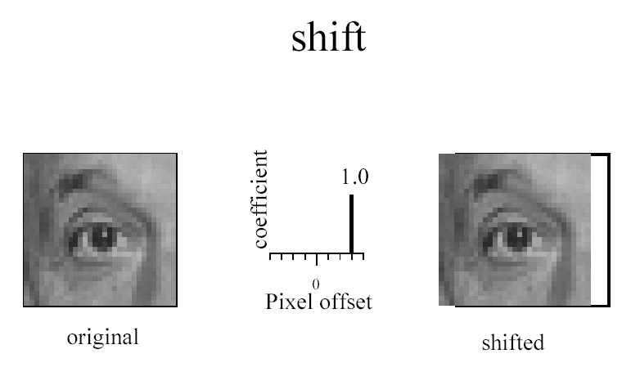

Slide 16
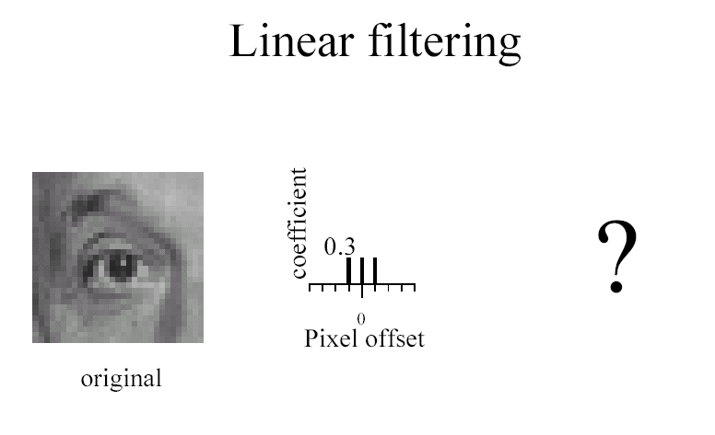

Slide 17
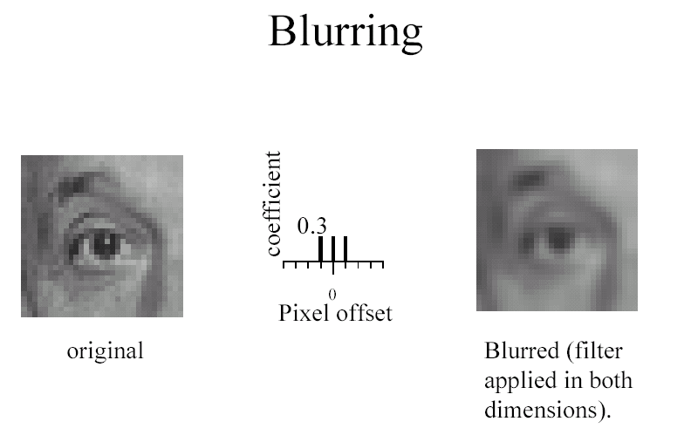

Slide 18
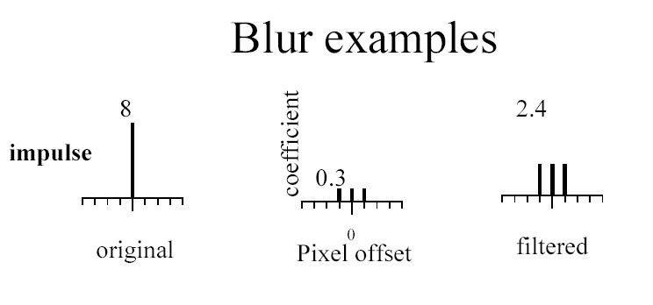

Slide 19
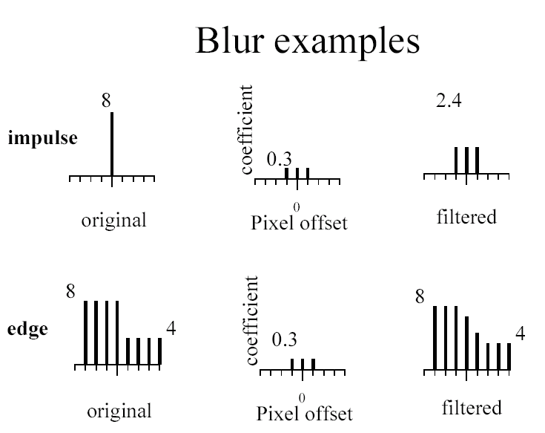

Slide 20
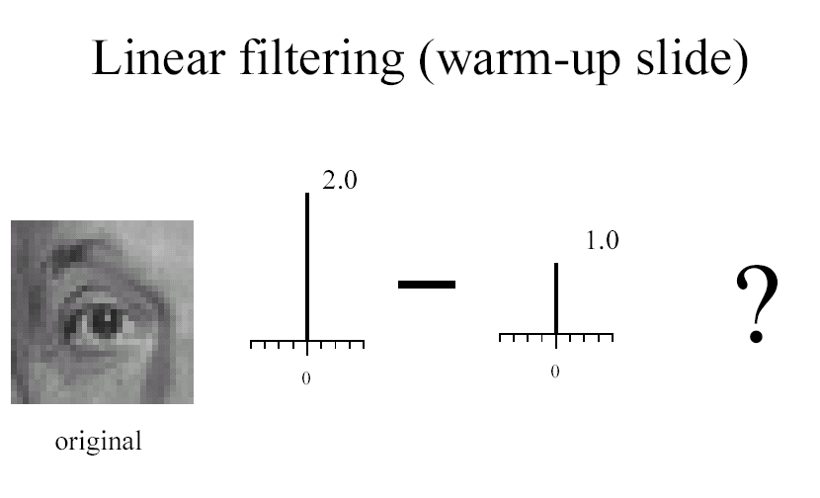

Slide 21
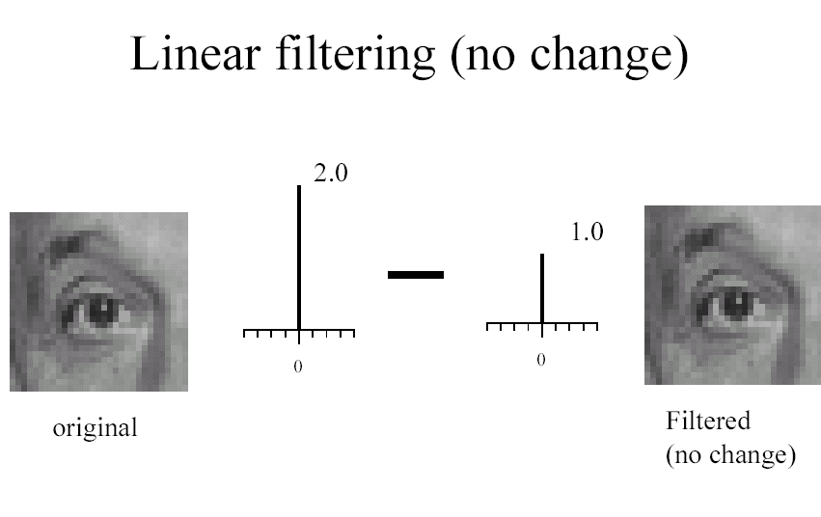

Slide 22
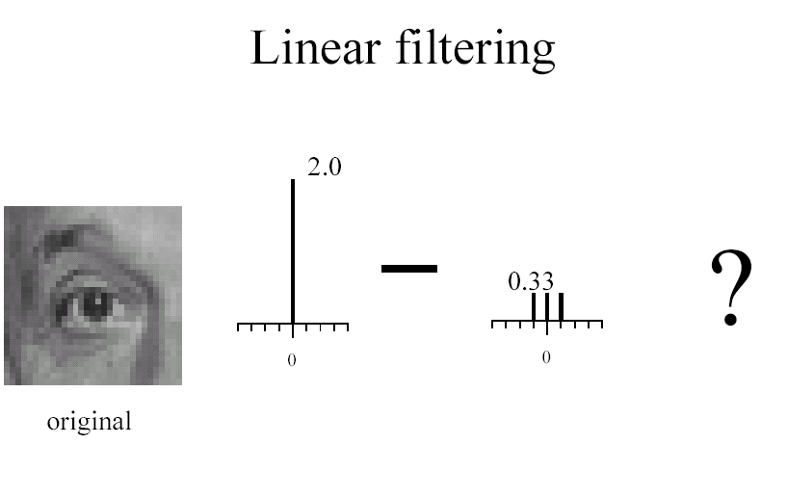

Slide 23
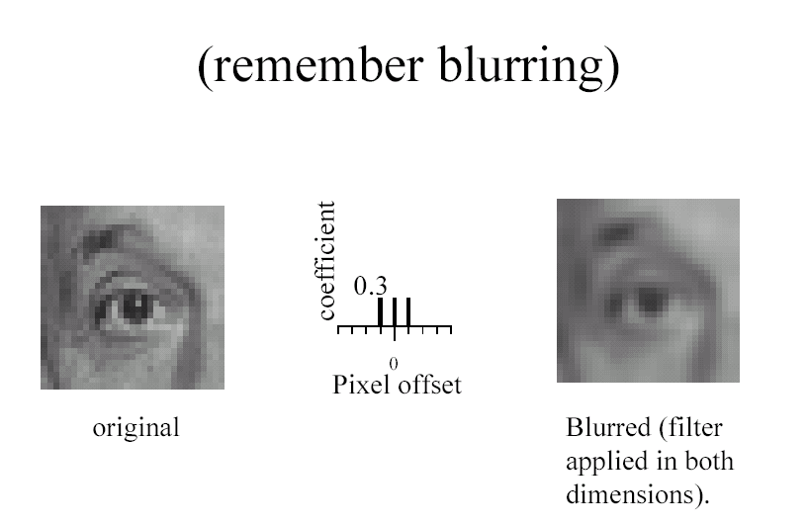

Slide 24
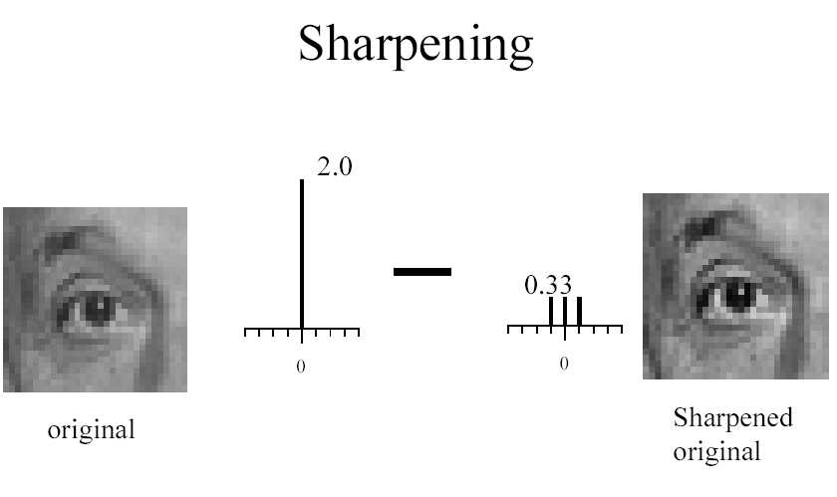

Slide 25
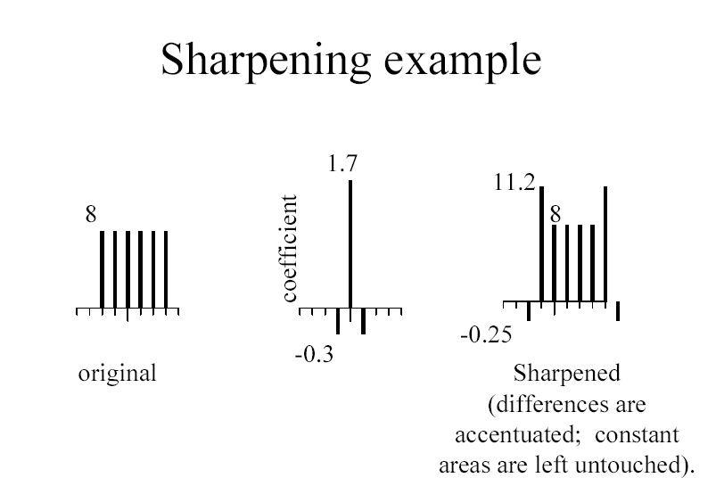

Slide 26


Slide 27
Filtering to reduce noise
Noise is what we’re not interested in.
  We’ll discuss simple, low-level noise today: Light fluctuations; Sensor noise; Quantization effects; Finite precision
  Not complex: shadows; extraneous objects.
A pixel’s neighborhood contains information about its intensity.
Averaging noise reduces its effect.

Slide 28
Additive noise
I = S + N. Noise doesn’t depend on signal.
We’ll consider:

Slide 29
Average Filter
Mask with positive entries, that sum 1.
Replaces each pixel with an average of its neighborhood.
If all weights are equal, it is called a BOX filter.
F
1
1
1
1
1
1
1/9
1
1
1
(Camps)

Slide 30
Does it reduce noise?
Intuitively, takes out small variations.
2
2
2
(Camps)

Slide 31
Matlab Demo of Averaging

Slide 32


Example: Smoothing by Averaging

Slide 33
Smoothing as Inference About the Signal
Neighborhood for averaging.
+
=
Nearby points tell more about the signal than distant ones.

Slide 34
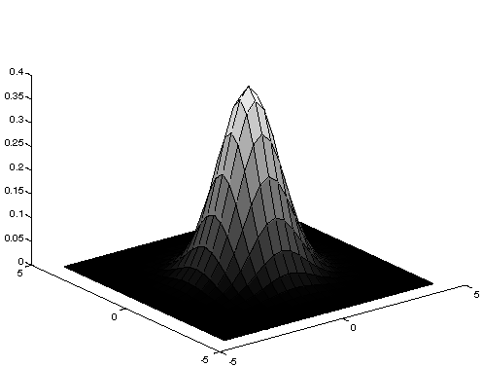
Gaussian Averaging
Rotationally symmetric.
Weights nearby pixels more than distant ones.
  This makes sense as probabalistic inference.
A Gaussian gives a good model of a fuzzy blob

Slide 35
An Isotropic Gaussian
The picture shows a smoothing kernel proportional to
(which is a reasonable model of a circularly symmetric fuzzy blob)

Slide 36

Smoothing with a Gaussian

Slide 37
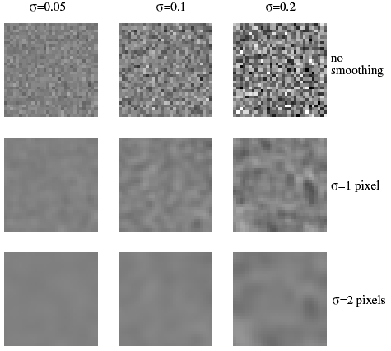
The effects of smoothing
Each row shows smoothing
with gaussians of different
width; each column shows
different realizations of
an image of gaussian noise.

Slide 38
Efficient Implementation
Both, the BOX filter and the Gaussian filter are separable:
  First convolve each row with a 1D filter
  Then convolve each column with a 1D filter.

Slide 39
Smoothing as Inference About the Signal: Non-linear Filters.
+
=
What’s the best neighborhood for inference?

Slide 40
Filtering to reduce noise: Lessons
Noise reduction is probabilistic inference.
Depends on knowledge of signal and noise.
In practice, simplicity and efficiency important.

Slide 41
Filtering and Signal
Smoothing also smooths signal.
Matlab
Removes detail
Matlab
This is good and bad:
- Bad: can’t remove noise w/out blurring shape.
- Good: captures large scale structure; allows subsampling.

Slide 42
Subsampling
Matlab

Slide 43
Referensi
Erkki Rämö, Digital Media, “Image Processing”, Principal Lecturer, Metropolia University of Applied Sciences.
Richard Alan Peters II, EECE/CS 253 -Image Processing, Lecture Notes: Spatial Convolution, Department of Electrical Engineering and Computer Science, Fall Semester 2011, Vanderbilt University School of Engineering

Slide 44
TERIMA KASIH

