Slide 1
KOMUNIKASI DATA
Materi Pertemuan 9

Slide 2
TRANSMISSION MODES
One of the primary concern when we are considering the transmission of data from one device to another is the wiring. And of the primary concern when we are considering the wiring is the data stream.
Do we send 1 bit at a time; or do we group into larger group and if so, how?
The transmission of binary data across a link can be accomplished in either parallel or serial mode.
In parallel mode, multiple bits are sent with each clock tick.
In serial mode, 1 bit is sent with each clock tick.

Slide 3
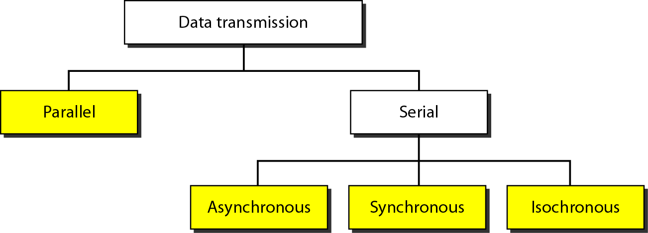
DATA TRANSMISSION
There are three subclasses of serial transmission: asynchronous, synchronous, and isochronous.

Slide 4
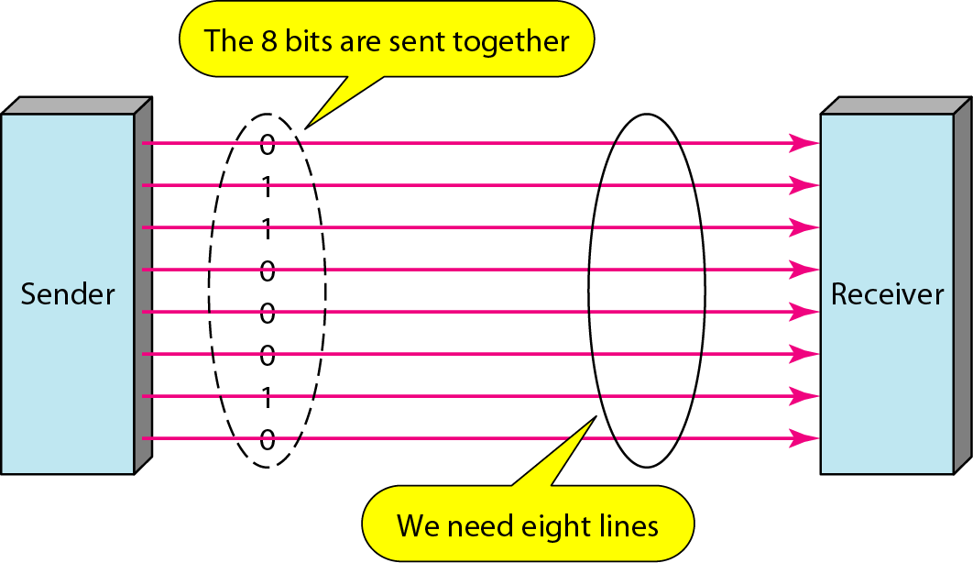
Parallel Transmission
Binary data, consisting of 1s and 0s, may be organized into group of n bits each
Advantages : speed
Disadvantages : cost, limited to short distances

Slide 5
Parallel Transmission
Suatu pengiriman data disebut paralel, jika sekelompok data ditransmisikan bersama sama dan melewati beberapa jalur transmisi yang terpisah
Dalam waktu yang bersamaan 8 bit (1 karakter) ditransmisikan secara paralel
Transfer data lebih cepat, tapi hanya digunakan untuk jarak yang relatif pendek
Umumnya tidak digunakan untuk hubungan antar komputer, digunakan untuk menghubungkan komputer dengan printer

Slide 6
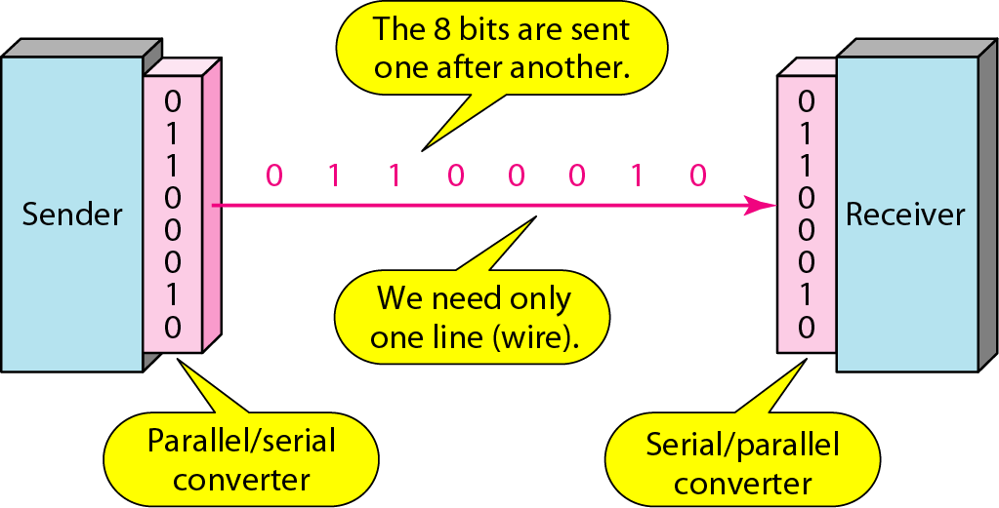
Serial Transmission
In serial transmission one bit follows another, so we need only one communication channel rather than n to transmit data between two communicating devices
Since communication within device is parallel, conversion devices are required as the interface between sender and the line (parallel to serial) and between the line and the receiver (serial to parallel)
Serial transmission occurs in one of three ways: asynchronous, synchronous and isochronous

Slide 7
Serial Transmission
Suatu pengiriman data disebut serial, jika sekelompok bit data ditransmisikan secara berurutan (serial/ bit demi bit) dengan melewati satu jalur antar pengirim dan penerima
Sebelum dikirimkan, data dikonversikan dari paralel ke serial
Sistem ini digunakan pada transmisi data untuk jarak jauh
Paling umum digunakan untuk komunikasi antar komputer

Slide 8
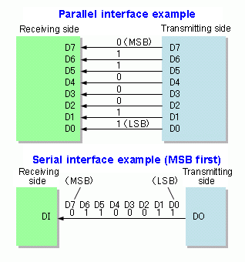

Slide 9
In serial mode, when sending bits, which bit should be sent across the medium first?
Consider an integer: Should a sender transmit
the Most Significant Bit (MSB)
or the Least Significant Bit (LSB) first?
We use the term little-endian to describe a system that sends the LSB first
We use the term big-endian to describe a system that sends the MSB first
Either form can be used, but the sender and receiver must agree

Slide 10
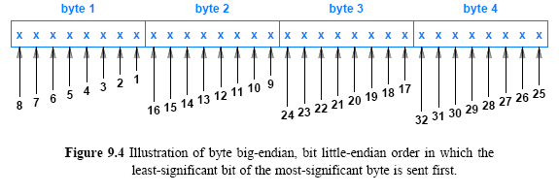

Slide 11
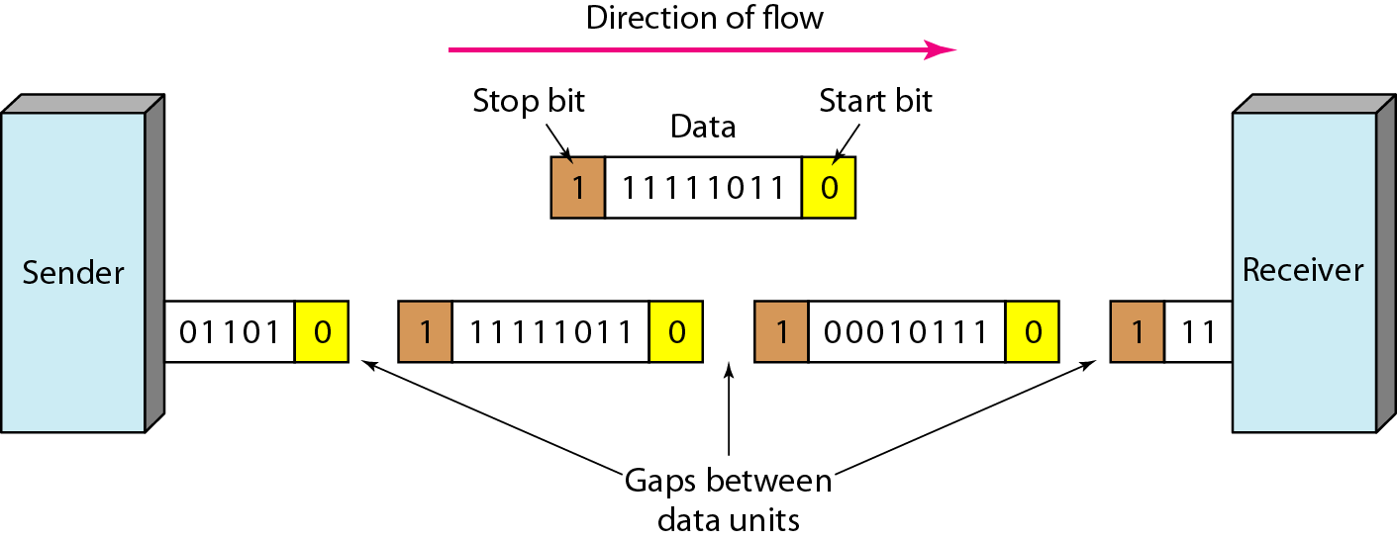
Asynchronous Transmission
In asynchronous transmission, we need 1 start bit (0) at the beginning and 1 or more stop bits (1) at the end of each byte. There may be a gap between each type

Slide 12
Asynchronous Transmission
Pada transmisi asinkron, sebelum terjadi komunikasi, tidak diadakan sinkronisasi clock antara pengirim dan penerima
Data dikirimkan per karakter dan masing-masing karakter memiliki bit start (biasanya 0) dan bit stop (biasanya 1)
Ada overhead 2-3 bit per karakter → transmisi menjadi lambat
Bit start dan bit stop harus berbeda polarisasinya agar penerima mengetahui kalau karakter berikutnya sedang dikirim
Metoda ini digunakan pada pengiriman data yang intermittent (misalnya dari keyboard)

Slide 13
Asynchronous Transmission
Star bit berfungsi untuk menandakan adanya rangkaian bit karakter yang siap dicuplik
Stop bit berfungsi untuk melakukan proses menunggu karakter berikutnya
Setiap karakter terdiri dari 10 bit dengan rincian:
0 | 1 | 2 | 3 | 4 | 5 | 6 | 7 | 1 | 1
Bit start
Bit data
Bit paritas
Bit stop

Slide 14
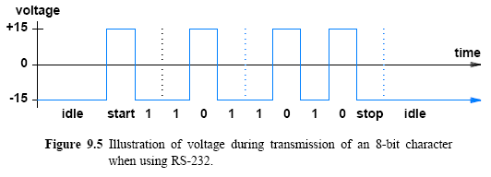
Asynchronous Transmission
RS-232 Asynchronous Character Transmission

Slide 15
Synchronous Transmission
In Synchronous transmission, the bit stream is combined into longer “frames”, which contain multiple bytes.

Slide 16
Synchronous Transmission
Pada pengiriman sinkron sebelum terjadi komunikasi, diadakan sinkronisasi clock antara pengirim dan penerima
Data dikirim dalam satu blok (yang disebut frame) yang berisi bit-bit pembuka (preamble bit), bit data itu sendiri dan bit-bit penutup (postamble bit). Ditambahkan bit-bit kontrol pada blok tersebut
Variasi ukuran frame mulai 1500 byte sampai 4096 byte
Dalam komunikasi sinkron, sebuah line 56kbps mampu membawa data hingga 7000byte per detik.
Contoh interface yang menggunakan transmisi sinkron: ethernet
Kecepatan transmisi lebih tinggi namun ada kemungkinan terjadi eror apabila clock tidak sinkron → perlu clock re-synchronization

Slide 17
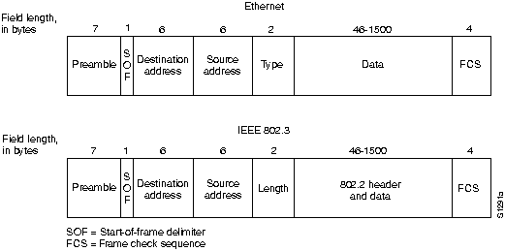
Synchronous Transmission
Blok data yang disebut suatu frame, digambarkan sbb:

Slide 18
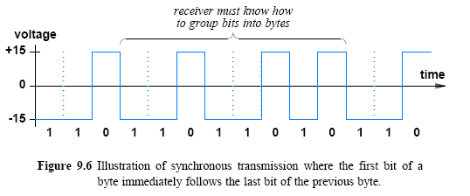
Synchronous Transmission
Ilustrasi dari transmisi sinkron

Slide 19
Isochronous Transmission
Isochronous transmission occurs at regular intervals
→ with a fixed gap between the transmission of two data items
in real time audio and video, in which uneven delays between frames are not acceptable, synchronous transmission fails. for example, TV images are broadcast at the rate of 30 images per second; they must be viewed at the same rate. If each image is sent by using one or more frames, there should be no delays between frames. for this type of application, synchronization between characters is not enough; the entire stream od bits must be synchronized. the isochronous transmission guarantees that the data arrive at a fixed rate

Slide 20
Isochronous Transmission
Isochronous transmission
is designed to provide steady bit flow for multimedia applications
Delivering such data at a steady rate is essential
because variations in delay known as jitter can disrupt reception (cause pops or clicks in audio/make video freeze for a short time)
Isochronous network is designed to accept and send data at a fixed rate, R
Network interface is such that data must be handed to the network for transmission at exactly R bits per second
For example, an isochronous mechanism designed to transfer voice operates at a rate of 64,000 bits per second
A sender must generate digitized audio continuously
A receiver must be able to accept and play the stream

