Slide 1
Persamaan differensial & Laplace
Dr. Ir. Yeffry Handoko Putra, M.T

Slide 2
Transfer Function, Poles and zeros
For zero initial condition, the differential equation:
Can be transformed into Transfer Function
Zero:B(s) = 0

Slide 3
Transfer Function, Poles and zeros
For zero initial condition, the differential equation:
Can be transformed into Transfer Function
Pole: A(s) = 0

Slide 4
Exercise
Find pole and zeros from this transfer function:

Slide 5
Exercise
Find pole and zeros from this transfer function:
zero : s²+2s+2=0

Slide 6
Exercise
Find pole and zeros from this transfer function:
Pole : s²+4s+13=0

Slide 7
Exercise
S-plane:
Pole-Zero Map
3
2
1
Imaginary Axis
0
-1
-2
-3
-2
-1.8
-1.6
-1.4
-1.2
-1
-0.8
-0.6
-0.4
-0.2
0
Real Axis
Notes:
H=tf([1 2 2],[1 4 13])
Pzmap(H)

Slide 8
Exercise
S-plane:
Notes:
clear
clf
colordef(1,'black')
rx = -3:0.1:0;
ix = -4:0.1:4.0;
[rrx,iix] = meshgrid(rx,ix);
xx = rrx + j*iix;
den = [ 1 4 13 ];
z = zeros(size(xx));
nn = max(size(rx));
for jj = 1:nn
z(:,jj) = polyval(den,xx(:,jj));
end
h = surf(rx,ix,20*log10(1./abs(z)));hold
plot3([-1 -1 ],[ -2 -2 ],[-30 10 ])
plot3([-1 -1 ],[ 2 2 ], [ -30 10 ])
xlabel('real')
ylabel('imag')
zlabel('magnitude (dB)')
view([50,40]);
fprintf(1,'Figure 3.2: press return to rotate\n')
pause
rotvec = 50:5:90;
ss = max(size(rotvec));
step = 30/(ss-1);
hvec = 40:-step:10;
for ii = 1:length(rotvec)
set(gca,'View',[rotvec(ii) hvec(ii)] )
drawnow
pause(2);
end

Slide 9
Frequency Response of single pole system
Frequency response H(ω) is found by substituted jω for s
Frequency response for is

Slide 10
Frequency Response from pole/zero diagram
If transfer function H(s) has m zero and n pole, it can be written as:
The Frequency response:

Slide 11
Frequency Response from pole/zero diagram
Magnitude of H(ω): Phase of H(ω):

Slide 12
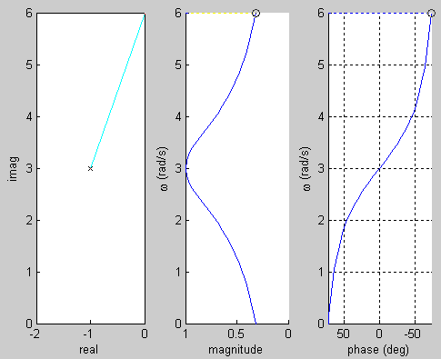
Frequency Response of single pole
Notes:
% Figure 3.3
%
% BM Mar 98
clf
colordef(1,'black')
clear
% frequency response
p1 = -1 + 3j;
num = 1;
den = [ 1 -p1 ];
wmax = 2*imag(p1);
w = 0:wmax/40:wmax;
iimax = max(size(w));
h = freqs(num,den,w);
gmax =max(abs(h));
hh = abs(h);
ang = unwrap(angle(h))/pi*180;
angmax = max(ang);
angmin = min(ang);
subplot(1,3,2)
set(gca,'XDir','reverse')
xlabel('magnitude')
ylabel('\omega (rad/s)')
axis([ 0 gmax 0 wmax]);
hold on
xx = hh(1);
yy = w(1);
l1 = line('Xdata',xx,'Ydata',yy,'Color','w','Marker','o','EraseMode','xor');
l2 = line('Xdata',[xx xx],'Ydata',[yy yy],'Color','y','LineStyle','-','EraseMode','none');
l5 = line('Xdata',[gmax xx],'Ydata',[0 0 ],'Color','b','LineStyle',':','EraseMode','xor');
subplot(1,3,3)
set(gca,'XDir','reverse')
xlabel('phase (deg)')
ylabel('\omega (rad/s)')
axis([ angmin angmax 0 wmax]);
grid
hold on
xx = ang(1);
yy = w(1);
l6 = line('Xdata',xx,'Ydata',yy,'Color','w','Marker','o','EraseMode','xor');
l7 = line('Xdata',[xx xx],'Ydata',[yy yy],'Color','y','LineStyle','-','EraseMode','none');
l8 = line('Xdata',[angmax xx],'Ydata',[0 0 ],'Color','b','LineStyle',':','EraseMode','xor');
subplot(1,3,1)
xlabel('real')
ylabel('imag')
axis([ 2*real(p1) 0 0 wmax ])
hold on
plot([0 0],[0 wmax],'w')
plot([ 2*real(p1) 0], [ wmax wmax],'w')
l3 = line('Xdata',real(p1),'Ydata',imag(p1),'Color','w','Marker','x','EraseMode','none');
l4 = line('Xdata',[real(p1) 0],'Ydata',[imag(p1) 0],'Color','r','LineStyle','-','EraseMode','xor');
fprintf(1,'Figure 3.3: Single pole system - press return\n')
pause
for ii =1:iimax
set(l1,'Xdata',hh(ii),'Ydata',w(ii))
set(l6,'Xdata',ang(ii),'Ydata',w(ii))
if ii > 1
set(l2,'Xdata',[hh(ii-1) hh(ii) ],'Ydata',[w(ii-1) w(ii)])
set(l7,'Xdata',[ang(ii-1) ang(ii) ],'Ydata',[w(ii-1) w(ii)])
end
set(l4,'Xdata',[real(p1) 0],'Ydata',[imag(p1) w(ii)])
set(l5,'Xdata',[gmax hh(ii)],'Ydata', [ w(ii) w(ii) ])
set(l8,'Xdata',[angmax ang(ii)],'Ydata', [ w(ii) w(ii) ])
pause(1)
end

Slide 13
Bode Plot
Write denumerator in the context of bode plot
Magnitude in logarithmic in decibels (dB):20log|H(ω)|

Slide 14
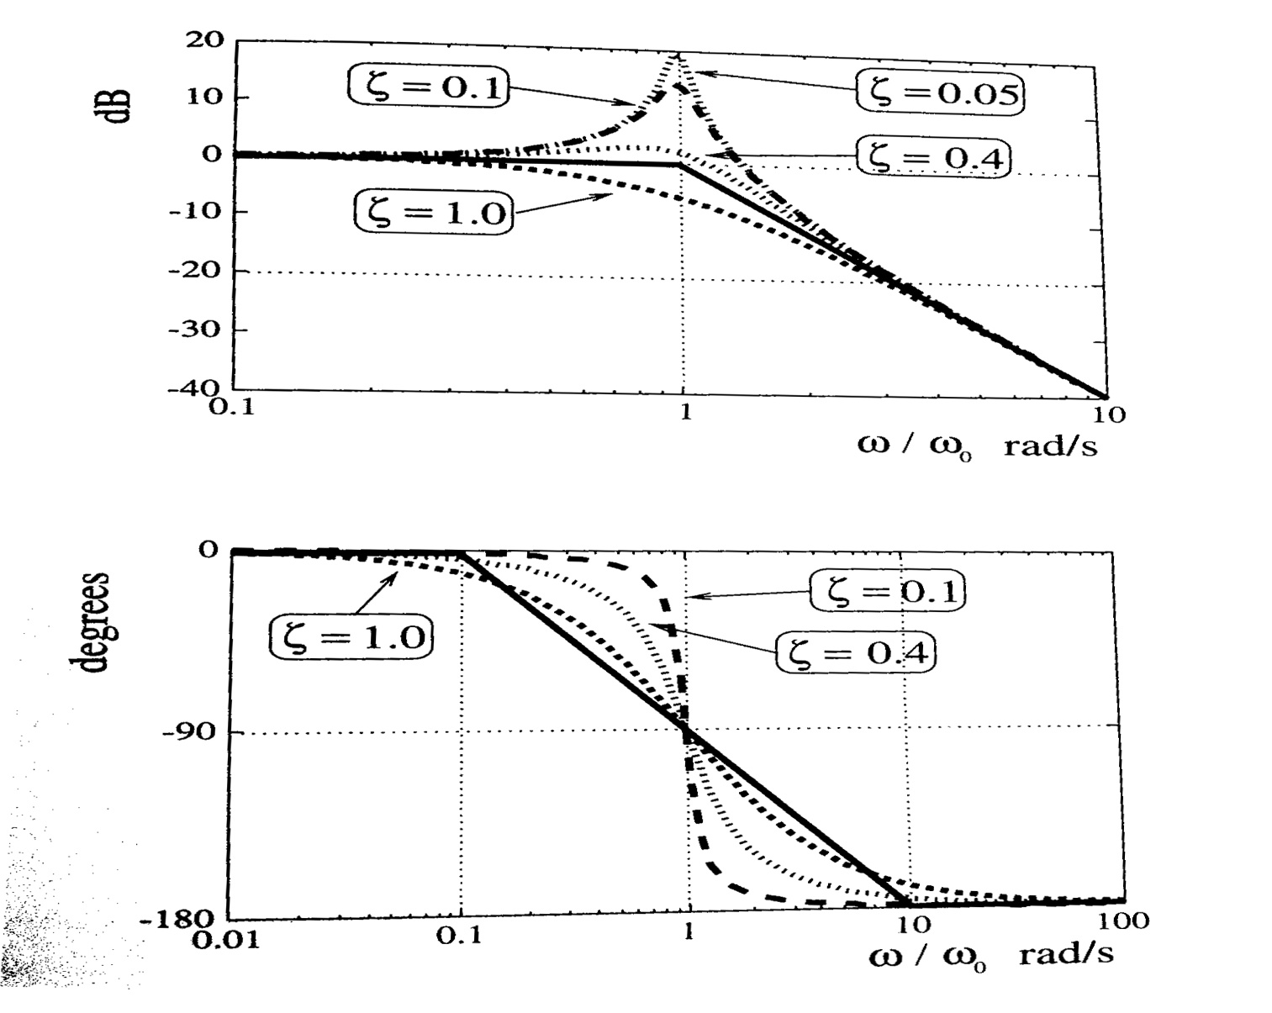
Bode Plot

Slide 15
Example Bode Plot
Sketch bode plot for following transfer function

Slide 16
Example Bode Plot
Sketch bode plot for following transfer function The frequency Response

Slide 17
Example Bode Plot
Sketch bode plot for following transfer function
Bode Diagram
0
-5
Magnitude (dB)
-10
-15
-20
60
Phase (deg)
30
0
0
1
2
3
4
10
10
10
10
10
Frequency (rad/sec)

