Slide 1
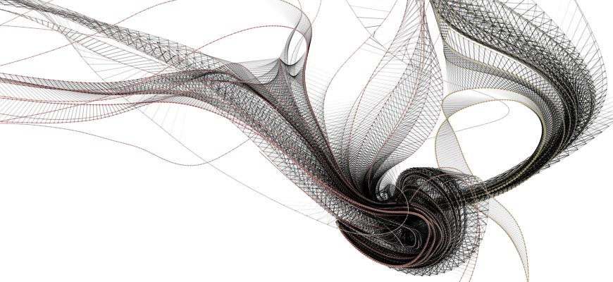
Project
Scheduling
Pert
PROJECT MANAGEMENT
Magister Information System
Universitas Komputer Indonesia
Source:
Larson, e.w., Gray C.F., 2011, 5tH ed.;
Pinto, j.k. 2010, 2ND. ED.

Slide 2
PROJECT NETWORK PLANNING
Program/Project Evaluation and Review Technique (PERT)
Critical Path Method (CPM) – Project Crashing
Precedence Diagram Method (PDM)

Slide 3
PERT (PROGRAM EVALUATION & REVIEW TECNIQUE)
In 1958 the Special Office of the Navy and the Booze Allen, and Hamilton consulting firm developed PERT to schedule the more than 3,300 contractors of the Polaris submarine project and to cover uncertainty of activity time estimates.
PERT is almost identical to the critical path method (CPM) except it assumes each activity duration has a range that follows a statistical distribution.

Slide 4
Activity and Project Frequency Distributions
Activity
Project
a
m
b
TE

Slide 5
Weighted Average Activity (te)
a + 4m + b
te = -------------
6
te = weighted average activity time
a = optimistic activity time (1 chance in 100 compliting activity under normal conditions)
b = pesimistic activity time
m = most likely activity time

Slide 6
Activity Standard Deviation
b - a
σte = -----
6
σTE = √ ∑ (σte )²

Slide 7
Probability of Completing the Project in Time
Ts – TE
Z = --------------
√ ∑ (σte )²
TE = Critical path duration
TS = Schedule project duration
Z = probability (of meeting scheduled duration) found in statistical

Slide 8
Z Values and Probabilities
Z Value | Probability | Z Value | Probability
-3.0 | .001 | +0.0 | .500
-2.8 | .003 | +0.2 | .579
-2.6 | .005 | +0.4 | .655
-2.4 | .008 | +0.6 | .726
-2.2 | .014 | +0.8 | .788
-2.0 | .023 | +1.0 | .841
-1.8 | .036 | +1.2 | .885
-1.6 | .055 | +1.4 | .919
-1.4 | .081 | +1.6 | .945
-1.2 | .115 | +1.8 | .964
-1.0 | .159 | +2.0 | .977
-0.8 | .212 | +2.2 | .986
-0.6 | .274 | +2.4 | .992
-0.4 | .345 | +2.6 | .995
-0.2 | .421 | +2.8 | .997

Slide 9
Example
Activity | a | m | b
1-2 | 17 | 29 | 47
2-3 | 6 | 12 | 24
2-4 | 16 | 19 | 28
3-5 | 13 | 16 | 19
4-5 | 2 | 5 | 14
5-6 | 2 | 5 | 8
1. Compute the expected time for each activity
2. Compute the variance for each activity
3. Compute the expected project duration
4. What is the probability of completing the project by day 67?
Within 60 days?

Slide 10
ANSWER

Slide 11
Answer – Hypothetical Network
 | B
 | 13
 | D
 | 16
0 | A
 | 30
 | F
 | 5
 | C
 | 20
 | E
 | 6
Legend
ES | ID | EF
SL | Description
LS | Dur | LF

Slide 12
Answer - Probability
Ts – TE
Z = --------------
√ ∑ (σte )²
67 – 64 + 3
Z = ----------------- = -------- = + 0.5
√ 25 + 9 + 1 + 1 √ 36
P = 0.69

Slide 13
Exercise 1
Given the project information below, what is the probability of completing the National Holiday Toy project in 79 time units?
Act. ID | Description | Predecessor | Optm.(a) | Most Likely (m) | Pess (b)
1 | Design package | None | 6 | 12 | 24
2 | Design product | 1 | 16 | 19 | 28
3 | Build package | 1 | 4 | 7 | 10
4 | Secure patent | 2 | 21 | 30 | 39
5 | Build product | 2 | 17 | 29 | 47
6 | Paint | 3,4,5 | 4 | 7 | 10
7 | Test market | 6 | 13 | 16 | 19

Slide 14
Exercise -2
Using the following information, create an AON network activity diagram. Calculate each activity TE, total duration & Critical Path
Activity | Preceeding Activities | Best | Likely | Worst
A | - | 12 | 15 | 25
B | A | 4 | 6 | 11
C | - | 12 | 12 | 30
D | B,C | 8 | 15 | 20
E | A | 7 | 12 | 15
F | E | 9 | 9 | 42
G | D,E | 13 | 17 | 19
H | F | 5 | 10 | 15
I | G | 11 | 13 | 20
J | G,H | 2 | 3 | 6
K | J,I | 8 | 12 | 22

Slide 15
Exercise -3
The Global Tea and Organic Juice companies have merged. The following information has been collected for the “Consolidation Project”.
Act | Description | Predecessor | a opt | m ml | b pess
1 | Codify accounts | None | 16 | 19 | 28
2 | File articles of unification | None | 30 | 30 | 30
3 | Unify price and credit policy | None | 60 | 72 | 90
4 | Unify personnel policies | None | 18 | 27 | 30
5 | Unify data processing | 1 | 17 | 29 | 47
6 | Train accounting staf | 1 | 4 | 7 | 10
7 | Pilot run data processing | 5 | 12 | 15 | 18
8 | Calculate P&L and balance sheet | 6,7 | 6 | 12 | 24
9 | Transfer real property | 2 | 18 | 27 | 30
10 | Train salesforce | 3 | 20 | 35 | 50
11 | Negotiate with unions | 4 | 40 | 55 | 100
12 | Determine capital needs | 8 | 11 | 20 | 29
13 | Explain personnel policies | 11 | 14 | 23 | 26
14 | Secure line of credit | 9,12 | 13 | 16 | 19
15 | End | 10,12,14 | 0 | 0 | 0

Slide 16
Exercise 3 - Question
1. Compute the expected time for each activity.
2. Compute the variance for each activity
3. Compute the expected project duration.
4. What is the probability of completing the project by day 112? Within 116 days?
5. What is the probability of completing “Negotiate with Unions” by day 90?

Slide 17
Solve exercise 1 Using WIN QS
File – New Problem

Slide 18
Input the data

Slide 19
Solve and Analyse – Solve Critical Path

Slide 20
Result – Gant Chart

Slide 21
Results – Perform Probability Analysis

Slide 22
Result – Perform Simulation . Use system clock – edit Number of simulated observation –

Slide 23
Show Analysis

Slide 24
TERIMA KASIH

