Slide 1
Project evaluation & control
Project Management
Magister Sistem Informasi
Universitas Komputer Indonesia
references:
Larson, e.w., Gray C.F., 2011, 5tH ed.;
Pinto, j.k. 2010, 2ND. ED.

Slide 2
Project Control
One of the most significant challenges with running a project has to do with maintaining an accurate monitoring and control system for implementation.
Because project are often defined by their costraints (i.e. Budget & schedule limitations), it is vital that we ensure they are controlled as carefully as possible.

Slide 3
Project Control Cycles

Slide 4
Monitoring Project Performance
The Project S-Curve
Milestone Analysis
Tracking Gantchart
Earned Value Management

Slide 5
The Project S-Curve
The project’s status is evaluated as a function of accumulated costs and labor hours or quantities plotted against time for both budgeted and actual ammount.

Slide 6
The Project S-Curve Example
Budgeted Cost for Project Sierra
Duration (in weeks)
 | 5 | 10 | 15 | 20 | 25 | 30 | 35 | 40 | 45 | Total
Design | 6 | 2
Engineer |  | 4 | 8 | 8 | 8
Install |  |  |  | 4 | 20 | 6
Test |  |  |  |  |  | 2 | 6 | 4 | 2
Total | 6 | 6 | 8 | 12 | 28 | 8 | 6 | 4 | 2
Cumulative | 6 | 12 | 20 | 32 | 60 | 68 | 74 | 78 | 80 | 80

Slide 7
Project S-Curve
Elapsed Time (in weeks) | 5 | 10 | 15 | 20 | 25 | 30 | 35 | 40 | 45
Cummulative (in thousands) | 6 | 12 | 20 | 32 | 60 | 68 | 74 | 78 | 80
Cummulative Actual Cost | 5 | 10 | 17 | 25 | 50 | 55 | 60 | 65 | 70

Slide 8
Milestone Analysis
A milestone is an event or stage of the project that represents a significant accomplishment on the road to the projects’s completion. Completion of a deliverable (a combination of multiple project tasks), an important activity on the project’s critical path, or even calendar date can all be milestones.
Milestone are road markers that we observe on our travels along the project’s life cycle.

Slide 9
Benefit Project Control Using Milestone
Milestone signals the completion of important project steps.
Milestone can motivate the project team.
Milestone offer at which to reevaluate client needs and any potential change request.
Milestone help coordinate schedules with vendor and suppliers.
Milestone identify key project review gates.
Milestone signal other team members when their participation is expected to begin.
Milestone can delineate the various deliverables developed in the work breakdown structure and therefore anable the project team to develop a better overall view of the project.

Slide 10
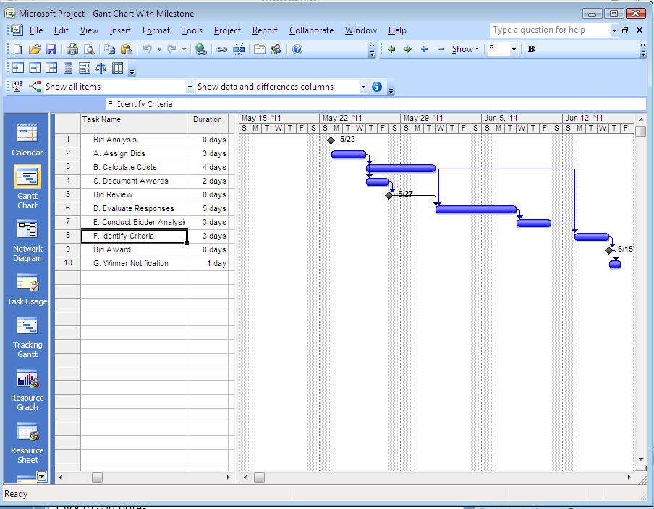
Gant Chart With Milestone - Example

Slide 11
The Tracking Gant Chart
The tracking Gant chart allows the project team to constantly update the project’s status by linking task completion to the schedule baseline.
Tracking Gant chart identifies the stage of completion each task has attained by specific date within the project.

Slide 12
The Tracking Gant Chart - Example

Slide 13
The Tracking Gant Chart - Example

Slide 14
Earned Value Management
EVM recognizes that it is necessary to jointly consider the impact of time, cost, and project performance on any analysis of current project status.
Earned value, directly links all three primary project success metric (cost, schedule and performance).

Slide 15
Performance Project Monitoring Approach
Cost
S-Curve Analysis
Tracking Control Chart
Earned Value
Project S-Curves
Performance
Schedule
Cost
Performance
Schedule
Tracking Control Chart
Cost
Earned Value
Performance
Schedule

Slide 16
Terminology for Earned Value
PV Planned Value. A cost estimate of the budgeted resources scheduled across the project’s life cycle (cumulative baseline).
EV Earned Value. This is the real budgeted cost , or “value”, of the work that has actually been performed to date.
AC Actual cost of work performed. The cumulative total costs incurred in accomplishing the various project work packages.
SPI Schedule Performance Index. The earned value to date divided by the planned value of work scheduled to be performed (EV/PV). This value allows us to calculated the projected schedule of the project to completion.
CPI Cost Performance Index. The earned value divided by the actual, cumulative cost of the work performed to date (EV/AC). This value allow us to calculate the project budgeted cost at completion. This represents the total budget for a project.

Slide 17
Earned Value - Example
Budgeted Cost for Project Sierra
Duration (in weeks)
 | 5 | 10 | 15 | 20 | 25 | 30 | 35 | 40 | 45 | % Complete
Design | 6 | 2 |  |  |  |  |  |  |  | 100
Engineer |  | 4 | 8 | 8 | 8 |  |  |  |  | 100
Install |  |  |  | 4 | 20 | 6 |  |  |  | 50
Test |  |  |  |  |  | 2 | 6 | 4 | 2 | 0
Total | 6 | 6 | 8 | 12 | 28 | 8 | 6 | 4 | 2
Cumulative | 6 | 12 | 20 | 32 | 60 | 68 | 74 | 78 | 80 | 80
 | Planned | % Complete | Earned Value
Design | 8 | 100 | 8
Engineer | 28 | 100 | 28
Install | 30 | 50 | 15
Test | 14 | 0 | 0
Cumul. Earned Value |  |  | 51

Slide 18
Project Baseline, using Earned Value
Cummulative Cost ($ in thousand)
Elapsed Time (in weeks)

Slide 19
Assesing a Project’s Earned Value - Example
Activity | Jan. | Feb | Mar. | Apr. | May | June | July | Plan | % C | Value
Staffing | 8 | 7 |  |  |  |  |  | 15 | 100 | 15
Blue Printing |  |  | 4 | 6 |  |  |  | 10 | 80 | 8
Prototype Dev |  |  | 2 | 8 |  |  |  | 10 | 60 | 6
Full Design |  |  |  | 3 | 8 | 10 |  | 21 | 33 | 7
Construction |  |  |  |  | 2 | 30 |  | 32 | 25 | 8
Transfer |  |  |  |  |  |  | 10 | 10 | 0 | 0
Punch List |  |  |  |  |  | 15 | 5 | 20 | 0 | 0
 |  |  |  |  |  |  | ∑ | 118 |  | 44
Monthly Plan | 8 | 7 | 6 | 17 | 10 | 55 | 15
Cumulative | 8 | 15 | 21 | 38 | 48 | 103 | 118
Monthly Actual | 8 | 11 | 8 | 11 | 10 | 30 | 0
Cumulative Act | 8 | 19 | 27 | 38 | 48 | 78

Slide 20
Assesing a Project’s Earned Value - Example
Schedule Variances for EVM
Scheduled Variances
Planned Value (PV) | 103
Earned Value (EV) | 44
Schedule Performance Index | EV/PV = 44/103 = 0.43
Estimated Time to Completion | (1/0.43 x 7) = 16.3 months
Cost Variances for EVM
Cost Variances
Cummulative Actual Cost (AC) | 78
Earned Value (EV) | 44
Cost Performance Index | EV/AC = 44/78 = 0.56
Estimated Cum Cost to Completion | (1/0.56 x 118,000) = $ 210,784

Slide 21
Exercise - 1
Assume the following Budgeted Costs for Sample Project information:
 | Duration (in weeks)
 | 5 | 10 | 15 | 20 | 25 | 30 | 35 | 40 | 45 | Total
Design | 4 | 4 | 2
Engineer |  | 3 | 6 | 12 | 8
Install |  |  | 4 | 12 | 24 | 6
Test |  |  |  |  | 2 | 6 | 6 | 4 | 2
Total
Monthly
Cumulative
a. Calculate the monthly budget & the monthly cumulative budget for
the project.
b. Draw a project S-curve identifying the relationship between the
project’s budget baseline and its schedule.

Slide 22
MS Project Exercise
Using the following data, enter the various tasks and create a Gant chart using MS Project. Assign the individual responsible for each activity and once you have completed the net work, update it with the percentage complete tool. What does the Ms Project output file look like?
Activity | Duration | Predecessor | Resource | % complete
A. Research product | 6 | - | Shanty | 100
B. Interview customer | 4 | A | Sofian | 75
C. Design survey | 5 | A | Adit | 50
D. Collect data | 4 | B,C | Sukri | 0

Slide 23
MS Project Exercise
Now, suppose we assign costs to each of the resources in the following ammounts:
Resources Cost
Shanty Rp. 300.000/day
Sofian Rp. 350.000/day
Adit Rp. 150.000/day
Sukri Rp. 100.000/day
Create the resource usage statement for the project as of the most recent update. What are project expenses per task to date?

Slide 24
TERIMA KASIH

