Slide 1
Mobile Communications
Market
GSM
Overview
Services
Sub-systems
Components
DECT
TETRA
UMTS/IMT-2000
Notes:
Digital Enhanced Cordless Telecommunications ( Digital European Cordless Telecommunications), usually known by the acronym DECT, is a digital communication standard
UMTS = Universal Mobile Telecommunication System: 3rd generation mobile cellular system for networks based on the GSM standard. Developed and maintained by the 3GPP (3rd Generation Partnership Project)
IMT-2000 standard set and compares with the cdma2000 standar set for network based on the competing cdmaone technology, UMTS uses wideband code division multiple access (W-CDMA) radio technology to offer greater spectral efficiency and bandwidth to mobile network operator. The technology described in UMTS is sometimes also referred to as Freedom of Mobile Multimedia Access (FOMA) or 3GSM. Unlike EDGE (IMT-Single Carrier, based on GSM) and CDMA2000(IMT Multi carrier) , UMTS requires new base station and new frequency allocationUMTS support theoritical data transfer rate of 42 Mbit/s when HSPA+ is implemented in the network. User in deployednetwork can expect a transfer rate of up to 384 kbit/s for Release ‚99 ) handset (the original UMTS release) and 7,2 Mbit/s for HSDPA handset in the downlink connection
TETRA

Slide 2
Mobile phone subscribers worldwide
1200
1000
800
GSM total
TDMA total
CDMA total
600
PDC total
Subscribers [million]
Analogue total
400
Total wireless
Prediction (2004)
200
0
1996
1997
1998
1999
2000
2001
2002
year

Slide 3
Development of mobile telecommunication systems
CT0/1
FDMA
AMPS
NMT
CT2
IMT-FT
DECT
IS-136
TDMA
D-AMPS
EDGE
IMT-SC
IS-136HS
UWC-136
TDMA
GSM
GPRS
PDC
IMT-DS
UTRA FDD / W-CDMA
IMT-TC
UTRA TDD / TD-CDMA
CDMA
IMT-TC
TD-SCDMA
IS-95
cdmaOne
cdma2000 1X
IMT-MC
cdma2000 1X EV-DO
1X EV-DV
(3X)
1G
2G
2.5G
3G

Slide 4
GSM: Overview
GSM
formerly: Groupe Spéciale Mobile (founded 1982)
now: Global System for Mobile Communication
Pan-European standard (ETSI, European Telecommunications Standardisation Institute)
simultaneous introduction of essential services in three phases (1991, 1994, 1996) by the European telecommunication administrations (Germany: D1 and D2) ➔ seamless roaming within Europe possible
today many providers all over the world use GSM (more than 184 countries in Asia, Africa, Europe, Australia, America)
more than 747 million subscribers
more than 70% of all digital mobile phones use GSM
over 10 billion SMS per month in Germany, > 360 billion/year worldwide

Slide 5
Performance characteristics of GSM (wrt. analog sys.)
Communication
mobile, wireless communication; support for voice and data services
Total mobility
international access, chip-card enables use of access points of different providers
Worldwide connectivity
one number, the network handles localization
High capacity
better frequency efficiency, smaller cells, more customers per cell
High transmission quality
high audio quality and reliability for wireless, uninterrupted phone calls at higher speeds (e.g., from cars, trains)
Security functions
access control, authentication via chip-card and PIN

Slide 6
Disadvantages of GSM
There is no perfect system!!
no end-to-end encryption of user data
reduced concentration while driving
electromagnetic radiation
abuse of private data possible
roaming profiles accessible
high complexity of the system
several incompatibilities within the GSM standards

Slide 7
GSM: Mobile Services
GSM offers
several types of connections
voice connections, data connections, short message service
multi-service options (combination of basic services)
Three service domains
Bearer Services
Telematic Services
Supplementary Services

Slide 8
Bearer Services
Telecommunication services to transfer data between access points
Specification of services up to the terminal interface (OSI layers 1-3)
Different data rates for voice and data (original standard)
data service (circuit switched)
synchronous: 2.4, 4.8 or 9.6 kbit/s
asynchronous: 300 - 1200 bit/s
data service (packet switched)
synchronous: 2.4, 4.8 or 9.6 kbit/s
asynchronous: 300 - 9600 bit/s
Today: data rates of approx. 50 kbit/s possible – will be covered later!

Slide 9
Tele Services I
Telecommunication services that enable voice communication via mobile phones
All these basic services have to obey cellular functions, security measurements etc.
Offered services
mobile telephony primary goal of GSM was to enable mobile telephony offering the traditional bandwidth of 3.1 kHz
Emergency number common number throughout Europe (112); mandatory for all service providers; free of charge; connection with the highest priority (preemption of other connections possible)
Multinumbering several ISDN phone numbers per user possible

Slide 10
Tele Services II
Additional services
Non-Voice-Teleservices
group 3 fax
voice mailbox (implemented in the fixed network supporting the mobile terminals)
electronic mail (MHS, Message Handling System, implemented in the fixed network)
...
Short Message Service (SMS) alphanumeric data transmission to/from the mobile terminal using the signaling channel, thus allowing simultaneous use of basic services and SMS

Slide 11
Supplementary services
Services in addition to the basic services, cannot be offered stand-alone
May differ between different service providers, countries and protocol versions
Important services
identification: forwarding of caller number
suppression of number forwarding
automatic call-back
conferencing with up to 7 participants
locking of the mobile terminal (incoming or outgoing calls)
...

Slide 12
Architecture of the GSM system
GSM is a PLMN (Public Land Mobile Network)
several providers setup mobile networks following the GSM standard within each country
components
MS (mobile station)
BS (base station)
MSC (mobile switching center)
LR (location register)
subsystems
RSS (radio subsystem): covers all radio aspects
NSS (network and switching subsystem): call forwarding, handover, switching
OSS (operation subsystem): management of the network

Slide 13
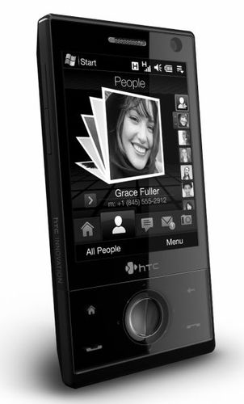
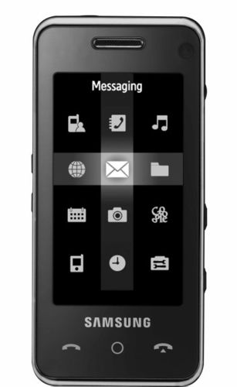
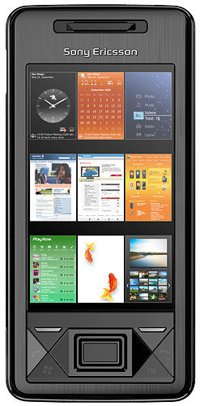
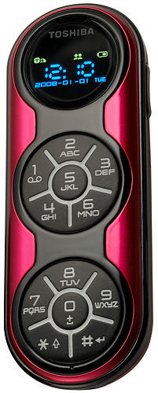
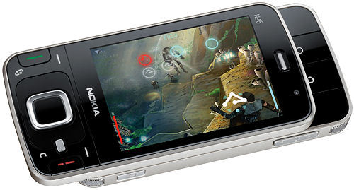
Ingredients 1: Mobile Phones, PDAs, etc
The visible but smallest
part of the network!

Slide 14
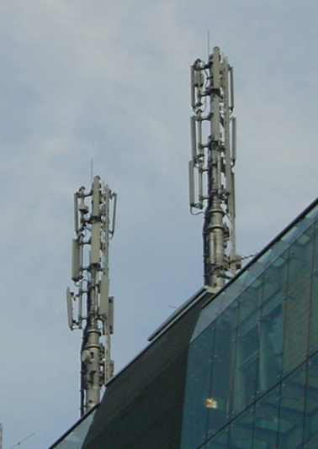
Ingredients 2: Antennas
Still visible – cause many discussions…

Slide 15
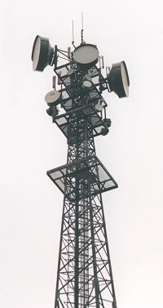
Ingredients 3: Infrastructure 1
Base Stations
Cabling
Microwave links

Slide 16
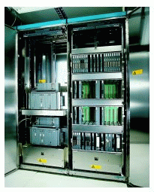
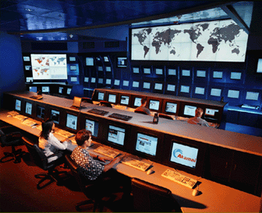
Ingredients 3: Infrastructure 2
Not „visible“, but comprise the major part of the network (also from an investment point of view…)
Management
Data bases
Switching units
Monitoring

Slide 17
GSM: overview
OMC, EIR, AUC
HLR
fixed network
GMSC
NSS
with OSS
VLR
MSC
VLR
MSC
BSC
BSC
RSS

Slide 18
GSM: elements and interfaces
radio cell
MS
MS
BSS
U_{m}
radio cell
RSS
BTS
MS
BTS
A_{bis}
BSC
BSC
A
MSC
MSC
NSS
VLR
VLR
signaling
HLR
GMSC
ISDN, PSTN
IWF
PDN
O
OSS
EIR
AUC
OMC

Slide 19
GSM: system architecture
radio subsystem
network and switching subsystem
fixed partner networks
MS
MS
ISDN PSTN
U_{m}
MSC
BTS
A_{bis}
BSC
EIR
BTS
SS7
HLR
BTS
VLR
BSC
ISDN PSTN
BTS
A
MSC
BSS
IWF
PSPDN CSPDN

Slide 20
System architecture: radio subsystem
radio subsystem
network and switching subsystem
MS
MS
Components
MS (Mobile Station)
BSS (Base Station Subsystem): consisting of
BTS (Base Transceiver Station): sender and receiver
BSC (Base Station Controller): controlling several transceivers
Interfaces
U_{m} : radio interface
A_{bis} : standardized, open interface with 16 kbit/s user channels
A: standardized, open interface with 64 kbit/s user channels
U_{m}
BTS
A_{bis}
BSC
MSC
BTS
A
BTS
MSC
BSC
BTS
BSS

Slide 21
System architecture: network and switching subsystem
network subsystem
fixed partner networks
Components
MSC (Mobile Services Switching Center):
IWF (Interworking Functions)
ISDN (Integrated Services Digital Network)
PSTN (Public Switched Telephone Network)
PSPDN (Packet Switched Public Data Net.)
CSPDN (Circuit Switched Public Data Net.)
Databases
HLR (Home Location Register)
VLR (Visitor Location Register)
EIR (Equipment Identity Register)
ISDN PSTN
MSC
EIR
SS7
HLR
VLR
ISDN PSTN
MSC
IWF
PSPDN CSPDN

Slide 22
Radio subsystem
The Radio Subsystem (RSS) comprises the cellular mobile network up to the switching centers
Components
Base Station Subsystem (BSS):
Base Transceiver Station (BTS): radio components including sender, receiver, antenna - if directed antennas are used one BTS can cover several cells
Base Station Controller (BSC): switching between BTSs, controlling BTSs, managing of network resources, mapping of radio channels (U_{m}) onto terrestrial channels (A interface)
BSS = BSC + sum(BTS) + interconnection
Mobile Stations (MS)

Slide 23
GSM: cellular network
segmentation of the area into cells
possible radio coverage of the cell
idealized shape of the cell
cell
use of several carrier frequencies
not the same frequency in adjoining cells
cell sizes vary from some 100 m up to 35 km depending on user density, geography, transceiver power etc.
hexagonal shape of cells is idealized (cells overlap, shapes depend on geography)
if a mobile user changes cells ⬇ handover of the connection to the neighbor cell

Slide 24
GSM frequency bands (examples)
Type | Channels | Uplink [MHz] | Downlink [MHz]
GSM 850 | 128-251 | 824-849 | 869-894
GSM 900 classical extended | 0-124, 955-1023 124 channels +49 channels | 876-915 890-915 880-915 | 921-960 935-960 925-960
GSM 1800 | 512-885 | 1710-1785 | 1805-1880
GSM 1900 | 512-810 | 1850-1910 | 1930-1990
GSM-R exclusive | 955-1024, 0-124 69 channels | 876-915 876-880 | 921-960 921-925
Additionally: GSM 400 (also named GSM 450 or GSM 480 at 450-458/460-468 or 479-486/489-496 MHz)
Please note: frequency ranges may vary depending on the country!
Channels at the lower/upper edge of a frequency band are typically not used

Slide 25
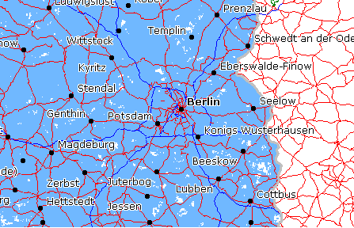
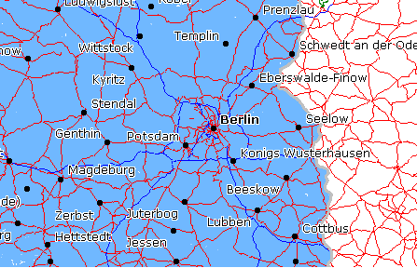
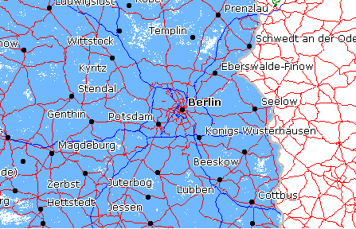
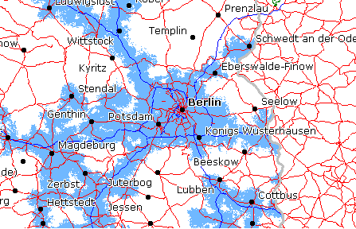
Example coverage of GSM networks (www.gsmworld.com)
T-Mobile (GSM-900/1800) Berlin
Vodafone (GSM-900/1800)
e-plus (GSM-1800)
O₂ (GSM-1800)

Slide 26
Base Transceiver Station and Base Station Controller
Tasks of a BSS are distributed over BSC and BTS
BTS comprises radio specific functions
BSC is the switching center for radio channels

Slide 27
Mobile station
Terminal for the use of GSM services
A mobile station (MS) comprises several functional groups
MT (Mobile Terminal):
offers common functions used by all services the MS offers
end-point of the radio interface (U_{m})
TA (Terminal Adapter):
terminal adaptation, hides radio specific characteristics
TE (Terminal Equipment):
peripheral device of the MS, offers services to a user
does not contain GSM specific functions
SIM (Subscriber Identity Module):
personalization of the mobile terminal, stores user parameters
TE
TA
MT
R
S
U_{m}

Slide 28
Power class of Mobile Station: GSM Rec. 2.06
GSM 900
Class | Max. Transmit Power [W] | Type of Device
1 | 20 | Mounted and Portable
2 | 8 | Portable and Mounted
3 | 5 | Hand-Portable
4 | 2 | Hand-Portable
5 | 0.8 | Hand-Portable

Slide 29
Network and switching subsystem
NSS is the main component of the public mobile network GSM
switching, mobility management, interconnection to other networks, system control
Components
Mobile Services Switching Center (MSC) controls all connections via a separated network to/from a mobile terminal within the domain of the MSC - several BSC can belong to a MSC
Databases
Home Location Register (HLR) central master database containing user data, permanent and semi-permanent data of all subscribers assigned to the HLR (one provider can have several HLRs)
Visitor Location Register (VLR) local database for a subset of user data, including data about all user currently in the domain of the VLR

Slide 30
Mobile Services Switching Center
The MSC (mobile switching center) plays a central role in GSM
switching functions
additional functions for mobility support
management of network resources
interworking functions via Gateway MSC (GMSC)
integration of several databases
Functions of a MSC
specific functions for paging and call forwarding
termination of SS7 (signaling system no. 7)
mobility specific signaling
location registration and forwarding of location information
provision of new services (fax, data calls)
support of short message service (SMS)
generation and forwarding of accounting and billing information

Slide 31
Operation subsystem
The OSS (Operation Subsystem) enables centralized operation, management, and maintenance of all GSM subsystems
Components
Authentication Center (AUC)
generates user specific authentication parameters on request of a VLR (authentication key)
authentication parameters used for authentication of mobile terminals and encryption of user data on the air interface within the GSM system
Equipment Identity Register (EIR)
registers GSM mobile stations and user rights
stolen or malfunctioning mobile stations can be locked and sometimes even localized
Operation and Maintenance Center (OMC)
different control capabilities for the radio subsystem and the network subsystem

Slide 32
GSM bands
There are 3 GSM bands:
GSM-900,
GSM-1800, and
GSM-1900,
with GSM-1900 used in the USA,
GSM-900 being the most widely used in the rest of the world, and
GSM-1800 being used for extra capacity in countries which also use GSM-900.
Most older handsets operate in the GSM-900 band, whereas many newer handsets are so-called dual band handsets, operating in GSM-900 as well as GSM-1800.

Slide 33
GSM FDMA/TDMA
There are two frequency bands allocated to GSM mobile phones, one at 900MHz, and one at 1800MHz.
GSM uses a combination of FDMA and TDMA.
Each band there are a hundred or so available carrier frequencies on 200kHz spacing (the FDMA bit), and each carrier is broken up into time-slots so as to support 8 separate conversations (the TDMA bit). Correspondingly, the handset transmission is pulsed with a duty cycle of 1:8; use http://www.techmind.org/gsm/ for further reading.
f
960 MHz
124
935.2 MHz
1
200 kHz
20 MHz
915 MHz
124
890.2 MHz
1
t

Slide 34
GSM - TDMA/FDMA
Physical Separation of the Medium into 8 x 124 duplex channels.
935-960 MHz
124 channels (200 kHz)
downlink
frequency
890-915 MHz
124 channels (200 kHz)
uplink
higher GSM frame structures
time
GSM TDMA frame
1
2
3
4
5
6
7
8
4.615 ms (i.e. 8x0.577)
GSM time-slot (normal burst)
guard
space
guard
space
tail
user data
S
Training
S
user data
tail
3 bits
57 bits
1
26 bits
1
57 bits
3
546.5 µs
577 µs

Slide 35
Logical Channels

Slide 36
Logical Channels (2)
Two main groups of logical channel
Traffic channels
Control channels.
Traffic Channels:
Logical Channels over which user data are exchanged.
Once call set-up procedures have been completed on the control channel, the MS switch to a traffic channel, TCH.
There are two types of TCH:
Full rate (TCH/F): transmits full speech (22.8 kbit/ s). A full rate TCH occupies one physical channel. Actually, 13 kbit/s, and the rest are used for error detection (TCH/FS)
Half rate (TCH/H): transmits half rate speech (11.4kbit/s).Two half rate TCHs can share one physical channel, thus doubling the capacity of a cell
Control Channels:
Are used for signaling and for system control.
When an MS is switched on, it searches for a BTS to connect to. When the MS finds the strongest carrier, it must then determine if it is a control channel. It does so by searching for a particular logical channel called Broadcast Control Channel (BCCH).

Slide 37
Logical Channels :Control Channels
Control Channels:
Are used for signaling and for system control.
Typical signaling tasks:
Signaling for establishing connection
Maintaining the connection
Releasing traffic Channels
Mobility Management
Access Control of the radio Channel
Examples of Control Channels
BCCH: Broadcast Control Channel BS -> MS
FCCH: Frequency Control Channel BS -> MS
CCCH: Common Control Channel BS -> MS
PCH: Paging Channel BS -> MS
RACH: Random Access Channel (it implement Slotted Aloha) MS ->BS
AGCH: Access Grant Channel BS -> MS
DCCH: Dedicated Control Channel
SDCCH: Stand-Alone Dedicated Control Channel MS <->BS
SACCH: Slow associated dedicated control channel
…..

Slide 38
Standard Interface
The GSM system can be described by considering several functional layers arranged in hierarchical form
The physical layer, data link layer, and “layer 3”. (OSI Model)
The application layer is composed of three sub-layers:
Radio Resources (RR),
Mobility Management (MM), and
Call Management (CM).
}
Application Layer
Data Link Layer
Physical Layer

Slide 39
Standard Interface (2)
RR: Handles all radio-specific functions. That includes the creation of bursts according to the five different format:
Multiplexing of bursts into TDMA frame
Synchronization with BTS
Detection of idle channel
Measurement of the channel quality on the downlink
Mobility Management (MM): Contains functions for registration, authentication, identification, and location updating
The network is alerted when the MS switched on/off or when it leaves it is location area.
Call Management (CM): Setup, maintenance, and termination of circuit-switched calls.
contains three entities call control CC, short message service SMS and supplementary service SS
The SS, provides call-based and non-call-based services such as diversion and billing
SMS, permits short messages to be sent on the SDCCH and SACCH control channels.
The GSM has three main standard interfaces: The Air Interface (MS to BTS) ,A_{bis} Interface (BTS to BSC), and A Interface (BSC to MSC).

Slide 40
GSM protocol layers for signaling
U_{m}
A_{bis}
A
MS
BTS
BSC
MSC
CM
CM
MM
MM
RR
RR’
BTSM
BSSAP
BSSAP
RR’
BTSM
SS7
SS7
LAPD_{m}
LAPD_{m}
LAPD
LAPD
radio
radio
PCM
PCM
PCM
PCM
16/64 kbit/s
64 kbit/s /
2.048 Mbit/s
LAPD_{m}: Link Access Procedure for the D-Channel in ISDN system ( A version of HDLC)
BTSM: BTS Management. BSSAP: BSS Application Part. PCM: Pulse Code Modulation

Slide 41
Mobile Terminated Call
1: calling a GSM subscriber
2: forwarding call to GMSC
3: signal call setup to HLR
4, 5: request MSRN from VLR
6: forward responsible MSC to GMSC
7: forward call to
current MSC
8, 9: get current status of MS
10, 11: paging of MS
12, 13: MS answers
14, 15: security checks
16, 17: set up connection
4
HLR
VLR
5
8
9
3
6
14
15
calling
station
7
PSTN
GMSC
MSC
1
2
10
10
13
10
16
BSS
BSS
BSS
11
11
11
11
12
17
MS

Slide 42
Mobile Originated Call
1, 2: connection request
3, 4: security check
5-8: check resources (free circuit)
9-10: set up call
VLR
3
4
6
5
PSTN
GMSC
MSC
7
8
2
9
1
MS
BSS
10

Slide 43
MTC/MOC
MS
MTC
BTS
MS
MOC
BTS
paging request
channel request
channel request
immediate assignment
immediate assignment
paging response
service request
authentication request
authentication request
authentication response
authentication response
ciphering command
ciphering command
ciphering complete
ciphering complete
setup
setup
call confirmed
call confirmed
assignment command
assignment command
assignment complete
assignment complete
alerting
alerting
connect
connect
connect acknowledge
connect acknowledge
data/speech exchange
data/speech exchange

Slide 44
4 types of handover
1
2
3
4
MS
MS
MS
MS
BTS
BTS
BTS
BTS
BSC
BSC
BSC
1. Intracell HO
2. Intercell /Intra-BSC HO
3. Inter-BSC/Intra-MSC HO
4. Inter-MSC HO
MSC
MSC

Slide 45
Handover decision
receive level
BTS_{old}
receive level
BTS_{old}
HO_MARGIN
MS
MS
BTS_{old}
BTS_{new}

Slide 46
Handover procedure
MS
BTS_{old}
BSC_{old}
MSC
BSC_{new}
BTS_{new}
measurement
report
measurement
result
HO decision
HO required
HO request
resource allocation
ch. activation
HO request ack
ch. activation ack
HO command
HO command
HO command
HO access
Link establishment
HO complete
HO complete
clear command
clear command
clear complete
clear complete

Slide 47
Security in GSM
Security services
access control/authentication
user ⬄ SIM (Subscriber Identity Module): secret PIN (personal identification number)
SIM ⬄ network: challenge response method
confidentiality
voice and signaling encrypted on the wireless link (after successful authentication)
anonymity
temporary identity TMSI (Temporary Mobile Subscriber Identity)
newly assigned at each new location update (LUP)
encrypted transmission
3 algorithms specified in GSM
A3 for authentication (“secret”, open interface)
A5 for encryption (standardized): Signaling Data and user data encryption
A8 for ciphering key generation (“secret”, open interface)

Slide 48
GSM - authentication
mobile network
SIM
RAND
K_{i}
RAND
RAND
K_{i}
AC
128 bit
128 bit
128 bit
128 bit
A3
A3
SIM
SRES* 32 bit
SRES 32 bit
MSC
SRES* =? SRES
SRES
32 bit
SRES
K_{i}: individual subscriber authentication key SRES: signed response

Slide 49
GSM - key generation and encryption
mobile network (BTS)
MS with SIM
RAND
K_{i}
RAND
RAND
K_{i}
AC
128 bit
128 bit
128 bit
128 bit
SIM
A8
A8
cipher
key
K_{c}
64 bit
K_{c}
64 bit
data
encrypted data
SRES
BSS
data
MS
A5
A5

