Slide 1
Project
Scheduling
NETWORK, DURATION ESTIMATION, & CRITICAL PATH
KULIAH 10
Magister Sistem Informasi
Universitas Komputer Indonesia
Source:
Larson, e.w., Gray C.F., 2011, 5tH ed.;
Pinto, j.k. 2010, 2ND. ED.

Slide 2
PROJECT SCHEDULING
Project Scheduling, represents the conversion of projects goals into an achievable methodology for their completion; it creates a timetable and reveals the network logic that relates the project activities to each other in a coherent fashion.

Slide 3
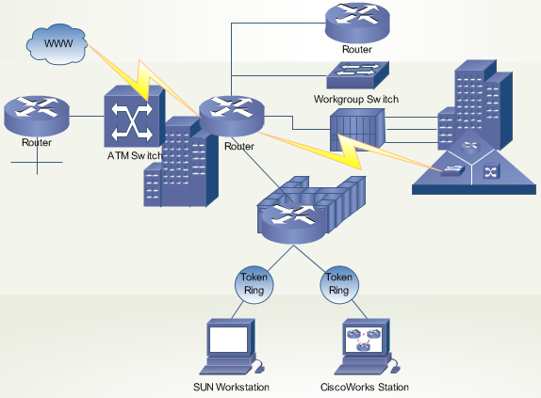
IT NETWORK
In information technology, a network is a series of points or nodes interconnected by communication paths. Networks can interconnect with other networks and contain subnetworks.

Slide 4
Business NETWORK
Business networking is the process of establishing a mutually beneficial relationship with other business people and potential clients and/or customers.

Slide 5
Project NETWORK
Network is the tool used for planning, scheduling, and monitoring the project/activity progress.
The network is developed from the information collected for WBS and is a graphic flow chart of the project job plan.

Slide 6
NETWORK TERMINOLOGY
Activity, is an element of the project that requires time. It may or may not require resources.
Merge activity, this is an activity that has more than one activity immediately preceeding it.
Parallel activities, are activities that can take place at the same time.
Path, a sequences of connected, dependent activities.
Critical path, the paths with the longest duration through the network.
Event, a point in time when an activity is started or completed. It does not consume time.
Burst activity, this activity has more than one activity immediately following it (more than one dependency).

Slide 7
Network & Scheduling
Scheduling define network logics for all activities ; that is, must either precede or follow other tasks from the beginning of the project to its completion.

Slide 8
Task Needed to Complete Assignment (Example)
Identify topic
Research topic
Write first draft of paper
Edit and rewrite paper
Prepare class presentation
Complete final draft
Complete presentation
Hand in paper and present topic in class

Slide 9
Network Diagram – Serial Sequential Logic
A
Identify topic
B
Research
C
Draft Paper
D
Edit Paper
E
Prepare Presentation
F
Final Draft
G
Finish Presentation
H
Finish

Slide 10
Network Diagram – Nonserial Sequential Logic
A
Identify topic
D
Edit Paper
F
Final Draft
B
Research
C
Draft Paper
H
Finish
E
Prepare Presentation
G
Finish Presentation

Slide 11
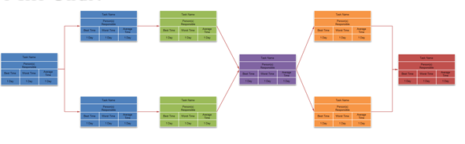
NETWORK APPROACHES
Activity on Node (AON)
Activity on Arrow (AOA)
Both methods use two building blocks – the arrow and the node.

Slide 12
BASIC RULES IN DEVELOPING NETWORK
Networks flow typically from left to right.
An activity cannot begin untill all preceeding connected activities have been completed.
Arrows indicate precedence and flow. Arrows can cross over each other.
Each activity should have a unique identification number.
An activity identification number must be larger than that of any activities that preecede it.
Looping is not allowed.
Conditional statements are not allowed.

Slide 13
ACTIVITY ON NODE
An activity is represented by a node (box). The node can take many forms, but in recent years the node represented as a rectangle. The dependencies among activities are depicted by arrows. The arrows indicate how the activities are related and the sequence in which must be accomplished. Sometimes called the precedence diagram method.

Slide 14
Three Basic Relationship
Which activities must be completed immediately before this activity? These activities are called predecessor activities.
Which activities must immediately follow this activity? These activities are called successor activities.
Which activities can occur while this activity is taking place? This is known as concurrent or parallel relationship.

Slide 15
Activity on Node Fundamentals
C
A is preceded by nothing
B is preceded by A
C is preceded by B
A
B
Y
Y and Z is preceded by X
Y and Z can begin at the same time
X is a burst activity
X
Z

Slide 16
Activity on Node Fundamentals
J
J,K, &L can all begin at the same time, but all (J,K,L) must be completed before M can begin.
M is a merge activity
K
M
L
O
Q
Q is preceeded by O and P
R is preceeded by O and P
P
R

Slide 17
AON Project Network Example
ID | Description | Preceding Activity
A | Contract Signing | None
B | Questioner Design | A
C | Target Market ID | A
D | Survey Sample | B,C
E | Develop presentation | B
F | Analyse results | D
G | Demographic Analysis | C
H | Presentation to Client | E,F,G

Slide 18
AON Network Example
E
Develop Presentation
B
Questioner
D
Survey Sample
F
Analyse Results
A
Contract Signing
H
Presentation
C
Market ID
G
Analyse Results

Slide 19
AON Project Duration Example
ID | Description | Preceding Activity | Estimated Duration
A | Contract Signing | None | 5
B | Questioner Design | A | 5
C | Target Market ID | A | 6
D | Survey Sample | B,C | 13
E | Develop presentation | B | 6
F | Analyse results | D | 4
G | Demographic Analysis | C | 9
H | Presentation to Client | E,F,G | 2

Slide 20
AON Network Example
 | B
 | Question Design
 | 5
 | E
 | Develop Presentati
 | 6
 | D
 | Survey Sample
 | 13
 | F
 | Analyse Result
 | 4
 | H
 | Present to Client
 | 2
 | A
 | Contract
 | 5
 | C
 | Target Market ID
 | 6
 | G
 | Demog. Analysis
 | 9
Legend
ES | ID | EF
SL | Description
LS | Dur | LF

Slide 21
Fordward Pass – Earliest Time
5 | B | 10
 | Question Design
 | 5
10 | E | 16
 | Develop Presentati
 | 6
11 | D | 24
 | Survey Sample
 | 13
24 | F | 28
 | Analyse Result
 | 4
28 | H | 30
 | Present to Client
 | 2
0 | A | 5
 | Contract
 | 5
5 | C | 11
 | Target Market ID
 | 6
11 | G | 20
 | Demog. Analysis
 | 9
Legend
ES | ID | EF
SL | Description
LS | Dur | LF

Slide 22
Backward Pass – Latest Time
5 | B | 10
 | Question Design
 | 5
10 | E | 16
 | Develop Presentati
 | 6
11 | D | 24
 | Survey Sample
 | 13
24 | F | 28
 | Analyse Result
 | 4
28 | H | 30
 | Present to Client
 | 2
0 | A | 5
 | Contract
 | 5
5 | C | 11
 | Target Market ID
 | 6
11 | G | 20
 | Demog. Analysis
 | 9
Legend
ES | ID | EF
SL | Description
LS | Dur | LF

Slide 23
SLACK (or FLOAT)
Total slack (TS), tells us the amount of time an activity can be delayed and not delay the project.
Free slack (FS), it is the amount of time an activity can be delayed without delaying any immediately following (successor) activity.

Slide 24
FREE SLACK EXAMPLE
2 | B | 7
0 | Install drainage
2 | 5 | 7
0 | A | 2
0 | Survey site
0 | 2 | 2
7 | D | 11
0 | Excavate site
7 | 4 | 11
11 | E | 14
0 | Pour foundation
11 | 3 | 14
TS=0
FS=0
2 | C | 5
2 | Install power line
4 | 3 | 7
TS=0
FS=0
TS=0
FS=0
Legend
ES | ID | EF
SL | Description
LS | Dur | LF
TS=2
FS=2

Slide 25
STEP TO REDUCE THE CRITICAL PATH
Eliminate task on the critical path
Replan serial paths to be in parallel
Overlap sequential tasks
Shorten the duration of critical path tasks
Shorten early task
Shorten longest task
Shorten easiest task
Shorten tasks that cost the least to speed up

Slide 26
Creating an activity network
Assume the following information:
Activity | Predecessor
A | -
B | A
C | B
D | B
E | C,D
F | C
G | E,F
H | D,G
Create an activity network that shows the sequential logic between project task. Can you identify merge activities? Burst activities?

Slide 27
Calculating Activity Duration
Assume that you have the following estimates. Using the beta distribution, estimate the activity duration for each task.
Duration Estimates
Activity | Pessimistic | Likely | Optimistic
A | 7 | 5 | 2
B | 5 | 3 | 2
C | 14 | 8 | 6
D | 20 | 10 | 6
E | 8 | 3 | 3
F | 10 | 5 | 3
G | 12 | 6 | 4
H | 16 | 6 | 5

Slide 28
Determining Critical Path and Activity Slack
J. Wold, project manager of Print Software, Inc. Wants you to prepare a project network; compute the early, late, and slack activity times; determine the planned project duration; and identify the critical path. His assistant has collected the following information for the Color Printer Drivers Software Project.

Slide 29
EXERCISE (Continued)
ID | Description | Predecessor | Time
A | External specifications | None | 8
B | Review design features | A | 2
C | Document new features | A | 3
D | Write software | A | 60
E | Program and test | B | 60
F | Edit and publish notes | C | 2
G | Review manual | D | 2
H | Alpha site | E,F | 20
I | Print manual | G | 10
J | Beta site | H,I | 10
K | Manufacture | J | 12
L | Release and ship | K | 3

Slide 30
Greendale Stadium Case
The G&E Company is preparing a bid to build the new 47,000 seat baseball stadium. The construction must start July 1, 2013, and be completed in time for the start of the 2016 season. A penalty clause $100,000 per day of delay beyond May 20, 2016, is written into the contract.
Ben Keith, the president of the company, expressed optimism of obtaining the contract and revealed that company could net as much as $2 million on the project. He also said if they are successful, the prospects for future projects are quite good since there is projected a renaissance in building classic ball parks with modern luxury boxes.
Assignment: Given the information provided in the next table, construct a network schedule for the stadium project and answer the following questions:
1. Will the project be able to be completed by the May deadline? How long will it take?
2. What is the critical path for the project?
3. Based on the schedule would you recommend that G&E pursue this contract? Why? Include a one-page Gant chart for the stadium schedule.

Slide 31
ID | Activity | Duration (days) | Predecessor(s)
1 | Baseball Stadium
2 | Clear stadium site | 70 | -
3 | Demolish building | 30 | 2
4 | Set up construction site | 70 | 3
5 | Drive support piling | 120 | 2
6 | Pour lower concrete bowl | 120 | 5
7 | Pour main concourse | 120 | 3,6
8 | Install Playing Field | 90 | 3,6
9 | Construct upper steel bowl | 120 | 3,6
10 | Install seats | 140 | 7,9
11 | Build luxury boxes | 90 | 7,9
12 | Install jumbotron | 30 | 7,9
13 | Stadium infrastructure | 120 | 7,9
14 | Construct steel canopy | 75 | 10
15 | Light installation | 30 | 14
16 | Build roof supports | 90 | 6
17 | Construct roof | 180 | 16
18 | Install roof tracks | 90 | 16
19 | Install roof | 90 | 17,18
20 | Inspection | 20 | 8,11,13,15,19

Slide 32
TERIMA KASIH

