Slide 1
CORPORATE STRATEGY
Magister Management Program
Universitas Komputer Indonesia

Slide 2
Referensi
T.L. Wheelen and J.W. Hunger, Strategic Management and Business Policy, 12th Ed., Pearson Education Ltd., 2010.

Slide 4
STRATEGY RELATIONSHIP

Slide 5
CORPORATE DIRECTIONAL STRATEGY
GROWTH | STABILITY | RETRENCHMENT
Concentration Vertical Growth Horizontal Growth Diversification Concentric Conglomerate | Pause/Proceed with Caution No Change Profit | Turnaround Captive Company Sell-Out/Divestment Bankruptcy/Liquidation

Slide 6
VERTICAL GROWTH
Can be achieved by taking over a function previously provided by a supplier or by distributor.

Slide 7
STRATEGIES FOR VERTICAL INTEGRATION
Full Integration | Taper Integration | Quasi Integration | Long-Term Contract

Slide 8
HORIZONTAL GROWTH
Achieve by expanding its operations into other geographic location and/or by increasing the range of products and services offered to current market.

Slide 9
INTERNATIONAL ENTRY OPTION FOR HORIZONTAL GROWTH
Exporting
Licensing
Franchising
Joint Ventures
Acquisition
Green-Field Development
Production Sharing
Turnkey Operation
Management Contract

Slide 10
STABILITY STRATEGY
Pause/Proceed with Caution Strategy
No-Change Strategy
Profit Strategy

Slide 11
RETREACHMENT STRATEGIES
Turnaround Strategy
Captive Company Strategy
Sell-Out/Divestment Strategy
Bankruptcy/Liquidation Strategy

Slide 12
DIRECTIONAL STRATEGY

Slide 13
PORTFOLIO ANALYSIS
BCG GROWTH-SHARE MATRIX
GE BUSINESS SCREEN

Slide 14
BCG GROWTH SHARE MATRIX

Slide 15
BCG GROWTH SHARE MATRIX

Slide 16
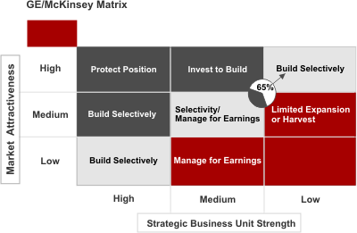
GE BUSINESS SCREEN

Slide 17
Parenting Matrix

