Slide 1
Knowledge Management

Slide 2
Knowledge Management
Process to help organization identify, select, organize, disseminate, transfer information
Structuring enables problem-solving, dynamic learning, strategic planning, decision-making
Leverage value of intellectual capital through reuse
The process through which organizations generate value from their intellectual property and knowledge-based assets

Slide 3
Knowledge Management
“Knowledge management (KM) is an effort to increase useful knowledge within the organization. Ways to do this include encouraging communication, offering opportunities to learn, and promoting the sharing of appropriate knowledge artifacts.”
McInerney, C. (2002). Knowledge management and the dynamic nature of knowledge. JASIST, 53 (2).

Slide 4
Understanding KM
Understanding Knowledge Management requires an understanding of knowledge and the knowing process and how that differs from information and information management.

Slide 5
Knowledge
Data = collection of facts, measurements, statistics
Information = organized data
Knowledge = contextual, relevant, actionable information
Strong experiential and reflective elements
Good leverage and increasing returns
Dynamic
Branches and fragments with growth
Difficult to estimate impact of investment
Uncertain value in sharing
Evolves over time with experience

Slide 6
Knowledge
Explicit knowledge
Objective, rational, technical
Policies, goals, strategies, papers, reports
Codified
Leaky knowledge
Tacit knowledge
Subjective, cognitive, experiential learning
Mental maps, know – how, trade secrets, skill sets
Highly personalized
Difficult to formalize
Sticky knowledge/embedded knowledge

Slide 7
The Need of Knowledge Management
Systematic and active management of ideas, information, and knowledge residing within organization’s employees
Knowledge management systems
Use of technologies to manage knowledge
Used with turnover, change, downsizing
Provide consistent levels of service

Slide 8
KM’s Role Is Changing
♦ The Early Focus:
Strengthen Operations by Improving Knowledge and Its Availability with IT and LO
♦ The Emerging Focus:
Make the Enterprise More Competitive from Strategic Perspectives by Creating and Utilizing Knowledge and Personal Understanding
“To Survive and Prosper You Need to
Innovate Faster Than Your Competitors
– It is Not Enough to Learn Faster!”

Slide 9
Organizational Learning
Learning organization
Ability to learn from past
To improve, organization must learn
Issues
Meaning, management, measurement
Activities
Problem-solving, experimentation, learning from past, learning from acknowledged best practices, transfer of knowledge within organization
Must have organizational memory, way to save and share it
Organizational learning
Develop new knowledge
Corporate memory critical
Organizational culture
Pattern of shared basic assumptions

Slide 10
Knowledge Management Initiatives
Aims
Make knowledge visible
Develop knowledge intensive culture
Build knowledge infrastructure
Surrounding processes
Creation of knowledge
Sharing of knowledge
Seeking out knowledge
Using knowledge

Slide 11
Knowledge Management Initiatives
Knowledge creation
Generating new ideas, routines, insights
Modes
Socialization, externalization, internalization, combination
Knowledge sharing
Willing explanation to another directly or through an intermediary
Knowledge seeking
Knowledge sourcing

Slide 12
Approaches to Knowledge Management
Process Approach
Codifies knowledge
Formalized controls, approaches, technologies
Fails to capture most tacit knowledge
Practice Approach
Assumes that most knowledge is tacit
Informal systems
Social events, communities of practice, person-to-person contacts
Challenge to make tacit knowledge explicit, capture it, add to it, transfer it

Slide 13
Approaches to Knowledge Management
Hybrid Approach
Practice approach initially used to store explicit knowledge
Tacit knowledge primarily stored as contact information
Best practices captured and managed
Best practices
Methods that effective organizations use to operate and manage functions
Knowledge repository
Place for capture and storage of knowledge
Different storage mechanisms depending upon data captured

Slide 14
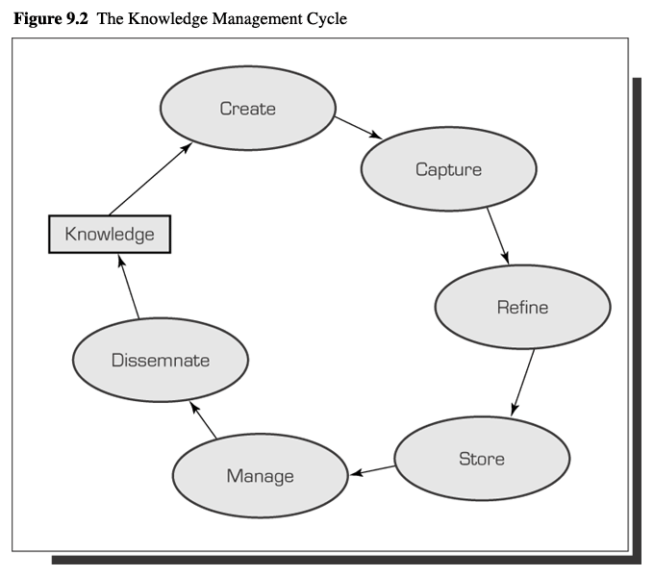
Knowledge Management System Cycle
Creates knowledge through new ways of doing things
Identifies and captures new knowledge
Places knowledge into context so it is usable
Stores knowledge in repository
Reviews for accuracy and relevance
Makes knowledge available at all times to anyone
Disseminate

Slide 15
Components of Knowledge Management Systems
Technologies
Communication
Access knowledge
Communicates with others
Collaboration
Perform groupwork
Synchronous or asynchronous
Same place/different place
Storage and retrieval
Capture, storing, retrieval, and management of both explicit and tacit knowledge through collaborative systems

Slide 16
Components of Knowledge Management Systems
Supporting technologies
Artificial intelligence
Expert systems, neural networks, fuzzy logic, intelligent agents
Intelligent agents
Systems that learn how users work and provide assistance
Knowledge discovery in databases
Process used to search for and extract information
Internal = data and document mining
External = model marts and model warehouses
XML
Extensible Markup Language
Enables standardized representations of data structures
Better collaboration and communication through portals

Slide 17
Knowledge Management System Implementation
Challenge to identify and integrate components
Early systems developed with networks, groupware, databases
Knowware
Technology tools that support knowledge management
Collaborative computing tools
Groupware
Knowledge servers : contains the main KM sw, knowledge repository
Enterprise knowledge portals : doorway into many KMS
Document management systems
Content management systems
Knowledge harvesting tools : capturing knowledge
Search engines : locating and retrieving necessary documents in corporate repositories
Knowledge management suites
Complete out-of-the-box solutions

Slide 18
Knowledge Management System Implementation
Implementation
Software packages available
Include one or more tools
Consulting firms
Outsourcing
Application Service Providers

Slide 19
Knowledge Management System Integration
Integration with enterprise and information systems
DSS/BI
Integrates models and activates them for specific problem
Artificial Intelligence
Expert system = if-then-else rules
Natural language processing = understanding searches
Artificial neural networks = understanding text
Artificial intelligence based tools = identify and classify expertise

Slide 20
Knowledge Management System Integration
Database
Knowledge discovery in databases
CRM
Provide tacit knowledge to users
Supply chain management systems
Can access combined tacit and explicit knowledge
Corporate intranets and extranets
Knowledge flows more freely in both directions
Capture knowledge directly with little user involvement
Deliver knowledge when system thinks it is needed

Slide 21
Human Resources
Chief knowledge officer
Senior level
Sets strategic priorities
Defines area of knowledge based on organization mission and goals
Creates infrastructure
Identifies knowledge champions
Manages content produced by groups
Adds to knowledge base
CEO
Champion knowledge management
Upper management
Ensures availability of resources to CKO
Communities of practice
Group of people in organization with a common professional interest
Knowledge management system developers
Team members that develop system
Knowledge management system staff
Catalog and manage knowledge

Slide 22
Knowledge Management Valuation
Asset-based approaches
Identifies intellectual assets
Focuses on increasing value
Knowledge linked to applications and business benefits approaches
Balanced scorecard
Economic value added
Inclusive valuation methodology
Return on management ratio
Knowledge capital measure
Estimated sale price approach

Slide 23
Metrics
Financial
ROI
Perceptual, rather than absolute
Intellectual capital not considered an asset
Non-financial
Value of intangibles
External relationship linkages capital
Structural capital
Human capital
Social capital
Environmental capital

Slide 24
Factors Leading to Success and Failure of Systems
Success
Companies must assess need
System needs technical and organizational infrastructure to build on
System must have economic value to organization
Senior management support
Organization needs multiple channels for knowledge transfer
Appropriate organizational culture
Failure
System does not meet organization’s needs
Lack of commitment
No incentive to use system
Lack of integration

Slide 25
questions
Jelaskan apa yang Anda pahami mengenai Knowledge Management
Berikan Contoh Implementasi KM di organisasi tempat Anda bekerja atau di lingkungan sekitar Anda

Slide 26
Questions
Buatlah daftar metoda KM yang Anda gunakan sehari - hari baik dalam pekerjaan maupun dalam kegiatan personal. Yang mana yang lebih efektif dan mana yang kurang efektif?
Gambarkan bagaimana mengendarai sepeda motor, menyetir mobil, membuat kopi. Lalu cobalah minta teman anda untuk melakukannya berdasarkan penjelasan anda. Bagaimana anda menerjemahkan pengetahuan ini dari tacit ke explicit ?

Slide 27
Question
Buatlah essay tentang enterprise system dalam bahasa indonesia yang baik dan benar dengan format standar jurnal minimal 4 halaman dan maksimal 6 halaman. Dikumpulkan paling lambat tanggal 17 Mei 2013 jam 23.59.59 WIB dan di kirim ke kuliah online atau ke email.

