Slide 1
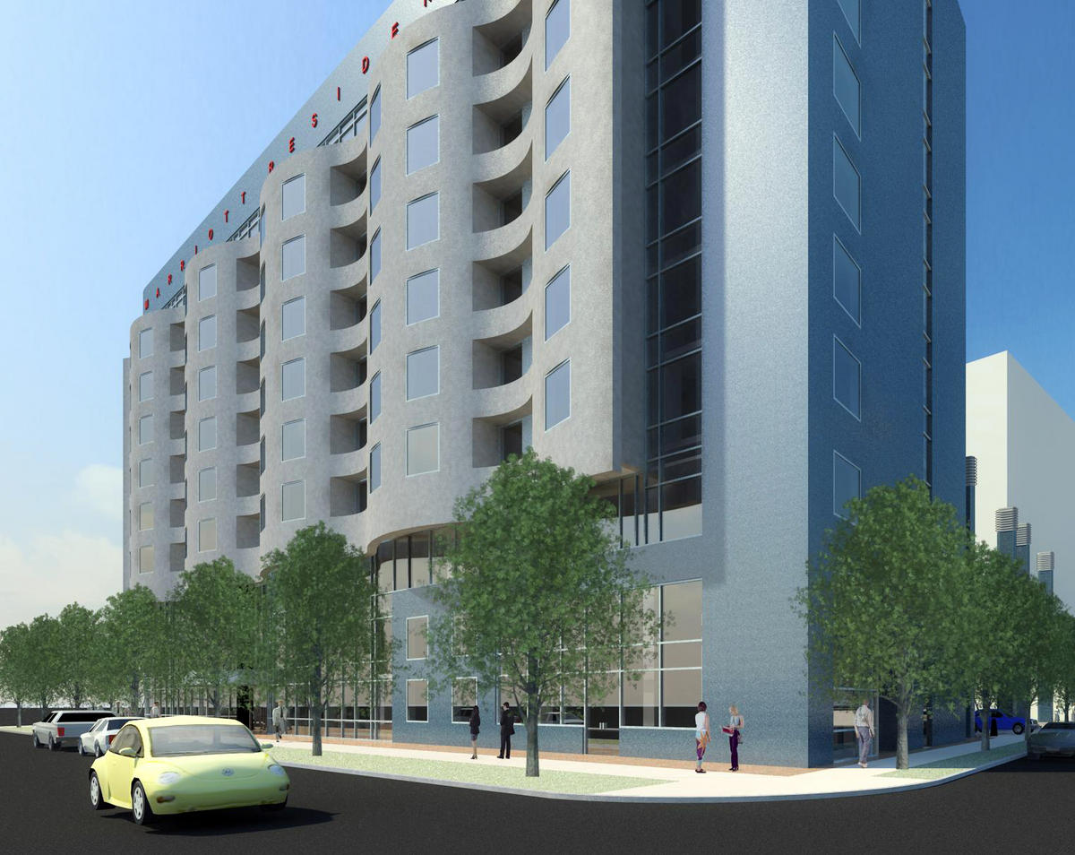
WEEK 2
Information Technology
for
business Project Management
Magister Management
Universitas Komputer Indonesia

Slide 2

PROJECT
SELECTION

Slide 3
WHY PROJECT SELECTION
Survey on companies IT project: over $ 50 billion a year that are created but never used by their intended clients (Pinto, 2010:92).
Firms are literally bombarded with opportunities, but no organizations enjoys infinite resources to be able to pursue every opportunity.
Selection model permit company to save time and money while maximizing the likelihood of success.

Slide 4
PROJECT SCREENING MODEL
Manager should consider five important issues when evaluating screening model:
1. Realism
2. Capability
3. Flexibility
4. Easy to Use
5. Cost
6. Comparability

Slide 5

ISSUES IN PROJECT SCREENING & SELECTION
Risk – factors that reflect elements of unpredictability to the firm, including:
a. Technical Risk
b. Financial Risk
c. Safety Risk
d. Quality Risk
e. Legal Exposure
2. Commercial
a. Expected ROI
b. Payback Period
c. Potential Market Share
d. Long-term market dominance, etc.
3. Internal Operating Issues
a. Need to develop / train employees
b. Change in workforce size or composition
c. Change in physical environment, manufacturing or service operations
4. Additional Factors
a. Patent protection
b. Impact on company’s image
c. Strategic Fit

Slide 6
APPROACHES TO PROJECTS SCREENING AND SELECTIONS
Method One: Checklist Model
Method Two: Simplified Scoring Model / Project Screening Matrix
Method Three: AHP
Method Four: Profile Models

Slide 7

CHECK LIST MODEL

Slide 8
CHECKLIST MODEL
Based on a list of criteria that pertain to choice of projects.
Issues in deciding among several new product development opportunities:
. Cost of development
. Potential Return on Investment
. Riskiness of new venture
. Stability of the development process
. Government or stakeholder interference
. Project durability and future market potential

Slide 9
CHECK LIST MODEL - EXAMPLE
PROJECT | CRITERIA | PERFORMANCE ON CRITERIA HIGH MEDIUM LOW
Project Alpha | Cost Profit Potential Time To Market Development Risk | X | X | X X
Project Beta | Cost Profit Potential Time To Market Development Risk | X | X X X
Project Gamma | Cost Profit Potential Time To Market Development Risk | X X X |  | X
Project Delta | Cost Profit Potential Time To Market Development Risk | X | X | X X

Slide 10

SIMPLIFIED SCORING MODEL

Slide 11
SIMPLIFIED SCORING MODEL
In the simplified scoring model, each criterion is ranked according to its relative importance.
Example:
Criterion Importance Weight
Time to market 3
Profit Potential 2
Development Risks 2
Cost 1

Slide 12
Example: Simple Scoring Model
Project | Criteria | (A) Importance Weight | (B) Score | X (B) Weighted Score
Project Alpha | Cost Profit Potential Time To Market Development Risk Total Score | 1 2 3 2 | 3 1 2 1 | 3 2 6 2 13
Project Beta | Cost Profit Potential Time To Market Development Risk Total Score | 1 2 3 2 | 2 2 3 2 | 2 4 9 4 19
Project Gamma | Cost Profit Potential Time To Market Development Risk Total Score | 1 2 3 2 | 3 3 1 3 | 3 6 3 6 18
Project Delta | Cost Profit Potential Time To Market Development Risk Total Score | 1 2 3 2 | 1 1 3 2 | 1 2 9 4 16

Slide 13
Project screening matrix
Criteria | Stay with core competencies | Strategic fit | Urgency | 25% of sales from new products | Reduce defects to less than 1% | Improve costumer loyalty | ROI of 18% plus | Weighted total
Weight | 2.0 | 3.0 | 2.0 | 2.5 | 1.0 | 1.0 | 3.0
Project 1 | 1 | 8 | 2 | 6 | 0 | 6 | 5 | 66
Project 2 | 3 | 3 | 2 | 0 | 0 | 5 | 1 | 27
Project 3 | 9 | 5 | 2 | 0 | 2 | 2 | 5 | 56
Project 4 | 3 | 0 | 10 | 0 | 0 | 6 | 0 | 32
Project 5 | 1 | 10 | 5 | 10 | 0 | 8 | 9 | 102
Project 6 | 6 | 5 | 0 | 2 | 0 | 2 | 7 | 55
Project n | 5 | 5 | 7 | 0 | 10 | 10 | 8 | 83

Slide 14
The analytical hierarchy process
AHP was developed by Dr. Thomas Saaty to adress many of the technical and managerial problems frequently associated with decission making trough scoring models.
AHP step process:
1. Structuring the hierarchy criteria
2. Allocating weight to criteria
3. Assigning numerical values to evaluation
dimmensions
4. Evaluating project proposals

Slide 15
Structuring the hierarchy of criteria
The first step consists of constructing of hierarchy of criteria and sub criteria.
Example:
First Level |  | Second Level
1 | Financial Benefit | 1A: Short-term
 |  | 1B: Long-term
2 | Contribution to Strategy | 2A: Increasing market share for product x
 |  | 2B: Retaining existing customer for product y
 |  | 2C: Improving cost management
3 | Contribution to IT Infrastructure

Slide 16
Allocating weight to criteria
The second step in applying AHP consists of allocating weight to previously developed criteria and, where necessary, splitting overall criterion weight among sub-criteria.
Example:
Rank Information Systems Project Proposals
Goal (1.000)
Finance (0.520) | Strategy (0.340) | Information Technology (0.140)
Short-term | Market share | Poor
Long-term | Retention | Fair
 | Cost management | Good
 |  | Very Good
 |  | Excellent

Slide 17
Assigning numerical values to evaluation dimmension
For our third step, once the hierarchy is established, we can use the pairwaise comparison process to assign numerical values to the dimensions of our evaluation scale.
Example
 | Nominal | Priority
Poor | 0.0 | 0.00
Fair | 0.1 | 0.05
Good | 0.3 | 0.15
Very Good | 0.6 | 0.30
Excellent | 1.0 | 0.50
Total | 2.0 | 1.00

Slide 18
Evaluating project proposal
The final step, we multiply the numeric evaluation of the project by the weight assigned to the evaluation criteria and then add up the results for all criteria.
 | Alternatives | Total | Finance (0.52) |  | Contribution to Strategy (0.34) |  |  | Technology
 |  |  | Short term 0.1560 | Long term 0.3640 | Market share 0.1020 | Retention 0.1564 | Cost Mgmt 0.0816 | 0.1400
1 | Perfect Project | 1.000 | Excellent | Excellent | Excellent | Excellent | Excellent | Excellent
2 | Alligned | 0.762 | Good | Excellent | Good | Excellent | Good | Excellent
3 | Not Alligned | 0.538 | Excellent | Good | Excellent | Good | Excellent | Good
4 | All Very Good | 0.600 | Very Good | Very Good | Very Good | Very Good | Very Good | Very Good
5 | Mixed | 0.284 | Poor | Fair | Good | Very Good | Excellent | Good
Poor 1 (0.000) | Fair 2 (0.100) | Good 3 (0.300) | Very Good 4 (0.600) | Excellent 5 (1.000)

Slide 19

PROFILE MODELS

Slide 20
Profile Models
Profile Models allow managers to plot risk/return options for various alternatives and then select project that maximizes return while staying within a certain range of minimum acceptable risk.

Slide 21
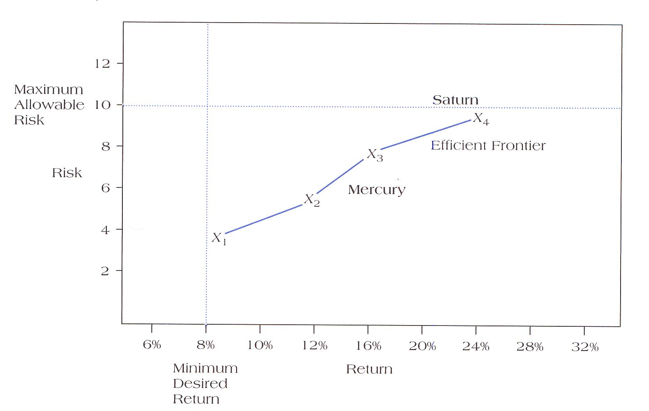
Profile Model Example
 | Risk | Return Potential
Project Saturn | 10 | 23%
Project Mercury | 6 | 16%

Slide 22

FINANCIAL MODELS

Slide 23

TIME VALUE OF MONEY
Financial models are all predicated on the time value of money.
Money earned today is worth more than money we expect to earn in the future.

Slide 24
Payback Period
Payback Period = investment/annual cash saving

Slide 25
Payback Period Example
 | Project A Revenues Outlays |  | Project B Revenues Outlays
Year 0 |  | 500,000 |  | 500,000
Year 1 | 50,000 |  | 75,000
Year 2 | 150,000 |  | 100,000
Year 3 | 350,000 |  | 150,000
Year 4 | 600,000 |  | 150,000
Year 5 | 500,000 |  | 900,000

Slide 26

Net Present Value
The difference between inflows cash (after tax) and investment outflows.
NPV > 0 → accepted
NPV < 0 → rejected
NPV = PV – I₀, or
= CF₁ + CF₂ + …. + CF_{n} – I₀
(1+i)¹ (1+i)² (1+i)^{n}

Slide 27
Net Present Value Example
Assume you are considering whether or not to invest in a project that will cost $100,000 in initial investment. Your company requires a rate of return of 10%, and you expect inflation to remain relatively constant at 4%. Future cash flow as follows:
Year 1: $ 20,000
Year 2: $ 50,000
Year 3: $ 50,000
Year 4: $ 25,000

Slide 28
Internal Rate of Return (IRR)
CF1 + CF2 + ……. + CFn - I_{o} = 0
(1+IRR) (1+IRR)² (1+IRR)^{n}
If IRR > % required return → accepted
If IRR < % required return → rejected

Slide 29
IRR Example
Suppose that a project required an initial cash investment of $ 5,000 and was expected to generate inflows of $2,500, $2,000, $2,000 for the next three years. Assume the company rate of return 10%.
Is this project worth funding?

Slide 30
Example
Choose which project should be funded based on pay back period, IRR & NPV, at 12% rate.
Tahun | Proyek A | Proyek B
0 | (250.000.000) | (250.000.000)
1 | 100.000.000 | 100.000.000
2 | 100.000.000 | 200.000.000
3 | 100.000.000 | 0
4 | 100.000.000 | 0

Slide 31
TERIMA KASIH

