Slide 1
ESTIMATING PROJECT COST & BUDGETING
Information Technology for business
Magister Management
Universitas Komputer Indonesia
Source:
Pinto, j.k. 2010, 2ND. ED.
Larson, e.w., & Gray c.f., 2011, 5th. Ed.

Slide 2
PROJECT ESTIMATION
Project estimation is indeed a yardstick for project cost control. And if the yardstick is faulty, you start on the “wrong foot”.
(Kharbanda, O.P., and Pinto, J.K. 1996:73)

Slide 3
Why Estimating Time & Cost Are Important
to support good decission
to schedule work
to determine how long the project should take and its cost
to determine whether the project is worth doing
to develop cash flow needs
to determine how well the project is progressing
to develop time-phased budgets and establish the project baseline.

Slide 4
The Relationship among WBS, Scheduling, and Budgeting
WBS
(WORK BREAKDOWN STRUCTURE)
Project
Plan
Budgeting
Scheduling

Slide 5
Factors Influencing The Quality of Estimates
Planning Horizon
Project Duration
People
Project Structure and Organization
Padding Estimates
Organization Culture
Other Factors

Slide 6
Estimating Guidelines for Times, Costs, and Resources
Responsibility
Use several people to estimate
Normal conditions
Time units
Independence
Contigencies
Adding risk assesment to estimate helps to avoid surprises to stakeholder

Slide 7
Problems with Cost Estimation
Low initial estimates
Unexpected technical difficulties
Lack of definition
Specification changes
External factors

Slide 8
PROJECT BUDGET APROACH
Top Down Budgeting
Bottom Up Budgeting
Activity-Based Costing

Slide 9
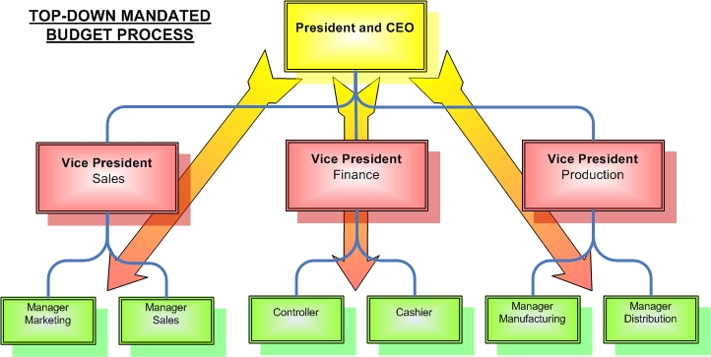
Top Down Estimating
Top down estimates usually are derived from someone who uses experience and/or information to determine the project duration and total cost. These estimates are sometimes made by top managers who have very little knowledge of the processes used to complete the project.

Slide 10
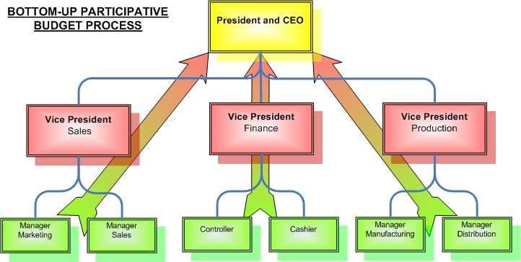
Bottom-Up Estimating
The Bottom-Up approach at the work package level can serve as a check on cost elements in the WBS by rolling up the work packages and associated cost accounts to major deliverables. Similarly, resource requirement can be checked. Later, the time, resource, and cost estimates from the work packages can be consolidated into time-phased networks, resource schedule, and budgets are used for control.

Slide 11
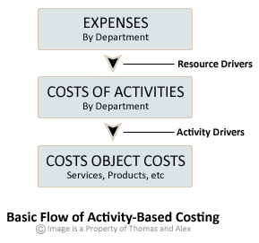
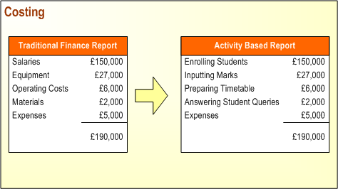
Activity-Based Costing
Is a budgeting method that asigns costs first to activities and then to the project’s based on each project’s use of resources.
Activity-based costing consists of four steps:
1. Identify the activities that consume resources and assign cost to them, as is done in a bottom-up budgeting process.
2. Identify the cost drivers associated with the activity. Resources, in the form of project personnel, and materials are key cost drivers.
3. Compute a cost rate per cost driver unit or transaction. Labor, for example, is commonly simply the cost of labor per hour, given as:
Cost rate/unit $cost/hour
4. Assign cost to projects by multiplying the cost driver rate times the volume of cost driver units consumed by the project. Example, assume the cost of senior software programmer is $40/hour and that she is to work on the project for a total of 80 hours. The cost to the project would be:
$40/hr x 80 hours = $3,200

Slide 12
Condition for Preferring Top-Down or Bottom-Up Time and Cost Estimates
Condition | Top-Down Estimates | Bottom-Up Estimates
Strategic decission making | X
Cost & time important |  | X
High uncertainty | X
Internall, small project | X
Fixed-price contract |  | X
Customer wants detail |  | X
Unstable scope | X

Slide 13
Top-Down and Bottom-Up Estimates
Top-Down Estimates | Bottom-Up Estimates
Intended Use Feasibility/conceptual phase Rough time/cost estimate Fund requirements Resource capacity planning | Intended Use Budgeting Scheduling Resource requirements Fund timing
Preparation Cost 1/10 to 3/10 of a percent of total project cost | Preparation Cost 3/10 to 1.0 of a percent of total project cost
Accuracy Minus 20 to plus 60% | Accuracy Minus 10 to plus 0%
Method Concencus Ratio Apportion Function point Learning curve | Method Template Parametric WBS packages Range estimates

Slide 14
Source of Project Cost
Labor
Material
Subcontractors
Equipment & facilities
Travel

Slide 15
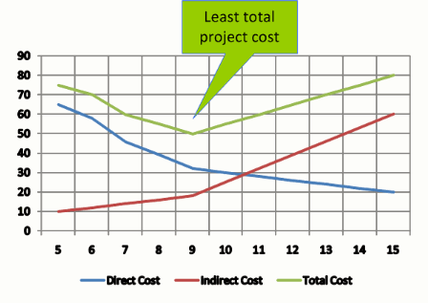
Direct vs Indirect Costs
Direct cost are those clearly assigned to the aspect of the project that generated the cost (example labor & materials).
Indirect cost, generally are linked to two features: overhead and selling and general administration.

Slide 16
Recurring vs. Nonrecurring Costs
Non recurring cost might be those associated with charges applied once at the beginning or end of the project, such as preliminary marketing analysis, personnel training, or outplacement services.
Recurring cost are those that typically continue to operate over the project’s life cycle. Most labor, material, logistics, and sales costs are consider recurring.

Slide 17
Fixed vs. Variable Costs
Fixed Cost, do not vary with respect to their usage. Example cost for leasing equipment.
Variable Cost, are those that accelerated or increase through usage; that is, the cost in direct proportion to the usage level. Example: equipment parts, materials, etc.

Slide 18
Normal vs Expedited Cost
Normal costs refer to those incurred in the routine process of working to complete the project according to the original, planned schedule agreed to by all project stakeholders at the beginning of the project.
Expedited costs are unplanned costs incurred when steps are taken to speed up the project’s completion.

Slide 19
Cost Classification
 | Type |  | Frequency |  | Adjustment |  | Schedule
Cost | Direct | Indirect | Recurring | Nonrecurring | Fixed | Variable | Normal | Expedited
Direct Labor | X |  | X |  | X |  | X
Building Lease |  | X | X |  | X |  | X
Expedite Costs | X |  |  | X |  | X |  | X
Material | X |  | X |  |  | X | X

Slide 20
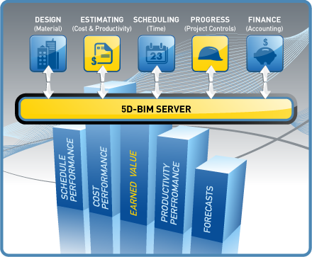
Time and Cost Estimate Accuracy by Type of Project
 | Bricks & Mortar | Information Technology
Conceptual stage | +60% to -30% | +200% to -30%
Deliverables defined | +30% to -15% | +100% to -15%
Work packages defined | +15% to -5% | +50% to -5%

Slide 21
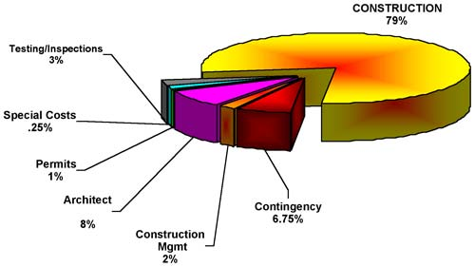
TOP DOWN APORTION METHOD EXAMPLE

Slide 22
BUILDING COST ESTIMATION TOP DOWN RATIO METHOD - example (CIPTA KARYA & TATA RUANG, BANDUNG 2008)
NO | JENIS BANGUNAN | STANDARD HARGA BANGUNAN (Rupiah/m^2)
 |  | Bertingkat | Tdk Bertingkat
1 | Sederhana | 2.500.000 | 1.833.000
2 | Tidak sederhana | 3.500.000 | 2.566.000
Jumlah lantai | Faktor Satuan Harga
1 | 1,000 x
2 | 1,090 x
3 | 1,120 x
4 | 1,135 x
5 | 1,162 x
6 | 1,197 x
7 | 1,236 x
8 | 1,265 x

Slide 23
NATIONAL INFLATION
YEAR | INFLATION RATE
2008 | 11.06
2009 | 2.78
2010 | 6.96
2011 | 3.79
2012 | 4.3
2013 (Jan-Jun) | 5.9

Slide 24
BUILDING COST ESTIMATION BOTTOM UP METHOD - example

Slide 25
BUILDING COST ESTIMATION BOTTOM UP METHOD - example
III | PEKERJAAN PONDASI
1 | Pekerjaan Cor Beton Pondasi Mini Bor D.30
 | - Cor Beton K-225 (Slump 16) | M3 | 67.86 | 807,620.00 | 54,801,862.72
 | - Pembesian (360 D13 + 300 d8) | Kg | 6142.50 | 12,160.00 | 74,692,800.00
2 | Pilecap (K-225 Site Mix)
 | 1. Type P1 & P1A (60x60x40), 7 buah | M3 | 1.21 | 807,620.00 | 976,897.15
 | Bekisting Pilecap P1, P1A | M2 | 8.06 | 74,700.00 | 602,380.80
 | Pembesian | Kg | 67.29 | 12,160.00 | 818,237.28
 | 2. Type P2 & P2a (120x60x40), 19 buah | M3 | 6.57 | 807,620.00 | 5,303,155.97
 | Bekisting Pilecap P2, P2A | M2 | 32.83 | 74,700.00 | 2,452,550.40
 | Pembesian | Kg | 365.24 | 12,160.00 | 4,441,348.80
 | 3. Type P3, P3A (150x95x50), 4 buah | M3 | 3.42 | 807,620.00 | 2,762,060.40
 | Bekisting Pilecap P3, P3A | M2 | 11.76 | 74,700.00 | 878,472.00
 | Pembesian | Kg | 152.19 | 12,160.00 | 1,850,593.92
 | 4. Type P4 (120x120x50) | M3 | 0.86 | 807,620.00 | 697,783.68
 | Bekisting Pilecap P4 | M2 | 2.88 | 74,700.00 | 215,136.00
 | Pembesian | Kg | 60.72 | 12,160.00 | 738,373.44
3 | Tie Beam/Sloof (K-225 Site Mix)
 | 1. Type S1 (15x30) | M3 | 7.34 | 807,620.00 | 5,931,161.28
 | Bekisting Sloof S1 | M2 | 97.92 | 74,700.00 | 7,314,624.00
 | Pembesian | Kg | 1,866.72 | 12,160.00 | 22,699,333.44
 | 2. Type S2 (20X35) | M3 | 2.59 | 807,620.00 | 2,093,351.04
 | Bekisting Sloof S2 | M2 | 25.92 | 74,700.00 | 1,936,224.00
 | Pembesian | Kg | 431.03 | 12,160.00 | 5,241,264.00
 | 3. Type S3 (20X35) | M3 | 1.08 | 807,620.00 | 872,229.60
 | Bekisting Sloof S3 | M2 | 10.80 | 74,700.00 | 806,760.00
 | Pembesian | Kg | 179.60 | 12,160.00 | 2,183,966.40
 | 4. Type S4 (25X50) | M3 | 1.20 | 807,620.00 | 969,144.00
 | Bekisting Sloof S4 | M2 | 9.60 | 74,700.00 | 717,120.00
 | Pembesian | Kg | 139.30 | 12,160.00 | 1,693,930.56
 | Sub Total Pekerjaan Pondasi |  |  |  |  | 203,690,760.88

Slide 26
BUILDING COST ESTIMATION BOTTOM UP METHOD - example
IV | PEKERJAAN BETON SEMI BASEMENT
a | Lantai Basement
 | - Lantai kerja dan pemadatan | M2 | 5.14 | 50,720.00 | 260,878.32
 | - Cor beton Tebal 15 cm | M3 | 34.29 | 753,250.00 | 25,828,942.50
 | - Pembesian wiremesh M8, 1 lapis | Kg | 127.31 | 12,880.00 | 1,639,785.00
b | Dinding Basement
 | 2. Tebal Tp = 200 mm (ready mix) | M3 | 25.34 | 807,620.00 | 20,468,321.28
 | Bekisting dinding | M2 | 126.72 | 86,300.00 | 10,935,936.00
 | Pembesian | Kg | 1,286.76 | 12,160.00 | 15,647,056.32
c | Tangga beton | M3 | 7.20 | 807,620.00 | 5,814,258.29
 | Bekisting Tangga | M2 | 36.00 | 86,300.00 | 3,106,476.38
 | Pembesian | Kg | 699.91 | 12,160.00 | 8,510,893.44
d | Kolom Beton Bertulang K-225
 | 1. Type K1 (30x30), 16 buah | M3 | 4.75 | 2,776,080.00 | 13,191,932.16
 | Bekisting Kolom K1 | M2 | 63.36 | 86,300.00 | 5,467,968.00
 | 2. Type K2 (15x60), 8 buah | M3 | 2.38 | 2,776,080.00 | 6,595,966.08
 | Bekisting Kolom K2 | M2 | 31.98 | 86,300.00 | 2,759,874.00
e | Pasangan Dinding Bata (1/2 Bata) + Kolom Praktis | M2 | 91.20 | 97,850.00 | 8,923,920.00
f | Plesteran Acian Dinding | M2 | 391.21 | 29,180.00 | 11,415,507.80
 | Sub Total Pekerjaan Struktur Semi basement |  |  |  |  | 140,567,715.56
V | PEKERJAAN STRUKTUR LANTAI 1
a | Balok beton bertulang K-225 (ready mix)
 | 1. Type B2 300 x 500 | M3 | 5.40 | 2,811,920.00 | 15,184,368.00
 | - Bekisting Balok B2 | M2 | 46.80 | 86,300.00 | 4,038,840.00
 | 2. Type B3 300 x 400 | M3 | 4.13 | 2,811,920.00 | 11,621,102.98
 | - Bekisting Balok B3 | M2 | 37.88 | 86,300.00 | 3,269,389.20
 | 3. Type B4 250 x 350 | M3 | 1.63 | 2,811,920.00 | 4,570,494.77
 | - Bekisting Balok B4 | M2 | 17.65 | 86,300.00 | 1,522,953.36
 | 4. Type B5 150 x 400 | M3 | 1.30 | 2,811,920.00 | 3,644,248.32
 | - Bekisting Balok B5 | M2 | 20.52 | 86,300.00 | 1,770,876.00
 | 5. Type B6 150 x400 | M3 | 2.51 | 2,811,920.00 | 7,071,866.32
 | - Bekisting Balok B6 | M2 | 39.82 | 86,300.00 | 3,436,483.26
b | Kolom beton bertulang K-225
 | 1. Type K1 (30x30), 2 buah | M3 | 0.78 | 2,776,080.00 | 2,158,679.81
 | - Bekisting Kolom K1 | M2 | 10.37 | 86,300.00 | 894,758.40
 | 2. Type K2 (15x60), 13 buah | M3 | 5.05 | 2,776,080.00 | 14,031,418.75
 | - Bekisting Kolom K2 | M2 | 67.69 | 86,300.00 | 5,841,819.60
 | 3. Type K3 150 x 500, 13 buah | M3 | 4.21 | 2,776,080.00 | 11,692,848.96
 | - Bekisting Kolom K3 | M2 | 73.01 | 86,300.00 | 6,300,590.40
c | Plat beton bertulang K-225 (ready mix)
 | - Lantai beton t = 120 mm | M3 | 20.09 | 2,714,460.00 | 54,528,072.48
 | - Bekisting Lantai Beton | M2 | 167.40 | 86,300.00 | 14,446,620.00
d | Pekerjaan pondasi lantai 1
 | - Galian Sloof | M3 | 0.25 | 18,300.00 | 4,575.00
 | - Pekerjaan sloof S1
 | Cor Sloof | M3 | 2.94 | 753,250.00 | 2,212,747.20
 | - Bekisting Sloof S1 | M2 | 39.17 | 74,700.00 | 2,925,849.60
 | - Pembesian | Kg | 533.35 | 12,160.00 | 6,485,523.84
e | Pekerjaan lantai dasar
 | - Urugan pasir lantai kerja | M3 | 7.50 | 104,610.00 | 784,575.00
 | - Pemadatan & Plur adukan lantai kerja | M2 | 150.00 | 50,720.00 | 7,608,000.00
f | Tangga beton | M3 | 5.44 | 753,250.00 | 4,095,796.88
 | - Bekisting Tangga | M2 | 27.19 | 86,300.00 | 2,346,281.25
 | - Pembesian | Kg | 533.26 | 12,160.00 | 6,484,490.24
g | Pasangan Dinding Bata :
 | - Dinding 1/2 Bata + Kolom Praktis | M2 | 367.40 | 97,850.00 | 35,950,090.00
 | - Dinding 1 Bata + Kolom Praktis | M2 | 13.10 | 195,700.00 | 2,563,670.00
 | Plesteran Acian Dinding | M2 | 859.15 | 29,180.00 | 25,069,997.00
 | Sub Total Pekerjaan Struktur Lantai 1 |  |  |  |  | 262,557,026.61

Slide 27
EXAMPLE OF TIME-PHASED BUDGET
Activity | Months
 | January | February | March | April | May | Total by Activity
Survey | 4000 |  |  |  |  | 4000
Design |  | 5000 | 3000 |  |  | 8000
Clear Site |  | 4000 |  |  |  | 4000
Foundation |  |  | 7500 | 8000 | 2000 | 7500
Framing |  |  |  | 1000 | 4000 | 10000
Plumb & Wire |  |  |  |  |  | 5000
Monthly Planned | 4000 | 9000 | 10500 | 9000 | 6000
Cumulative | 4000 | 13000 | 23500 | 32500 | 38500 | 38500

Slide 28
TERIMA KASIH

