Slide 1
Bab Pendahuluan

Slide 2
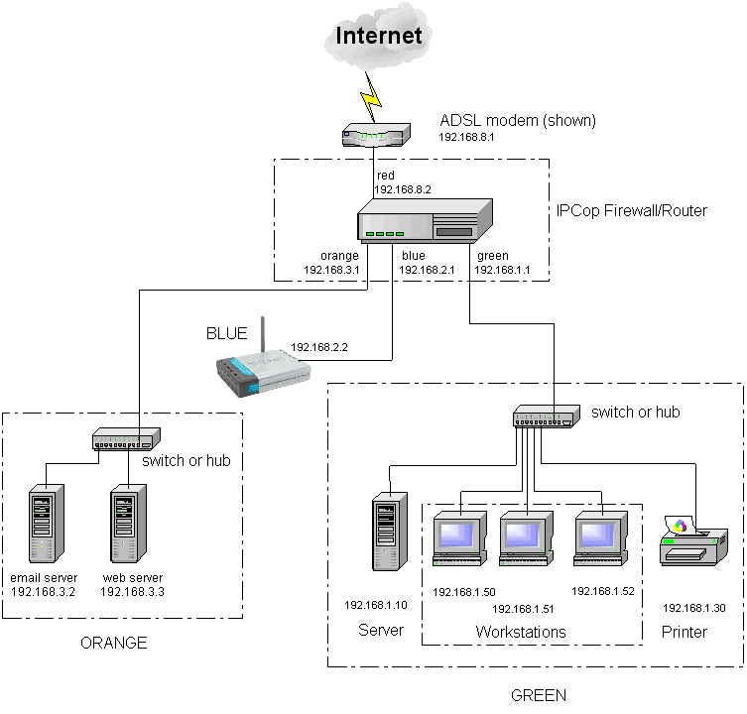
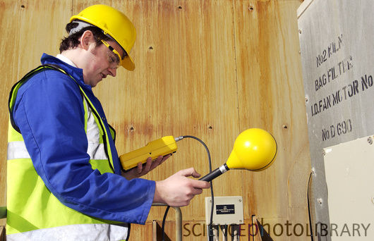
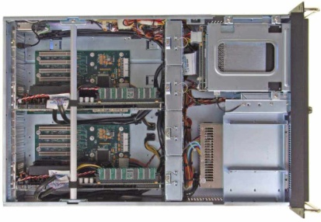
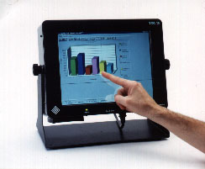
Contoh-contoh Sistem yang dianalisa dalam Teknik komputer
Sistem komputer
Sistem Pengukuran dan Monitoring
Sistem Jaringan
Sistem Pengontrolan Alat dengan komputer

Slide 3
Bagaimana belajar Analisa Kinerja Sistem
Pelajari dasar matematika statistik
Baca artikel secara sistematis
Peroleh pengalaman dengan bereksperimen

Slide 4
Terminologi Kinerja
Metriks : variabel ukur kinerja (metric)
Tujuan Kinerja (Goal) : untuk mencapai suatu fungsi tujuan yang dipersyaratkan.(maksimal, minimal atau optimal) Fungsi tujuan bisa berupa fungsi biaya (cost function), fungsi kehandalan (reliabilitas function).
Kriteria : Output hasil pencapaian /pemenuhan dari usaha pengelolaan kinerja
Spesifikasi/Requirement: output ideal yang diinginkan (demanding) dari usaha pengeloaan kinerja

Slide 5
Terminologi Kinerja (2)
Beban/Load : Variaabel yang mempengaruhi kinerja
Kapasitas Kemampuan sistem mengelola beban

Slide 6
Tahapan Kinerja
Goal
Metrix Evaluation
Loading
Leveling
Bench-marking
Measurement
Simulation
Modeling

Slide 7
Masalah dalam analisa kinerja sistem [Jain]
Specifying Performance Requirement
Evaluating design alternative
Comparing two or more system
Determining optimal value of parameter (tunning system)
Bottleneck Identification
Workload Characterization
Capacity Planning
Forecasting performance

Slide 8
Metriks berdasarkan
Waktu
- lifetime, MTBF, MTTF, MTTR - Settling time, rise time, peak time, transmission time
Availabilitas, Capacity channel , throughput, cost
Signal to Noise Ratio, bit error ratio, CMMR
Fidelity, liniearitas, reliabilitas (fault tolerance, hazardous/fail rate),
Hysterisis, capasitas channel, download speed, bitrate
Akurasi, presisi, bias, error
Jumlah
Rasio
konsistensi
Beban/load
Acauan

Slide 9
QoS Metrics usual in Computer Engineering
Response time
Throughput
Availability
Reliability
Security
Scalability
Extensibility

Slide 10
Response Time Breakdown
Service time (does not depend on the load)
• Congestion (load-dependent)

Slide 11
Throughput
Measured in units of work completed over time. It’s a rate.
I/O’s/sec
Page downloads/sec
HTTP requests/sec
Jobs/sec
Transactions per second (tps)

Slide 12
Throughput Example
An I/O operation at a disk of an OLTP system takes 10 msec on average.
What is the maximum throughput of the disk?
What is the throughput of the disk if it receives I/O requests at a rate of 80 requests/sec?

Slide 13
Throughput example

Slide 14
Availability
Fraction of time a system is available (i.e.,operational).
Service interruptions can damage the reputation of a company, may endanger lives, and may cause financial disasters.
A system with 99.99% availability over 30 days is unavailable (1-0.9999) x 30 x 24 x 60 = 4.32 minutes.

Slide 15
Availability Problems

Slide 16
Admission Control

Slide 17
Admission Control
•Improved response time
•Decreased availability

Slide 18
Scalability
System A is not scalable

Slide 19
Extensibility
Property of a system to constantly evolve to meet functional and performance requirements.
Autonomic computing, self-managing systems, self-healing systems.

Slide 20
Computer System Lifecycle
Functional requirements: what the system has to do and on what type of platforms.
Non-functional requirements: how well the system has to accomplish
its functions. Service Level Agreements (SLA) are established.
In many cases, non-functional requirements have been neglected or
considered only at system test time!

Slide 21
Computer System Lifecycle
How will the requirements be met?
- System architecture
- System broken down into components
- Major data structures, files, and databases are designed.
- Interfaces between components are specified

Slide 22
Computer System Lifecycle
Components are implemented.
- some are new
- some are re-used
- some are adapted
Components are interconnected to form a system
Components should be instrumented as they are built

Slide 23
Computer System Lifecycle
Concurrent with system development, as components become available
(unit testing)
Integrated tests are carried out when the entire system is ready.
Often, more time is spent in testing functional requirements than in testing non-functional requirements.

Slide 24
Computer System Lifecycle
Configuration parameters have to be set in order to meet the SLAs.
e.g., TCP parameters, database poolsize, maximum number of threads, etc.

Slide 25
Computer System Lifecycle
Constant monitoring to check if the system is meeting demands:
workload (peak periods, unusual patterns)
external metrics (user-perceived)
internal metrics (help to detect bottlenecks and to fine tune the system)
availability (external and internal)
May need to dynamically adjust configuration parameters

Slide 26
Computer System Lifecycle
Systems may need to evolve to cope with new laws and Regulations (e.g., HIPPA)
Systems may need to evolve to provide new functions (e.g., sale of downloadable MP3 music in addition to CDs)
How are the IT resources going to cope with evolution in terms of SLAs?

Slide 27
Reference Model for IT
Business Model:
- number of branches
- number and location of ATMs
- number of accounts of each type
business evolution plans (e.g., mergers)
Social Model
- privacy policy
- accessibility policy

Slide 28
User Model: Customer Behavior Model Graph

Slide 29
IT Infrastructure: Example

