Slide 1
Input Output Device
Pengantar Ilmu Komputer

Slide 2
Definition
Input Device :
→ any peripheral (piece of computer hardware equipment) used to provide data and control signals to an information processing system such as a computer or other information appliance

Slide 3
Types of Input
Types of input :
Signal Input
→ Data
Maintenance Input
→ Program

Slide 4
Terminal
Terminal →A device that enables you to communicate with a computer. Generally, a terminal is a combination of input device and output device.

Slide 5
Types Of Terminal
dumb terminal: has no processing capabilities. It relies entirely on the computer's processor.
smart terminal: contains some processing power, but not as much as an intelligent terminal.
intelligent terminal (programmable Terminal): a stand-alone device that contains main memory and a CPU.

Slide 6
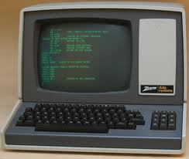
Dumb Terminal
Zenith Z – 19

Slide 7
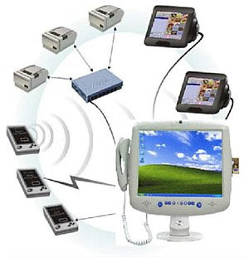
Smart Terminal

Slide 8
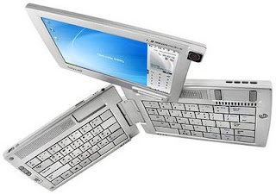
Intelligent Terminal

Slide 9
Input Devices Types
Keyboard
keyboard is a typewriter-style device, which uses an arrangement of buttons or keys, to act as mechanical levers or electronic switches.
basic design by Christopher Latham at 1868 and marketed 1877 by Remington.

Slide 10
Keyboard Types
Keyboard types :
Qwerty Keyboard
is the most common modern-day keyboard layout. The name comes from the first six letters (keys) appearing in the top left letter row of the keyboard, read left to right: Q-W-E-R-T-Y. The QWERTY design is based on a layout created for the Sholes and Glidden typewriter and sold to Remington in the same year, when it first appeared in typewriters. It became popular with the success of the Remington No. 2 of 1878, and remains in use on electronic keyboards due to the network effect of a standard layout and a belief that alternatives fail to provide very significant advantages.

Slide 11
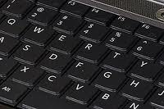
Qwerty Keyboard

Slide 12
Keyboard Types (2)
Concept Keyboard
Keyboard with special design
Dvorak Keyboard
A keyboard designed for speed typing. The Dvorak keyboard was designed in the 1930s by August Dvorak, a professor of education, and his brother-in-law, William Dealy. Unlike the traditional QWERTY keyboard, the Dvorak keyboard is designed so that the middle row of keys includes the most common letters. In addition, common letter combinations are positioned in such a way that they can be typed quickly.
In addition to the standard Dvorak keyboard, there are two additional Dvorak keyboards, a left-handed and right-handed keyboard. These keyboards are designed for people who have only one hand for typing.

Slide 13
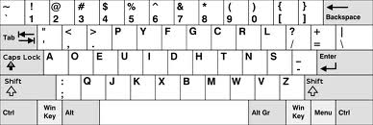
Dvorak Keyboard

Slide 14
Keyboard Types (3)
Chord Keyboard
A keyset or chorded keyboard (also called a chorded keyset, chord keyboard or chording keyboard) is a computer input device that allows the user to enter characters or commands formed by pressing several keys together, like playing a "chord" on a piano.
Numeric Keyboard
A numeric keypad, numpad or tenkey, is the small, palm-sized, seventeen key section of a computer keyboard, usually on the very far right. The numeric keypad features digits 0 to 9, addition (+), subtraction (−), multiplication (*) and division (/) symbols, a decimal point (.) and Num Lock and Enter keys.

Slide 15
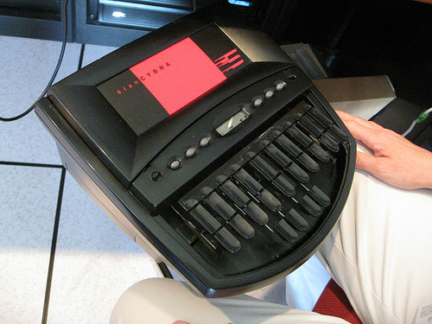
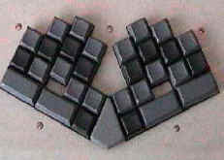
Chord Keyboard
Senotype Keyboard Palantype Keyboard

Slide 16
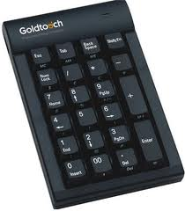
Numeric Keyboard

Slide 17
Input Devices Types (2)
Mouse
A mouse is a pointing device that functions by detecting two-dimensional motion relative to its supporting surface. Physically, a mouse consists of an object held under one of the user's hands, with one or more buttons.

Slide 18
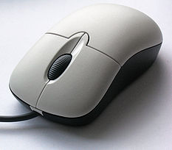
Mouse

Slide 19
Input Devices Types (3)
Scanner
is a device that optically scans images, printed text, handwriting, or an object, and converts it to a digital image.

Slide 20
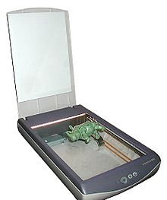
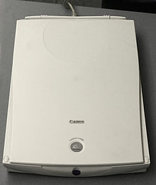
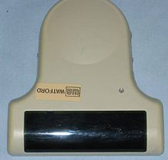
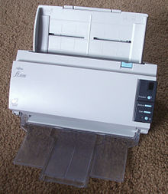
Scanner

Slide 21
Input Devices Types (4)
Digital Camera
a camera that takes video or still photographs by recording images on an electronic image sensor.
Mic
is an acoustic-to-electric transducer or sensor that converts sound into an electrical signal

Slide 22
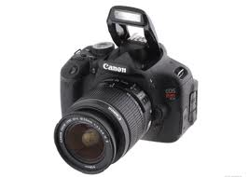
Digital Camera

Slide 23
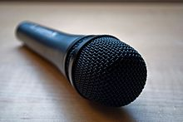
Mic

Slide 24
Output Devices
is any piece of computer hardware equipment used to communicate the results of data processing carried out by an information processing system (such as a computer) which converts the electronically generated information into human-readable form

Slide 25
Output Device Classification
Output device classification from output Form
Hardcopy Device
Softcopy Device
Drive device

Slide 26
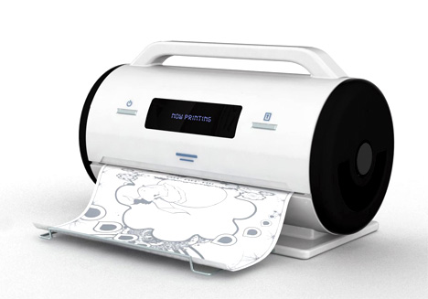
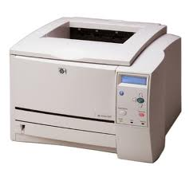
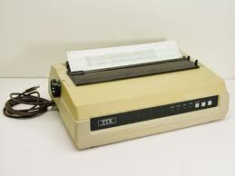
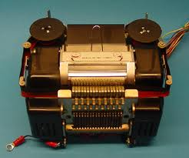
Printer

Slide 27
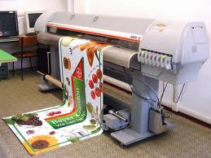
Plotter

Slide 28
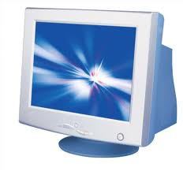
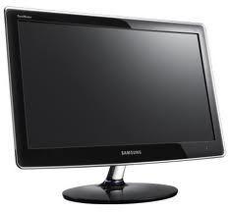
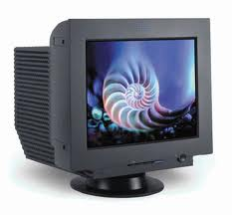
Monitor

Slide 29
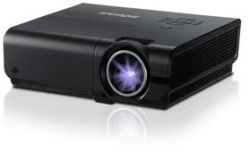
Infocus

Slide 30
Output Devices (2)
Smart Card
A smart card, chip card, or integrated circuit card (ICC) is any pocket-sized card with embedded integrated circuits. Smart cards are made of plastic, generally polyvinyl chloride, but sometimes acrylonitrile butadiene styrene or polycarbonate.
Smart cards can provide identification, authentication, data storage and application processing. Smart cards may provide strong security authentication for single sign-on (SSO) within large organizations.

Slide 31
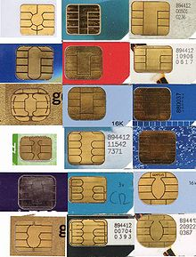
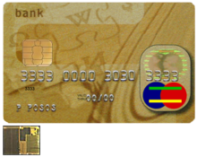
Smart Card

Slide 32
Output Devices (3)
Biometrics
Biometrics (or biometric authentication) refers to the identification of humans by their characteristics or traits. Biometrics is used in computer science as a form of identification and access control. It is also used to identify individuals in groups that are under surveillance.

Slide 33
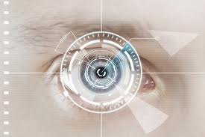
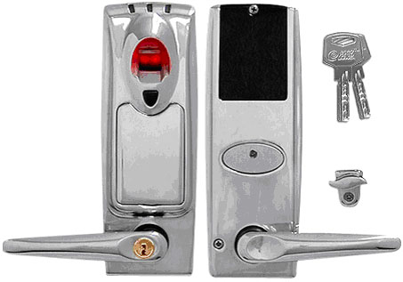
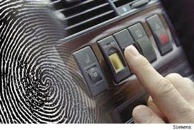
Biometric

Slide 34
Output Devices (4)
Haptics
Haptic technology, or haptics, is a tactile feedback technology which takes advantage of the sense of touch by applying forces, vibrations, or motions to the user. This mechanical stimulation can be used to assist in the creation of virtual objects in a computer simulation, to control such virtual objects, and to enhance the remote control of machines and devices (telerobotics). It has been described as "doing for the sense of touch what computer graphics does for vision". Haptic devices may incorporate tactile sensors that measure forces exerted by the user on the interface.

Slide 35
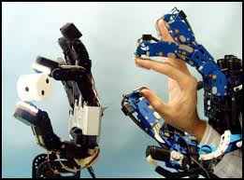
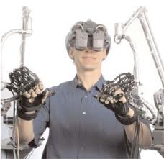
Haptics

Slide 36
Output Devices (5)
Wearable Computer
Private Eye TM (Reflection Technology)
Wearable Computer TM (Computing Devices International)

Slide 37
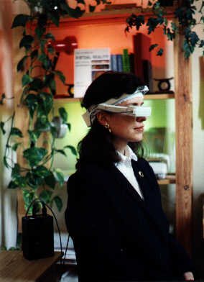
Private Eye

Slide 38
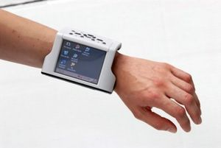
Wearable Computer

Slide 39
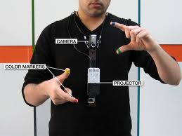
Output Devices (6)
Sixth Sense
SixthSense' is a wearable gestural interface that augments the physical world around us with digital information and lets us use natural hand gestures to interact with that information.

Slide 40
Output Devices (7)
Helmet Mounted Display
A helmet-mounted display (HMountD - pronounced "H-mount-D") is a device used in some modern aircraft, especially combat aircraft

Slide 41
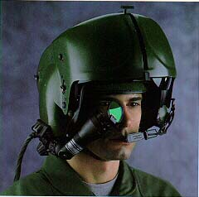
Helmet Mounted Display

Slide 42
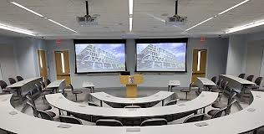
Smart Rooms

Slide 43
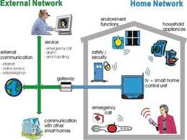
Smart Home

Slide 44
Smart Clothes
Smart Clothes
"Smart Clothing" is made from fabrics that are wireless and washable that integrate computing fibers and materials into the integrity of the fabrics.

Slide 45
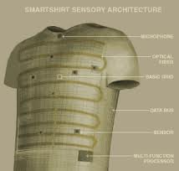
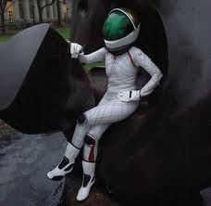
Smart Clothes

Slide 46
Questions
Find Input and output device for certain tasks! Describe about the technology and task
Find information about printer types and how it works!
Find information about monitor types, and describe its weaknesses and strength!
Describe which biometric technologies you used before and what for? Give your opinion which technologies will booming in the future, write your reasons!

