Slide 1
Analysis and System Design Terminology
Information System Analysis and Design
Week 4

Slide 2
Definition
Analysis
An activity starts from early process in studied and evaluate some case
System
Some tools consist of human, machine or tools and procedure and concept collect become one to achieve aim
Information
Data processed to useful form to recipient

Slide 3
Systems Analysis and Design What is it?
System
organized set of related components established to accomplish certain task
Natural
Planned and placed by people
Computer system
A system that has computers as one of its components

Slide 4
Information Systems Analysis and Design
A method used by companies to create and maintain systems that perform basic business functions
Main goal is to improve employee efficiency by applying software solutions to key business tasks
A structured approach must be used in order to ensure success

Slide 5
Information Systems Analysis and Design
Systems Analyst performs analysis and design based upon:
Understanding of organization’s objectives, structure and processes
Knowledge of how to exploit information technology for advantage

Slide 6
General Model of System
Simple Model system
System with many input or output

Slide 7
System with many input or output
Input
Output
Input
Process
Output
Input
Output

Slide 8
Systems Analysis and Design: Core Concepts
Major goal: to improve organizational systems by developing or acquiring software and training employees in its use
Application software, or a system, supports organizational functions or processes

Slide 9
Systems Analysis and Design: Core Concepts
System: Turns data into information and includes:
Hardware and system software
Documentation and training materials
Job roles associated with the system
Controls to prevent theft or fraud
The people who use the software to perform their jobs

Slide 10
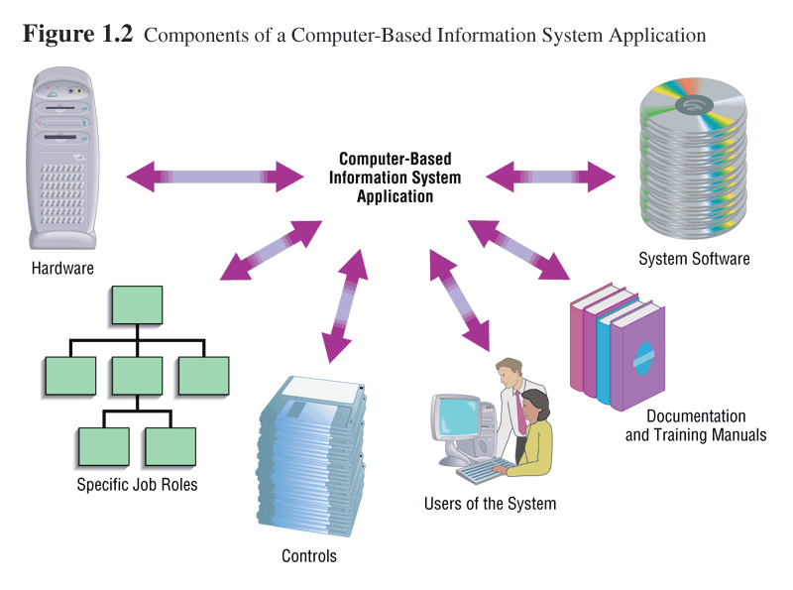

Slide 11
Approaches to Systems Development
Process-Oriented Approach
Focus is on flow, use and transformation of data in an information system
Involves creating graphical representations such as data flow diagrams and charts
Data are tracked from sources, through intermediate steps and to final destinations
Natural structure of data is not specified
Disadvantage: data files are tied to specific applications

Slide 12
Approaches to Systems Development
Data-Oriented Approach
Depicts ideal organization of data, independent of where and how data are used
Data model describes kinds of data and business relationships among the data
Business rules depict how organization captures and processes the data

Slide 13
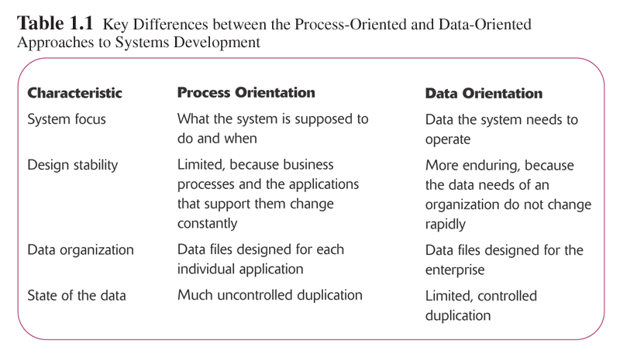

Slide 14
System Analyst
Expert in problem identification and prepared written documentation about how computer solved the problem. System analyst work together with user developed new system and repair current system

Slide 15
Systems Analyst
Professional computer employee who performs analysis and design
Change agent
Overcome reluctance of users to change
Typical career path
Programmer
Programmer / Analyst
Systems Analyst

Slide 16
Systems Analyst
Professional computer employee who performs analysis and design
Change agent
Overcome reluctance of users to change
Typical career path
Programmer
Programmer / Analyst
Systems Analyst

Slide 17
Systems Analyst Functions
Coordination
Schedules and system-related tasks
Personnel
Manager
Programmers
Users
Vendors of computer equipment
Mail room employees
Contractors

Slide 18
Systems Analyst Functions
Communication
Oral presentations
Written documentation
Planning and design
Plans and designs new system
Involved from beginning of project through final implementation of the system

Slide 19
Systems Analyst Personal Qualities
Analytical mind
Good communication skills
Self-discipline
Self-direction
Organizational skills
Creativity
Ability to work without tangible results

Slide 20
Types of Information Systems and Systems Development
Transaction Processing Systems (TPS)
Automate handling of data about business activities (transactions)
Management Information Systems (MIS)
Converts raw data from transaction processing system into meaningful form
Decision Support Systems (DSS)
Designed to help decision makers
Provides interactive environment for decision making

Slide 21
Types of Information Systems and Systems Development
Expert Systems (ES)
Replicates decision-making process
Knowledge representation describes the way an expert would approach the problem

Slide 22
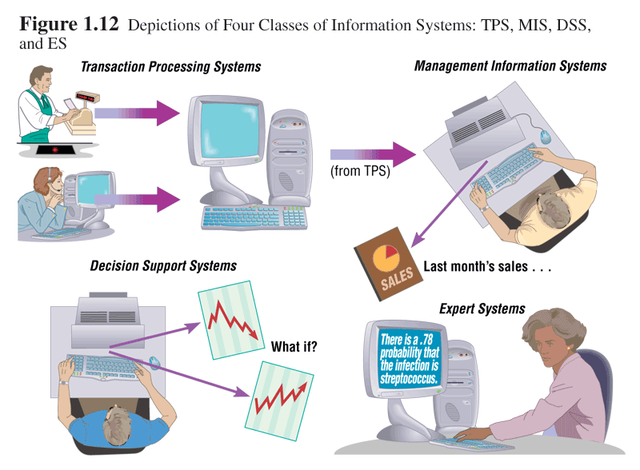

Slide 23
Developing Information Systems and the SDLC
System Development Methodology
Standard process followed in an organization

Slide 24
SDLC Systems Development Life Cycle
Consist Of
Preliminary investigation
Analysis
Design
Development
Implementation

Slide 25
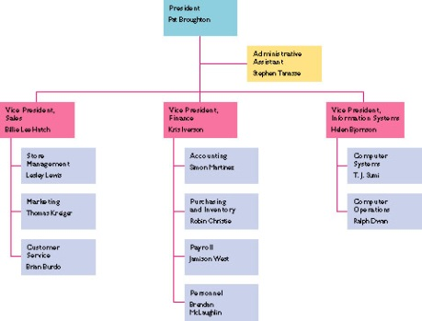
SDLC Preliminary Investigation
Feasibility study / System survey
Determine the problem
Describe the problem
Understand management decisions
Organizational chart
Informal hierarchy
Produces rough plan and what to do

Slide 26
SDLC Preliminary Investigation
Problem Definition
Nature of the problem
Separate problem from symptoms of problem
Scope of the project
Budget and schedule
Objectives of the project
What user thinks system should do

Slide 27
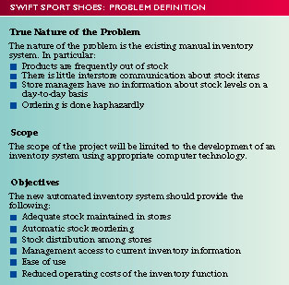
SDLC Preliminary Investigation
Report
What you have found
Recommendations
Financially feasible

Slide 28
SDLC Preliminary Investigation
Resulting Management Decision
Drop
Fix a simple problem
Authorize the analysis phase

Slide 29
SDLC Analysis
Understand the existing system
Gather data
Analyze data
Establish system requirements

Slide 30
SDLC Analysis – Data Gathering
Written documents
Interviews
Structured
Unstructured
Questionnaires
Observation
Visits by appointment
Participant observation
Sampling

Slide 31
SDLC Analysis – Analyze Data
How the current system works
Determine system requirements
Basis for documentation
Tools
Data flow diagram (DFD)
Decision tables

Slide 32
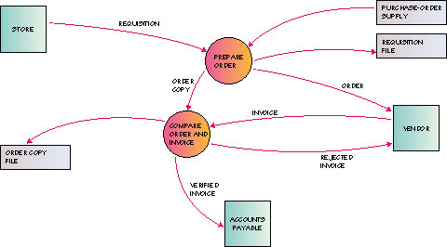
SDLC Analysis – Data Flow Diagram

Slide 33
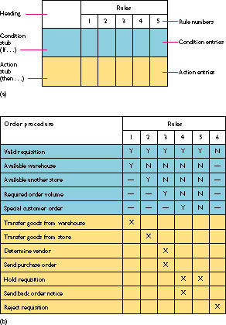
SDLC Analysis –Decision Tables

Slide 34
SDLC Analysis – System Requirements
Detailed list of things the system must be able to do
Design is based upon system requirements
Agreement upon requirements is needed before proceeding

Slide 35
SDLC Analysis – Report to Management
Summarize problems
Describe requirements
Cost analysis
Recommendations for next step
Obtain authorization to proceed

Slide 36
SDLC Design
Planning the new system
Two phases
Preliminary design
Detail design

Slide 37
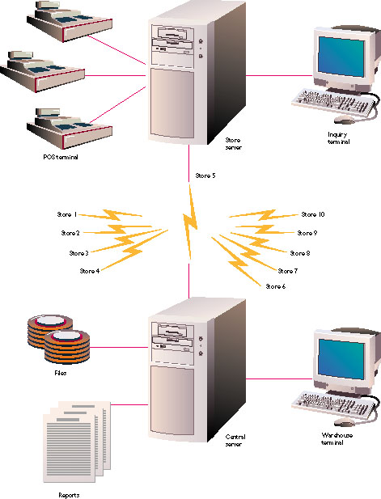
SDLC Preliminary Design
Major system aspects
Centralized or distributed
Online or batch
PC-based?
How will input be captured?
Necessary reports

Slide 38
SDLC Preliminary Design
Make or buy decision
Packaged software
Meet at least 75% of requirements?
Change business procedures for part or all of remainder?
Customize for part of all of remainder?
Custom software
Programmers write code
Outsourcing
System is developed by external organization

Slide 39
SDLC Preliminary Design
Create an overall plan
Offer alternatives that meet requirements
Explain differences
Evaluate costs

Slide 40
SDLC Preliminary Design
Build a prototype
Limited working system of subset
Does not need true functionality
Output looks like anticipated system output
Working model that can be modified and fine-tuned
Uses high-level software tools – CASE
Best for small-scale systems

Slide 41
SDLC Preliminary Design
CASE tools
Computer-Aided Software Engineering
Supports specific analysis and design tasks
Integrated environment that supports the entire systems development process

Slide 42
SDLC Preliminary Design
Presentation
All alternatives
Selected plan
Prototype of the system
Obtain authorization to proceed

Slide 43
SDLC Detail Design
Parts of detail design phase
Output requirements
Input requirements
Files and databases
Systems processing
Systems controls and backup

Slide 44
SDLC Detail Design
Output requirements
Medium
Type of reports
Contents

Slide 45
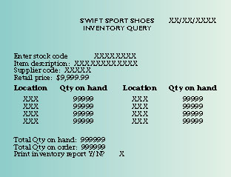
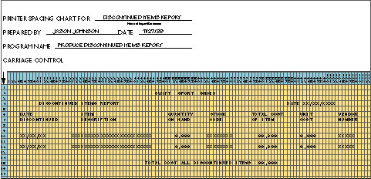
SDLC Detail Design

Slide 46
SDLC Detail Design
Input requirements
Medium
Content
Input forms
Validation
Volume

Slide 47
SDLC Detail Design
Files and Databases
Organization
Access
Format of records
Coordinate with database administrator regarding external databases and updating

Slide 48
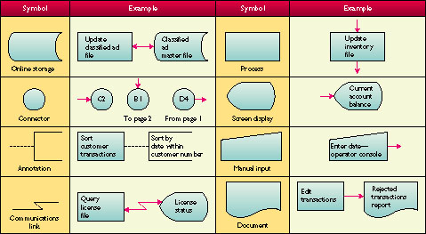
SDLC Detail Design
Flowchart Symbols

Slide 49
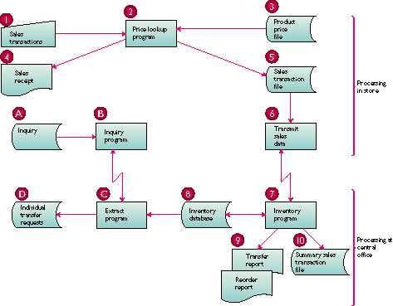
SDLC Detail Design

Slide 50
SDLC Detail Design
Systems Controls and Backup
Insure that input is processed correctly
Prevent fraud and tampering
System journals
Backup of system files

Slide 51
SDLC Detail Design
Report to Management
Detailed design specifications report
Presentation
Obtain authorization to proceed

Slide 52
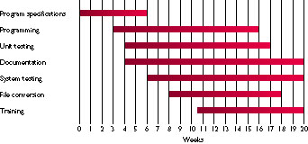
SDLC Development
Doing the work to bring the new system into being
Scheduling

Slide 53
SDLC Development
Programming
Refine the design
Detailed logic flowcharts and pseudocode
Testing
Unit testing
System testing
Volume testing

Slide 54
SDLC Implementation
Converting to the new system
Training
Equipment conversion
File conversion
System conversion
Auditing
Evaluation
Maintenance

Slide 55
SDLC Implementation – Training
Begin during testing
User’s manual (Technical Writers)
Hands-on
Training consideration
Space
Equipment
Data
User’s schedules

Slide 56
SDLC Implementation – Conversion
Equipment
Planning
Installation of new equipment
File
Manual to electronic
Special programs to convert old format to new

Slide 57
SDLC Implementation – Conversion
System
Direct conversion
Phased conversion
Pilot conversion
Parallel conversion

Slide 58
SDLC Implementation –Auditing
Audit trail
Trace output back to source

Slide 59
SDLC Implementation – Evaluation
Working
Meets original requirements
Benefits
Meets budget
Improvements

Slide 60
SDLC Implementation – Maintenance
Ongoing activity for life of system

Slide 61
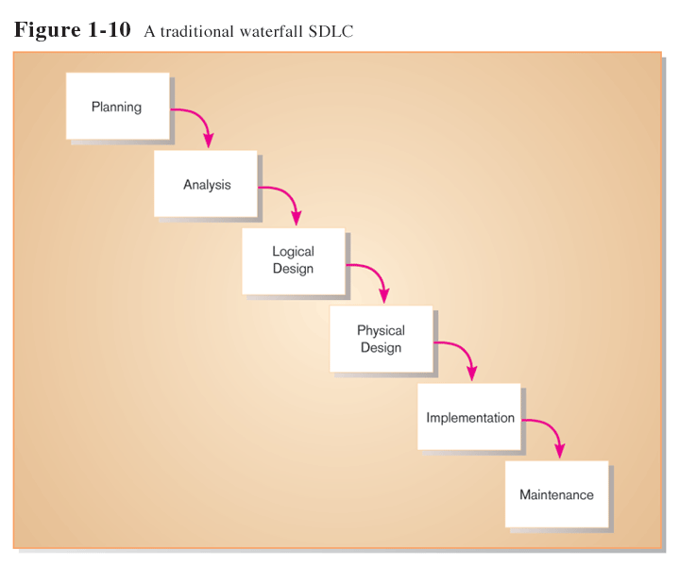
Traditional Waterfall SDLC
One phase begins when another completes, little backtracking and looping

Slide 62
Problems with Waterfall Approach
System requirements “locked in” after being determined (can't change)
Limited user involvement (only in requirements phase)
Too much focus on milestone deadlines of SDLC phases to the detriment of sound development practices

Slide 63
Alternatives to Traditional Waterfall SDLC
Prototyping
CASE tools
Joint Application Design (JAD)
Rapid Application Development (RAD)
Agile Methodologies
eXtreme Programming

Slide 64
Questions
Explain role of System Analyst in system development
Describe System Analyst capabilities needed to develop system
Find out and describe about TPS, MIS, DSS, ES

Slide 65
Question 2
Find out symbols of Flow Chart, Flow Map, Context Diagram, Data Flow Diagram and function of every diagram

Slide 66
To be Continue ….

