Slide 1

ESTIMATING PROJECT TIME, COST & BUDGETING
Information Technology Project Management
Magister Sistem Informasi
Universitas Komputer Indonesia
Source:
Pinto, j.k. 2010, 2ND. ED.
Larson, e.w., & Gray c.f., 2011, 5th. Ed.

Slide 2
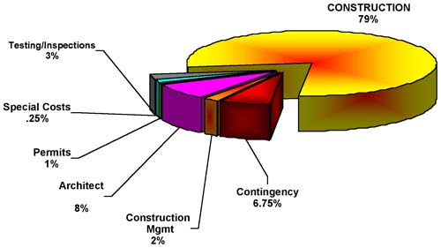
PROJECT ESTIMATION
Project estimation is indeed a yardstick for project cost control. And if the yardstick is faulty, you start on the “wrong foot”.
(Kharbanda, O.P., and Pinto, J.K. 1996:73)

Slide 3

Why Estimating Time & Cost Are Important
to support good decission
to schedule work
to determine how long the project should take and its cost
to determine whether the project is worth doing
to develop cash flow needs
to determine how well the project is progressing
to develop time-phased budgets and establish the project baseline.

Slide 4
The Relationship among WBS, Scheduling, and Budgeting
WBS
Project
Plan
Budgeting
Scheduling

Slide 5

Factors Influencing The Quality of Estimates
Planning Horizon
Project Duration
People
Project Structure and Organization
Padding Estimates
Organization Culture
Other Factors

Slide 6

Estimating Guidelines for Times, Costs, and Resources
Responsibility
Use several people to estimate
Normal conditions
Time units
Independence
Contigencies
Adding risk assesment to estimate helps to avoid surprises to stakeholder

Slide 7

Problems with Cost Estimation
Low initial estimates
Unexpected technical difficulties
Lack of definition
Specification changes
External factors

Slide 8

PROJECT BUDGET APROACH
Top Down Budgeting
Bottom Up Budgeting
Activity-Based Costing

Slide 9
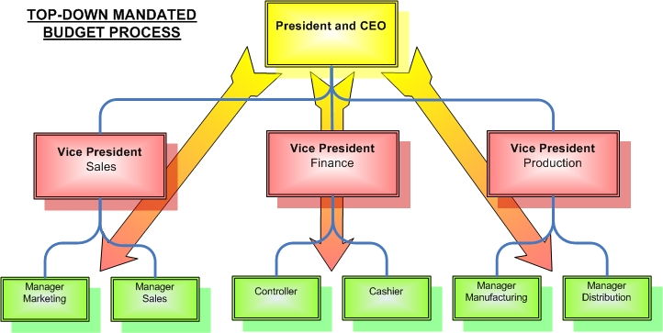
Top Down Estimating
Top down estimates usually are derived from someone who uses experience and/or information to determine the project duration and total cost. These estimates are sometimes made by top managers who have very little knowledge of the processes used to complete the project.

Slide 10
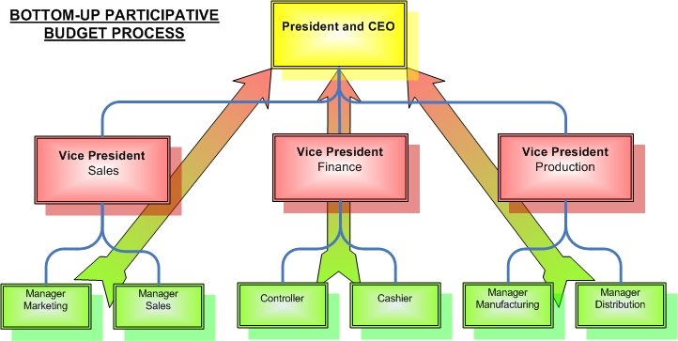
Bottom-Up Estimating
The Bottom-Up approach at the work package level can serve as a check on cost elements in the WBS by rolling up the work packages and associated cost accounts to major deliverables. Similarly, resource requirement can be checked. Later, the time, resource, and cost estimates from the work packages can be consolidated into time-phased networks, resource schedule, and budgets are used for control.

Slide 11
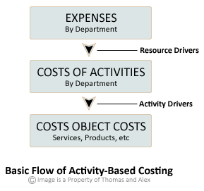
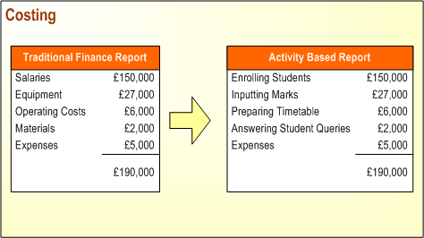
Activity-Based Costing
Is a budgeting method that asigns costs first to activities and then to the project’s based on each project’s use of resources.
Activity-based costing consists of four steps:
1. Identify the activities that consume resources and assign cost to them, as is done in a bottom-up budgeting process.
2. Identify the cost drivers associated with the activity. Resources, in the form of project personnel, and materials are key cost drivers.
3. Compute a cost rate per cost driver unit or transaction. Labor, for example, is commonly simply the cost of labor per hour, given as:
Cost rate/unit $cost/hour
4. Assign cost to projects by multiplying the cost driver rate times the volume of cost driver units consumed by the project. Example, assume the cost of senior software programmer is $40/hour and that she is to work on the project for a total of 80 hours. The cost to the project would be:
$40/hr x 80 hours = $3,200

Slide 12
Condition for Preferring Top-Down or Bottom-Up Time and Cost Estimates
Condition | Top-Down Estimates | Bottom-Up Estimates
Strategic decission making | X
Cost & time important |  | X
High uncertainty | X
Internall, small project | X
Fixed-price contract |  | X
Customer wants detail |  | X
Unstable scope | X

Slide 13
Top-Down and Bottom-Up Estimates
Top-Down Estimates | Bottom-Up Estimates
Intended Use Feasibility/conceptual phase Rough time/cost estimate Fund requirements Resource capacity planning | Intended Use Budgeting Scheduling Resource requirements Fund timing
Preparation Cost 1/10 to 3/10 of a percent of total project cost | Preparation Cost 3/10 to 1.0 of a percent of total project cost
Accuracy Minus 20 to plus 60% | Accuracy Minus 10 to plus 0%
Method Concencus Ratio Apportion Function point Learning curve | Method Template Parametric WBS packages Range estimates

Slide 14

Source of Project Cost
Labor
Material
Subcontractors
Equipment & facilities
Travel

Slide 15
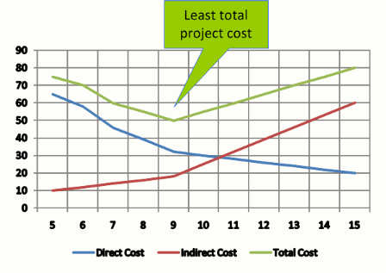
Direct vs Indirect Costs
Direct cost are those clearly assigned to the aspect of the project that generated the cost (example labor & materials).
Indirect cost, generally are linked to two features: overhead and selling and general administration.

Slide 16
Recurring vs. Nonrecurring Costs
Non recurring cost might be those associated with charges applied once at the beginning or end of the project, such as preliminary marketing analysis, personnel training, or outplacement services.
Recurring cost are those that typically continue to operate over the project’s life cycle. Most labor, material, logistics, and sales costs are consider recurring.

Slide 17

Fixed vs. Variable Costs
Fixed Cost, do not vary with respect to their usage. Example cost for leasing equipment.
Variable Cost, are those that accelerated or increase through usage; that is, the cost in direct proportion to the usage level. Example: equipment parts, materials, etc.

Slide 18

Normal vs Expedited Cost
Normal costs refer to those incurred in the routine process of working to complete the project according to the original, planned schedule agreed to by all project stakeholders at the beginning of the project.
Expedited costs are unplanned costs incurred when steps are taken to speed up the project’s completion.

Slide 19
Cost Classification
 | Type |  | Frequency |  | Adjustment |  | Schedule
Cost | Direct | Indirect | Recurring | Nonrecurring | Fixed | Variable | Normal | Expedited
Direct Labor | X |  | X |  | X |  | X
Building Lease |  | X | X |  | X |  | X
Expedite Costs | X |  |  | X |  | X |  | X
Material | X |  | X |  |  | X | X

Slide 20
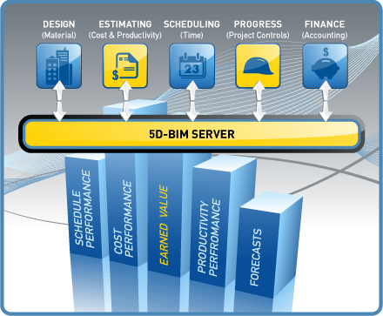
Time and Cost Estimate Accuracy by Type of Project
 | Bricks & Mortar | Information Technology
Conceptual stage | +60% to -30% | +200% to -30%
Deliverables defined | +30% to -15% | +100% to -15%
Work packages defined | +15% to -5% | +50% to -5%

Slide 21

TERIMA KASIH

