Slide 1
Bab 7: IT Infrastructure [Laudon] Chap 6
Dr. Ir. Yeffry Handoko Putra, M.T

Slide 2
Overview
Defining IT Infrastructure
Levels of IT Infrastructure
Evolution of IT Infrastructure: 1950–2005
Technology Drivers of Infrastructure Evolution

Slide 3
What is IT Infrastructure?
Shared technology resources that provide the platform for the firm’s specific information system applications.
IT infrastructure includes investment in hardware, software, and services—such as consulting, education, and training—that are shared across the entire firm or across entire business units in the firm.
For instance, a firm’s investment in thousands of new desktop computers networked together and linked to the Internet is an infrastructure investment because it serves many groups, goals, and business initiatives.
Notes:
As a manager, you’ll face many decisions about investments in hardware, software,
and other elements of IT infrastructure that are necessary for your firm to conduct its
business—and which may even give your firm new capabilities to surge ahead of
competitors. This chapter provides an overview of the technology and service components
of IT infrastructure and the most important trends in hardware and software platforms. We
look at the capabilities of major technology vendors as well as the technologies themselves
to help managers make intelligent choices about the appropriate technology platform for
their firm. If you would like a more introductory discussion of hardware and software or a
review of basic hardware and software concepts, you can find this information at the
Laudon Web site for Chapter 6.
In Chapter 1, we defined information technology (IT) infrastructure as the shared
technology resources that provide the platform for the firm’s specific information system
applications. IT infrastructure includes investment in hardware, software, and services—
such as consulting, education, and training—that are shared across the entire firm or
across entire business units in the firm. For instance, a firm’s investment in thousands of
new desktop computers networked together and linked to the Internet is an infrastructure
investment because it serves many groups, goals, and business initiatives.
Supplying U.S. firms with IT infrastructure is a $1.8 trillion dollar industry when
telecommunications, networking equipment and telecommunications services (Internet,
telephone, and data transmission) are included. Investments in infrastructure account for
between 25 and 35 percent of information technology expenditures in large firms (Weill et
al., 2002).
A firm’s IT infrastructure provides the foundation for serving customers, working
with vendors, and managing internal firm business processes (see Figure 6-1). In this
sense, IT infrastructure defines the capabilities of the firm today and in the near term of,
say, three to five years (the length of time it takes to make a significant change in the
firm’s IT infrastructure). For instance, if you want to provide customers with a daily
balance of cell phone charges on a Web site, and if you plan to use this capability as a
strategic differentiating feature of your firm, this implies certain infrastructure capabilities.
If you are a bank and want to sell banking services anywhere in the United States or the
world to all your customers, whether they have car loans, home loans, brokerage accounts, or just checking accounts, you will need an infrastructure that crosses these
different lines of business and operates on a global enterprise-wide basis.

Slide 4
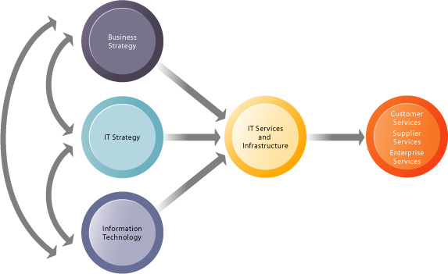
The connection between the firm, IT infrastructure, and business capabilities
Notes:
FIGURE 6-1 The connection between the firm, IT infrastructure, and business capabilities
The services a firm is capable of providing to its customers, suppliers, and employees are a direct function
of its IT infrastructure. Ideally, this infrastructure should support the firm’s business and information
systems strategy. New information technologies have a powerful impact on business and IT strategies, as
well as the services that can be provided to customers.

Slide 5
Defining IT Infastructure
Defining IT Infrastructure
as technology a set of physical devices and software applications that are required to operate the entire enterprise.
as services clusters a set of firmwide services budgeted by management and comprising both human and technical capabilities (Weill et al., 2002)

Slide 6
As service Platform
Computing platforms used to provide computing services that connect employees customers, and suppliers into a coherent digital environment, including large mainframes, desktop and laptop computers, and personal digital assistants (PDAs) and Internet appliances
Telecommunications services that provide data, voice, and video connectivity to employees, customers, and suppliers.
Data management services that store and manage corporate data and provide capabilities for analyzing the data.
Application software services that provide enterprise-wide capabilities such as enterprise resource planning, customer relationship management, supply chain management, and knowledge management systems that are shared by all business units.
Notes:
Computing platforms used to provide computing services that connect employees,customers, and suppliers into a coherent digital environment, including large
mainframes, desktop and laptop computers, and personal digital assistants (PDAs) and
Internet appliances.
Telecommunications services that provide data, voice, and video connectivity to
employees, customers, and suppliers.
Data management services that store and manage corporate data and provide
capabilities for analyzing the data.
Application software services that provide enterprise-wide capabilities such as
enterprise resource planning, customer relationship management, supply chain
management, and knowledge management systems that are shared by all business
units.
Physical facilities management services that develop and manage the physical
installations required for computing, telecommunications, and data management
services.
IT management services that plan and develop the infrastructure, coordinate with the
business units for IT services, manage accounting for the IT expenditure, and provide
project management services.
IT standards services that provide the firm and its business units with policies that determine which information technology will be used, when, and how.
IT education services that provide training in system use to employees and offer managers training in how to plan for and manage IT investments.
IT research and development services that provide the firm with research on potential
future IT projects and investments that could help the firm differentiate itself in the
marketplace.
This “service platform” perspective makes it easier to understand the business value
provided by infrastructure investments. For instance, the real business value of a fully loaded
Pentium 4 PC operating at 2 gigahertz that costs about $1,500 with a high-speed Internet
connection is hard to understand without knowing who will use it and how it will be used. When we
look at the services provided by these tools, however, their value becomes more apparent: The
new PC makes it possible for a high-cost employee making $100,000 a year to connect to all the
company’s major systems and the public Internet. The high-speed Internet service saves this
employee about one hour per day in reduced wait time for corporate and Internet information.
Without this PC and Internet connection, the value of this one employee to the firm might be cut
in half.

Slide 7
As service Platform
Physical facilities management services that develop and manage the physical installations required for computing, telecommunications, and data management services.
IT management services that plan and develop the infrastructure, coordinate with the business units for IT services, manage accounting for the IT expenditure, and provide project management services.
IT standards services that provide the firm and its business units with policies that determine which information technology will be used, when, and how.
IT education services that provide training in system use to employees and offer managers training in how to plan for and manage IT investments.
IT research and development services that provide the firm with research on potential future IT projects and investments that could help the firm differentiate itself in the marketplace.
Notes:
Computing platforms used to provide computing services that connect employees,customers, and suppliers into a coherent digital environment, including large
mainframes, desktop and laptop computers, and personal digital assistants (PDAs) and
Internet appliances.
Telecommunications services that provide data, voice, and video connectivity to
employees, customers, and suppliers.
Data management services that store and manage corporate data and provide
capabilities for analyzing the data.
Application software services that provide enterprise-wide capabilities such as
enterprise resource planning, customer relationship management, supply chain
management, and knowledge management systems that are shared by all business
units.
Physical facilities management services that develop and manage the physical
installations required for computing, telecommunications, and data management
services.
IT management services that plan and develop the infrastructure, coordinate with the
business units for IT services, manage accounting for the IT expenditure, and provide
project management services.
IT standards services that provide the firm and its business units with policies that determine which information technology will be used, when, and how.
IT education services that provide training in system use to employees and offer managers training in how to plan for and manage IT investments.
IT research and development services that provide the firm with research on potential
future IT projects and investments that could help the firm differentiate itself in the
marketplace.
This “service platform” perspective makes it easier to understand the business value
provided by infrastructure investments. For instance, the real business value of a fully loaded
Pentium 4 PC operating at 2 gigahertz that costs about $1,500 with a high-speed Internet
connection is hard to understand without knowing who will use it and how it will be used. When we
look at the services provided by these tools, however, their value becomes more apparent: The
new PC makes it possible for a high-cost employee making $100,000 a year to connect to all the
company’s major systems and the public Internet. The high-speed Internet service saves this
employee about one hour per day in reduced wait time for corporate and Internet information.
Without this PC and Internet connection, the value of this one employee to the firm might be cut
in half.

Slide 8
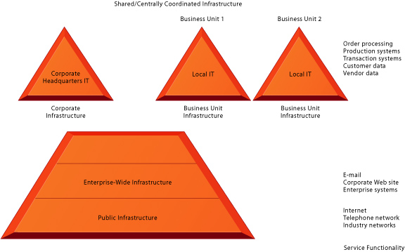
Level of IT Infrastructure
Notes:
Firm infrastructure is organized at three major levels: public, enterprise, and business unit
(Figure 6-2). There may be other lower levels, such as departments or individual
employees, but for now we focus on these three.
FIGURE 6-2 Levels of IT infrastructure
IT infrastructure exists at three different levels: public, enterprise, and business unit. Each level of
infrastructure provides a set of IT services and capabilities.
All firms are dependent on public IT infrastructure, which includes the Internet, the
public switched telephone network, industry-operated networks, and other IT support
facilities such as cable systems and cellular networks. Enterprise-wide infrastructure
includes services such as e-mail, a central corporate Web site, corporate-wide intranets,
and an increasing array of enterprise-wide software applications (see Chapter 11).
Business units also have their own infrastructure that is uniquely suited to their line of
business such as specialized production software and systems, customer and vendor
systems, and local order entry and other transaction systems.
In multiunit businesses, typical of most large firms, a central corporate infrastructure is also used to manage the entire enterprise, receive reports from business
units, and exercise central oversight.
Figure 6-2 raises some interesting questions: What, for instance, should be
handled by enterprise infrastructure and what by local business units? How much should
local business units be charged (and on what basis) for use of enterprise architecture?
Local business units may have unique demands that an enterprise-wide infrastructure may not address.

Slide 9
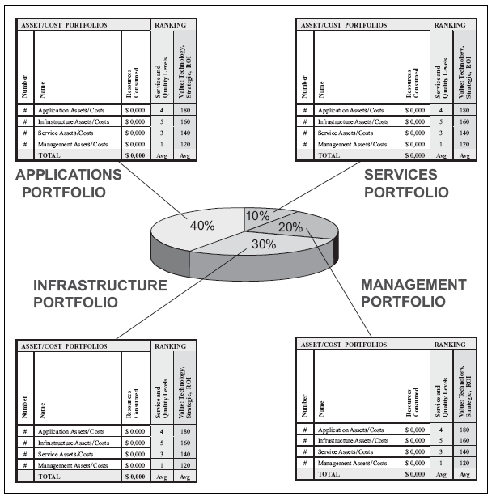
Infrastructure as A part of IT Portfolio
Notes:
[Benson] Chap 4

Slide 10
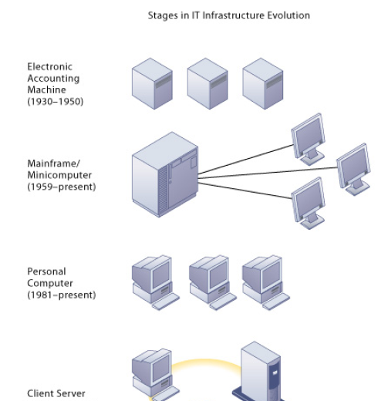
Evolution of IT Infrastructure: 1950–2005
Notes:
The IT infrastructure in organizations today is an outgrowth of over 50 years of evolution
in computing platforms. We have identified five stages in this evolution, each representing
a different configuration of computing power and infrastructure elements (see Figure 6-3). These eras do not necessarily end for all organizations at the same time, and the
technologies that characterize one era may also be used in another time period for other
purposes. For example, some companies still run traditional mainframe or minicomputer
systems. Mainframe computers today are used as massive servers supporting large Web
sites and corporate enterprise applications. More detail on infrastructure history can be
found on the Laudon Web site for Chapter 6.
The five eras are automated special-purpose machines, general-purpose mainframe and
minicomputer computing, personal computers, client/server networks, and enterprise and
Internet computing.

Slide 11
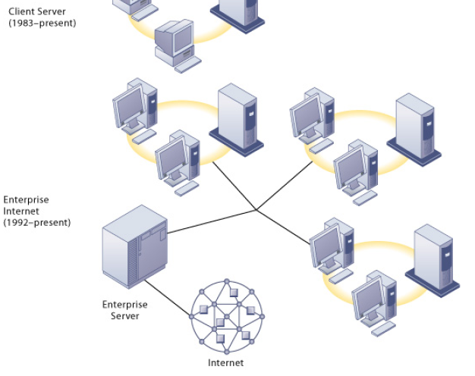

Slide 12
ELECTRONIC ACCOUNTING MACHINE ERA: 1930–1950
GENERAL-PURPOSE MAINFRAME AND MINICOMPUTER ERA: 1959 TO PRESENT
PERSONAL COMPUTER ERA: (1981 TO PRESENT)
CLIENT/SERVER ERA (1983 TO PRESENT)
ENTERPRISE INTERNET COMPUTING ERA (1992 TO PRESENT)
Notes:
ELECTRONIC ACCOUNTING MACHINE ERA: 1930–1950
The first era of business computing used specialized machines that could sort computer cards into bins, accumulate totals, and print reports (DaCruz, 2004). Although the electronic accounting machine was an efficient processor of accounting tasks, the machines were large and cumbersome. Software programs were hardwired into circuit boards, and they could be changed by altering the wired connections on a patch board. There were no programmers, and a human machine operator was the operating system, controlling all system resources.
GENERAL-PURPOSE MAINFRAME AND MINICOMPUTER ERA: 1959 TO PRESENT
The first commercial all-electronic vacuum tube computers appeared in the early 1950s
with the introduction of the UNIVAC computers and the IBM 700 Series. Not until 1959
with the introduction of the IBM 1401 and 7090 transistorized machines did widespread
commercial use of mainframe computers begin in earnest. In 1965, the general-purpose
commercial mainframe computer truly came into its own with the introduction of the IBM
360 series. The 360 was the first commercial computer with a powerful operating system
that could provide time sharing, multitasking, and virtual memory in more advanced
models.
Mainframe computers eventually became powerful enough to support thousands of
online remote terminals connected to a centralized mainframe using proprietary
communication protocols and proprietary data lines. The first airline reservation systems
appeared in 1959 and became the prototypical online, real-time interactive computing
system that could scale to the size of an entire nation.
IBM dominated mainframe computing from 1965 onward and still dominates this
$27 billion global market in 2004. Today IBM mainframe systems can work with a wide
variety of different manufacturers’ computers and multiple operating systems on client/
server networks and networks based on Internet technology standards.
The mainframe era was a period of highly centralized computing under the control
of professional programmers and systems operators (usually in a corporate data center),
with most elements of infrastructure provided by a single vendor, the manufacturer of the
hardware and the software. This pattern began to change with the introduction of
minicomputers produced by Digital Equipment Corporation (DEC) in 1965. DEC
minicomputers (PDP-11 and later the VAX machines) offered powerful machines at far
lower prices than IBM mainframes, making possible decentralized computing, customized
to the specific needs of individual departments or business units rather than time sharing
on a single huge mainframe.
For instance, at the first level a Web server will serve a Web page to a client in
response for a request for service. Web server software is responsible for locating and
managing stored Web pages. If the client requests access to a corporate system (a product
list or price information, for instance), the request is passed along to an application server.
Application server software handles all application operations between a user and an
organization’s back-end business systems. The application server may reside on the same
computer as the Web server or on its own dedicated computer. Chapters 7 and 8 provide more detail on other pieces of software that are used in multitiered client/server
architectures for e-commerce and e-business. Client/server computing enables businesses to distribute computing work across a
number of smaller, inexpensive machines that cost much less than minicomputers or
centralized mainframe systems. The result is an explosion in computing power and
applications throughout the firm.
Novell Netware was the leading technology for client/server networking at the
beginning of the client/server era. Today Microsoft is the market leader, with its Windows
operating systems (Windows Server, Windows XP, Windows 2000), controlling 78 percent
of the local area network market.
PERSONAL COMPUTER ERA: (1981 TO PRESENT)
Although the first truly personal computers (PCs) appeared in the 1970s (the Xerox Alto,
MIT’s Altair, and the Apple I and II, to name a few), these machines had only limited
distribution to computer enthusiasts. The appearance of the IBM PC in 1981 is usually
credited as the beginning of the PC era because this machine was the first to become
widely adopted in American businesses. At first using the DOS operating system, a textbased
command language, and later the Microsoft Windows operating system, the Wintel
PC computer (Windows operating system software on a computer with an Intel microprocessor)
became the standard desktop personal computer. Today, 95 percent of the
world’s estimated 1 billion computers use the Wintel standard.
Proliferation of PCs in the 1980s and early 1990s launched a spate of personal
desktop productivity software tools—word processors, spreadsheets, electronic
presentation software, and small data management programs—that were very valuable to
both home and corporate users. These PCs were standalone systems until PC operating
system software in the 1990s made it possible to link them into networks
CLIENT/SERVER ERA (1983 TO PRESENT)
In client/server computing, desktop or laptop computers called clients are networked to
server computers that provide the client computers with a variety of services and
capabilities. Computer processing work is split between these two types of machines. The
client is the user point of entry, whereas the server provides communication among the
clients, processes and stores shared data, serves up Web pages, or manages network
activities. The term server refers to both the software application and the physical
computer on which the network software runs. The server could be a mainframe, but today
server computers typically are more powerful versions of personal computers, based on
inexpensive Intel chips and often using multiple processors in a single computer box.
The simplest client/server network consists of a client computer networked to a
server computer, with processing split between the two types of machines. This is called a
two-tiered client/server architecture. Whereas simple client/server networks can be found
in small businesses, most corporations have more complex, multitiered (often called Ntier)
client/server architectures in which the work of the entire network is balanced over
several different levels of servers, depending on the kind of service being requested (see
Figure 6-4)
ENTERPRISE INTERNET COMPUTING ERA (1992 TO PRESENT)
The success of the client/server model posed a new set of problems for corporations. Many
large firms found it difficult to integrate all of their local area networks (LANs) into a single,
coherent corporate computing environment. Applications developed by local departments
and divisions in a firm, or in different geographic areas, could not communicate easily with
one another and share data.
In the early 1990s, firms turned to networking standards and software tools that
could integrate disparate networks and applications throughout the firm into an enterprisewide
infrastructure. As the Internet developed into a trusted communications environment
after 1995, business firms began using the Transmission Control Protocol/Internet Protocol
(TCP/IP) networking standard to tie their disparate networks together. We discuss TCP/IP
in detail in Chapter 8.
The resulting IT infrastructure links different types and brands of computer
hardware and smaller networks into an enterprise-wide network so that information can
flow freely across the organization and between the firm and other organizations.
Enterprise networks link mainframes, servers, PCs, mobile phones, and other handheld
devices, and connect to public infrastructures such as the telephone system, the Internet,
and public network services.
The enterprise infrastructure employs software that can link disparate applications
and enable data to flow freely among different parts of the business. Chapter 2 describes
how enterprise applications perform this function. Other solutions for enterprise integration
include enterprise application integration software, Web services, and outsourcing to
external vendors that provide hardware and software for a comprehensive enterprise
infrastructure. We discuss these solutions in detail in section 6.4 and in Chapter 11.
The enterprise era promises to bring about a truly integrated computing and IT
services platform for the management of global enterprises. The hope is to deliver critical
business information painlessly and seamlessly to decision makers when and where they
need it to create customer value. This could be everything from getting inventory data to
the mobile salesperson in the customer’s office, to helping a customer at a call center with
a problem customer, or providing managers with precise up-to-the-minute information on
company performance.
That is the promise, but the reality is wrenchingly difficult and awesomely expensive. Most large firms have a huge, tangled web of hardware systems and software
applications inherited from the past. This makes achieving this level of enterprise
integration a difficult, long-term process that can last perhaps as long as a decade and
cost large companies hundreds of millions of dollars. Table 6-1 compares each era on the
infrastructure dimensions discussed above.

Slide 13
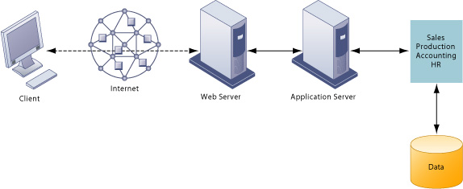
A multitiered client/server network (N-tier)
Notes:
For instance, at the first level a Web server will serve a Web page to a client in
response for a request for service. Web server software is responsible for locating and
managing stored Web pages. If the client requests access to a corporate system (a product
list or price information, for instance), the request is passed along to an application server.
Application server software handles all application operations between a user and an
organization’s back-end business systems. The application server may reside on the same
computer as the Web server or on its own dedicated computer. Chapters 7 and 8 provide more detail on other pieces of software that are used in multitiered client/server
architectures for e-commerce and e-business. Client/server computing enables businesses to distribute computing work across a
number of smaller, inexpensive machines that cost much less than minicomputers or
centralized mainframe systems. The result is an explosion in computing power and
applications throughout the firm.
Novell Netware was the leading technology for client/server networking at the
beginning of the client/server era. Today Microsoft is the market leader, with its Windows
operating systems (Windows Server, Windows XP, Windows 2000), controlling 78 percent
of the local area network market.

Slide 14
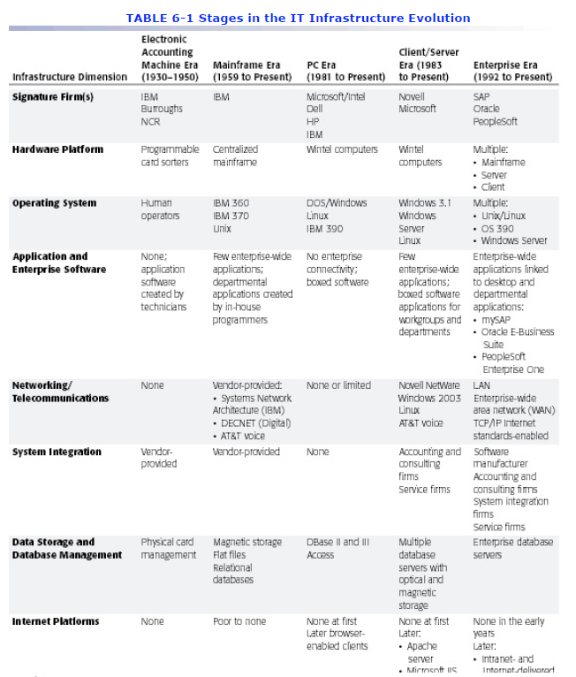

Slide 16
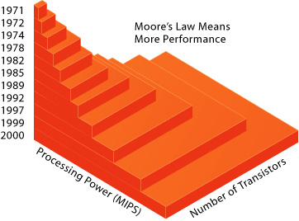
Technology Drivers of Infrastructure Evolution
Moore’s Law and microprocessor performance
Notes:
The changes in IT infrastructure we have just described have resulted from developments
in computer processing, memory chips, storage devices, telecommunications and
networking hardware and software, and software design that have exponentially increased
computing power while exponentially reducing costs. Let’s look at the most important
developments.
MOORE’S LAW AND MICROPROCESSING POWER
In 1965, Gordon Moore, the director of Fairchild Semiconductor’s Research and
Development Laboratories, an early manufacture of integrated circuits, wrote in Electronics
magazine that since the first microprocessor chip was introduced in 1959, the number of
components on a chip with the smallest manufacturer costs per component (generally
transistors) had doubled each year. This assertion became the foundation of Moore’s Law.
Moore later reduced the rate of growth to a doubling every two years (Tuomi, 2002).
This law would later be interpreted in multiple ways. There are at least three
variations of Moore’s Law, none of which Moore ever stated: (1) the power of
microprocessors doubles every 18 months (Tuomi, 2002); (2) computing power doubles
every 18 months; and (3) the price of computing falls by half every 18 months.
Figure 6-5 illustrates the relationship between number of transistors on a
microprocessor and millions of instructions per second (MIPS), a common measure of
processor power. Figure 6-6 shows the exponential decline in the cost of transistors and
rise in computing power.

Slide 17
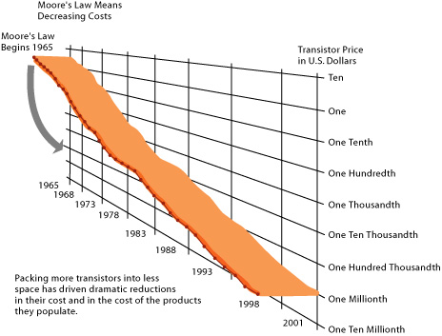
Moore’s Law and microprocessor performance
Falling cost of chips
Notes:
FIGURE 6-6 Falling cost of chips
Packing more transistors into less space has driven down transistor cost dramatically as well as the cost of
the products in which they are used.
There is reason to believe the exponential growth in the number of transistors and
the power of processors coupled with an exponential decline in computing costs will
continue into the future. Chip manufacturers continue to miniaturize components. Intel has
recently changed its manufacturing process from 0.13-micron component size (a micron is
a millionth of a meter), introduced in 2002, to a newer 90-nanometer process in 2004 (a
nanometer is a billionth of a meter). With a size of about 50 nanometers, today’s
transistors should no longer be compared to the size of a human hair but rather to the size
of a virus, the smallest form of organic life.
By using nanotechnology, Intel believes it can shrink the size of transistors down to
the width of several atoms. Nanotechnology uses individual atoms and molecules to create
computer chips and other devices that are thousands of times smaller than current
technologies permit. IBM and other research labs have created transistors from nanotubes
and other electrical devices (IBM, 2004) and have developed a manufacturing process that
could produce nanotube processors economically (Figure 6-7). Other new technologies
include strained silicon, 300-millimeter production wafers (which decrease the costs of
production), and denser interconnections among components.

Slide 18
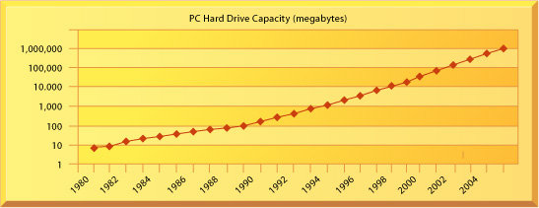
Technology Drivers of Infrastructure Evolution
THE LAW OF MASS DIGITAL STORAGE
The capacity of hard disk drives grows exponentially, 1980–2004
Notes:
THE LAW OF MASS DIGITAL STORAGE
A second technology driver of IT infrastructure change is the Law of Mass Digital Storage.
The world produces as much as 5 exabytes of unique information per year (an exabyte is a
billion gigabytes, or 1018 bytes). The amount of digital information is roughly doubling
every year (Lyman and Varian, 2003). Almost all of this information growth involves
magnetic storage of digital data, and printed documents account for only 0.003 percent of
the annual growth.
Fortunately, the cost of storing digital information is falling at an exponential rate.
Figure 6-8 shows that PC hard drive capacity—beginning with a Seagate 506 in 1980 that
had 5 megabytes of memory—has grown at a compound annual growth rate of 25 percent
in the early years to over 60 percent a year since 1990. Today’s PC hard drives have
storage densities approaching 1 gigabyte per square inch and total capacities of over 200
gigabytes (IBM, Seagate).

Slide 19
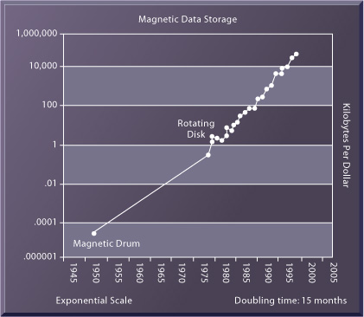
THE LAW OF MASS DIGITAL STORAGE
The cost of storing data declines exponentially, 1950–2004
Source: Kurzweill, 2003.
Notes:
Figure 6-9 shows that the number of kilobytes that can be stored on magnetic
disks for one dollar from 1950 to 2004 roughly doubled every 15 months.
FIGURE 6-9 The cost of storing data declines exponentially, 1950–2004
Since the first magnetic storage device was used in 1955, the cost of storing a kilobyte of data has fallen
exponentially, doubling the amount of digital storage for each dollar expended every 15 months on
average.
Source: Kurzweill, 2003.

Slide 20
Technology Drivers of Infrastructure Evolution
METCALFE’S LAW AND NETWORK ECONOMICS
The value or power of a network grows exponentially as a function of the number
of network members. Metcalfe and others point to the increasing returns to scale that
network members receive as more and more people join the network. As the number of
members in a network grows linearly, the value of the entire system grows exponentially
and theoretically continues to grow forever as members increase.
Notes:
Moore’s Law and the Law of Mass Storage help us understand why computing resources
are now so readily available. But why do people want more computing and storage power?
The economics of networks and the growth of the Internet provide some answers.
Robert Metcalfe—inventor of Ethernet local area network technology—claimed in
1970 that the value or power of a network grows exponentially as a function of the number
of network members. Metcalfe and others point to the increasing returns to scale that
network members receive as more and more people join the network. As the number of
members in a network grows linearly, the value of the entire system grows exponentially
and theoretically continues to grow forever as members increase. Demand for information
technology has been driven by the social and business value of digital networks, which
rapidly multiply the number of actual and potential links among network members. We
discuss Metcalfe’s Law in greater detail in Chapter 8.

Slide 21
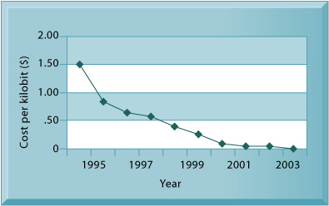
METCALFE’S LAW AND NETWORK ECONOMICS
DECLINING COMMUNICATIONS COSTS AND THE INTERNET
Exponential declines in Internet communications costs
Notes:
DECLINING COMMUNICATIONS COSTS AND THE INTERNET
A fourth technology driver transforming IT infrastructure is the rapid decline in the costs of
communication and the exponential growth in the size of the Internet. An estimated 1
billion people worldwide now have Internet access, and over 250 million Web host
computers exist in the United States. Figure 6-10 illustrates the exponentially declining
cost of communication both over the Internet and over telephone networks (which
increasingly are based on the Internet). As communication costs fall toward a very small
number and approach 0, utilization of communication and computing facilities explodes.
FIGURE 6-10 Exponential declines in Internet communications costs
One reason for the growth in the Internet population is the rapid decline in Internet connection and overall
communication costs. The cost per kilobit of Internet access has fallen exponentially since 1995. Digital
Subscriber Line (DSL) and cable modems now deliver a kilobit of communication for a retail price of around
2 cents.
Source: Authors.
To take advantage of the business value associated with the Internet, firms must
greatly expand their Internet connections, including wireless connectivity, and greatly
expand the power of their client/server networks, desktop clients, and mobile computing
devices. There is every reason to believe these trends will continue.

Slide 22
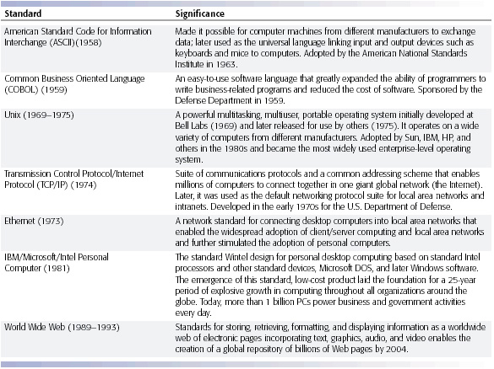
METCALFE’S LAW AND NETWORK ECONOMICS
STANDARDS AND NETWORK EFFECTS
Notes:
Today’s enterprise infrastructure and Internet computing would be impossible—both now
and in the future—without agreements among manufacturers and widespread consumer
acceptance of technology standards. Technology standards are specifications that establish
the compatibility of products and the ability to communicate in a network (Stango, 2004).
Technology standards unleash powerful economies of scale and result in price
declines as manufacturers focus on the products built to a single standard. Without these
economies of scale, computing of any sort would be far more expensive than is currently
the case. Table 6-2 describes some important standards that have shaped IT
infrastructure.
Beginning in the 1990s, corporations started moving toward standard computing
and communications platforms. The Wintel PC with the Windows operating system and
Microsoft Office desktop productivity applications became the standard desktop and mobile
client computing platform. Widespread adoption of Unix as the enterprise server operating
system of choice made possible the replacement of proprietary and expensive mainframe
infrastructure. In telecommunications, the Ethernet standard enabled PCs to connect
together in small local area networks (LANs; see Chapter 8), and the TCP/IP standard
enabled these LANs to be connected into firmwide networks, and ultimately, to the
Internet.

Slide 23
INFRASTRUCTURE COMPONENTS
Computer Hardware Platforms
Operating System Platforms
Enterprise Software Applications
Data Management and Storage
Networking/Telecommunications Platforms
Internet Platforms
Consulting and System Integration Services

Slide 24
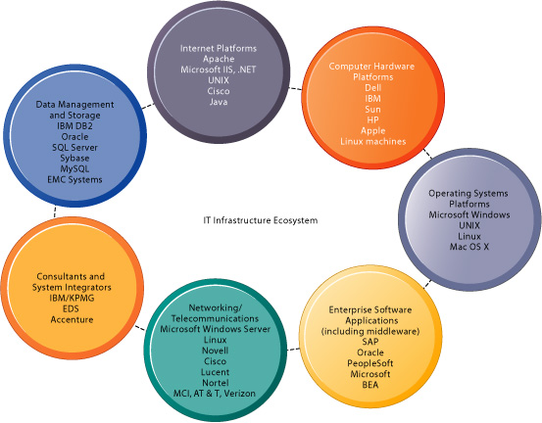
The IT infrastructure ecosystem

Slide 25
CONTEMPORARY HARDWARE PLATFORM TRENDS
The Integration of Computing and Telecommunications Platforms
Grid Computing
On-Demand Computing (Utility Computing)
Autonomic Computing
Window on Management
Edge Computing

Slide 26
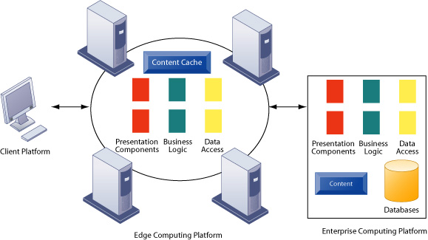
Edge computing platform
Notes:
Edge computing is a multitier, load-balancing scheme for Web-based applications in which
significant parts of Web site content, logic, and processing are performed by smaller, less
expensive servers located nearby the user. In this sense, edge computing is another
technique like grid computing and on-demand computing for using the Internet to share
the workload experienced by a firm across many computers located remotely on the
network.
Figure 6-12 illustrates the components of edge computing. There are three tiers in
edge computing: the local client; the nearby edge computing platform, which consists of
servers positioned at any of the 5,000-plus Internet service providers in the United
States; and enterprise computers located at the firm’s main data center. The edge
computing platform is owned by a service firm such as Akamai, which employs about
15,000 edge servers around the United States.
FIGURE 6-12 Edge computing platform
Edge computing involves the use of the Internet to balance the processing load of enterprise platforms
across the client and edge computing platform.
In an edge platform application, requests from the user client computer are
initially processed by the edge servers. Presentation components such as static Web page
content, reusable code fragments, and interactive elements gathered on forms are
delivered by the edge server to the client. Database and business logic elements are
delivered by the enterprise computing platform.
There are four main business benefits to edge computing:
l Technology costs are lowered because the firm does not need to purchase infrastructure at
its own data center to handle all of the requests from customers and can instead focus on
building infrastructure to contain corporate databases and business logic.
l Service levels are enhanced because response time of Web-based applications is reduced.
Local client computers can be served with most static and dynamic content immediately,
and customer response time is dramatically reduced.
l Flexibility of the firm is enhanced because it can respond to business opportunities quickly
without going through a lengthy infrastructure acquisition cycle by making use of service
provider platforms that already exist.
l Resilience is increased because seasonal or even daily spikes in the workload can be shared
across the Web, and failure in edge nodes will not disable the entire system.

Slide 27
CONTEMPORARY SOFTWARE PLATFORM TRENDS
Linux and open-source software
Java
Web services and service-oriented architecture
Software outsourcing

Slide 28
Enterprise application integration (EAI) software versus traditional integration
Notes:
EAI software (a) creates a common platform through which all applications can freely communicate with
each other. EAI requires much less programming than traditional point-to-point integration (b).

Slide 29
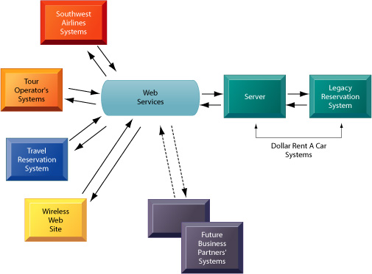
How Dollar Rent A Car uses Web services
Notes:
Dollar Rent A Car uses Web services to provide a standard intermediate layer of software to “talk” to
other companies’ information systems. Dollar Rent A Car can use this set of Web services to link to other
companies’ information systems without having to build a separate link to each firm’s systems.

