Slide 1
JavaScript
Pertemuan 7

Slide 2
POKOK BAHASAN
Alert box
Alert box with line breaks
Confirm box
Prompt box

Slide 3
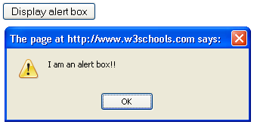
Alert box
<html>
<head>
<script type="text/javascript">
function disp_alert()
{
alert("I am an alert box!!");
}
</script>
</head>
<body>
<input type="button" onclick="disp_alert()" value="Display alert box" />
</body>
</html>

Slide 4
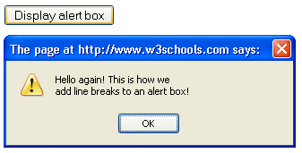
Alert box with line breaks
<html>
<head>
<script type="text/javascript">
function disp_alert()
{
alert("Hello again! This is how we" + '\n' + "add line breaks to an alert box!");
}
</script>
</head>
<body>
<input type="button" onclick="disp_alert()" value="Display alert box" />
</body>
</html>

Slide 5
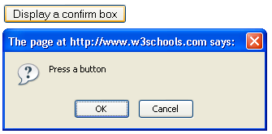
Confirm box
<html>
<head>
<script type="text/javascript">
function disp_confirm()
{
var r=confirm("Press a button");
if (r==true)
{
document.write("You pressed OK!");
}
else
{
document.write("You pressed Cancel!");
}
}
</script>
</head>
<body>
<input type="button" onclick="disp_confirm()" value="Display a confirm box" />
</body>
</html>
You pressed OK!

Slide 6
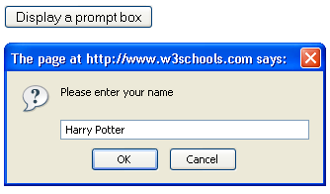
Prompt box
<html>
<head>
<script type="text/javascript">
function disp_prompt()
{
var name=prompt("Please enter your name","Harry Potter");
if (name!=null && name!="")
{
document.write("Hello " + name + "! How are you today?");
}
}
</script>
</head>
<body>
<input type="button" onclick="disp_prompt()" value="Display a prompt box" />
</body>
</html>
Hello Harry Potter! How are you today?

Slide 7
Tugas

