Slide 1
Introduction
INFORMATION SYSTEM AUDIT

Slide 2
Book Reference
Auditor's Guide to Information Systems Auditing by Richard E. Cascarino
Information System Audit and Assurance, Dube – Gulati, 2005
CISA
COBIT
Information system Control and Audit, Ron Weber, 1999

Slide 3
Introduction
Information ???
System ???
Information System??
Information Technology???
Information System Audit ???
Why IS need to Audit??

Slide 4
Introduction (2)
Information → Strategic Resources to reach organization vision and mission.
Information → Organization Asset
Information System → Sub sytem of Organization to process information
Information System Technology → Information System Component

Slide 5
Methodologies in Developing System

Slide 6
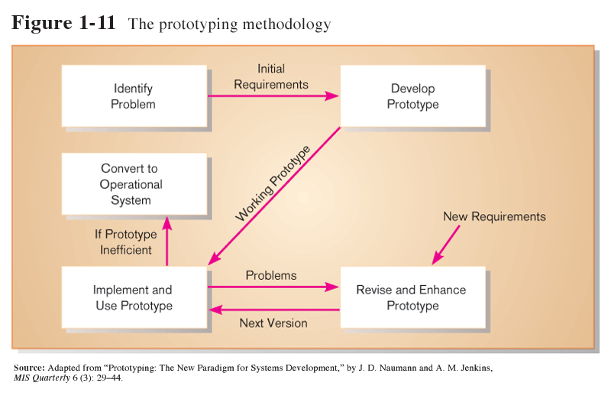
Prototyping
Iterative development process:
Requirements quickly converted to a working system
System is continually revised
Close collaboration between users and analysts

Slide 7
CASE Tools
Computer-Aided Software Engineering
Software tools providing automated support for systems development
Project dictionary/workbook: system description and specifications
Diagramming tools
Example products: Oracle Designer, Rational Rose

Slide 8
Joint Application Design (JAD)
Structured process involving users, analysts, and managers
Several-day intensive workgroup sessions
Purpose: to specify or review system requirements

Slide 9
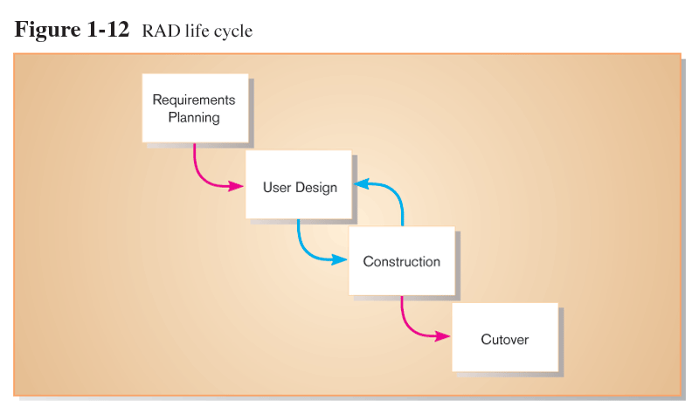
Rapid Application Development (RAD)
Methodology to decrease design and implementation time
Involves: prototyping, JAD, CASE tools, and code generators

Slide 10
Agile Methodologies
Motivated by recognition of software development as fluid, unpredictable, and dynamic
Three key principles
Adaptive rather than predictive
Emphasize people rather than roles
Self-adaptive processes

Slide 11
eXtreme Programming
Short, incremental development cycles
Automated tests
Two-person programming teams
Coding and testing operate together
Advantages:
Communication between developers
High level of productivity
High-quality code

Slide 12
Object-Oriented Analysis and Design
Based on objects rather than data or processes
Object: a structure encapsulating attributes and behaviors of a real-world entity
Object class: a logical grouping of objects sharing the same attributes and behaviors
Inheritance: hierarchical arrangement of classes enable subclasses to inherit properties of superclasses

Slide 13
Audit
Audit : a planned and documented activity performed by qualified personnel to determine by investigation, examination, or evaluation of objective evidence, the adequacy and compliance with established procedures, or applicable documents, and the effectiveness of implementation

Slide 14
Information Systems Auditing
Information Systems Auditing → is the process of collecting and evaluating evidence to determine whether a computer system safeguards assets, maintains data integrity, allows organizational goals to be achieved effectively, and users resources efficiently (Weber, 2000)

Slide 15
Audit Function
Go Public Corporate
Go public → Good corporate governance?
Audit for technique faculty?
A company support by operational system and conceptional system (information system)
Need to get feed back
Information with Value added

Slide 16
Audit Function
To ascertain whether the information system has been designed and implemented in accordance with the procedures and standards that have been set
Auditing is important for information system

Slide 17
Audit Category
Application Control
To ensure the data is correctly input into application, processed correctly, and ther is adequate control over the output produced
General Control
To ensure data integrity in the computer system and at the same time assuring the program or application integrity that used to performed the data processing

Slide 18
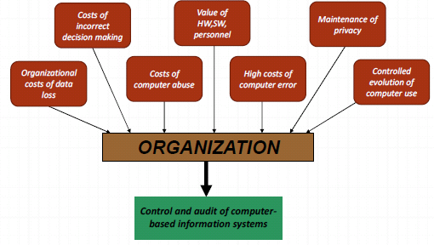
Factors affect Control and IS audit

Slide 19
Factors affect Control and IS audit
Organization Cost of Data Loss
Ex :
Incorrect Decision Making
Incorrect Data cause incorrect decision making and causing organization Data lost
Ex :
Cost of Computer Abuse
Ex :

Slide 20
Factors affect Control and IS audit
Value of Hardware, Software and Personnel
Ex :
High Cost of Computer Error
Ex :
Maintenance of Privacy
Computer ability to process data causing changes to individuals privacy and organization
Ex :
Controlled Evaluation of Computer use
Ex :

Slide 21
Professional Standards & Operational Procedures
Professional Standards
Knowledge, skill and professional attitude must have to conduct the profession
Operational Procedures
Standardized Instructions for completing a certain routine work procedures

Slide 22
Auditor Organization
IIA – institute of Internal Auditors
AAA – American Accounting Association
ISACA – Information System Audit and Control Association
The only association for information system auditor profession
Issued CISA certification

Slide 23
Who is doing the Audit
General activities of the audit / financial statements take place by accountants
non general audit is not to be done by the accountants
Especially for operation and management audit
Information Technology development forcing auditor to have skills related with IT
This point accommodated by information system field and accounting computer
It is expected that the two departments had to have competence in the field of information technology and accounting
Technical Skill/hard skill & soft skill

Slide 24
Audit types base on field
Finance Audit
Operational Audit (management audit)
compliance audit
Information System Audit
E-Commerce Audit
Forensic Audit

Slide 25
Audit types – base on Auditor
External Independence Auditor
Internal Auditor
Government Auditor
Tax Auditor

Slide 26
Information System Audit
Include:
IT Governance
Information system Development Audit (SDLC), certain application

Slide 27
IS Audit– History
America
Univac – computer used for census
1959 – computer used for bookkeeping
IBM360 – mainframe for accounting
Known term : audit around computer
EEDPAA – electronic data processing auditors association founded on 1969
issued control objective (since 1994 called CobIT)
As international set of generally accepted IT control objectives for day-to day use by business managers, users of it and IS auditors

Slide 28
IS Audit
As Special audit – need to do to check the level of maturity or readiness of an organization in managing IT
Level of maturity can be seen from awareness of stake holder
That is why IT implementation must through a good planning

Slide 29
IS Audit needs
General Financial Audit
Audit objective in accordance with accounting standards
Model reference is COSO (committee of sponsoring Organization)
IT Governance
Operational Audit to information resource management
Effectiveness aspects , efficiency of data , data integrity, save guarding asset, reliability, confidentiality, availability, security.

Slide 30
IS Audit– IT Governance
The audit not just for the whole system but can do for certain part such as:
General information review
Audit to IS
Quality Assurance
Auditor (not as developer team), helping to improve system quality. Auditor as project leader representative
Postimplementation Audit
Does the system needed to be updated or corrected or discontinued
Term audit around and audit through the computer doesn’t apply to this type audit

Slide 31
IS Audit
IT/IS Audit not a must
This is a form of awareness from management because of IT activity

Slide 32
IS Audit - Factor
Detecting whether the computer is poorly organized
Without vision, mission, IT planning, without training
Detecting data lost risk
Detecting risk of inaccurate information
Protecting asset
Detecting computer error

Slide 33
IS Audit - Factor(2)
Detecting risk of computer abuse
Protecting confidentiality
To improve control of the evolution for computer or development for the future

Slide 34
Questions
Explain difference of each auditor base on auditor types
Find out standardization of IS auditor profession and which organization issued the standard
On your opinion how importance IT and IS audit for an organization

