Slide 1
Multiple Processor Systems
Slide perkuliahan
SISTEM OPERASI
Sumber :
- Modern Operating System, Tanenbaum
Operating System, Internal and Design Principles, William Stallings
Ken Kinanti Purnamasari

Slide 2
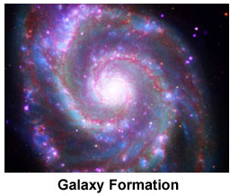
The Universe…

Slide 3
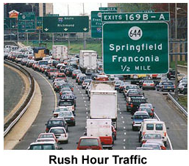
The Real World …

Slide 4
Parallel Processing
Pengolahan informasi yang memanipulasi data-data secara simultan.

Slide 5
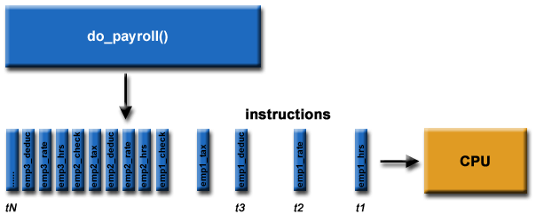
Single Processing

Slide 6
Single Processing
Program
CPU
CPU

Slide 7
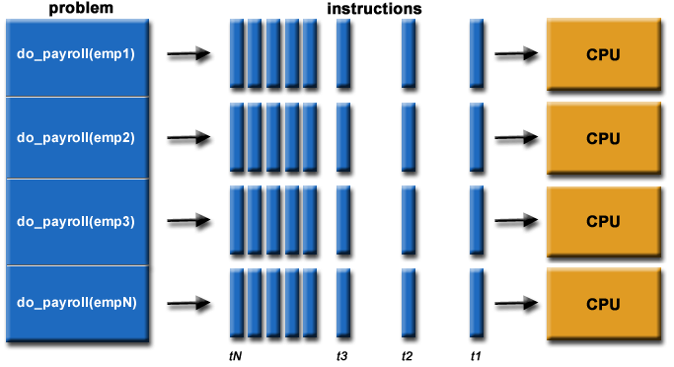
Parallel Processing

Slide 8
Parallel Processing
1
CPU
2
CPU
Program
3
CPU
4
CPU

Slide 9
Why Use Parallel Processing ?

Slide 10
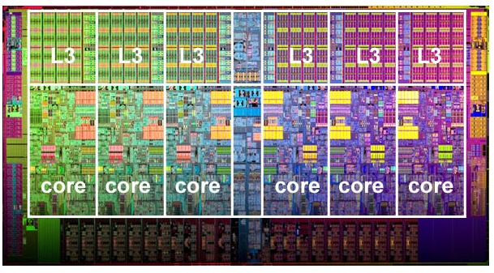
Why Parallel Processing ???
Save Time & Money
Solve Larger Problem
Provide Concurrency
Use of Non-Local Resources
Limits to Serial Computing

Slide 11
Who Use Parallel Processing ?

Slide 12
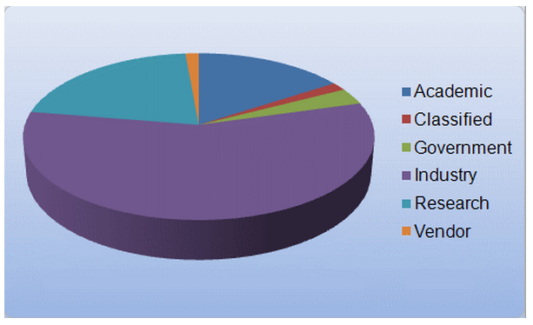
Who Use Parallel Processing ???

Slide 13
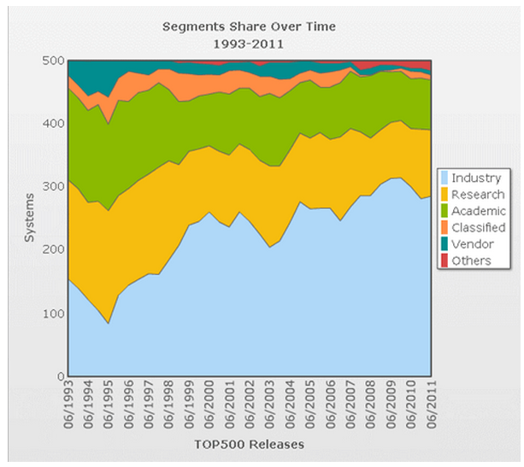
Who Use Parallel Processing ???

Slide 14
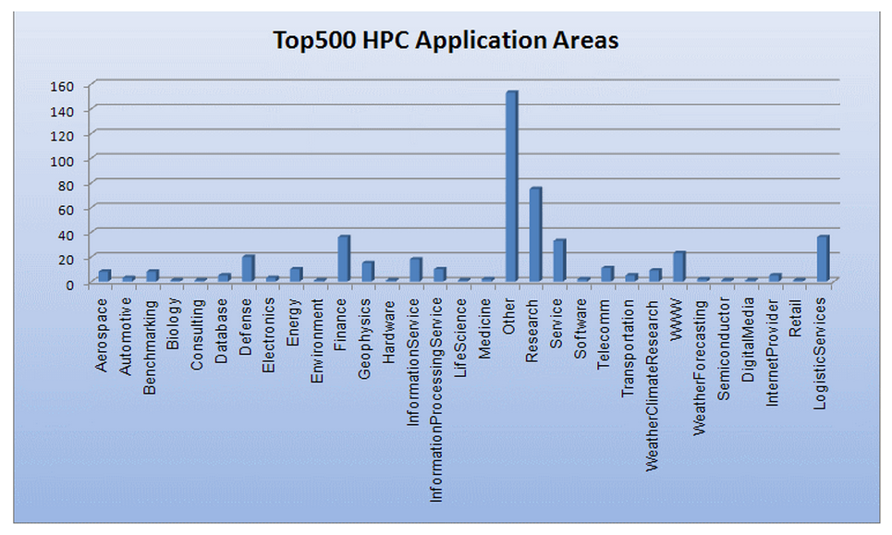
Who Use Parallel Processing ???

Slide 15
Who Use Parallel Processing ???

Slide 16
The Type of Parallel Processing ?

Slide 17
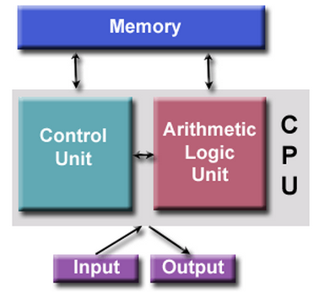
Concept

Slide 18
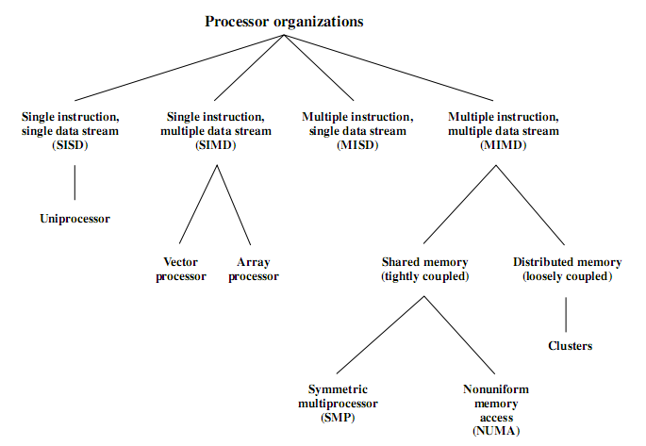
Parallel Processing

Slide 19
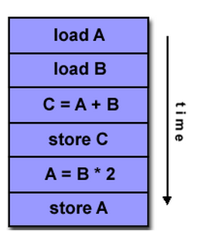
SISD

Slide 20
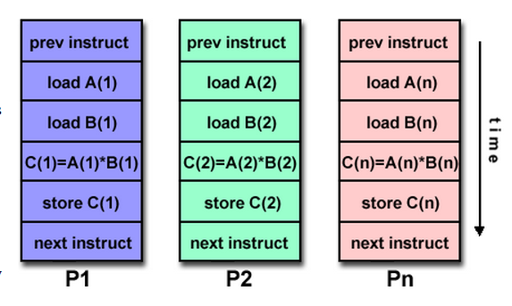
SIMD

Slide 21
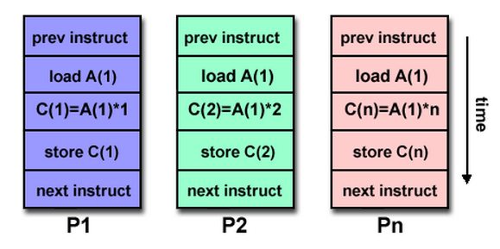
MISD

Slide 22
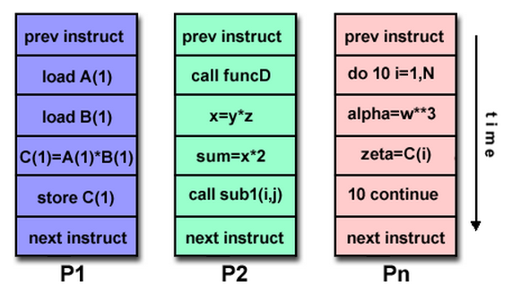
MIMD

Slide 23
Memory Architecture of Parallel Processing

Slide 24
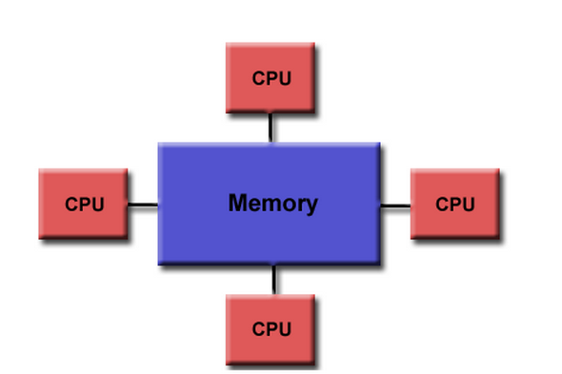
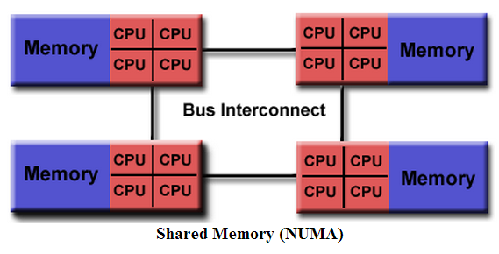
Shared Memory
UMA
NUMA

Slide 25
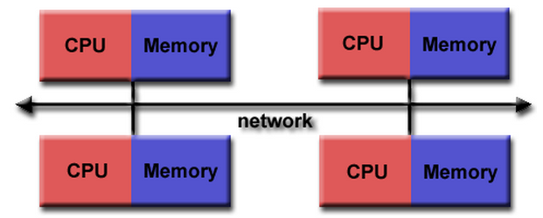
Distributed Memory

Slide 26
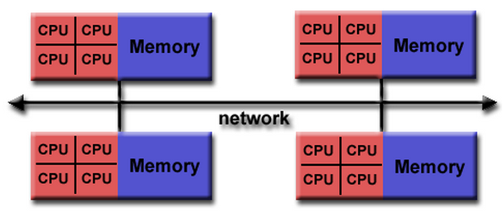
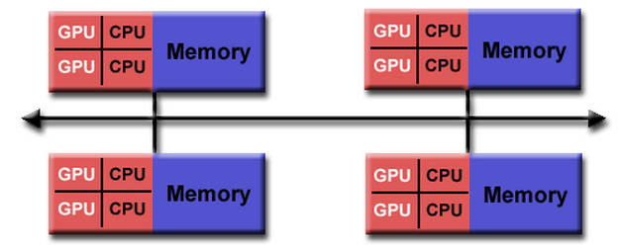
Hybrid Distributed-Shared Memory

Slide 27
Multi-Processor

Slide 28
A Brief History of Intel Architecture
1970-1993:
4004 → 8008 → 808x → 80186 → 80286 → 80386 → 80486 [Pipelined] → 80586 (Intel Pentium / P5) [Superscalar]
1995: P5 → P6
[Superpipelined Superscalar]
Intel Pentium II
Intel Pentium III
Intel Pentium II/III Xeon (Server)

Slide 29
A Brief History of Intel Architecture
2000: P6 → NetBurst [SMT]
Intel Pentium 4
Problem with NetBurst: Heating

Slide 30
A Brief History of Intel Architecture
Heating Problem:
2003-2006: Solved by multiplying P6 architecture
P6 → Extended Pentium M (M = Mobile)
Intel Core Solo
Intel Core Duo
Intel Dual-Core
First attempt on multiplying core
Reverts back to Superpipelined Superscalar

Slide 31
A Brief History of Intel Architecture
2006: P6 → Core Architecture
Core 2 Duo
Core 2 Quatro
Core 2 Extreme
Second (true) attempt on multiplying core
Parallelization stays on Superpipelined Superscalar

Slide 32
A Brief History of Intel Architecture
Third attempt on multiplying (and optimizing) core
2008: NetBurst → Nehalem Architecture
Core i3
Core i5
Core i7
Re-implementing SMT parallelization

Slide 33
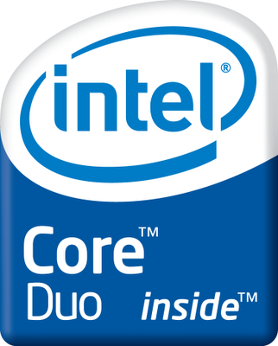
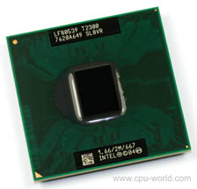
Intel Core Duo

Slide 34
Intel Core Duo T2700
# of Cores | 2
Clock Speed | 2.33 GHz
L2 Cache | 2 MB
Bus/Core Ratio | 14
FSB Speed | 667 MHz
FSB Parity | No
Instruction Set | 32-bit
Embedded Options Available | No
Lithography | 65 nm
Max TDP | 31 W
VID Voltage Range | 1.1625V - 1.30V

Slide 35
Main Components
L1 Cache
L2 Cache
APIC
Thermal Control Unit
Power Management

Slide 36
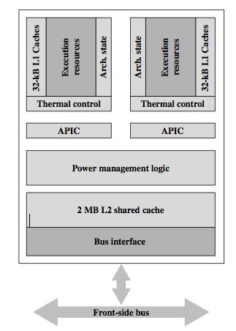
Intel Core Duo

Slide 37
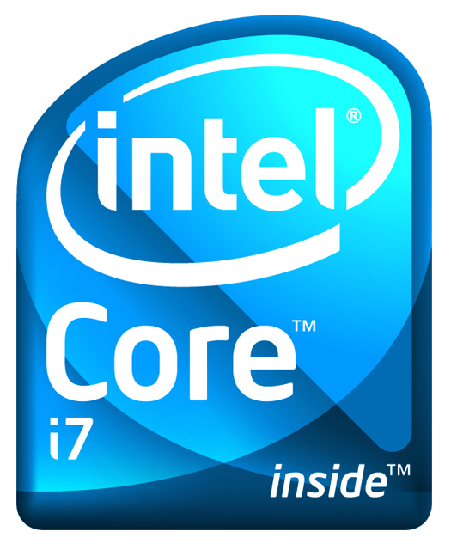
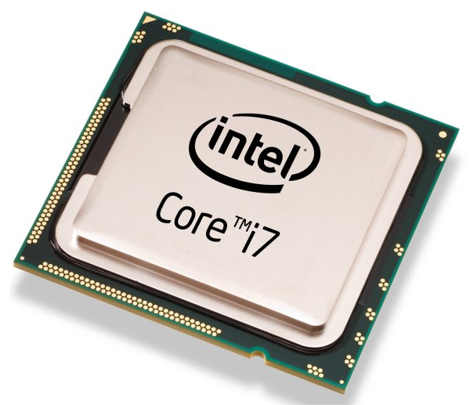
Intel Core i7

Slide 38
Intel Core i7-880
# of Cores | 4
# of Threads | 8
Clock Speed | 3.06 GHz
Max Turbo Frequency | 3.73 GHz
Intel® Smart Cache | 8 MB
Bus/Core Ratio | 23
DMI | 2.5 GT/s
Instruction Set | 64-bit
Instruction Set Extensions | SSE4.2
Embedded Options Available | No
Lithography | 45 nm
Max TDP | 95 W
VID Voltage Range | 0.6500V-1.4000V

Slide 39
Intel Core i7-980
# of Cores | 6
# of Threads | 12
Clock Speed | 3.33 GHz
Max Turbo Frequency | 3.6 GHz
Intel® Smart Cache | 12 MB
Bus/Core Ratio | 25
Intel® QPI Speed | 4.8 GT/s
# of QPI Links | 1
Instruction Set | 64-bit
Instruction Set Extensions | SSE4.2
Embedded Options Available | No
Lithography | 32 nm
Max TDP | 130 W
VID Voltage Range | 0.800V-1.300V

Slide 40
Main Components
L1 Cache
L2 Cache
L3 Cache
DDR3 Controller
QuickPath Interconnect

Slide 41
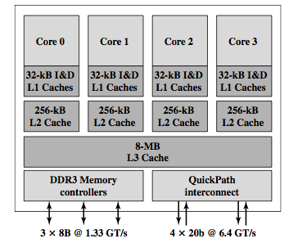
Intel Core i7

Slide 42
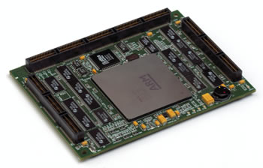
ARM11 MPCore

Slide 43
ARM11MPcore
Architecture | ARMv6
Dhrystone Performance | 1.25 DMIPS / MHz
Multicore | 1-4 cores Single core version also available
ISA Support | ARM Thumb Jazelle® DBX DSP extenstion Floating Point Unit (Optional)
Memory Management | Memory Management Unit
Debug & Trace | CoreSight Design Kit

Slide 44
Main Components
L1 Cache
DIC
Timer
CPU+VFPU
Watchdog (alerting)
SCU

Slide 45
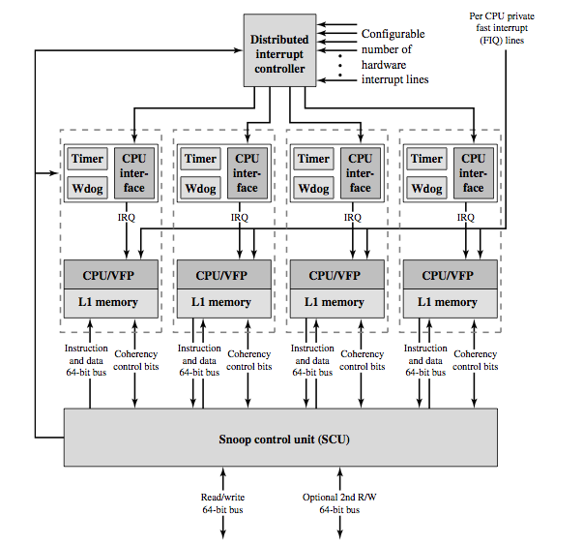
ARM11 MPCore

Slide 46
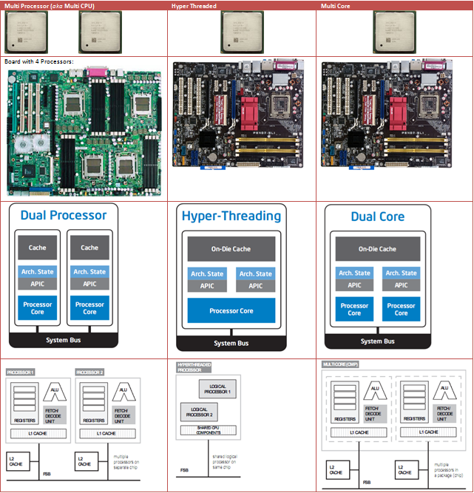
Multiprocessor vs Multicore

Slide 47
Multi-Computer

Slide 48
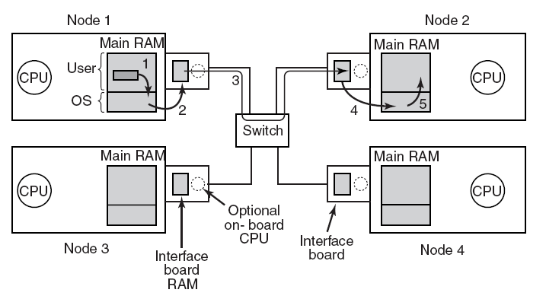
Multi-Computer
Figure 8-18. Position of the network interface boards in a multicomputer.

Slide 49
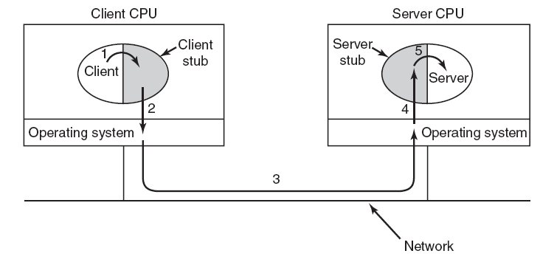
Multi-Computer
RPC
Figure 8-20. Steps in making a remote procedure call. The stubs are shaded gray.

Slide 50
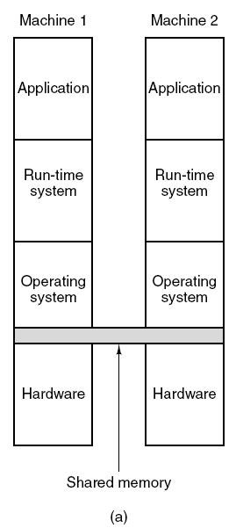
Distributed Shared Memory (1)
Figure 8-21. Various layers where shared memory can be implemented. (a) The hardware.
Tanenbaum, Modern Operating Systems 3 e, (c) 2008 Prentice-Hall, Inc. All rights reserved. 0-13-6006639

Slide 51
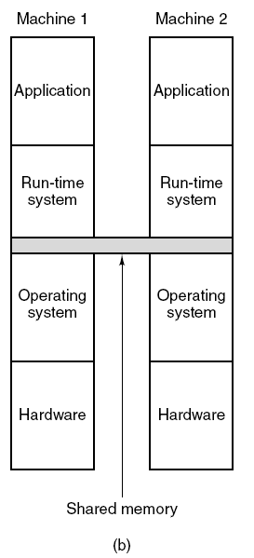
Distributed Shared Memory (2)
Figure 8-21. Various layers where shared memory can be implemented. (b) The operating system.
Tanenbaum, Modern Operating Systems 3 e, (c) 2008 Prentice-Hall, Inc. All rights reserved. 0-13-6006639

Slide 52
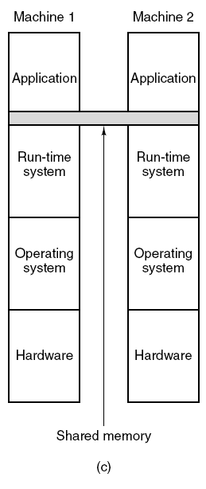
Distributed Shared Memory (3)
Figure 8-21. Various layers where shared memory can be implemented. (c) User-level software.
Tanenbaum, Modern Operating Systems 3 e, (c) 2008 Prentice-Hall, Inc. All rights reserved. 0-13-6006639

Slide 53
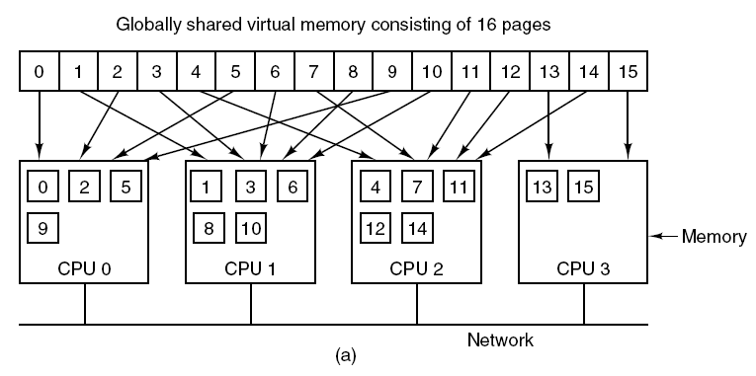
Distributed Shared Memory (4)
Figure 8-22. (a) Pages of the address space distributed among four machines.
Tanenbaum, Modern Operating Systems 3 e, (c) 2008 Prentice-Hall, Inc. All rights reserved. 0-13-6006639

Slide 54
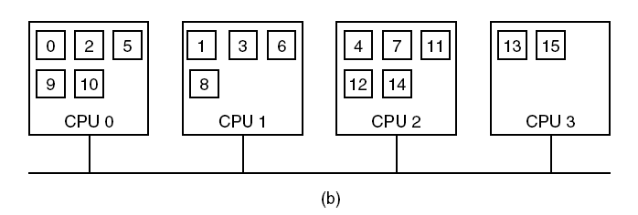
Distributed Shared Memory (5)
Figure 8-22. (b) Situation after CPU 1 references page 10 and the page is moved there.
Tanenbaum, Modern Operating Systems 3 e, (c) 2008 Prentice-Hall, Inc. All rights reserved. 0-13-6006639

Slide 55
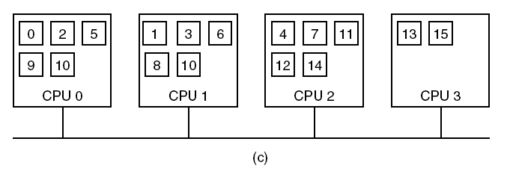
Distributed Shared Memory (6)
Figure 8-22. (c) Situation if page 10 is read only and replication is used.
Tanenbaum, Modern Operating Systems 3 e, (c) 2008 Prentice-Hall, Inc. All rights reserved. 0-13-6006639

Slide 56
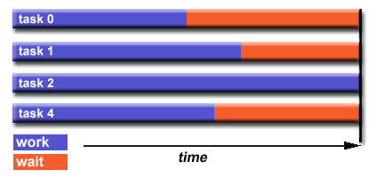
Multi-Computer
Load Balancing
Bagaimana mencapai load balance
Partisi yang sama bekerja menerima setiap task
Use dynamic work assignment
Menggunakan penugasan pekerjaan dinamis

Slide 57
The Uses of Parallel Processing ?

Slide 58
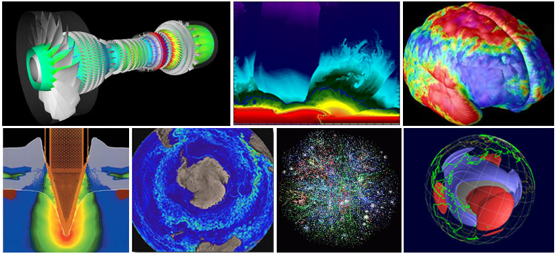
Science & Engineering

Slide 59
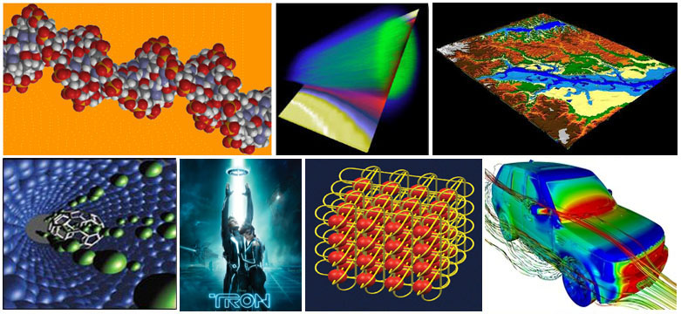
Industrial & Commercial

Slide 60
Uses for Parallel Processing
1.3 million users, 3.2 million computers
in nearly every country in the world

