Slide 1
Introduction
Pengantar Ilmu Komputer

Slide 2
What is Computer?

Slide 3
Previous Computer

Slide 4
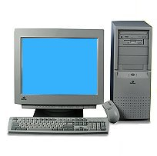
“The Box”
CRT Display
CD-ROM Drive
Floppy
Disk
Drive
Keyboard
Mouse

Slide 5
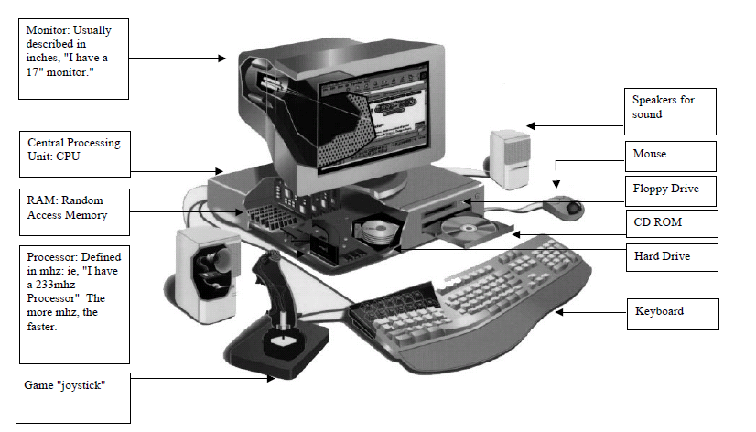
Computer

Slide 6
Just it ????

Slide 7
Do you know any other form of computer?

Slide 8
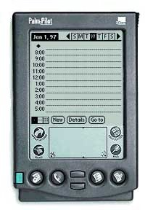
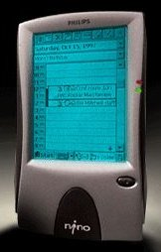
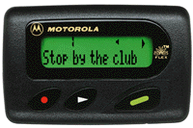
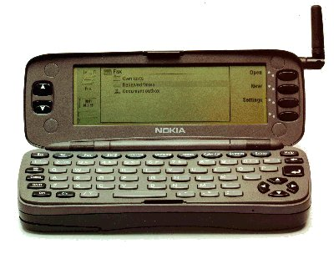
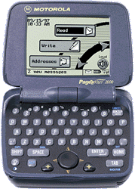
Mobile Computing

Slide 9
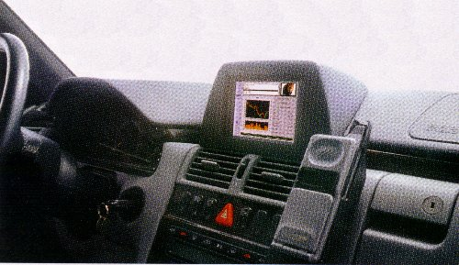
Other Computer

Slide 10
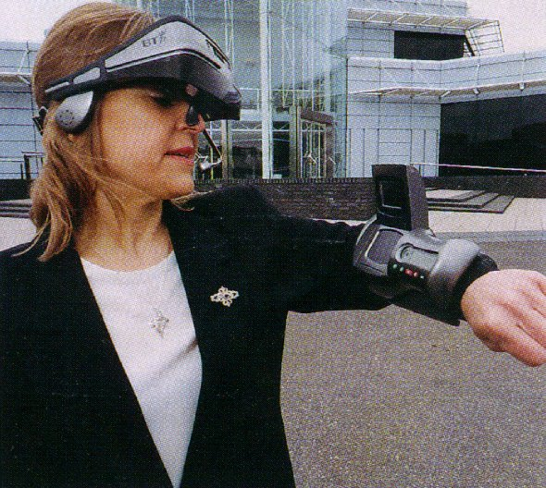
Other Computer

Slide 11
Computer Defenition
Computere → To Count
Computer today :
Electronic Device
Accepting Input
Processing
Producing Output : Information
Program
Storing Output
Otomatic

Slide 12
Computer System
System → Network or elements that link together become united to reach goal of the system
The goal of computer system : processing data and provide information
Computer System element :
Hardware
Software
Brainware

Slide 13
Hardware
Physical Devices in computer system that make up the computer system
Example : Printer, Memory, Monitor
Else????

Slide 14
Software
Stuff that make your computer working /do things for you. It contains instruction to process data.
Example : C, Mathlab, Fortran
Else ???

Slide 15
Brainware
Person that operate and manage computer system
Example : System Analyst, Computer operator, Network Engineer
Else?????

Slide 16
Computer Capability
Basic Operation : counting in fast speed.
Unit measurement for computer speed are : millisecond, microsecond, nanosecond or picosecond

Slide 17
Unit measurement for computer speed
Measurement | Speed
Millisecond (ms) | (1/1000)
Microsecond (us) | (1/1.000.000)
Nanosecond (ns) | (1/1.000.000.000)
Picosecond (ps) | (1/1.000.000.000.000)

Slide 18
Capacity
Measurement | Capacity
1 byte | 8 bit = 1 char
1 Kb | 1024 byte
1 Mb | 1024 Kb or 1.048.576 byte
1 Gb | 1024 Mb or 1.048.576 Kb or 1.073.741.824 byte
1 Tb | 1.099.511.627.776 bit atau 137.438.953.472 byte

Slide 19
Questions
Write computer definition in your opinion
What is computer system!
Explain computer system elements!
Explain computer process measurement!
Write the smallest computer memory measurement!
Explain what for are you using computer in your daily life?
Explain does computer giving you advantage or not? Explain your answer!
Do you expecting any device that will make your life easier ? Describe how you expected that device in fulfill your needs?
Are you depend on certain technology? Make a list that contain of technologies you need in life. Write the consequences you could get when the device broken. What do you do to keep the devices in good conditions.

