Slide 1
Project scheduling
Precedence diagram method
Project Management
Magister Desain
Universitas Komputer Indonesia
references:
Larson, e.w., Gray C.F., 2011, 5tH ed.;
Pinto, j.k. 2010, 2ND. ED.

Slide 2
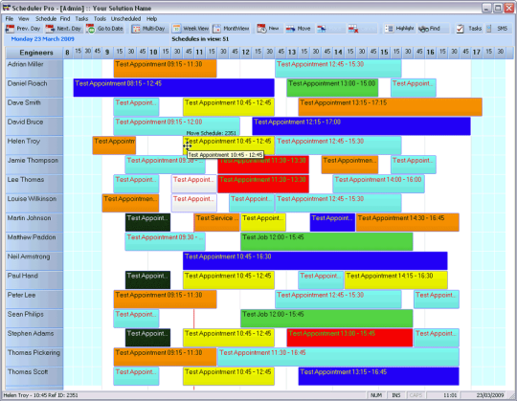
PRECEDENCE DIAGRAM METHOD
The Precedence Diagram Method is a tool for scheduling activities in a project plan. It is a method of constructing a project schedule network diagram that uses boxes, referred to as nodes, to represent activities and connects them with arrows that show the dependencies.
Critical Tasks, noncritical tasks, and slack time
Shows the relationship of the tasks to each other
Allows for what-if, worst-case, best-case and most likely scenario
Key elements include determining predecessors and defining attributes such as
early start date
late start date
early finish date
late finish date
Duration
WBS reference

Slide 3
PRECEDENCE DIAGRAM METHOD
Extension of AON Network
Allows concurrent activities to overlap
Schedule logic is easier and quicker to develop
Easier to modify
Better represents work flow in continuous operations

Slide 4
Types of Task Relationship
FS – Finish to Start
Finish
Start
SS – Start to Start
Start
Start
FF – Finish to Finish
Finish
Finish
SF – Start to Finish
Start
Finish

Slide 5
Leads & Lags
Activity Lead – Lag
Lag = time that a following activity is delayed from the start of the previous activity
Lead = time that an activity precedes the start or finish of the next activity

Slide 6
Leads & Lags
Normal
Finish - Start
Finish – Start
Modified by a Lead
Finish – Start
Modified by a Lag
Lead and Lag are used to Modify Relationships
Lead and Lag Can be used with any Relationship Type (FS, FF, SS)

Slide 7
EXAMPLE for EMR Project
No | Activities | Duration | Predecessor
1 | Electronic Medical Reference Project
2 | Architectural Decision | 5 days
3 | Specification
4 | Internal Specification | 12 days | 2
5 | External Specification | 7 days | 2
6 | Feature Specification | 10 days | 2
7 | Design Phase
8 | Voice Recognition | 10 days | 4SS+7 and 5
9 | Case | 4 days | 4 and 5FS+1
10 | Screen | 2 days | 4,5
11 | Database | 25 days | 6
12 | Microphone-soundcard | 5 days | 6 and 11FF-4
13 | Digital Devices | 7 days | 6
14 | Computer I/O | 5 days | 6
15 | Review Design | 5 days | 8,9,10,11,12,13,14

Slide 8
TERIMA KASIH

