Slide 1
Process and customizations
Information System Project Management

Slide 2
Project Management Process
Project Processes : projects are composed of process. A process is a series of actions bringing about a result.
Project processes are performed by people and generally fall into one of two major categories :
Project Management Processes describe, organized and complete the work of the project
Product – oriented processes
specify and create the project’s product. Product – oriented processes are typically defined by the project life and vary by application area

Slide 3
Project Management Process
Process Groups : Project management processes can be organized into five groups of one or more processes each :
Initiating processes : authorizing the project phase
Planning process : defining and refining objectives and selecting the best of the alternatives courses of action to attain the objectives that the project was undertaken to address
Executing processes : coordinating people and other resources to carry out the plan
Controlling processes : ensuring that monitoring and measuring progress regularly to identify variances from plan so that corrective action can be taken when necessary meet project objectives
Closing processes : formalizing acceptance of the project or phase and bringing it to an orderly end

Slide 4
Project Management Process
Process Interactions : within each process group, the individual processes are linked by their inputs and outputs.
So each process can describe in terms :
Inputs : documents or documentable items that will be acted upon
Tools and techniques : mechanism applied to the inputs to create the outputs
Outputs : documents or documentable items that are a result of the process

Slide 5
Project Management Process
Core processes : some planning processes have clear dependencies that require them to be performed in essentially the same order on most project.

Slide 6
Project Management Process
Core planning processes include :
Scope planning : developing a written scope statement as the basis for future project decisions
Scope definition : subdiving the major project deliverables into smaller, more manageable components
Activity definition : identifying the specific activities that must be performed to produce the various project deliverable
Activity sequencing : identifying and documenting interactivity dependencies

Slide 7
Project Management Process
Activity duration estimating : estimating the number of work periods that will be needed to complete individual activities
Schedule development : analyzing activity sequences, activity durations, and resource requirements to create the project schedule
Risk management planning : deciding how to approach and plan for risk management in project

Slide 8
Project Management Process
Resource Planning : determining what resources (people, equipment, materials) and what quantities of each should be used to perform project activities
Cost Estimating : developing an approximation (estimate) of the costs of the resources required to complete project activities
cost budgeting : allocating the overall cost estimate to individual work activities
Project plan development : taking the results of other planning processes and putting them into a consistent, coherent document

Slide 9
Project Management Process
Facilitating Processes : interactions among the other planning processes are more dependent on the nature of project

Slide 10
Project Management Process
Facilitating processes include :
Quality planning
Organizational planning
Staff acquisition
Communications planning
Risk identification
Qualitative risk analysis
Quantitative risk analysis
Risk response planning
Procurement planning
Solicitation planning

Slide 11
Project Management Process
Executing Processes : the executing processes include core processes and facilitating processes
Project plan execution
Quality assurance
Team development
Information distribution
Solicitation
Source selection
Contract administration

Slide 12
Project Management Process
Controlling processes : to monitor and measured project performances and as preventive action in anticipation possible problems.

Slide 13
Project Management Process
Closing processes components are :
Contract closeout : completion and settlement of the contract, including resolution of any open systems
Administrative closure : generating, gathering and disseminating information to formalize phase or project completion, including evaluating the project and compiling lessons learned for use in planning future projects or phases

Slide 14
Input and output of Knowledge Areas

Slide 15
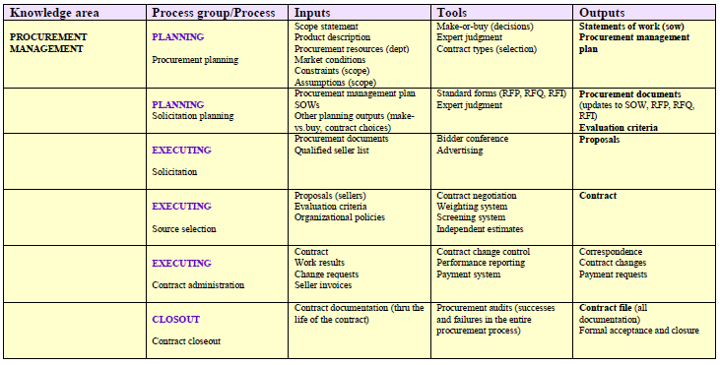
Input and output of Knowledge Areas

Slide 16
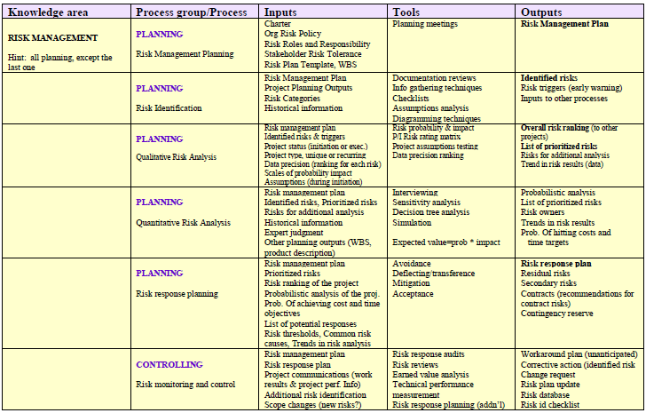
Input and output of Knowledge Areas

Slide 17
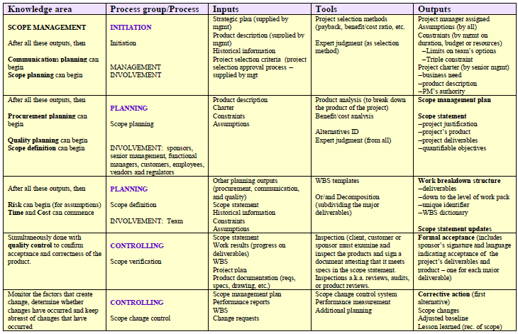
Input and output of Knowledge Areas

Slide 18
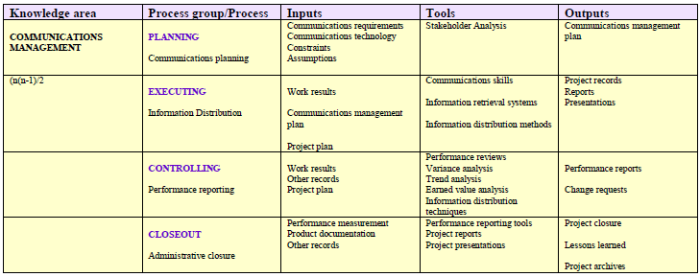
Input and output of Knowledge Areas

Slide 19
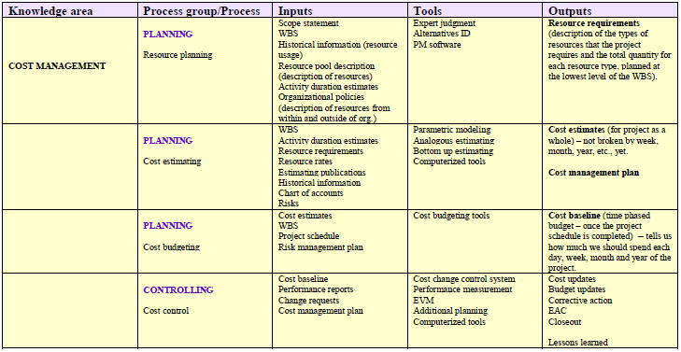
Input and output of Knowledge Areas

Slide 20
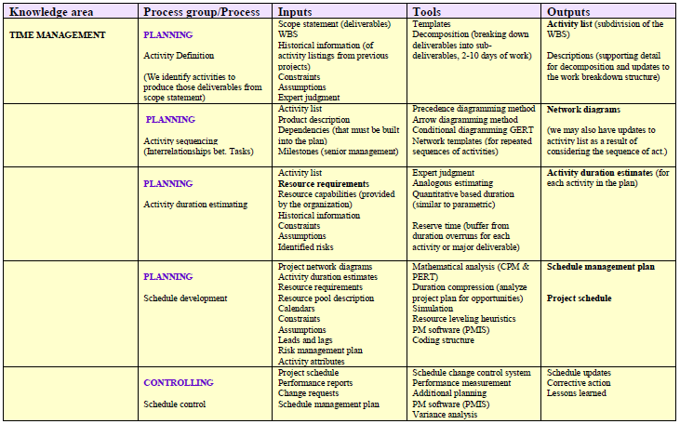
Input and output of Knowledge Areas

Slide 21
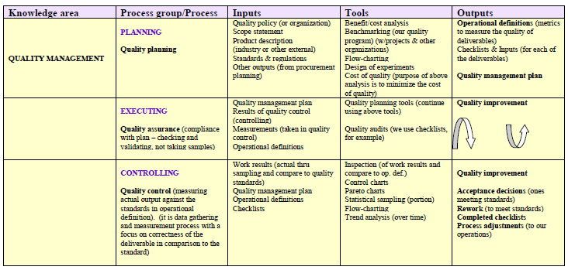
Input and output of Knowledge Areas

Slide 22
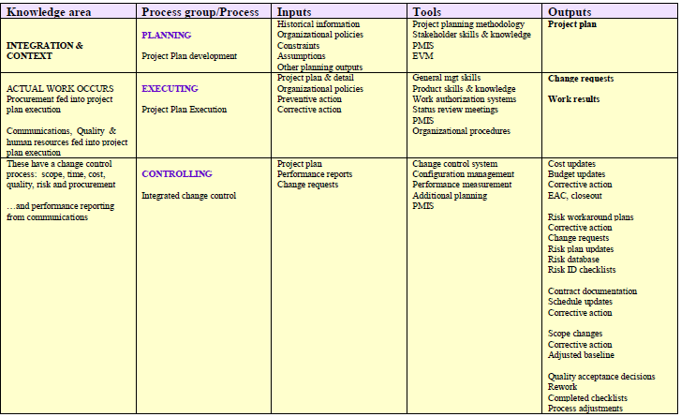
Input and output of Knowledge Areas

Slide 23
Standards & Certification
Project Management Body of Knowledge by Project Management Institute (PMI)
PRINCE ( Projects IN Controlled Environments) by OGC

Slide 24
Reading task
Read and make resume from a journal : “Project Management in The Information Systems and Information Technologies Industries”

