Slide 1
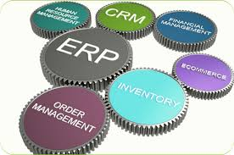
Pendahuluan sistem informasi enterprise
Rani Susanto
Teknik Informatika
Universitas Komputer Indonesia

Slide 2
Information system
An Information System is a work systems whose business process is devoted to capturing , transmitting, storing, retrieving, manipulating, and displaying information, thereby supporting other work systems (Alter, 2002).
An Information System can be defined technically as a set of interrelated components that collect (or retrieve), process, store, and distribute information to support decision making, coordination, and control in an organization (Laundon, 2001).
A Management Information System is an integrated user-machine system for providing information to support the operations, management, analysis, and decision-making functions in an organization (Davis, 1985).
Notes:
Sistem Informasi adalah sistem kerja dimana proses bisnis didalamnya digunakan untuk menangkap, mentransmisikan, menyajikan, menerima, memanipulasi dan menyajikan informasi yang berguna untuk mendukung sistem kerja yang lain. (Alter, 2002)
Sistem Informasi secara teknik berupa kumpulan komponen yang saling berelasi untuk mengumpulkan proses, menyajikan dan mendistribusikan informasi untuk mendukung pengambilan keputusan, koordinasi dan mengontrol di dalam organisasi. (Laudon, 2001)
Sistem Informasi Manajemen adalah integrasi user dengan sistem yang menyediakan informasi untuk mendukung fungsi operasi, manajemen, analisis dan pengambilan keputusan dalam sebuah organisasi. (Davis, 1985)

Slide 3
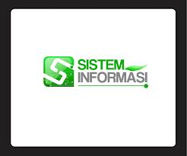
Information system-2
Kumpulan dari komponen-komponen yang saling berinteraksi untuk mengelola informasi pada suatu organisasi untuk mendukung kegiatan bisnis organisasi.
Suatu sistem terintegrasi/terpadu yang mampu menyediakan informasi yang bermanfaat bagi penggunanya.

Slide 4
Organization & Information Systems
An organization is a stable, formal, social structure that takes resouces from the environment and processes them to produce outputs.
Information Systems must be aligned with the organization to provide information that important groups within the organization need.
Notes:
Organisasi adalah struktur sosial yang mengambil sumber daya dari lingkungan dan memprosesnya untuk mendapatkan output.
Sistem Informasi harus sejalan dengan organisasi untuk mendapatkan informasi yang penting dalam kelompok sesuai dengan kebutuhan.

Slide 5
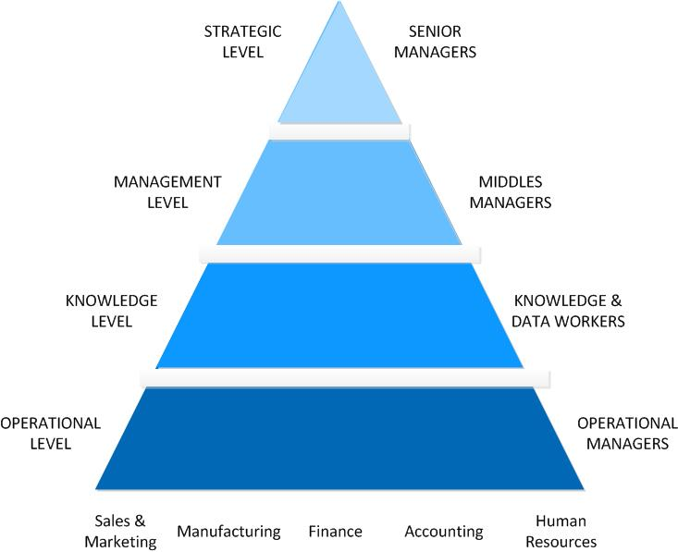
Kind of Information System

Slide 6
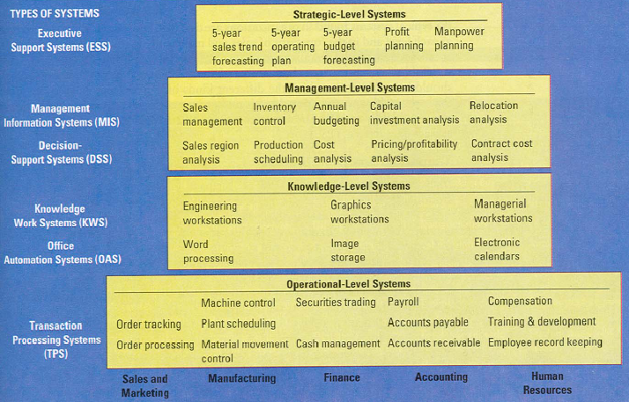
Types of System in Enterprise
RNL - 2014

Slide 7
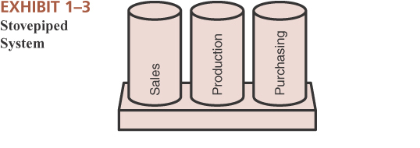
Aren’t all enterprise systems integrated ?
NO!
Why Not?
Enterprise “stove pipes” or “silos”
As enterprises grow, they typically become divided based on functional areas
Each functional area typically has its own system
Even within functional areas, enterprises often develop different systems for different information needs
If existing systems lack functionality, additional systems are built to satisfy new needs
RNL - 2014

Slide 8
Business function and business processes

Slide 9
Functional areas of operation

Slide 10
Business processes
Kumpulan aktifitas yang memiliki satu atau lebih input dan menghasilkan output yang berguna bagi customer

Slide 11
Functional Areas and Business of a very small business

Slide 12
Example
Accounting and Finance
Marketing and Sales
Supply Chain Management
Human Resources

Slide 13
Marketing and sales
Pengembangan Produk, menentukan harga, promosi produk, menerima pesanan.
Merupakan bisnis langsung sehingga tidak membutuhkan pencatatan formal tetapi tetap dibutuhkan untuk melihat pelanggan yang sering datang,
Menganalisa histori penjualan sehingga mengetahui jenis lemon yang banyak disukai.

Slide 14
Supply chain management
Pembuatan (manufacturing/production)
Pembelian bahan baku.
Perencanaan bahan baku agar selalu ada saat dibutuhkan.

Slide 15
Accounting and finance
Merekam data tentang transaksi (termasuk penjualan), pembelian bahan baku, daftar gaji, pembayaran dari pelanggan.
Data tersebut digunakan untuk melihat keuntungan dan pengambilan keputusan.

Slide 16
Human resources
Menentukan jumlah pegawai dan penentuan perekrutan pegawai yang ditentukan oleh penjualan lemon.

Slide 17
Functional Areas information system

Slide 18
Marketing and sales
Input :
Customer Data
Order Data
Sales trend data
Per-unit cost
Output:
Sales Strategies
Product pricing
Employment needs

Slide 19
Supply chain management
Input :
Product Sales data
Production plans
Inventory level
Output:
Raw material orders
Packaging orders
Resource expenditure data
Production and inventory report
Hiring information

Slide 20
Accounting and finance
Input :
Payments from customers
Accounts receivable data
Accounts payable data
Sales data
Production and inventory data
Payroll and expense data
Output:
Payments to suppliers
Financial reports
Customer credit data

Slide 21
Human resources
Input :
Personel Forecast
Skills data
Output:
Regulation compliance
Employee training and certification
Skills database
Employee evaluation and compensation

Slide 22
kesimpulan
Companies that make and sell products have business processes that involve these basic functional areas: Marketing and Sales, Supply Chain Management, Accounting and Finance, and Human Resources. They perform these functions:
Marketing and Sales sets product prices, promotes products through advertising and marketing, takes customer orders, supports customers, and creates sales forecasts.
Supply Chain Management develops production plans, orders raw materials from suppliers, receives the raw material into the facility, manufactures products, maintains facilities, and ships products to customers.
Accounting and Finance performs financial accounting to provide summaries of operational data in managerial reports, and also is responsible for tasks such as controlling accounts, planning and budgeting, and cash-flow management.
Human Resources recruits, hires, trains, and compensates employees, ensures compliance with government regulations, and oversees the evaluation of employees.

Slide 23
Thank you

Slide 24
Common Integration Attempts
Integrate the end results
Let each functional area have its own system and require them to submit end results in a standardized format that can be merged with results from other areas
Integrate similar types of systems
All financial areas use same system
All manufacturing areas use same system
All areas associated with human resources use same system
Etc……
However, each of those systems are different from each other
Enterprise Systems
May be created from scratch
May be based on packaged software (e.g. OracleApps, PeopleSoft, SAP)
RNL - 2014

Slide 25
erp
ENTERPRISE RESOURCE PLANNING
ERP – penggabungan seluruh departemen dan fungsi di organisasi kedalam sebuah sistem IT tunggal sehingga pekerja dapat membuat keputusan perusahaan dengan melihat informasi perusahaan di seluruh operasi bisnis.
ERP – Integration of financial, manufacturing and human resources on a single computer system.
ERP – biasanya digunakan untuk menggabungkan aplikasi individual kedalam aplikasi tunggal yang mengintegrasikan data serta proses bisnis ke dalamnya.

Slide 26
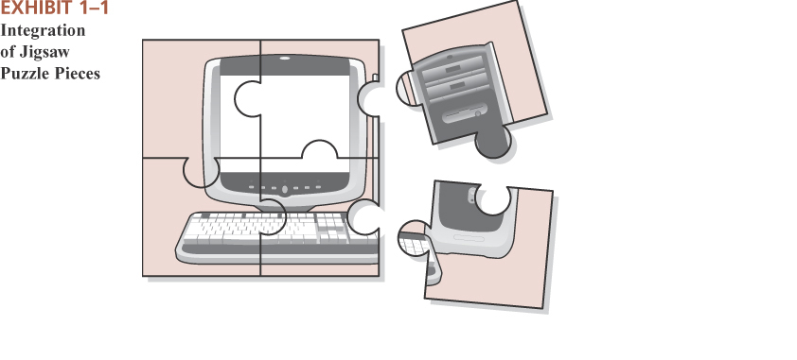
Enterprise Integration
Enterprise
A business, an industrious effort, especially one directed toward making money
Integrated
Joined together, united, made into a whole by having brought all parts together

