Slide 1

WEEK 6
Project team building,
conflict,
& negotiation
Project Management
Magister Desain
Universitas Komputer Indonesia
Source:
Pinto, j.k. 2010, 2ND. ED.; Scwalbe, K. 2007, 5TH. ED. q.q. International 2008
DAWSON, R.SECRETS OF POWER NEGOTIATING,, 1999

Slide 2

Building the project team
Identify Necessary Skill Sets
Identify People Who Match the Skills
Talk to Potential Team Members
Negotiate with Functional Header
Build in Fallback Position
Assemble The Team

Slide 3
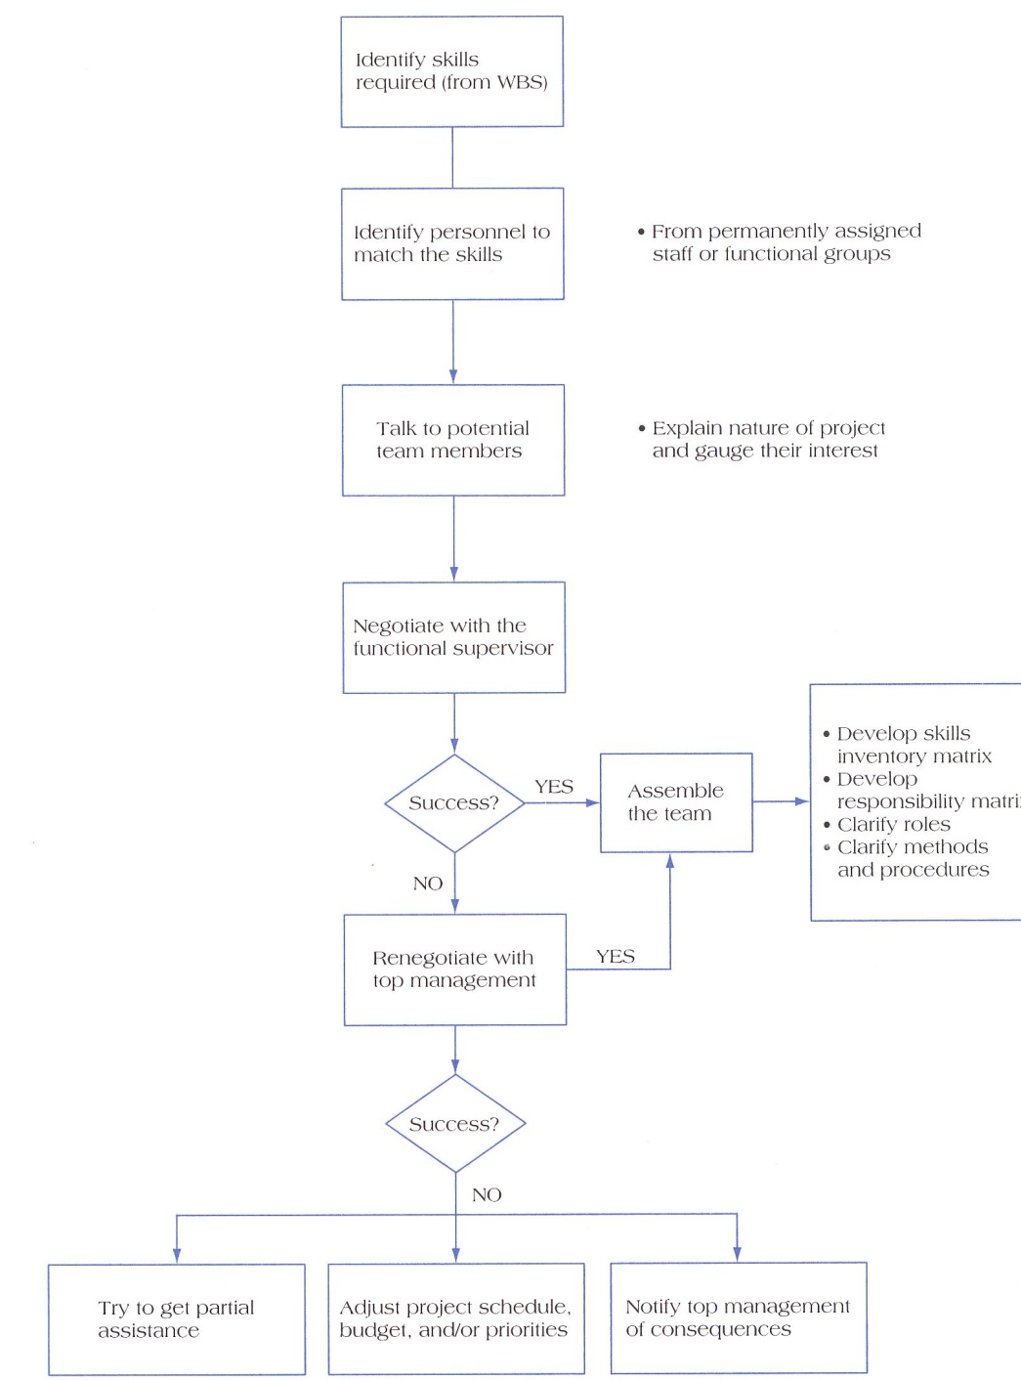
Basics step in assembling the project team
Source: Verma, V.K., 1997:127,
Managing The Project Team,
Upper Darby.

Slide 4
Characteristics of effective project teams
A Clear Sense of Mission
A Productive Interdependency
Cohesiveness
Trust
Enthusiasm
Result Orientation

Slide 5
Reasons why teams fail
Poorly Developed or Unclear Goals
Poorly Defined Project Team Roles & Interdependency
Lack of Project Motivation
Poor Communication
Poor Leadership
Turn Over Among Project Team Members
Dysfunctional Behaviour

Slide 6
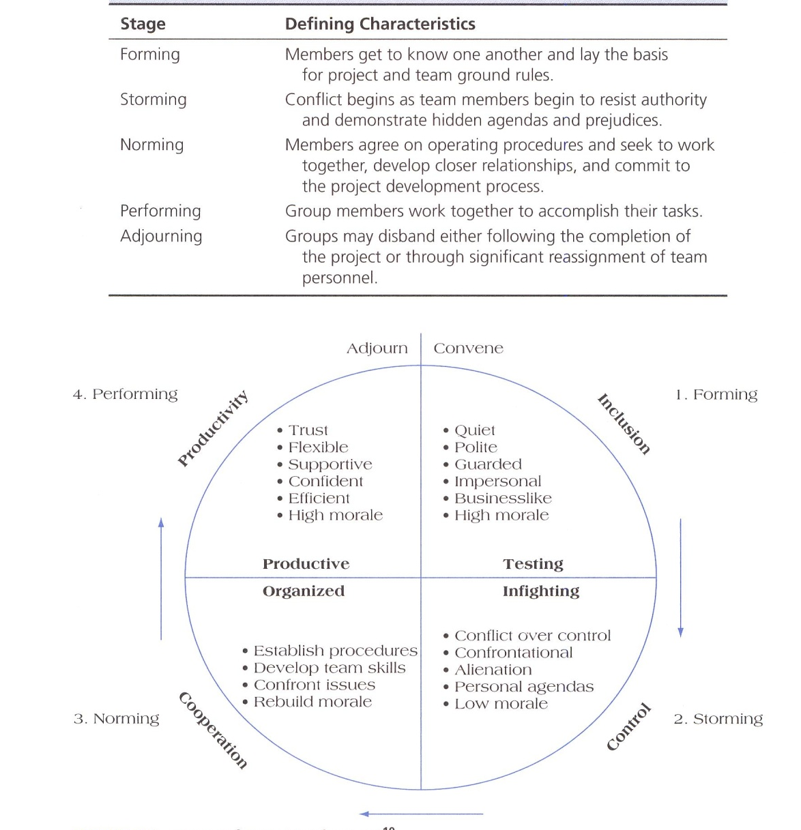
Stages in group development
Source: Verma, V.K., 1997:71,Managing The Project Team,
Upper Darby.

Slide 7
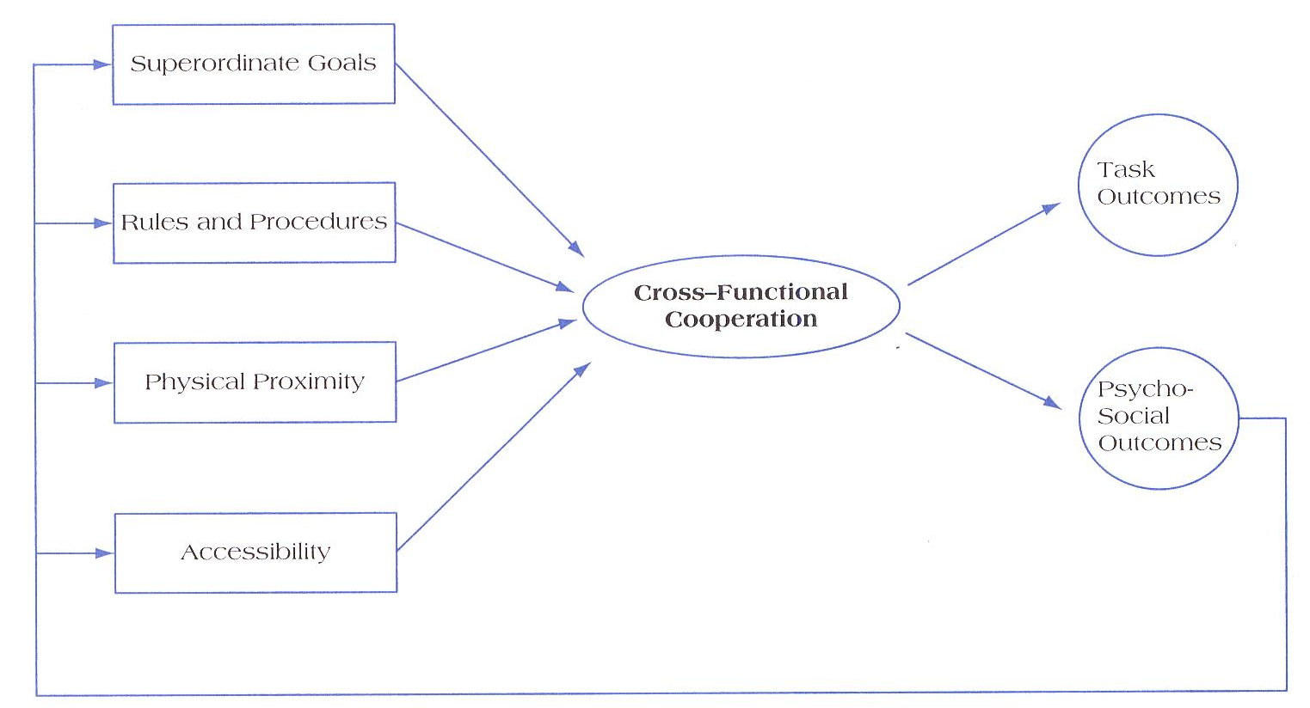
Project team cross functional cooperation
Source: Pinto, J.K. 2010:198, Project Management, Pearson.

Slide 8

Virtual project team
Virtual Teams involves the use of electronic media, including e-mail, the Internet, and teleconferencing to link together members of geographycally dispersed project team.

Slide 9
Building team with disc model

Slide 10
Career guidelines with disc
D Drive – Independent Analysis
Attorney, Consultant, Engineering (Director, Manager, Supervisor), Marketing Service, O & M, Planning Consultant, Production, Production (Director, Manager, Supervisor), Personnel, Researcher, Self-Employment, Transport Technologist and Trouble Shooting.
DI Inspirational – Entrepreneurial
Advertising, Consultancy, Dealing/Broking, General Management (Directing/Managing/Supervising any function for which knowledge and experience is available), Industrial Relations, Lecturing, Marketing, Public Relations, Promoting, Production (Director, Manager, Supervisor), Sales and Sales Management, Self-Employment and Trouble Shooting.

Slide 11
Career guidelines with disc
IC Specialist Communicator
Engineering and Production (Manager Supervision), Inventing, Lecturer, Project Engineer, Public Relations, Politician, Service Engineer or Supervising within a Technical/Specialist Area, Specialist Selling (Engineering, Finance or any area involving capital equipment), Teaching, and Training.
ISC Counseling - Negotiating- Advising
Accounting, Administration work, Artist, Attorney, Customer Service, Demonstrator, Engineering (Sales, Service, Project, Draughtsman, Designer), Hotelier, Industrial Relations Specialist, Instructor, Purchasing, Personnel, Public Relations, Selling, Specialist (Soft/Services), Supervising (Engineering, Production, Accounts), Secretarial, Training, Teaching, Technical and Welfare.

Slide 12
Career guidelines with disc
SD Specialist - Concentration
Accountant, Administration Manager, Attorney, Credit Controller, Computer Specialist, DP Supervisor, Engineering, Engineering (Designer, Draughtsman, Project Engineer), Investigator, Production/Engineering Quality Controller, Researcher, Sales and Service Engineer, Supervisor, and Transport/Warehouse Supervisor.
SI Counseling
First Assistant, Hotelier, Lecturing, Nurse, Personnel Welfare, Promoting, Psychologist, Soft or Service Selling, Training, Travel Agent, Upmarket/Speciality Sales.
SC Administrative
Accountant, Cashier, Chief Clerk, Company Secretary, Doctor, Draughtsman, Engineering (Project Manager, Supervisor, Technician), General Administrator, Office (Manager, Supervisor, Person), Planner, Production Supervisor, Programmer, Receptionist, Research and Development, Security Specialist, Soft/Service Selling, Statistician, System Analyst.

Slide 13
Career guidelines with disc
CD Creating
Accountancy, Chemist, Finance, Engineering (Management, Research, Design), Research (R&D), Quality Control and Specialist work in any area where knowledge and experience is available, Planning, Production, Planning, Management, Safety Officer, Specialist, Technician.
CS Technical
Computer Programmer, Engineer (Project, Draugthsman, Designer), Planning and Accounting, Medical Specialist, Quality Control, Researcher (Technician, Chemist, Quality Control), Surgeon.

Slide 14

Conflict management
Conflict is a prosses that begins when you perceived that someone has frustrated or is about to frustrate a major concern of yours
Category of conflict:
1. Goal-oriented conflict
2. Administrative conflict
3. Interpersonal conflict

Slide 15
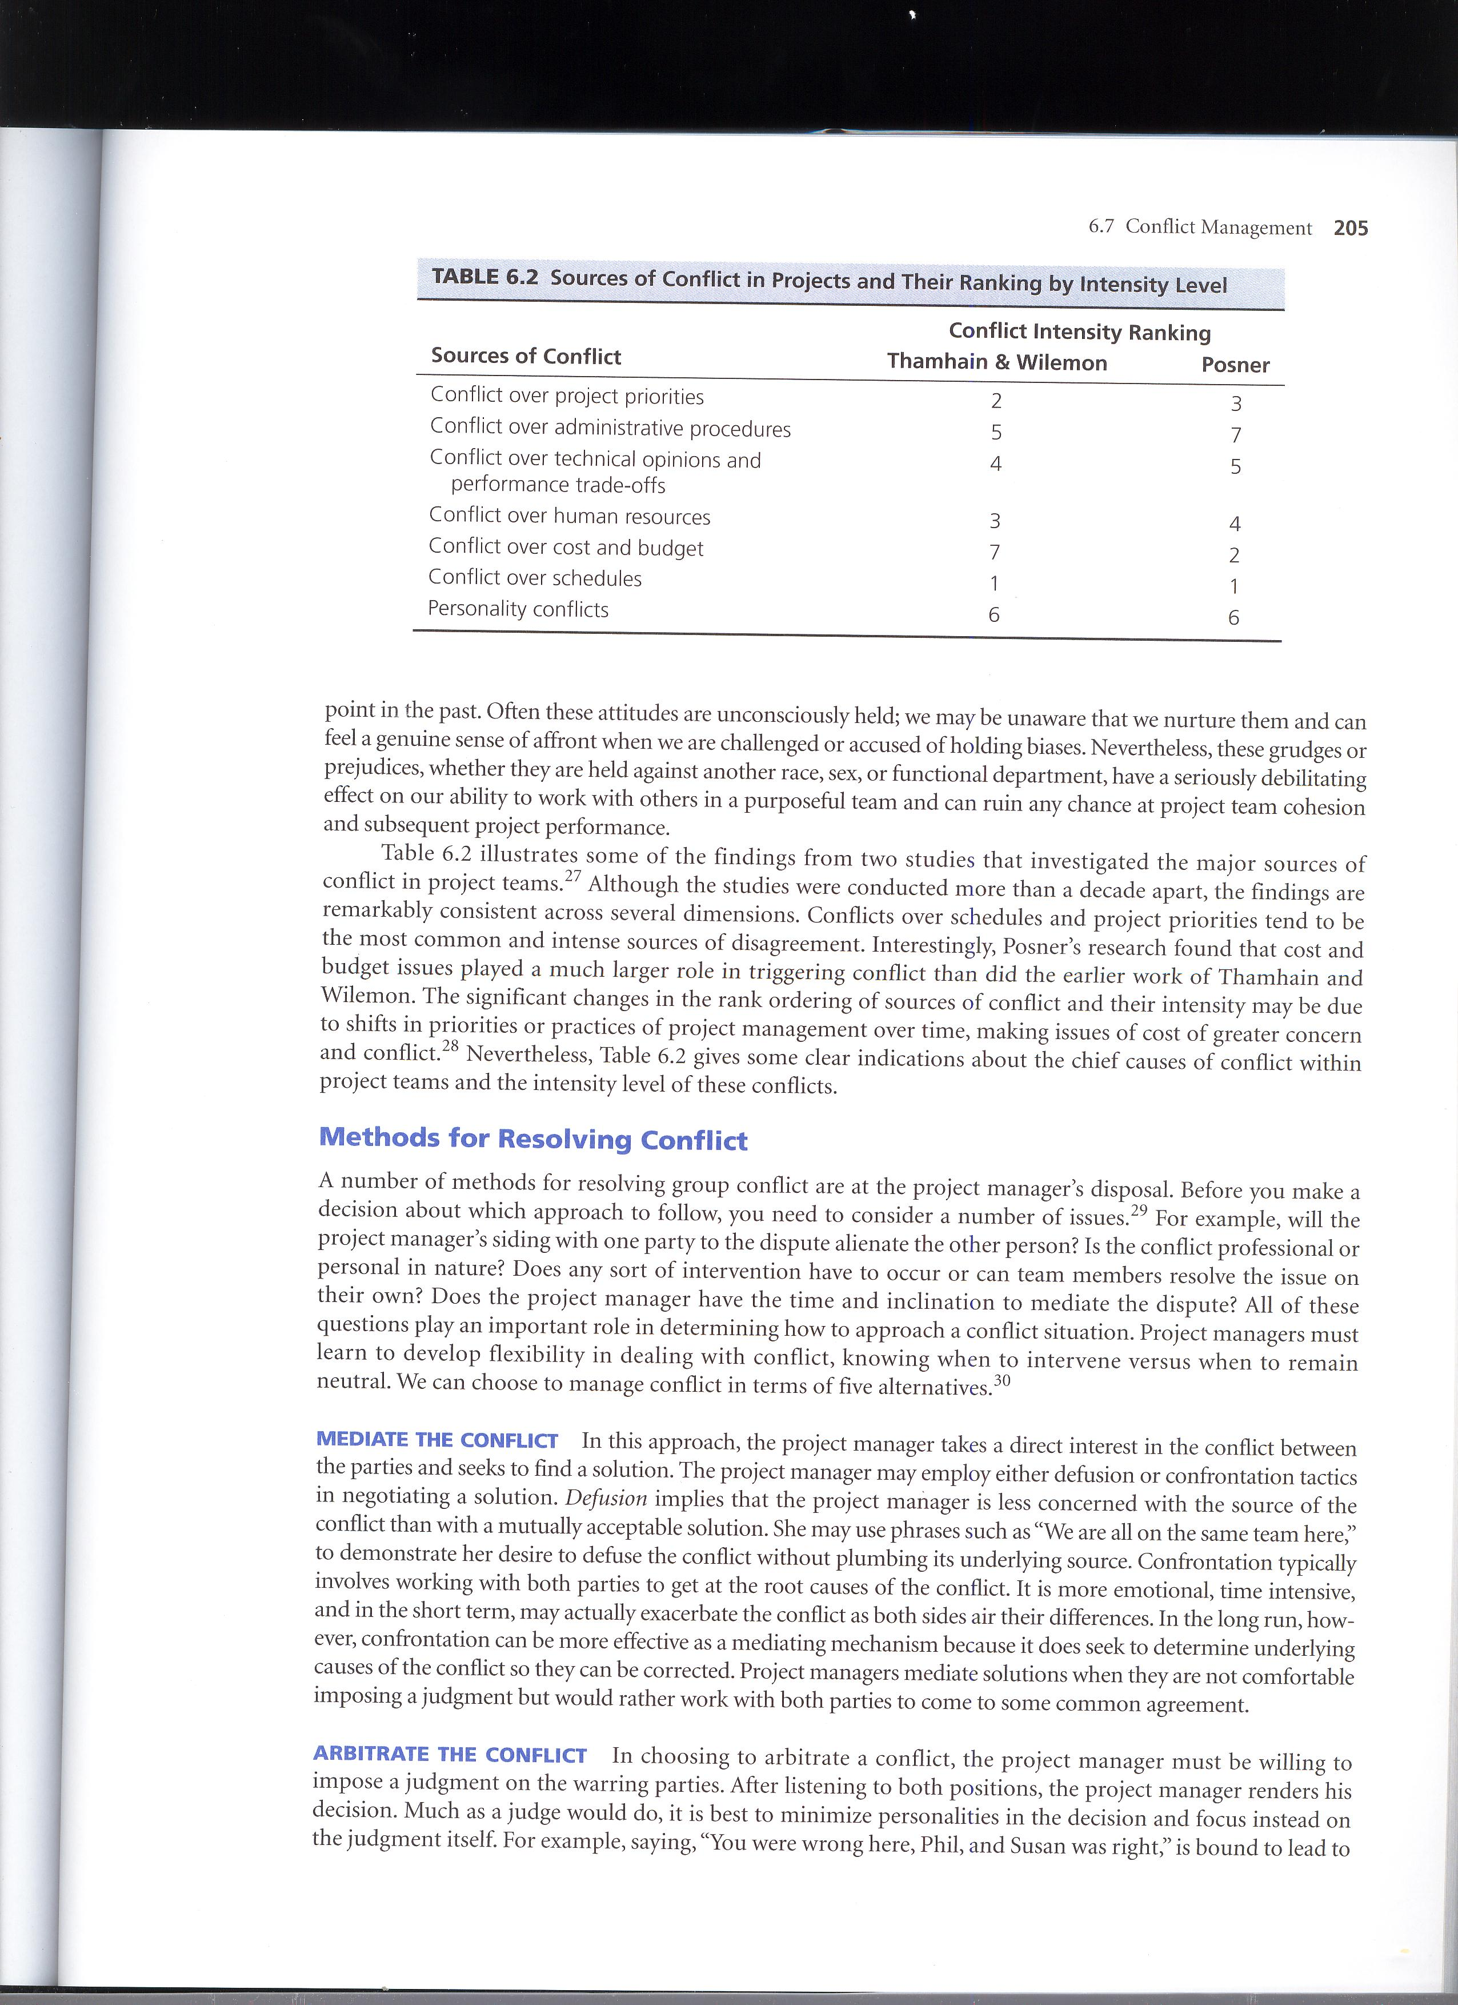
Source of conflict
Source: Pinto, J.K. 2010:205, Project Management, Pearson.

Slide 16

Methods for resolving conflict
Mediate the Conflict
Arbitrate the Conflict
Control the Conflict
Accept the Conflict
Eliminate the Conflict

Slide 17
resolving conflict using disc methode
Problem Solving with D
Dalam menyelesaikan persoalan jika anda harus bersama orang D, yang dilakukan adalah :
Tantanglah dia untuk menyelesaikan persoalan.
Bersikaplah praktis dan result oriented.
Permasalahan yang komplek harus diselesaikan hati-hati, tidak buru-buru, jangan lupa memperhatikan hal detil dari persoalan.
Problem Solving with I
Perhatikan kondisi perasaannya.
Bantu dia dalam memilah-milah persoalan kedalam hal-hal kecil.
Yakinkan dia untuk tidak mengabaikan masalah melainkan harus dicari pemecahannya.
Problem Solving with S
Pendekatan terhadap masalah harus bertahap.
Sabar dan ajaklah dia untuk mencoba mengambil keputusan yang lain dari sebelumnya.
Jangan terlalu di push, karena biasanya dia justru menjadi tidak bisa bergerak.
Problem Solving with C
Gunakanlah pendekatan yang sistematik, jelas dan analitis.
Jangan terlalu lama memikirkan persoalan yang sifatnya urgent.
Harus hati-hati karena mereka menginginkan kesempurnaan dan akurasi tinggi.

Slide 18
negotiation
GOAL
WIN-WIN SOLUTION

Slide 19

negotiation
Principle Negotiation:
- Separate People from the Problem
- Invent Option for Mutual Gain
- Insist on Using Objective Criteria

Slide 20
TEKNIK NEGOSIASI AWAL
(Roger dawson)
Mintalah lebih dari yang Anda harapkan
Jangan pernah katakan ya pada tawaran pertama
Melakukan flinch terhadap proposal
Hindari negosiasi yang konfrontatif
Reluctant seller, reluctant buyer
Gunakan vise technique

Slide 21
TEKNIK NEGOSIASI tengah
(Roger dawson)
Menghadapi seseorang yg tdk memiliki wewenang memutuskan
Penurunan nilai jasa
Jangan pernah memberi tawaran Splitting the Difference
Menangani Impasse
Menangani Stalemate
Menangani Deadlock
Mintalah selalu Trade-off

Slide 22
TEKNIK NEGOSIASI Akhir
(Roger dawson)
Good Guy Bad Guy
Nibbling
Meruncingkan konsesi
Menarik kembali penawaran
Positioning for easy acceptance

Slide 23

TERIMA KASIH

