Slide 1
ESTIMATING PROJECT TIME, COST & BUDGETING
Universitas Komputer Indonesia
Source:
Pinto, j.k. 2010, 2ND. ED.
Larson, e.w., & Gray c.f., 2014, 6th. Ed.

Slide 2
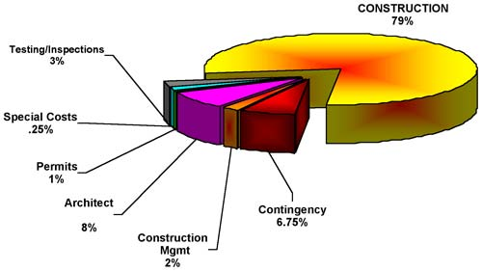
PROJECT ESTIMATION
Project estimation is indeed a yardstick for project cost control. And if the yardstick is faulty, you start on the “wrong foot”.
(Kharbanda, O.P., and Pinto, J.K. 1996:73)

Slide 3
Why Estimating Time & Cost Are Important
to support good decission
to schedule work
to determine how long the project should take and its cost
to determine whether the project is worth doing
to develop cash flow needs
to determine how well the project is progressing
to develop time-phased budgets and establish the project baseline.

Slide 4
The Relationship among WBS, Scheduling, and Budgeting
WBS
Project
Plan
Budgeting
Scheduling

Slide 5
Factors Influencing The Quality of Estimates
Planning Horizon
Project Duration
People
Project Structure and Organization
Padding Estimates
Organization Culture
Other Factors

Slide 6
Estimating Guidelines for Times, Costs, and Resources
Responsibility
Use several people to estimate
Normal conditions
Time units
Independence
Contigencies
Adding risk assesment to estimate helps to avoid surprises to stakeholder

Slide 7
Problems with Cost Estimation
Low initial estimates
Unexpected technical difficulties
Lack of definition
Specification changes
External factors

Slide 8
PROJECT BUDGET APROACH
Top Down Budgeting
Bottom Up Budgeting

Slide 9
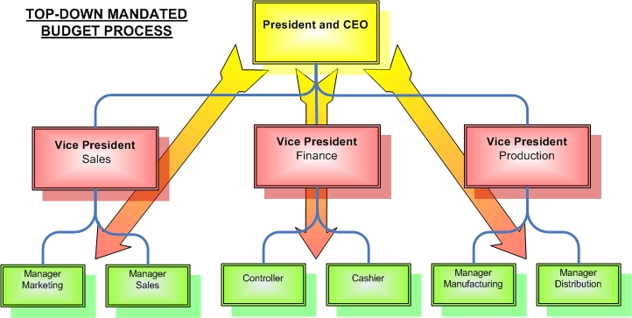
Top Down Estimating
Top down estimates usually are derived from someone who uses experience and/or information to determine the project duration and total cost. These estimates are sometimes made by top managers who have very little knowledge of the processes used to complete the project.

Slide 10
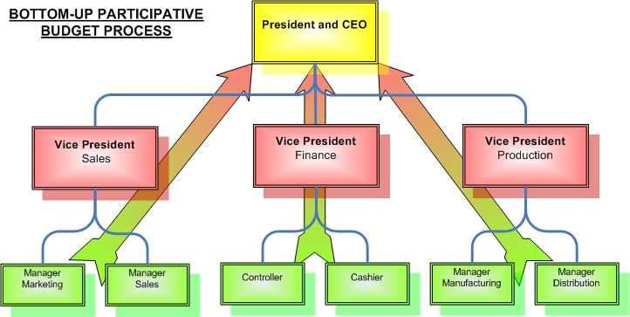
Bottom-Up Estimating
The Bottom-Up approach at the work package level can serve as a check on cost elements in the WBS by rolling up the work packages and associated cost accounts to major deliverables. Similarly, resource requirement can be checked. Later, the time, resource, and cost estimates from the work packages can be consolidated into time-phased networks, resource schedule, and budgets are used for control.

Slide 11
Condition for Preferring Top-Down or Bottom-Up Time and Cost Estimates
Condition | Top-Down Estimates | Bottom-Up Estimates
Strategic decission making | X
Cost & time important |  | X
High uncertainty | X
Internall, small project | X
Fixed-price contract |  | X
Customer wants detail |  | X
Unstable scope | X

Slide 12
Top-Down and Bottom-Up Estimates
Top-Down Estimates | Bottom-Up Estimates
Intended Use Feasibility/conceptual phase Rough time/cost estimate Fund requirements Resource capacity planning | Intended Use Budgeting Scheduling Resource requirements Fund timing
Preparation Cost 1/10 to 3/10 of a percent of total project cost | Preparation Cost 3/10 to 1.0 of a percent of total project cost
Accuracy Minus 20 to plus 60% | Accuracy Minus 10 to plus 0%
Method Concencus Ratio Apportion Learning curve | Method Template WBS packages Range estimates

Slide 13
Source of Project Cost
Labor
Material
Subcontractors
Equipment & facilities
Travel

Slide 14
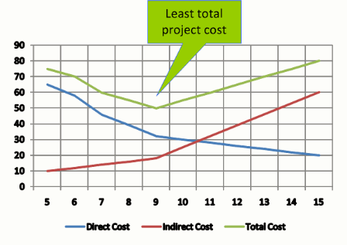
Direct vs Indirect Costs
Direct cost are those clearly assigned to the aspect of the project that generated the cost (example labor & materials).
Indirect cost, generally are linked to two features: overhead and selling and general administration.

Slide 15
Recurring vs. Nonrecurring Costs
Non recurring cost might be those associated with charges applied once at the beginning or end of the project, such as preliminary marketing analysis, personnel training, or outplacement services.
Recurring cost are those that typically continue to operate over the project’s life cycle. Most labor, material, logistics, and sales costs are consider recurring.

Slide 16
Fixed vs. Variable Costs
Fixed Cost, do not vary with respect to their usage. Example cost for leasing equipment.
Variable Cost, are those that accelerated or increase through usage; that is, the cost in direct proportion to the usage level. Example: equipment parts, materials, etc.

Slide 17
Normal vs Expedited Cost
Normal costs refer to those incurred in the routine process of working to complete the project according to the original, planned schedule agreed to by all project stakeholders at the beginning of the project.
Expedited costs are unplanned costs incurred when steps are taken to speed up the project’s completion.

Slide 18
Cost Classification
 | Type |  | Frequency |  | Adjustment |  | Schedule
Cost | Direct | Indirect | Recurring | Nonrecurring | Fixed | Variable | Normal | Expedited
Direct Labor | X |  | X |  | X |  | X
Building Lease |  | X | X |  | X |  | X
Expedite Costs | X |  |  | X |  | X |  | X
Material | X |  | X |  |  | X | X

Slide 19
TERIMA KASIH

