Slide 1
Panduan Komponen Observasi User
Human Computer Interaction
IMK – Teknik Informatika
UNIKOM

Slide 2
Hasil Akhir: 1. Contextual Inquiry (CI) 2. User Experience Map 3. Empathy Map

Slide 3
Pertimbangan Faktor Manusia dalam Mendesain
Pengetahuan dan Pengalaman Pengguna
Karakteristik Kebutuhan & Tugas User
Karakteristik Psikologis
Karakteristik Fisik
Lingkungan Fisik

Slide 4
Pengetahuan dan Pengalaman Pengguna
Educational Level | Reading Level | Typing Skills
TK, SD, SMP, SMA, S1, S2, S3 dsb | Berhubungan dengan tingkat pendidikan | Expert (135 wpm) Good (55 wpm) Average (40 wpm)
Computer Literacy | Task Experience | System Experience
Highly Moderate Low | (Semantik Knowledge) Melihat apakah user mempunyai pengalaman dalam tugasnya. | (Syntactic Knowledge) Melihat pada pengalaman user dalam menggunakan sistem
Application Experience | Native Language | Use of Other System
User pernah mempunyai pengalaman menggunakan aplikasi yang serupa | Bahasa asal (Bahasa Indonesia, Inggris dsb) | Penggunaan system yang lain

Slide 5
Pengetahuan dan Pengalaman Pengguna
System Experience | Task Experience | Design Goal
Low | Low | Banyak Instruksi yang disediakan & Prosedur penanganan error yang efektif.
High | High | Instruksi efektif, pesan kesalahan ringkas/jelas
High | Low | Disediakan help/user guide
Low | High | Minimalkan instruksi, karena user sudah tahu apa yang harus dilakukan

Slide 6
Karakteristik Kebutuhan, Tugas & Pekerjaan User
Frequency of Use | Primary Training | System Use
High Medium Low | None Manual Only Formal Mandatory | Mandatory Discretionary
Task Importance | Task Structure
High Low | High Moderate Low
Job Categories | Turnover Rate | Other Tools
Executive Engineer Secretary Clerk | High Moderate Low | Calculator Telephone

Slide 7
Karakteristik Kebutuhan, Tugas & Pekerjaan User
Characteristic | Design Goal
Frequency of Use High Low | Ease of Use Ease of Learning & Remember
Task Importance High Low | Ease of Use Ease of Learning & Remember
System Use Mandatory Discretionary | Ease of Use Ease of Learning & Remember

Slide 8
Karakteristik Psikologis User
PSYCHOLOGICAL CHARACTERISTICS
Attitude | Positive, neutral, or negative feeling toward job or system.
Motivation | Low, moderate, or high due to interest or fear.
Patience | Patience or impatience expected in accomplishing goal.
Expectations | Kinds and reasonableness.
Stress Level | High, some, or no stress generally resulting from task performance.
Cognitive Style | Verbal or spatial, analytic or intuitive, concrete or abstract.

Slide 9
Karakteristik Fisik User
PHYSICAL CHARACTERISTICS
Age | Young, middle aged, or elderly.
Gender | Male or female.
Handedness | Left, right, or ambidextrous.
Disabilities | Blind, defective vision, deafness, motor handicap.

Slide 10
Kondisi Panca Indera
Menggambarkan kondisi panca indera user terkait kemampuan mereka dalam penggunaan panca indera.

Slide 11
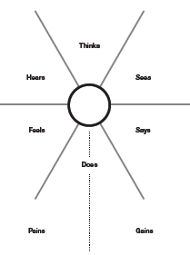

Slide 12
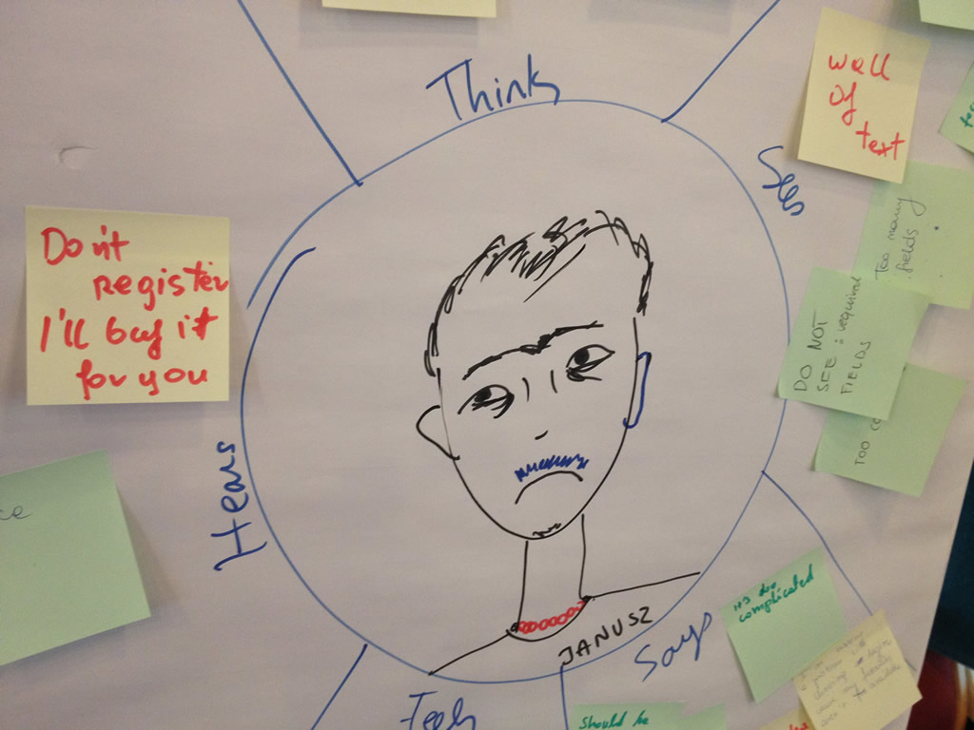

Slide 13
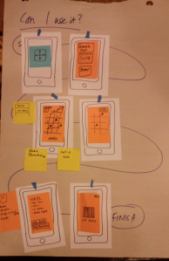
Kerangka Kerja
Skenario pekerjaan dan tindakan eksekusi pekerjaan dari sisi pengguna (Model mental)
Bentuk penggambaran Model mental memilih model contohnya: flow chart/ flow diagram

