Slide 1
STRATEGIC MANAGEMENT
DR. HERMAN S. MBA
Magister Management Program
Universitas Komputer Indonesia

Slide 2
REFERENCE
Wheelen, T.L., Hunger J.D., 2010. Concepts in Strategic Management and Business Policy, 12th Ed., Pearson Education Inc.
Hill, C.W.L., Jones, G.R., 2008. Strategic Management: An Integrated Approach, 7th. Ed., Houghton Muffin Co.

Slide 3
100 PERUSAHAAN
YANG MASUK
FORTUNE 100
TAHUN 1917, BERAPA
PERUSAHAAN YANG
MASIH BERTAHAN ?

Slide 4
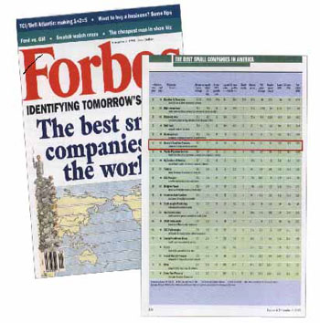
10 biggest companies Forbes 2009
General Electric (AS) dengan total aset US$ 797,77 miliar
Royal Dutch Shell (Belanda) dengan total aset US$ 278,44 miliar
Toyota Motor (Jepang) dengan total aset US$ 324,98 miliar
ExxonMobil (AS) dengan total aset US$ 228,05 miliar
BP (Inggris) dengan total aset US$ 228,24 miliar
HSBC Holdings (Inggris) dengan total aset US$ 2,520 triliun
AT&T (AS) dengan total aset US$ 265,25 miliar
Wal-Mart Stores (AS) dengan total aset US$ 163,43 miliar
Banco Santander (Spanyol) dengan total aset US$ 1,318 triliun
Chevron (AS) dengan total aset US$ 161,17 miliar

Slide 5
10 biggest companies Forbes 2015
Wells Fargo, US Banking, Assets: US$1.701 trillion.
General Electric, US Conglomerate, Assets: US$648.3 billion.
Petrochina, China Oil & Gas, Assets: US$387.7 billion.
Exxon Mobile, US Oil & Gas, Assets: US$349.5 billion
JP Morgan, US Banking, Assets: US$2.594 trillion

Slide 6
Enam perusahaan Indonesia
yang masuk Forbes Global 2000
tahun 2009
Telkom di urutan 675 dengan aset US$ 8,74 miliar
BCA di urutan 930 dengan aset US$ 23,17 miliar
BRI di urutan 988, dengan aset US$ 21,56 miliar.
Bank Mandiri di urutan 1.014 dengan aset US$ 33,54 miliar
Bumi Resources di urutan 1.809, dengan aset US$ 2,79 miliar.
BNI di urutan 1.960, dengan total aset US$ 19,44 miliar.

Slide 7
perusahaan Indonesia – Forbes tahun 2015
Bank Mandiri, Aset - $60.2 Billion
Bank BRI, Aset - $51.5 B
Bank BCA – Aset $40.8 B
Bank BNI – Aset $31.8 B
Telkom – Aset $10.5 B
PGN – Aset $4.4 B

Slide 8
HOW DOES A COMPANY
BECOME SUCCESSFULL
AND
STAY SUCCESSFULL?

Slide 9
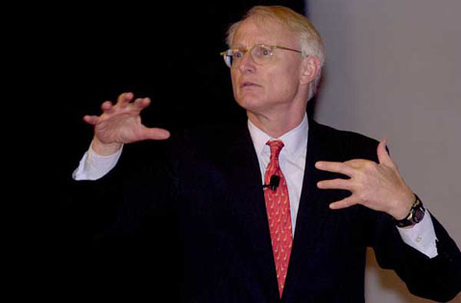
ALASAN MENGAPA PERUSAHAAN GAGAL ATAU BERHASIL MUNGKIN ADA PADA PERTANYAAN UTAMA DALAM STRATEGI

Slide 10
WHAT IS
STRATEGIC
MANAGEMENT?

Slide 11
STRATEGIC MANAGEMENT IS A SET OF MANAGERIAL DECISSION AND ACTIONS THAT DETERMINES THE LONG RUN PERFORMANCE OF CORPORATION.

Slide 12
WHY STRATEGIC MANAGEMENT?

Slide 13
Why Strategic Management
Strategic Management emphasizes long term performance.
To be successfull in the long run, companies must not only be able to execute current activities to satisfy an existing market, but they must also adapt those activities to satisfy new and changing market.

Slide 14
Benefits of Strategic Management
Clearer sense of strategic vision for the firm.
Sharper focus on what is strategically important.
Improved understanding of a rapidly changing environment.

Slide 15
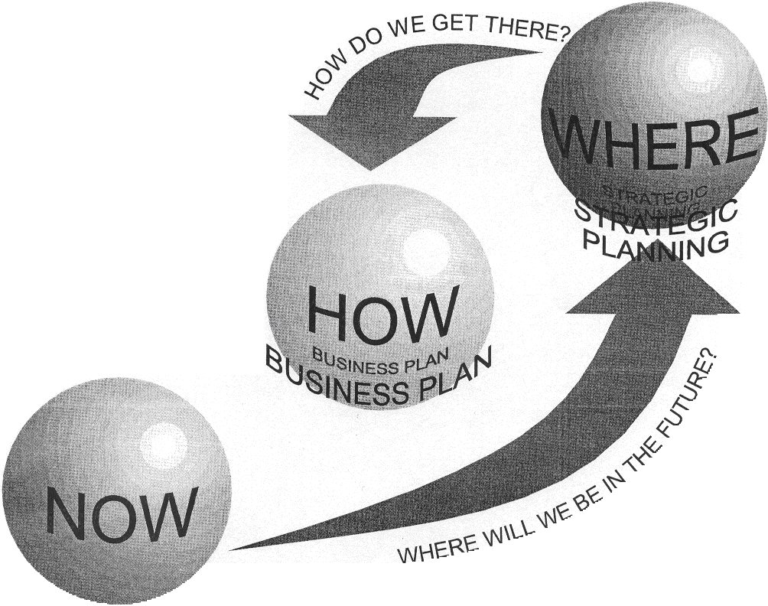
Strategic Management Question
Where the organization now?
If no change are made, where will the organization be in one year? Two years? 10 years? Are the answer acceptable?
If the answer are not acceptable, what specific actions should management undertake?What are the risks and payoffs involved?

Slide 16
IMPACT OF

Slide 17
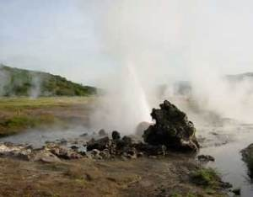
IMPACT ON ENVIRONMENT SUSTAINABILITY

Slide 18
Learning Organization

Slide 19
LEARNING ORGANIZATION SKILL
Solving Problem Systematically
Experimenting with new approaches
Learning from their own experiences and past history as well as from the experiences of others
Transferring knowledge quickly and efficiently throughout the organization

Slide 20
BASIC MODEL OF
STRATEGIC MANAGEMENT

Slide 22
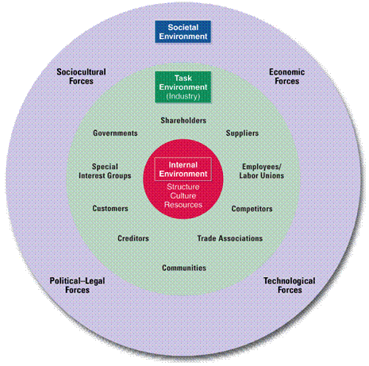
ENVIRONMENTAL VARIABLES

Slide 23
External Analysis
Identify strategic opportunities and threats in the operating environment.
Internal Analysis
Identify strengths
Quality and quantity of resources available
Distinctive competencies
Identify weaknesses
Inadequate resources
Managerial and organizational deficiencies

Slide 24
SWOT and Strategic Choice
Strengths and Weaknesses
Opportunities and Threats (SWOT Analysis)
Strategic Choice Business Functional Global Corporate

Slide 25
STRATEGY FORMULATION
MISSION
OBJECTIVES
STRATEGY
POLICY

Slide 26
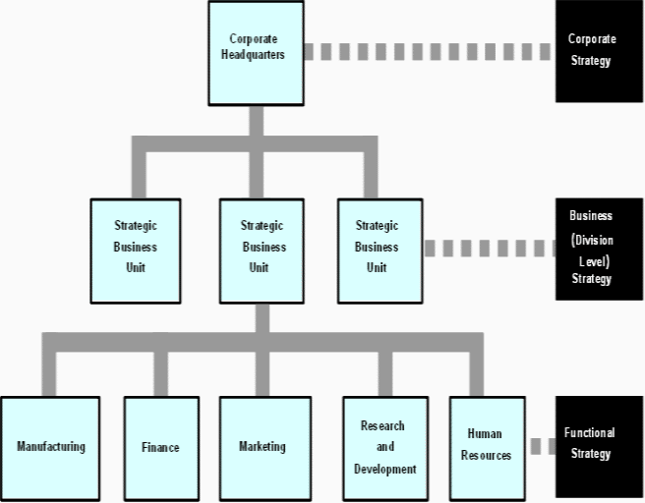
Hierarchy of strategy

Slide 27
Managing Strategic Change
The only constant is change.
Success requires adapting strategy and structure to a changing world.
The feedback loop in strategic planning.
Corporate
Operational
Business
Functional

Slide 28
STRATEGY IMPLEMENTATION
PROGRAMS
BUDGETS
PROCEDURES

Slide 29
EVALUATION & CONTROL
PERFORMANCE

