Slide 1
Introduction : IT for Design
Dr. Yeffry Handoko Putra, M.T Magister of Design

Slide 2
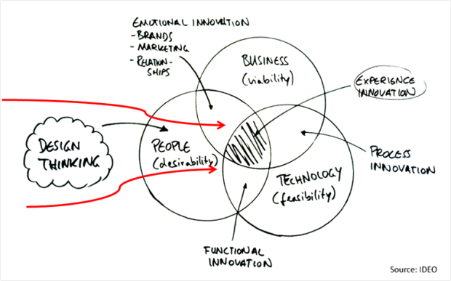
Imaginasi mendorong kreativitas, ketidakpuasan membentuk inovasi, kegigihan meningkatkan daya saingan, ketulusan adalah awal semuanya

Slide 3
MOTIVATION
Developing new products containing digital media interfaces and systems:
1. Integrating interactive media
text, image, animation, video, sound, virtual reality
such as computer network applications, interactive CD/DVD ROM, mobile devices, information kiosks and objects
2. Requires specific knowledge and skills
in electronic engineering
information technology
media design – user interface design

Slide 4
REAL SITUATION 1/2
Companies
There are many companies where engineers and designers work together, but in many there are only engineers or designers.
The need to find a common language for communication and the knowledge of fundamentals in other field is very valuable.
Education
In many countries exist schools providing a combined education in IT and art design. In Slovakia there exists no such educational institution.
Goal
The goal is to create comprehensive curriculum to overcome the gap between the world of media engineering and art design

Slide 5
REAL SITUATION 2/2
The main idea
To create such study program, which graduates would cover the lack of experts in our market area.
Problems
Existing subjects should be modified to meet existing knowledge for both groups of students.
Traditional border between world of science and engineering on one side and the art and design on the other.

Slide 6
DEFINITIONS OF DIGITAL MEDIA DESIGN
Digital media belongs to a group together with
multimedia, intermedia, cross-media, new media and interactive media
Design is understood differently
is art emphasizing creativity and attraction
has standardized rules, necessary to learn and respect
Same field – different groups
each group has own vocabulary => don’t understand each other

Slide 7
IT versus ART
focus:
improve and invent new theories, techniques and technologies of digital media
education:
+ functional principles
+ working with multimedia information
- aesthetics
focus:
creativity and visual aesthetics
education:
+ multimedia creation
+ authoring tool
– principles of functionality

Slide 8
FUNCTION OF INFORMATION SYSTEM

Slide 9
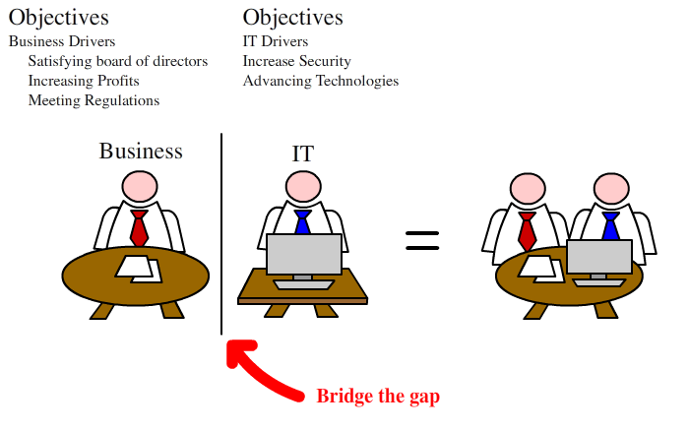

Slide 10
Information System Quality Characteristic
Complete Data
Accurate Data
Precise Data
Understandable Output
Timely Output
Relevant Output
Meaningful Output
User friendly Operation
Error Resistant Operation
Authorize Use
Protected System and Operation
Ref: Gordon B. Davis

Slide 11
Business Perspective on Information Systems

Slide 12
Scope of Information System
Data : raw facts that describe the characteristic of an event
Information : data converted into a meaningful and useful context
Business Intelligent. E.g. Customer Relationship Management
Knowledge . E.g. Knowledge Management System

Slide 13
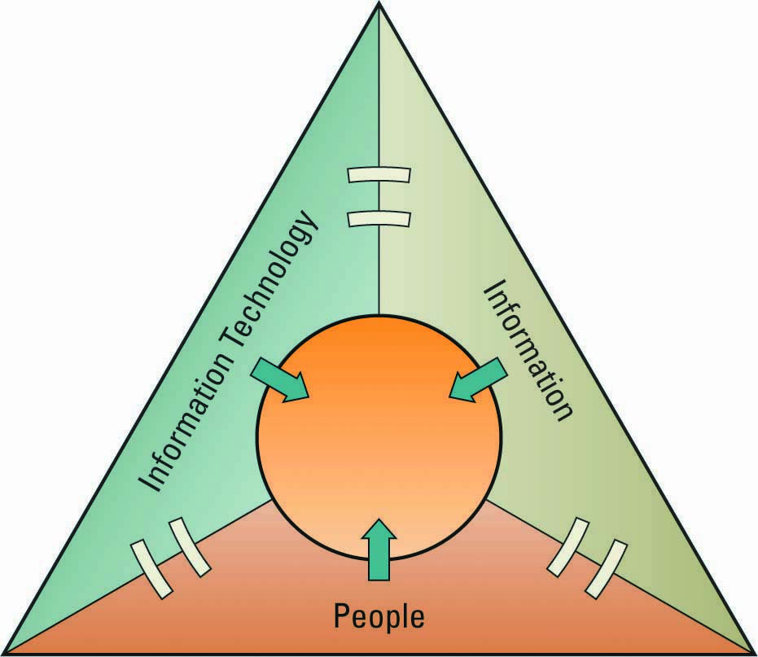
IT Resources
People use
Information technology to work with
Information
Notes:
What is useful about this slide? Not much.
You need people who are trained to use the hardware and software
You need hardware and software
You need raw data and information to be processed. Is this always true?

Slide 14
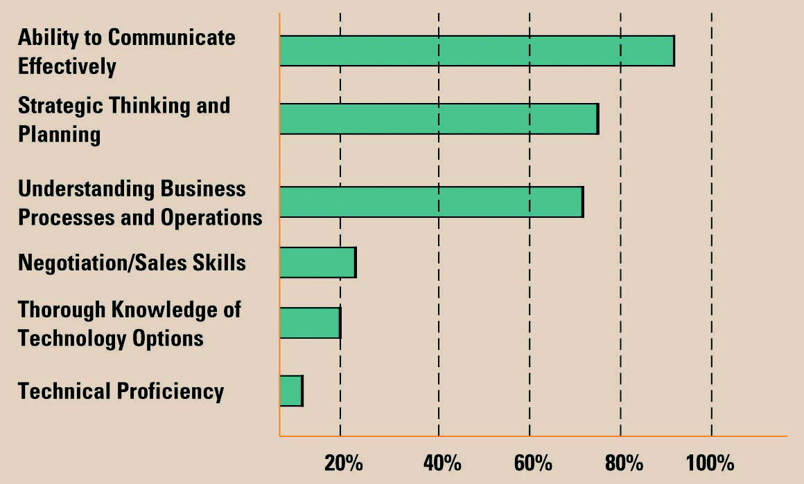
ROLES AND RESPONSIBILITIES IN IT
Skills pivotal for success in executive IT roles
Notes:
Presentation skills are vital in management. IT is no exception.
Look how low technical proficiency is valued.
I wonder what is the source of this “information”. Can this kind of thing even be measured?

Slide 15
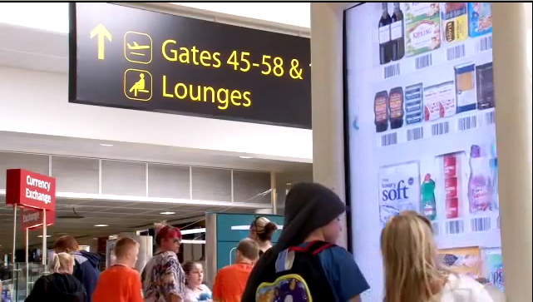
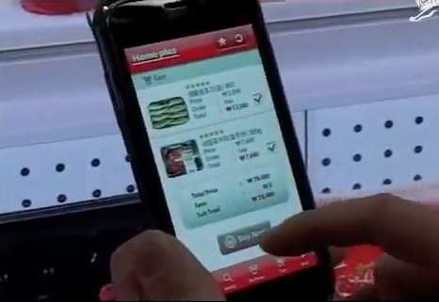
Virtual Shop by TESCO.COM
Gatwick, Airport, UK. November 2011
TESCO Homeplus, Virtual Subway Shop South Korea, 2010

Slide 16
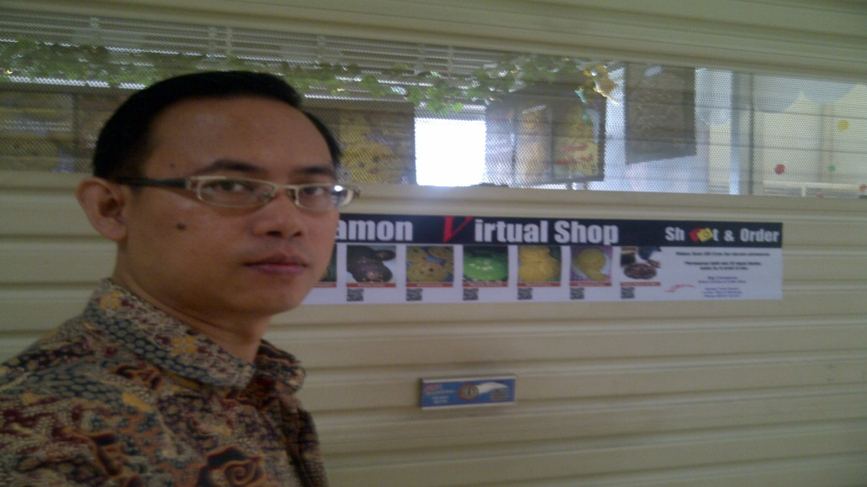
Virtual Shop by Me

Slide 17
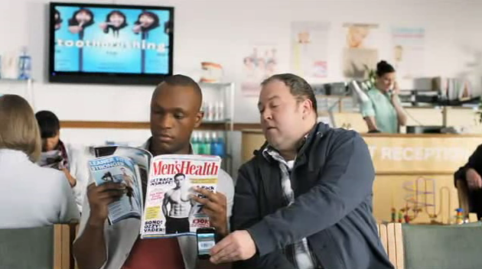
Virtual Shop : Social Behavior

